Slide 1
UCL Gender, Ethnicity and Disability pay report 2023-24
Human Resources

Slide 2
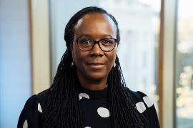
Foreword
This report outlines UCL’s latest pay gap position. The report shows that we continue to make good progress on gender with both the median and mean reducing since the same point last year. We have continued to see progress in an increased proportion of Black, Asian and Minority Ethnic (BAME) staff at senior grades, with our overall ethnicity gap reducing by the median, but increasing by the mean. There remains a very high number of staff with unknown ethnicity and disability status which we need to prioritise to reduce in the coming year and a specific exercise is planned to address that.
The report also outlines our declared disability gap for the second time and, while the gaps remain substantial, we are pleased to see a reduction in the mean and median since last year's report. We remain one of the few organisations to report this gap and it remains difficult to compare our significant gap to any external benchmarking.
This year both the mean and median gender pay gaps are likely to again to be amongst the lowest in the Russell Group. We can see that the proportion of female staff at each of the grades above the median UCL earnings (Grades 8-10) is increasing and reward mechanisms such as the senior promotions process continue to increase gender diversity at senior levels - for example over 45% of promotions to professors were female (compared to a current proportion of female professors circa 33%). The pay gap reducing is irrespective of the fact that there has been a significant spike in female staff at G6.
Donna Dalrymple, Chief People Officer
Distribution of staff between the grades continues to be the overwhelming reason for overall gaps. This is shown by the quartile positioning data later in the report.. It remains the case that there are no substantial equal pay gaps in grades 1-9 or with the senior G10 pay bands.
We remain committed to addressing gender, ethnicity and disability pay gaps over the coming years. In particular, we will continue to support the career development of women, Black, Asian and Minority Ethnic (BAME) and disabled staff to increase their representation at our highest grades.
It is important to note that this report focuses on data taken as at 31st March 2023. As such there will be a lag between initiatives undertaken and their effect on the data. In particular, the initial pay changes announced as part of UCL’s new reward strategy will have a positive effect on reducing gaps but the effect of that will not be seen until future reports. The changes agreed to London allowance in 2023, changes in our approach to recruitment and our current review of Research Promotions (to Grade 7 and 8) are all progressive actions that will lower pay gaps in future reporting years.

Slide 3
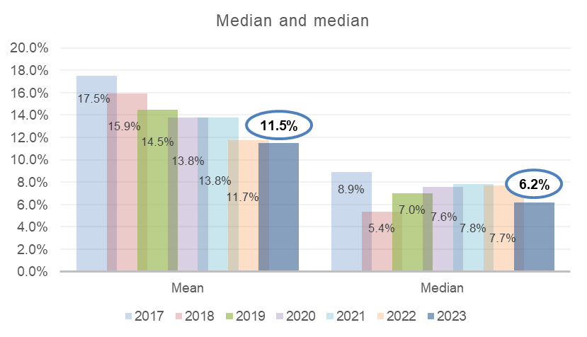
Gender pay gap analysis
Gender pay focuses on the differential between the average (median and mean*) salary of all women and men at UCL. The mean gap at UCL now stands at 11.5% and the median at 6.2%. This remains significantly below averages in wider society. As a reference point the ONS reported 2023 median gap for all staff in the UK is 14.3%, over double the UCL median.
Comparing these figures with 2022 reports would mean that UCL has the second lowest median and mean gap amongst the Russell group.
*The mean is calculated by adding up all of the wages of employees and dividing that figure by the number of employees. The median is the number that falls in the middle of a range when everyone’s wages are lined up from smallest to largest.

Slide 4
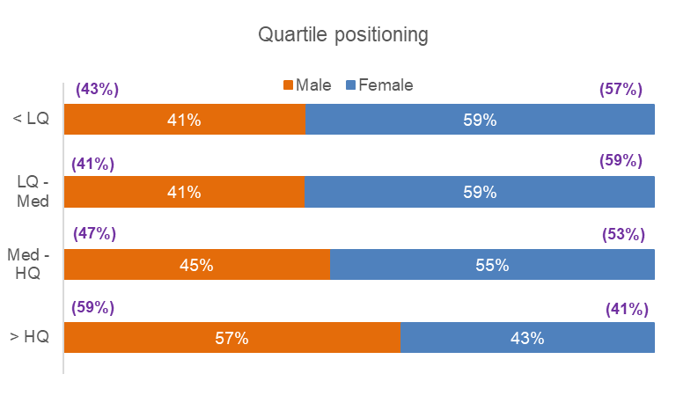
Gender pay gap analysis
The proportion of female staff increased overall across UCL. However, the proportion of female staff paid above the median has increased by more than the increase of female staff below the median. Overall, this results in a more even distribution of women throughout the pay quartiles and a narrowing of the median gap.
*Percentages in brackets represent last years figures

Slide 5
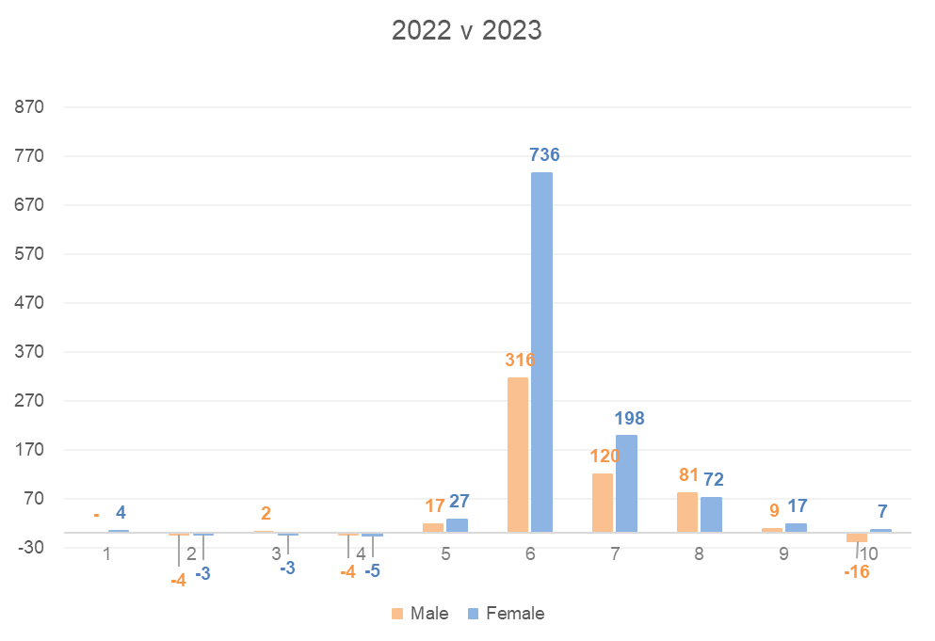
Increase/decrease of employees in grades by gender since 2022
We can see that, as a collective, there has been a larger increase in number of female staff at G8-10) than male staff.
In a contrast to last year where there was a large spike in male G6’s, this year there has again been another significant increase in G6 employees but a greater number of those are female. This would have caused the pay gap to widen but thankfully this has been offset by an increased proportion of female staff at senior levels. The majority of the G6 staff are PGTA’s engaged on fractional employment contracts.

Slide 6
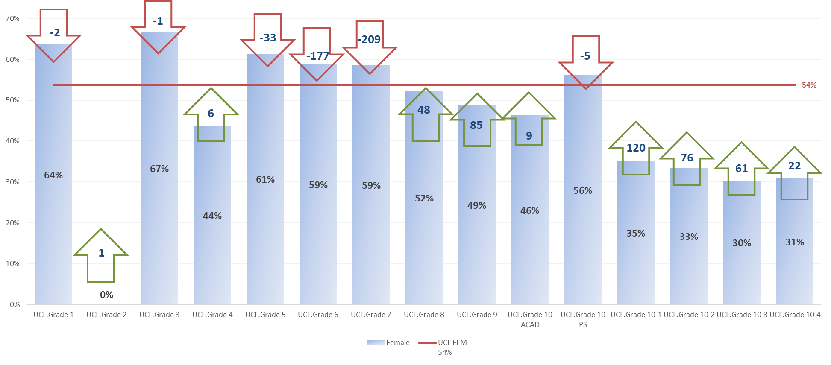
Adjustment in female staff numbers needed at each grade to eradicate pay gap
This chart shows the extent of changes needed to female staff numbers at each grade. We can see that female staff continue to be underrepresented at grade 9 and professorial level in particular. Even more significant is the over representation of women in grades 6 and 7. Progression for these staff would be an important measure in tackling the pay gap further.

Slide 7
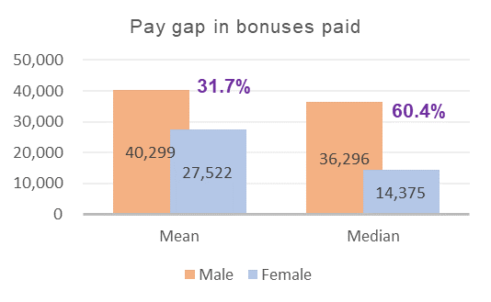
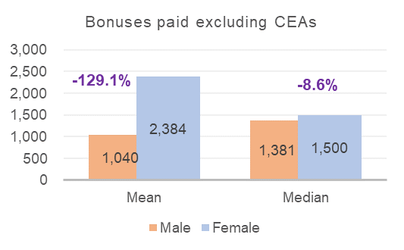
Gender pay – bonus reporting
As in previous years UCL needs to categorise clinical excellence awards as bonus payments. UCL actually pays few one-off payments and over 90% of them are clinical excellence awards. These awards are mandated by the NHS and much larger than any bonuses agreed internally. As a larger proportion of our senior clinical staff in receipt of the awards are male it substantially distorts our data. As such, with CEAs included, the average bonuses are high and heavily in favour of men. Including the CEA’s bonuses went to 0.6% of female staff and 1.2% of male staff.
Where CEA’s are excluded (lower graph), to include only the payments UCL has control over, bonuses are much smaller and much higher average amounts are paid to female staff- which follows the trend from previous years.
Pay gap in bonuses paid
Pay gap in bonuses paid excluding Clinical Excellence Awards (CEAs)

Slide 8
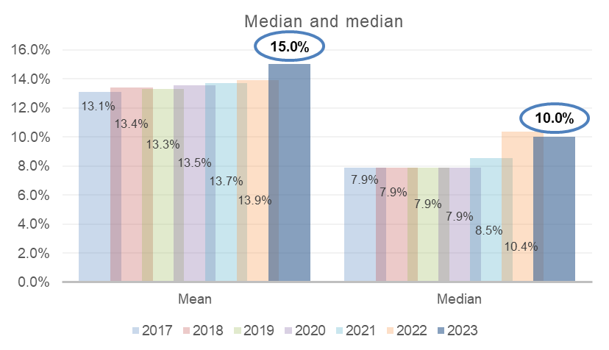
Ethnicity pay gap analysis
As with gender, Black, Asian and Minority Ethnic (BAME) staff are underrepresented at senior levels which continues to be the overwhelming reason for the ethnicity pay gaps. As was the case last year there has been a marginal increase in the proportion of staff in the senior grades (8-10) who are BAME, which is encouraging.
UCL does not have a fairness issue in terms of equal pay for work of equal value. We have repeated the equal pay audit this year and again this is not driving the overall ethnicity gap.
The mean gap this year has increased and is now 15% and the median gap has reduced to 10.4%. The proportion of BAME and white staff between the grades and the quartiles remains very similar to previous years.
We are again concerned at the number of staff whose ethnicity is unknown, as this could result in material differences in the gaps – either positively or negatively. We have begun to address this but due to reporting lag this has not evidenced any reduction in unknowns from the previous report.
*The mean is calculated by adding up all of the wages of employees and dividing that figure by the number of employees. The median is the number that falls in the middle of a range when everyone’s wages are lined up from smallest to largest

Slide 9
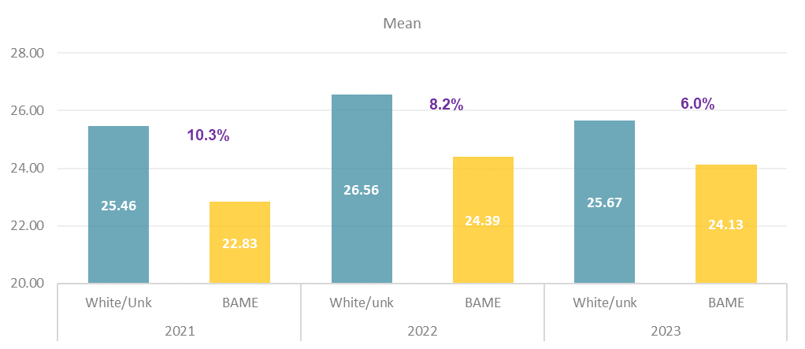
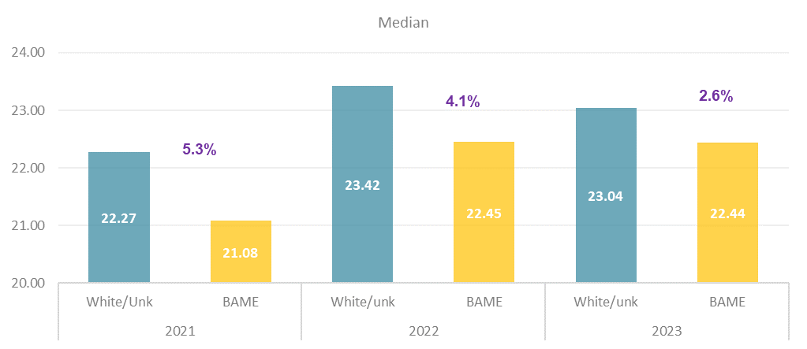
Ethnicity pay gap – average pay of BAME staff vs white AND unknown
When outlining our ethnicity pay gap we compare the average salaries of white staff with Black, Asian and Minority Ethnic (BAME) staff. Staff with unknown ethnicity continue to be too high at UCL. While we know there is an ethnicity pay gap, this makes it difficult to ascertain the true level of gap. This year we have again also compared the salaries of BAME staff with white AND unknown staff over the last three years and in both of the last two years the mean and median gaps have reduced. This could be a positive signal, but it underlines the importance of reducing the unknowns.

Slide 10
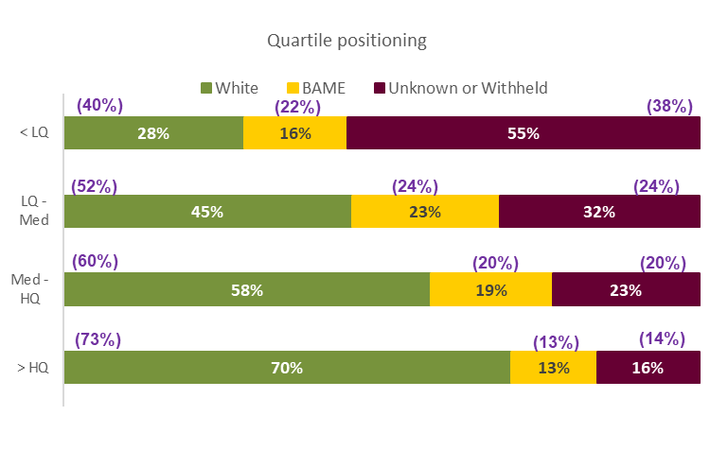
Ethnicity – quartile positioning
In terms of the quartile positioning the proportion of Black, Asian and Minority Ethnic (BAME) and white staff has marginally reduced overall, with that being compensated for by an increase in those with unknown ethnicity.
The distribution of BAME and white staff between the pay quartiles remains similar to last year, albeit the proportion of BAME staff in the two higher pay quartiles above the median has increased relative to white staff.
The fact that there is a significant drop (12%) in the percentage of white staff (replaced by unknowns) within the low pay quartile is the predominant reason for the rise in the ethnicity gap.
There is an increase in the percentage of unknown staff at every quartile, but in particular the lower quartiles. It is important to reduce this to have a better and more accurate picture of our true ethnicity pay gap.
*Percentages in brackets represent last years figures

Slide 11
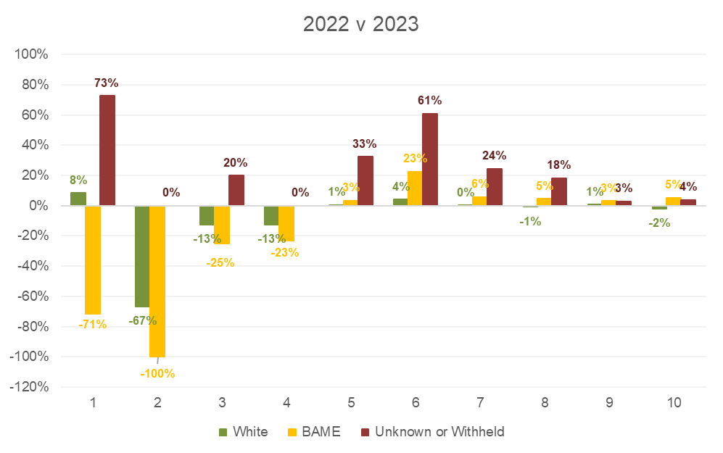
Ethnicity analysis – % increase/decrease in population by grade since 2022
The table shows the change in proportion of staff at each grade from last year.
Encouragingly, the same as last year, we can see the percentage of Black, Asian and Minority Ethnic (BAME) staff within grades above median (G8-G10) has increased more than the proportion of white staff in the same grades However, below the median at G7 the population of BAME staff has increased by 6% where the proportion of white staff remains flat.
At grade 5 and below there are less staff (numerical increases/decreases are shown on the following slide) so the effect is less, albeit there is tendency for the proportion of BAME staff increasing in these grades vs the proportion of white staff decreasing. This will have added to the average salary for white staff rising, relative to the averages for BAME staff.
The ethnicity pay gap is calculated by considering the differences between the pay of BAME and white staff only. However, this year the proportion of staff with an ‘unknown’ ethnicity has increased again and this has caused issues with data reliability. Depending on the proportion of unknown staff who are white or BAME the gap would shrink or widen.

Slide 12
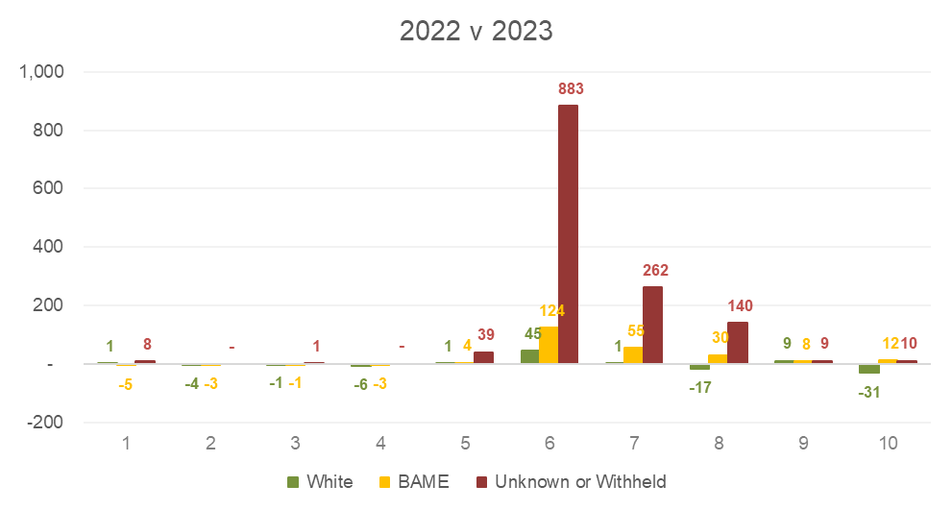
Ethnicity pay gap – number increase/decrease in population by grade
The graph replicates the last one but focused on staff number increases/decreases rather than percentages. There is a substantial increase in Black, Asian and Minority Ethnic (BAME) staff at G6 (124), compared to only 45 white staff.
There is again a significant number of unknown staff who are not included in the ethnicity pay calculation- which is focused on the salary average of BAME staff vs white staff.
It is positive that both the proportion and number of BAME staff has increased at all the grades above median salary (G8-10). In isolation (without the changes at G6 and G7) this would have narrowed both the mean and median pay gaps.

Slide 13
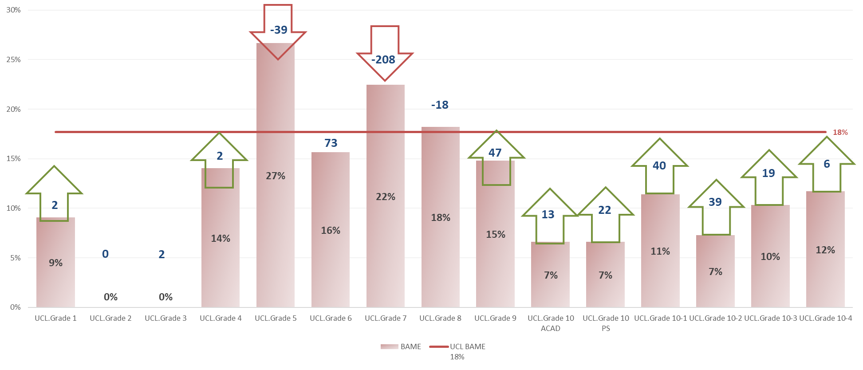
Adjustment in BAME staff needed at each grade to eradicate pay gap
Like gender, this shows the Black, Asian and Minority Ethnic (BAME) staff are underrepresented at grades 9 and 10. Specifically the numbers of BAME staff at grade 10 (PS and Academic) need to be increased significantly. An even larger issue is that BAME staff are overrepresented in the grades below the average UCL salary. In particular, there is significant over representation (208) of BAME staff at grade 7. Progression from this level upwards is important, particularly for research staff- where there is an established promotion process.

Slide 14
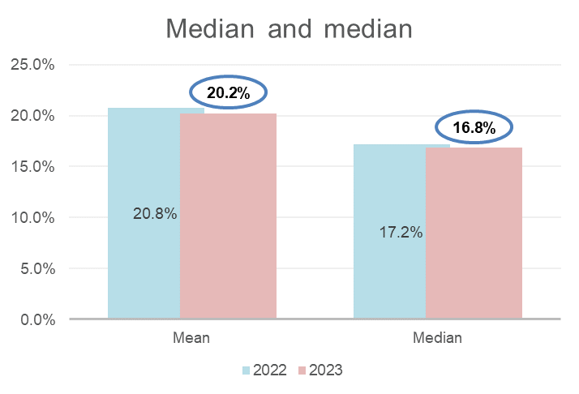
Pay gap – declared disability vs no declared disability
This is the second year in which UCL is measuring its pay gaps between the average salaries of staff who have disclosed a disability and those who have not declared a disability. The gaps are substantial but both the mean and median gaps have reduced(by 0.6% and 0.4%) from the same point last year. Like our gender and ethnicity gaps we can see in the following slides that the distribution of staff between the grades is again the primary reason for the gaps.
UCL still remains one of very few organisation to reports their disability pay gap which makes it difficult to benchmark against others. However, clearly the gaps remain large and we want to continue the downward trajectory we have seen since last year's report.
*The mean is calculated by adding up all of the wages of employees and dividing that figure by the number of employees. The median is the number that falls in the middle of a range when everyone’s wages are lined up from smallest to largest

Slide 15
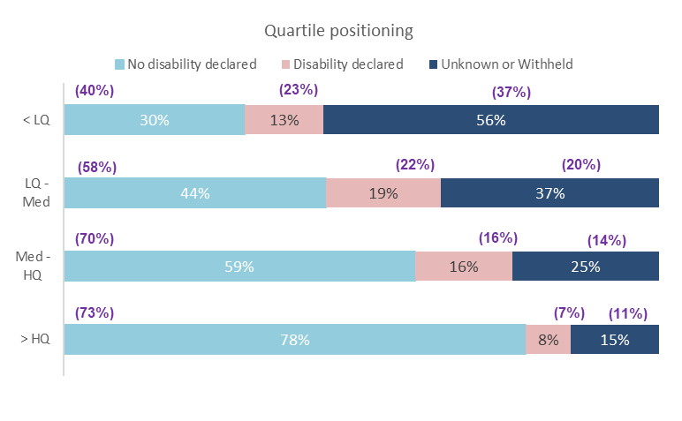
Declared disability – quartile positioning
The quartile positioning shows the clear drop of disabled staff as we move up the grading structure. Disabled staff are much more likely to be within the low pay quartile (G1-G6), where 13% of staff are disabled than in the top pay quartile (G9-G10) where only 8% of staff are disabled.
Those with an unknown disability also drop off at each quartile while staff who have declared that they do not have a disability are much more likely to be within higher pay grades.
*Percentages in brackets represent last years figures

Slide 16
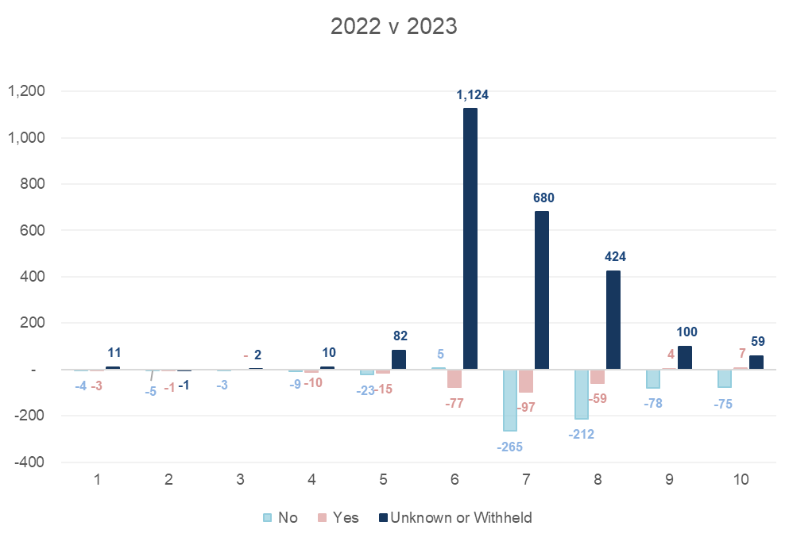
Increase/decrease of employees in grades by disability declared since 2022
Similar to ethnicity we can see an increase where disability status is unknown. This is really important to address. This means that overall the numbers of disabled staff and non-disabled staff has declined overall.
Therefore, it is positive to see the marginal increase in disabled staff at UCL’s most senior grades – G9 and G10. There has also been a ~100% rise in the proportion of people promoted in the latest round of senior academic promotions. This is not reflected in this data but should help continue the positive increase at G9 and G10.

Slide 17
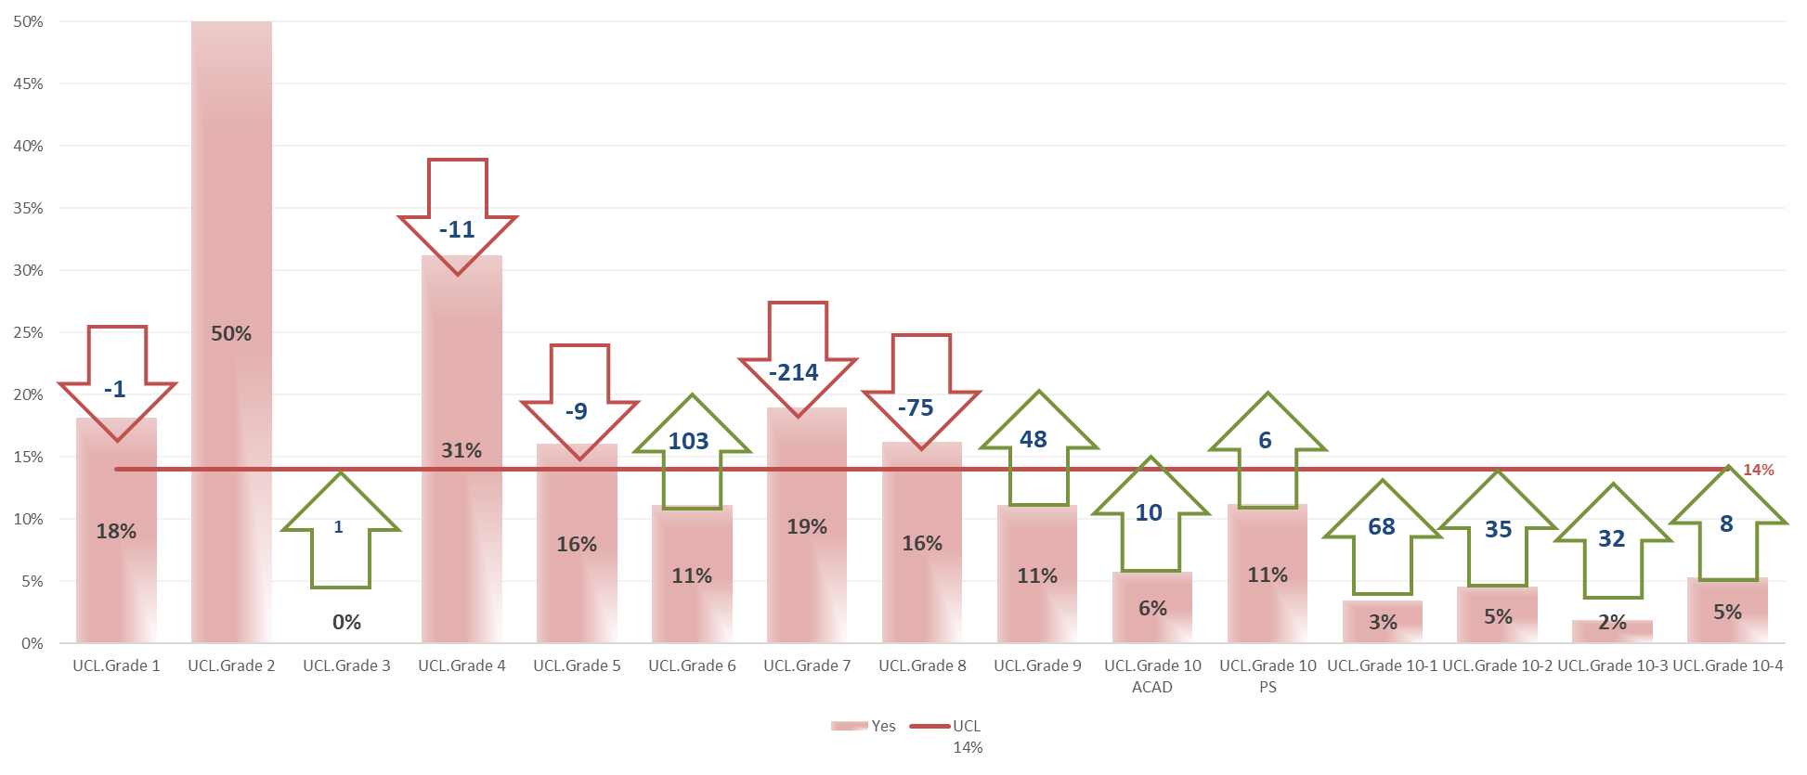
Declared disability – adjustment in staff numbers needed at each grade to eradicate pay gap
Aside from G8, disabled staff continue to be underpopulated in senior grades. Promotion and recruitment of disabled staff G8 upwards should remain a focus. The results from the recent senior promotions round should help with this in future years.
In terms of representation at grades below the median, G7 is the grade where disabled staff are proportionately overrepresented and we need to remain focused on progression of these staff, in particular related to researchers where there is an established promotion process.

Slide 18
Positive actions which have narrowed UCL’s gaps
As part of a commitment to remain an employer of choice UCL has undertaken a series of positive initiatives to reduce pay gaps, some of which are outlined below:
Academic promotions – Introducing our academic careers framework in 2017 has led to increased diversity at senior levels after each promotion round. Last year 46% of promoted staff and 45% of all new professors were female (34% of the current professoriate are female). 17%of promoted staff are BAME and 8% disabled. While clearly there is more to do, this will increase diversity from the current position.
Professional services progression – In 2020 UCL launched our Accelerate to Leadership scheme for Black, Asian and Minority Ethnic (BAME) staff. Leadership posts (Grades 8-10) can initially be placed as short term (3-12 months) posts which BAME staff exclusively can apply to undertake. As part of the placement staff receive coaching and professional development time- which puts them in a good position to undertake permanent roles at the grade.
Pay strategy – UCL’s approach to London allowance in the new pay and reward strategy will reduce our pay gaps (by circa 1%) in future pay gap reporting.
Recruitment – As part of centralising recruitment and implementing a new system in 2023 we simplified the application process. This has helped us significantly increase our applicant pool which has resulted in an increase in diversity of applicants and a marked increase in diversity of senior hires at senior grades. Wider routes to market are being used alongside a conscious effort to reach a more diverse applicant pool.

Slide 19
Actions
Review of early career promotion process. A review is underway of the research promotion process from Grade 6 to 7 and Grade 7 to 8. Given the distribution staff at this grade it is important that the consistency of the process is improved. Initial recommendations from the external review will be considered within 2024.
Senior promotions review- disability accessibility. Changes were made to the process prior to the last round from a disability accessibility perspective and a wider review will take place in summer 2024 – once the current promotions round closes. We will continue to monitor the proportion of disabled staff promoted through the process.
Monitor the impact of the new pay and reward strategy. Initial modelling suggested that the initial tranche of changes to UCL’s pay scale and London allowance (from August and December 2023) would have the effect of reducing the pay gaps. This should show up in the 2024 report which needs to be reported before April 2025.
Information session on the gender and ethnicity pay gaps in the 2023-24 academic year. The HR & EDI Team will host an information session on the gender and ethnicity pay gaps. The session's aim is to raise awareness and understanding of gender and ethnicity pay gaps and how they manifest in a localised context. The socialising of these reports will encourage local-level investigation into processes and practices contributing to gaps.
The Reasonable Adjustments sub-group of the Disability Equality Implementation Group to develop actions to ensure that reasonable adjustments for staff are implemented fairly, consistently and effectively and meet the needs of Disabled and Neurodivergent staff. The group will:
Review the current processes for Reasonable Adjustments for both staff and students (including PEEPs). Oversee the development of a Reasonable Adjustments process for built environment works.
Consider how all reasonable adjustments (including PEEPS) are funded by UCL.
Consider improvements to all reasonable adjustments processes at UCL.
Consider a communications package on reasonable adjustments (including PEEPs).
Reduce the proportion of staff with unknown ethnicity and disability status. Urgent Work is underway to address this, and there will be a promotion of a technological solution within the Inside UCL app to help drive down unknown EDI data as well as a disclosure campaign to increase reporting rates.
A tracked positive action pilot in partnership with the EDI team and our hiring community in the next few months for defined identified academic vacancies will launch in April 2024. We will be measuring all interventions in this pilot and their impact and looking at how we can roll out learnings from this more broadly.
Better use of the Accelerate to Leadership programme – using our new recruitment system, Talentlink and ensure that we can track the use and outcomes of this. Increased awareness-raising sessions/campaigns for hiring managers, leaders and the wider UCL community make A2L front of mind for all short-term recruitment opportunities.

