Slide 1
UCL Gender, Ethnicity and Disability pay report 2022/23

Slide 2
Foreword
This report outlines UCL’s latest pay gap position. Overall the report shows that we continue to make good progress on gender and we have seen some progress in increased seniority of BAME staff at senior grades but unfortunately our overall ethnicity gap has increased. The report also outlines our declared disability gap for the first time.
This year both the mean and median gender pay gaps are likely to again to be amongst the lowest in the Russell Group and we are pleased that the gender gap has reduced again, following a plateau last year. Importantly, we can see that the proportion of female staff at each of the grades above the median UCL earnings (Grades 8-10) is increasing and reward mechanisms such as the senior promotions process continue to increase gender diversity at senior levels.
With regard to our ethnicity gap, as was the case last year, the proportion of BAME staff above the UCL median is increasing (which is a positive development). However, this is offset by an increasing proportion of BAME staff compared to white staff at Grade 6. As a result, disappointingly we have again not made progress on the ethnicity pay gap with the gaps increasing since last year. There remains a very high number of staff with unknown ethnicity which we need to reduce.
Distribution of staff between the grades continues to be the overwhelming reason for overall gaps. This is shown by the quartile positioning data later in the report. To check this we have also conducted an equal pay audit which outlines that within grades there are not significant gaps between men and women or white and BAME staff.
We also here report on our disability pay gap which shows a wide differential between the salaries of those who have disclosed a disability and those who have not. This is our first year of reporting this metric and gives us a baseline to work from in the future reports. The gap is substantial, caused by a severe drop off in disabled staff at higher graded roles and something we now need to work to address.
We remain committed to addressing gender, ethnicity and disability pay gaps over the coming years. In particular we will continue to support the career development of women, BAME and disabled staff to increase their representation at our highest grades. It is important to note that this report focuses on data taken as at 31st March 2022. As such there will be a lag between initiatives undertaken and their effect on the data. In particular we are beginning to see a reduction in those with an ‘unknown’ ethnicity but this is not yet reflected in the data in this report.
Donna Dalrymple
Chief People Officer

Slide 3
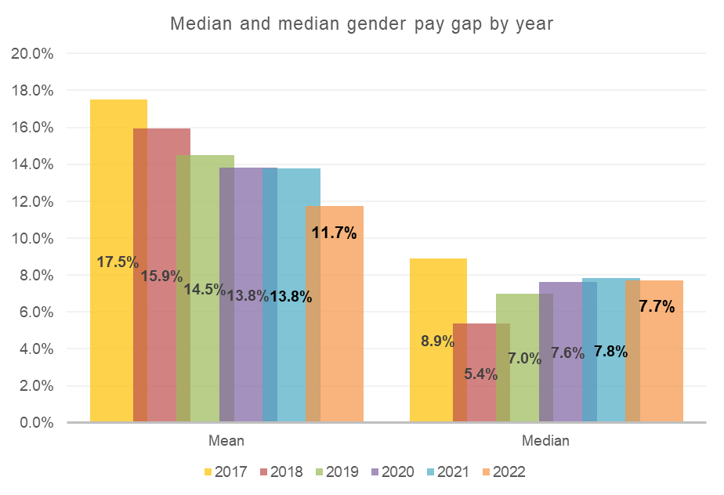
Gender pay gap analysis
Gender pay focuses on the differential between the average (median and mean*) salary of all women and men at UCL. The mean gap at UCL now stands at 11.7% and the median at 7.7%. This remains significantly below averages in wider society. As a reference point the ONS reported 2022 median gap for all staff in the UK is 14.9%, nearly double the UCL median.
Comparing these figures with 2021 reports would mean that UCL has the second lowest median and mean gap amongst the Russell group.
*The mean is calculated by adding up all of the wages of employees and dividing that figure by the number of employees. The median is the number that falls in the middle of a range when everyone’s wages are lined up from smallest to largest

Slide 4
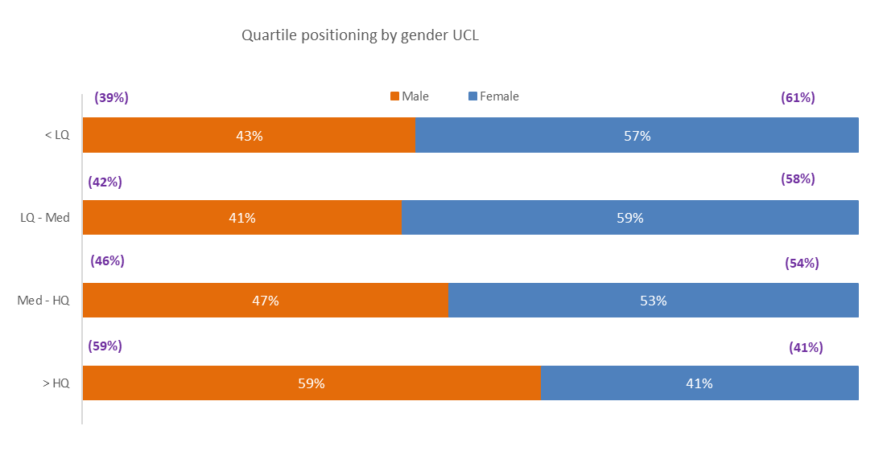
Gender pay gap analysis
The proportion of female staff has reduced overall across UCL. While the proportion of women paid above the median reduced by around 1%, the proportion of women paid below the median has reduced by around 3%.Overall this results in a more even distribution of women throughout the pay quartiles and a narrowing of the median gap. The fact that the same proportion of females are employed in the upper quartile but there has been a 4% reduction in women within the low quartile has had a significant effect on reducing the mean pay gap.

Slide 5
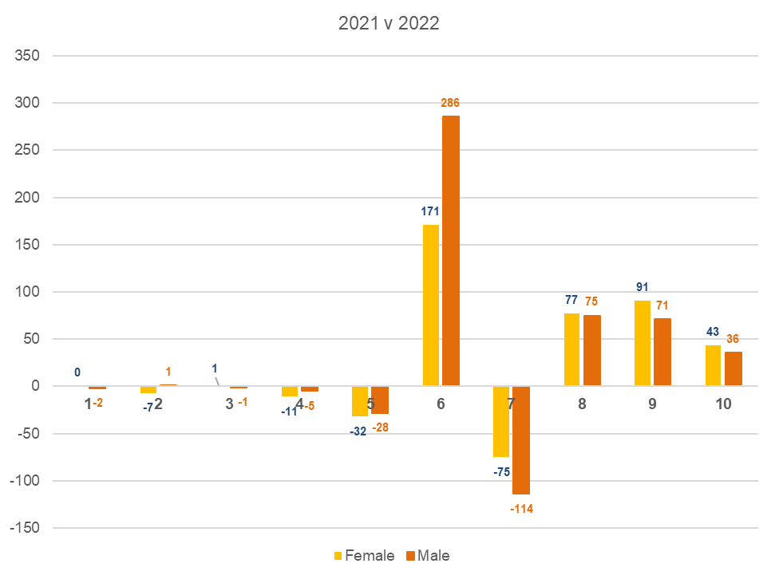
Increase/decrease of employees in grades by gender since 2021
As was the case last year We can see that at each of G8, 9 and 10 (above median) there has been a higher increase in the number of female staff in each grade. This reflects the positive action that UCL has taken at this level.
We can also see a reduction in the number of G7 employees, possibly driven by Lecturers (Teaching) being more routinely employed at G8.
In a contrast to last year where there was a large spike in female G6’s, this year there has again been another significant increase in G6 employees but a greater number of those are male. This has contributed to the narrowing of the pay gap. Many of these G6 staff are PGTA’s engaged on fractional employment contracts.

Slide 6
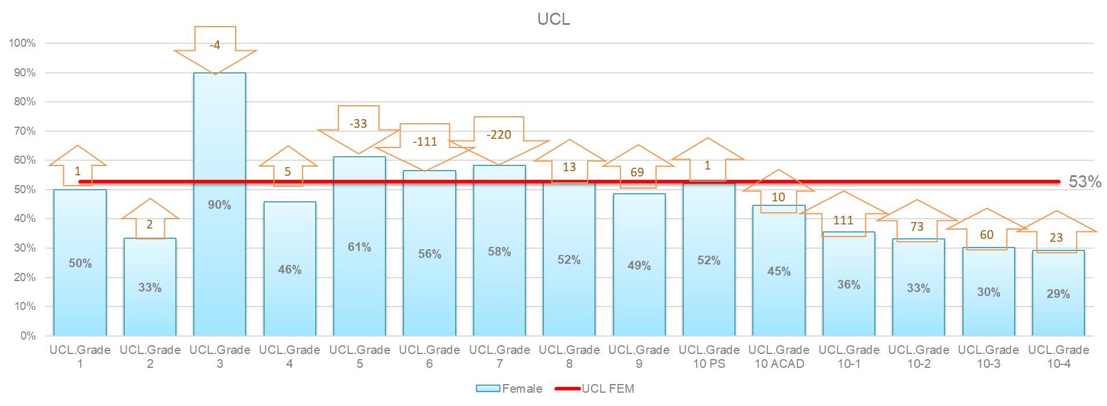
Adjustment in female staff numbers needed at each grade to eradicate pay gap
This chart shows the extent of changes to female staff numbers at each grade. We can see that female staff continue to be underrepresented at grade 9 and professorial level in particular. Even more significant is the over representation of women in grades 6 and 7. Progression for these staff would be an important measure in tackling the pay gap further.

Slide 7
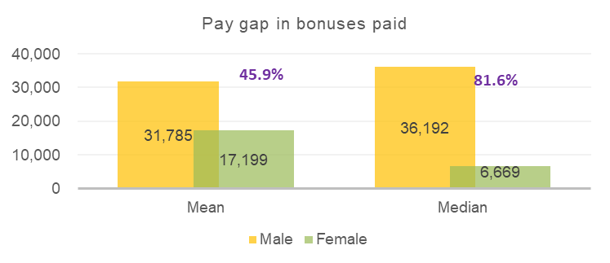
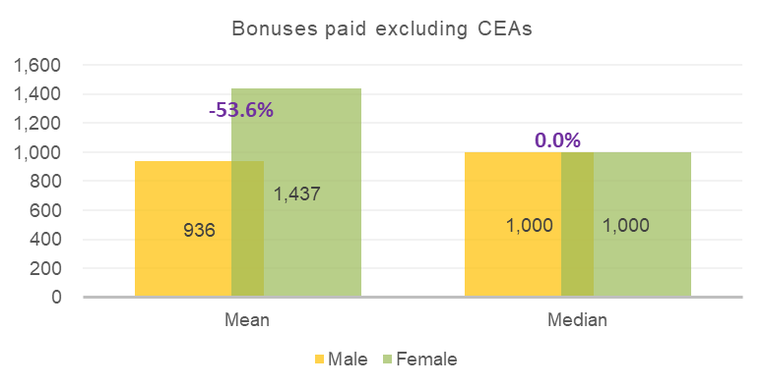
Gender pay – bonus reporting
As in previous years UCL needs to categorise clinical excellence awards as bonus payments. UCL actually pays few one off payments and over 90% of them are clinical excellence awards. These awards are mandated by the NHS and much larger than any bonuses agreed internally. As a larger proportion of our senior clinical staff in receipt of the awards are male it substantially distorts our data. As such, with CEAs included, the average bonuses are high and heavily in favour of men.
Where CEA’s are excluded (lower graph), to include only the payments UCL has control over, bonuses are much smaller and higher amounts are paid on average to female staff.
Pay gap in bonuses paid
Pay gap in bonuses paid excluding Clinical Excellence Awards (CEAs)

Slide 8
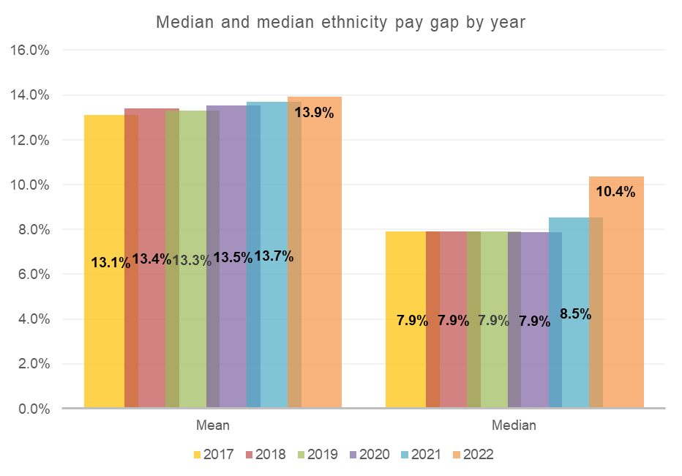
Ethnicity pay gap analysis
As with gender, BAME staff are underrepresented at senior levels which continues to be the overwhelming reason for the ethnicity pay gaps. As was the case last year there has been a marginal increase in the proportion of staff in the senior grades (8-10) who are BAME- which is encouraging.
Last year UCL checked starting salary and salary position within grade by ethnicity as part of an equal pay audit. This has shown that, as with gender, UCL does not have a fairness issue in terms of equal pay for work of equal value. We have repeated the equal pay audit this year and again this is not driving the overall ethnicity gap.
The mean gap this year has increased marginally by 0.2% and is now 13.9% and the median gap has increased more substantially to 10.4%. The proportion of BAME and white staff between the grades and the quartiles remains very similar to previous years.
We are again concerned at the number of staff whose ethnicity is unknown, as this could result in material differences in the gaps- either positively or negatively. We have begun to address this but due to reporting lag this has not evidenced any reduction in unknowns from the previous report
%

Slide 9
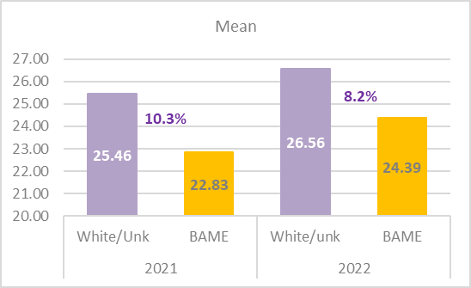
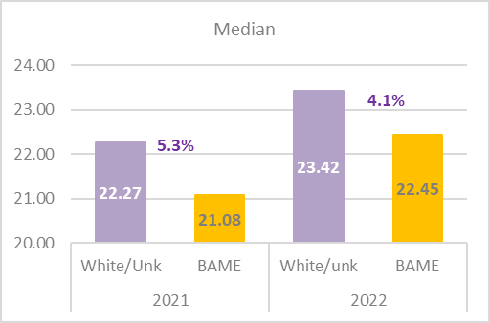
Ethnicity pay gap- average pay of BAME staff vs white AND unknown
When we outline our ethnicity pay gap we compare the average salaries of white staff with BAME staff. Staff with unknown ethnicity continue to be too high at UCL. While we know there is an ethnicity pay gap, this makes it difficult to ascertain the true level of gap. This year we have also compared the salaries of BAME staff with white AND unknown staff- both this year and last year. This demonstrates that the gap between BAME salaries and all other salaries has narrowed between 2021 and 2022- both the mean and median. This could be a positive signal, but it underlines the importance of reducing the unknowns.

Slide 10
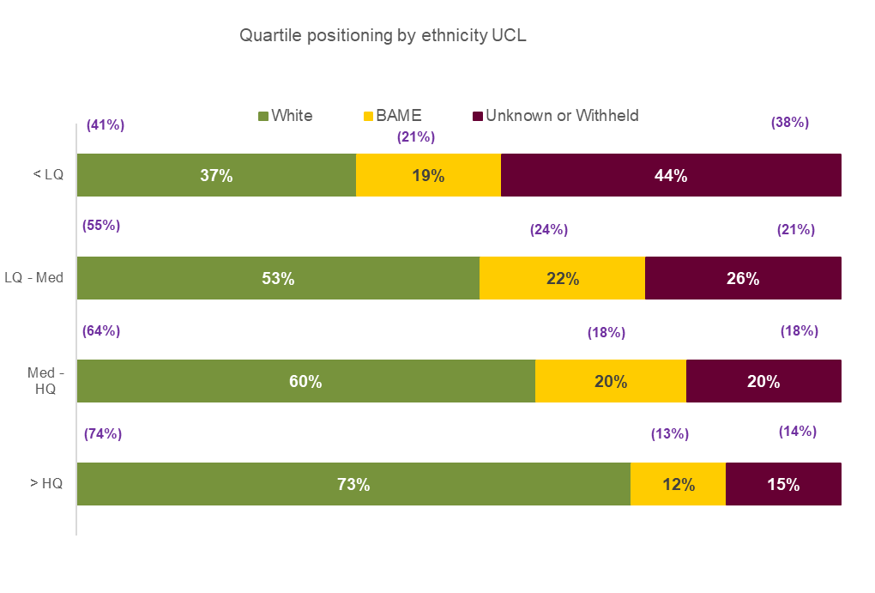
Ethnicity- quartile positioning
In terms of the quartile positioning the proportion of BAME and white staff has marginally reduced overall, with that being compensated for by an increase in those with unknown ethnicity.
The distribution of BAME and white staff between the pay quartiles remains similar to last year, albeit the proportion of BAME staff in the two higher pay quartiles above the median has increased relative to white staff.
The fact that there is a significant drop (4%) in the percentage of white staff (replaced by unknowns) within the low pay quartile is the predominant reason for the rise in the ethnicity gap
There is an increase in the percentage of unknown staff at every quartile, but in particular the lower quartiles. It is important to reduce this.

Slide 11
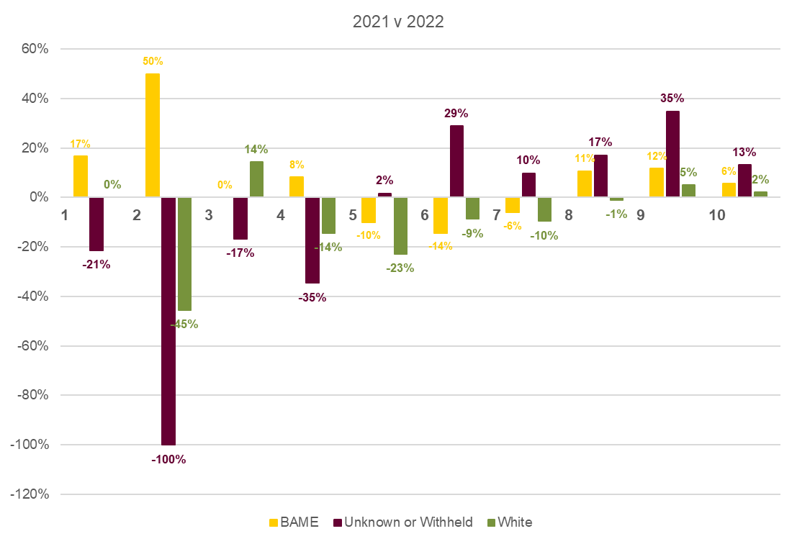
Ethnicity pay gap analysis % increase/decrease in population by grade since 2021
The table shows the change in proportion of staff at each grade from last year.
Encouragingly, the same as last year, we can see the percentage of BAME staff within grades above median (G8-G10) has increased more than the proportion of white staff in the same grades However, below the median at G7 the population of BAME has decreased by a smaller proportion than the decrease in white staff (6% vs 10%)
At grade 5 and below there are less staff (numerical increases/decreases are shown on the following slide) so the effect is less, albeit there is tendency for the proportion of BAME staff increasing in these grades vs the proportion of white staff decreasing. This will have added to the average salary for white staff rising, relative to the averages for BAME staff.
The ethnicity pay gap is calculated by considering the differences between the pay of BAME and white staff only. However, this year the proportion of staff with an ‘unknown’ ethnicity has increased again and this has caused issues with data reliability. Depending on the proportion of unknown staff who are white or BAME the gap would shrink or widen.

Slide 12
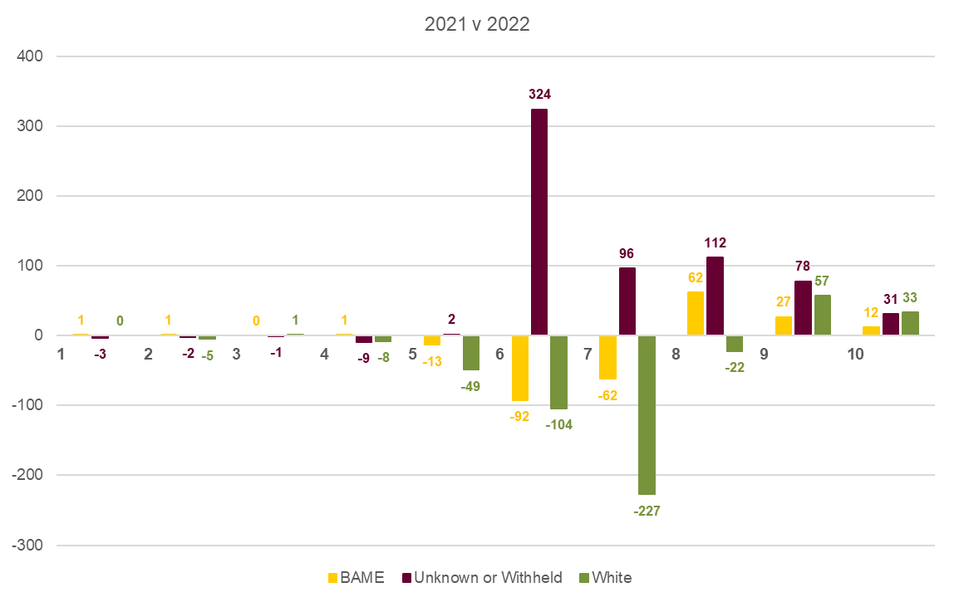
Ethnicity pay gap number increase/decrease in population by grade
The graph replicates the last one but focused on staff number increases/decreases rather than percentages. There is a substantial decrease in white staff at G6 (104) and G7 (227) who are paid below the median which has resulted in the median salary for white staff rising. This outweighs the decrease in BAME staff in the same grades There is also a larger decrease in white staff paid at G5.
There is again a significant number of unknown staff who are not included in the ethnicity pay calculation- which is focused on the salary average of BAME staff vs white staff.
It is positive that both the proportion and number of BAME staff has increased at all the grades above median salary (G8-10). In isolation this would have narrowed both the mean and median pay gaps. However, the substantial reduction in white staff at G6/G7 again more than offsets this increased diversity at G8 upwards and results in the overall gap.

Slide 13
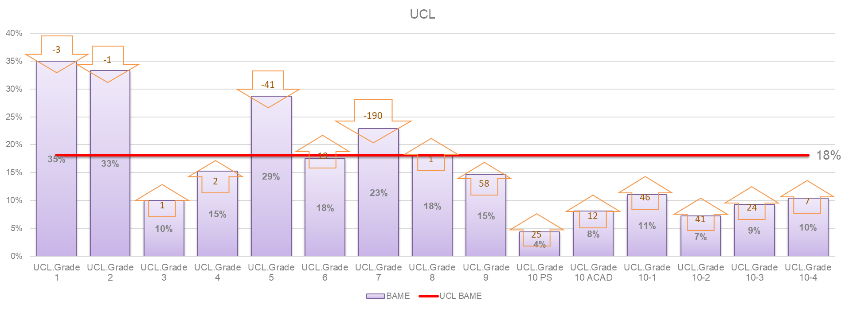
Adjustment in BAME staff needed at each grade to eradicate pay gap
Similar to gender, this shows the BAME staff are under represented at grades 9 and 10. Specifically the numbers of BAME staff at grade 10 (PS and Academic) need to be increased significantly. An even larger issue is that BAME staff are overrepresented in the grades below the average UCL salary. In particular there is significant over representation (190 staff) of BAME staff at grade 7. Progression from this level upwards is important, particularly for researcher staff- where there is an established promotion process.

Slide 14
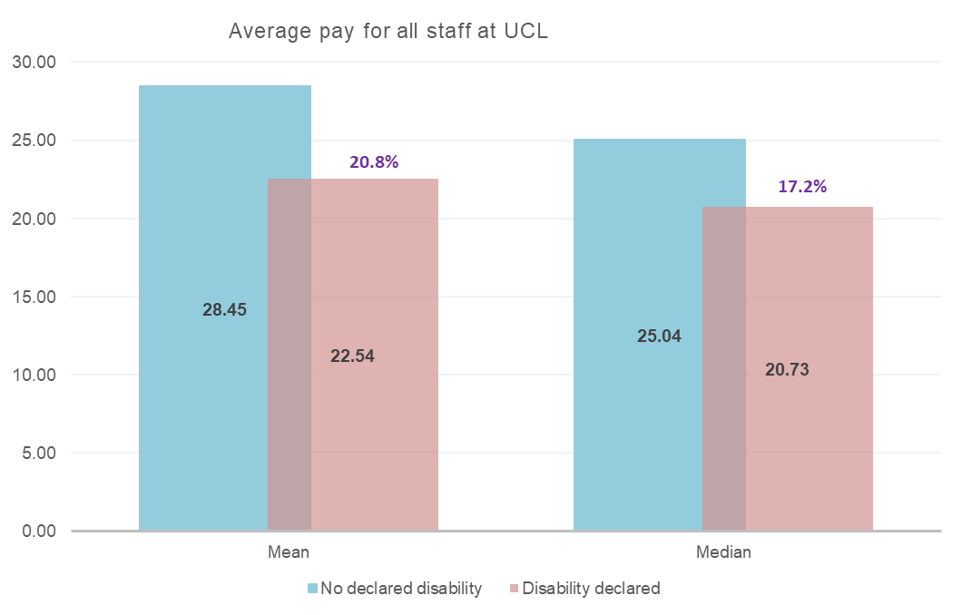
Pay gap- declared disability vs no declared disability
This is the first year in which UCL is measuring its pay gaps between the average salaries of staff who have disclosed a disability and those who have not declared a disability. The gaps are substantial. Like our gender and ethnicity gaps we can see in the following slides that the distribution of staff between the grades is again the primary reason for the gaps.
Typically other organisations are not monitoring, or disclosing this data which makes it difficult to benchmark against wider society, or the sector. However, these gaps are evidently large and we need to work to reduce them

Slide 15
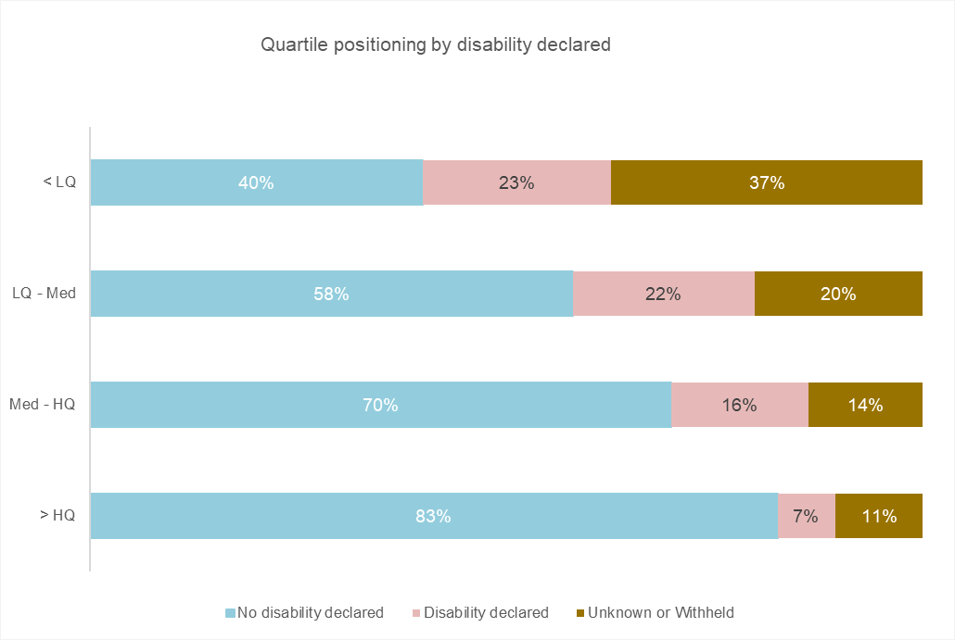
Declared disability- quartile positioning
The quartile positioning shows the clear drop off of disabled staff as we move up the grading structure. Disabled staff are much more likely to be within the low pay quartile (G1-G6), where 23% of staff are disabled than in the top pay quartile (G9-G10) where only 7% of staff are disabled.
Those with an unknown disability also drop off at each quartile while staff who have declared that they do not have a disability are much more likely to be within higher pay grades.

Slide 16
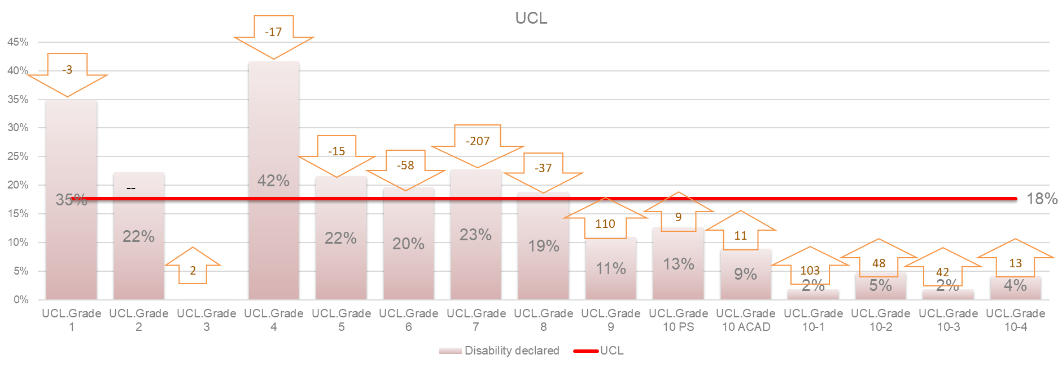
Declared disability- adjustment in staff numbers needed at each grade to eradicate pay gap
Similar to gender and ethnicity this shows that staff with a declared disability staff are under represented at grades 9 and 10 and over represented at Grades below the average salary- in particular G6 and G7. However the drop off in disabled staff as we move up the grades is substantially more acute than for either gender or ethnicity- and this results in the larger overall gap. Like ethnicity, progression from G7 to G8 for disabled staff should be a key focus in the upcoming year.

Slide 17
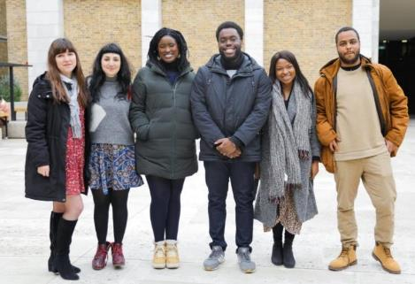
Actions
Review of early career promotion process. A review of the process for early career promotions from grade 6 to 7 and 7 to 8 will be undertaken to ensure consistency. Researchers are a significant cohort of our population where we know there is less diversity as we move up the grading structure.
Senior promotions review- disability accessibility. While the senior promotions process has delivered positive year on year outcomes for both ethnicity and gender equality, we will review the senior promotions process in terms of disability accessibility ahead of the 2023- 2024 round to ensure there are no unintended barriers.
Information session on the gender and ethnicity pay gaps in 2023 The HR & EDI Team will host an information session on the gender and ethnicity pay gaps. The session's aim is to raise awareness and understanding of gender and ethnicity pay gaps and how they manifest in a localised context. The socialising of these reports will encourage local level investigation into process and practices contributing to gaps.
Achieving more consistency in workplace adjustments for disabled staff to remove barriers and develop an inclusive culture to provide more accessible and inclusive work opportunities through for example awareness raising of the role of managers in workplace adjustments and supporting them through training and other tools.
Reduce the proportion of staff with unknown ethnicity. Work is underway to address this and there will be a promotion of a technological solution within the Inside UCL app to help drive down unknown EDI data
A tracked positive action pilot in partnership with the EDI team and our hiring community in the next few months for defined identified vacancies (academic and professional services). We will be measuring all interventions in this pilot and their impact and looking at how we can roll out learnings from this more broadly.
Better use of the Accelerate to Leadership programme – using our new recruitment system, Talentlink we are making accelerate to leadership front of mind for all secondment opportunities and we can track the use and outcomes for this.

