Slide 1
overview
Professorial Appraisal Review System
Quick Reference Guide - Appraiser
OVERVIEW
The Professorial Appraisal Review system allows members of the UCL professoriate to complete their appraisal online. The system uses an electronic, interactive form, which automatically draws data from UCL databases regarding a professor's publications, research grants, research students, honours and awards during the appraisal period. Please note that if publications or grants have been used in previous submissions, they will no longer be available for the next appraisal cycle.
This guide sets out an overview of how to navigate the Professorial Appraisal Review system as an appraiser, how to review each section and add feedback. A high level process map of the Professorial Appraisal Review (PAR) can be found here.
SYSTEM ACCESS
The Professorial Appraisal Review (PAR) system can be located using the following link:
https://www.ucl.ac.uk/par/
Users can log into PAR using their UCL user ID and password. Please note the username needs to be entered in capital letters (e.g. CCEARJF)
The page is split into a section for Appraisees and a section for Appraisers (HoD and Deans).
To access open appraisals, users should select the Open Appraisals hyperlink from the appropriate section based on the users role.
Access to PAR is restricted to professors, heads of departments (HODs) and Deans.
Only the professor and their line management have access to the appraisal record. Once an appraisal is closed at any stage the previous stages cannot be altered.

Slide 2
Support
Professorial Appraisal Review System
Quick Reference Guide - Appraiser
SUPPORT
If you experience any issues when creating your appraisal for the current academic year, and require support, please contact the One Desk team by sending an e-mail to hr-services@ucl.ac.uk and clearly indicate the problem area in the subject of your email e.g. “PAR – Incorrect Appraiser” (contacting this address will create a help ticket in RemedyForce allowing the issue to be tracked).
The helpdesk team will prioritise these requests and a member of the team will be in touch as quickly as possible to assist you.
Alternatively we have created a Frequently Asked Questions document that covers many of the trouble shooting issues you may experience. The FAQ document can be accessed on the Professorial Appraisal Review HR website page.
TERMINOLOGY
Appraisee
Individual Professors on an academic contract who are responsible for creating & submitting their appraisal and associated stretch objectives in the PAR system (Part A), ensuring all data that is pulled from the databases mentioned above are accurate and up to date. The appraisee will need to sign off Part B once updated by the appraiser before it can be signed off
Appraiser
The Head of Department or those with delegated responsibility, who
will review the appraisal submission and add details on the appraisee’s progress (Part B) for the Appraisee’s final comments and sign off. Once the Appraisee has signed off Part B, the appraiser can sign off the appraisal (Part B) and submit to the Dean for final review and closure.
Dean
Once the appraisal review has been completed and signed off by the Appraisee and Appraiser, the Dean will receive notification to review and close the appraisal (Part C)

Slide 3
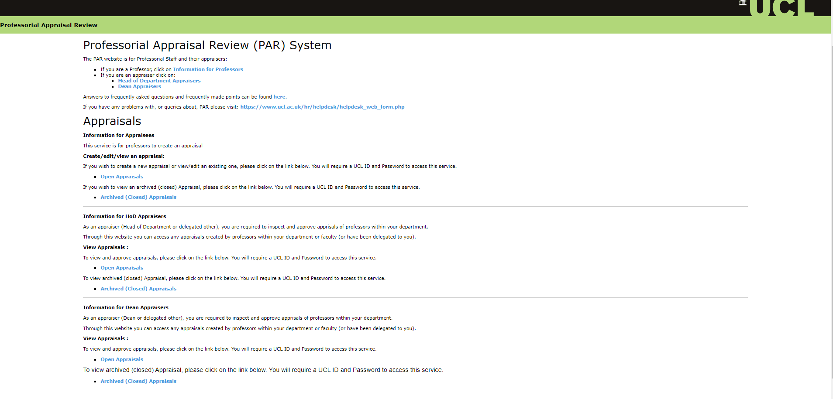
Access
Professorial Appraisal Review System
Quick Reference Guide - Appraiser
The Professorial Appraisal Review system web page is broken into multiple sections based on the role being performed, i.e. Appraisee, HoD Appraiser or Dean Appraiser. From this page, users can access either open or archived (closed) appraisals that they have permission to view. The user will be taken to the PAR system once they have selected either the Open or Archived appraisals link.

Slide 4
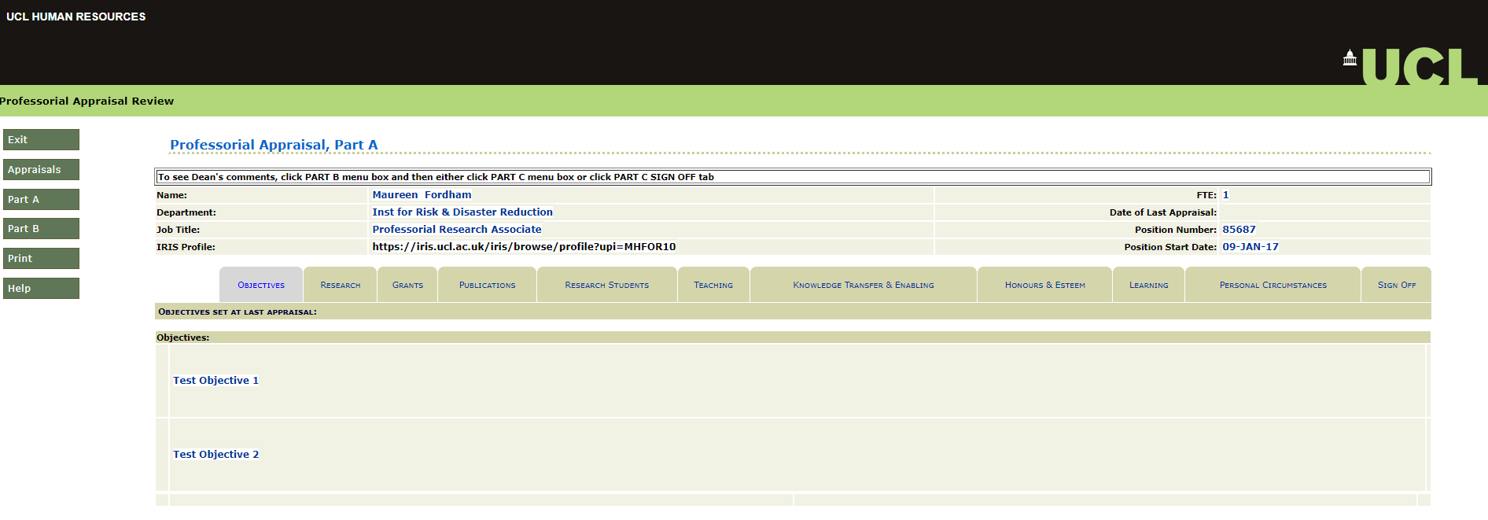
Reviewing and Updating an appraisal
Professorial Appraisal Review System
Reviewing and Updating an appraisal
Once an Appraisee has created their appraisal and signed off Part A of the form, the Appraiser will receive an Outlook e-mail notifying them that an appraisal has been submitted for review and sign off. Once the Appraiser has logged into the Professorial Appraisal Review system they will be presented with the ‘Appraisal Selection’ screen. Users are able to filter the list of appraisals by department, year, status and role.
Note: An Appraiser cannot view an appraisal until the Appraisee has signed off Part A. In other words, Appraiser’s cannot select appraisals of status “New.” In addition, this summary screen only displays appraisals which exist in PAR (so if an Appraisee is not listed then that means they have not created an appraisal in PAR yet).
John Doe
123456
Joe Bloggs
To start reviewing the appraisal, click on the ‘select’ button against the relevant professors appraisal that is being assessed. The user will automatically be taken to Part B of the appraisal, however they can access Part A to review the information, by selecting the ‘Part A’ button on the left hand side menu.
The user can navigate between the different tabs to review the information entered by the Appraisee. When the Appraiser is ready to input feedback into Part B, they can select the ‘Part B’ button on the left hand side menu.
John Doe
123456

Slide 5
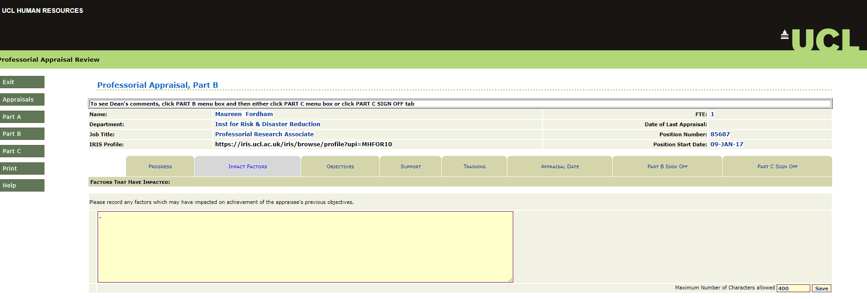
Part B tabs
Professorial Appraisal Review System
Part B tabs
Progress
On this tab the appraiser can view the previous year’s objectives and give details of Appraisees progress. Comments can be added to the text boxes against each objective as highlighted below. Click ‘save’ once completed.
Joe Bloggs
123456
Impact Factors
Here the appraiser can set out details of any factors that might have impacted on the achievement of the appraisee’s objectives.
Joe Bloggs
123456

Slide 6
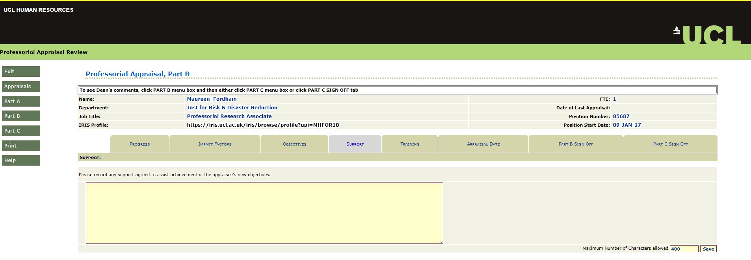
Part B tabs
Professorial Appraisal Review System
Part B tabs
Objectives
The appraiser sets out the objectives for the current year in this tab. There should be one objective per row. New rows are inserted by clicking ‘Create New Objective’. Th Appraiser can add the new objective in the text box that appears, as highlighted below. Click ‘save’ once completed.
Joe Bloggs
123456
Support
Any support agreed to assist the achievement of the appraisee’s objectives should be listed here.
Joe Bloggs
123456

Slide 7
Part B tabs
Professorial Appraisal Review System
Part B tabs
Training
Training and development to support the appraisee in the coming year should be recorded here. There should be one row per requirement. New requirements are created by clicking ‘Create Training Requirement’. Users can enter the relevant information in the boxes as highlighted below. Click ‘save’ once completed.
Joe Bloggs
123456
Appraisal Date
The appraiser needs to enter the date the appraisal meeting takes place in the text box highlighted below. Click ‘save’ once completed.
Joe Bloggs
123456

Slide 8
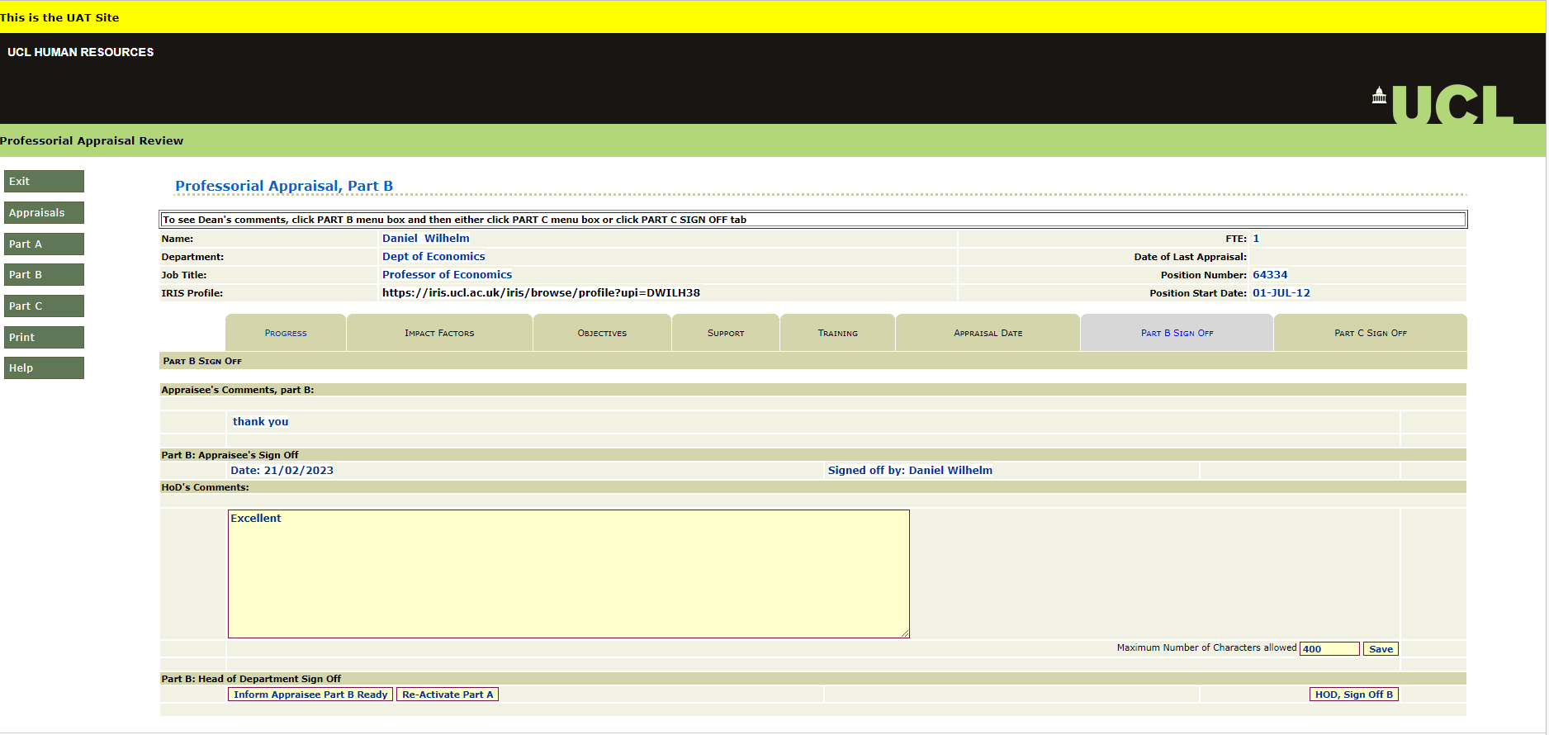
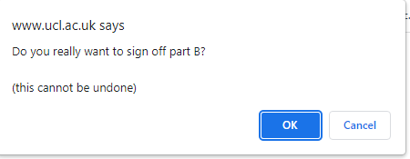
Part B tabs
Professorial Appraisal Review System
Part B tabs
Part B Sign Off
Signing off Part B of an appraisal usually involves both the Professor and Appraiser, however the Appraiser can sign off an appraisal without the professor signing off their part of it.
Note: Neither a professor nor an Appraiser can sign-off Part B of an appraisal unless there is a minimum of one New Objective specified.
The Appraiser can add final comments in the ‘HoD Comments’ text box highlighted below and click the ‘save’ button. They can then notify the Appraisee that Part B is ready for review and sign off by clicking ‘Inform Appraisee Part B Ready’ button. The Appraisee will be notified that Part B is available for comment and sign off. Once Part B has been signed off by the Appraisee, the Appraiser will receive an e-mail notification and can retrieve the appraisal and view any comments made by the appraisee.
Joe Bloggs
123456
Joe Bloggs
Once Part B has been signed off by the appraisee or alternatively if the Appraiser decides to sign off Part B without informing the Appraisee, the Appraiser can retrieve the appraisal in PAR, accessing Part B and selecting the ‘Part B Sign Off’ tab. The Appraiser can click the ‘HOD Sign off B’ button. The system will generate a warning message to confirm the user would like to sign off Part B of the appraisal. If the user is happy to proceed they can click ‘OK’.

Slide 9
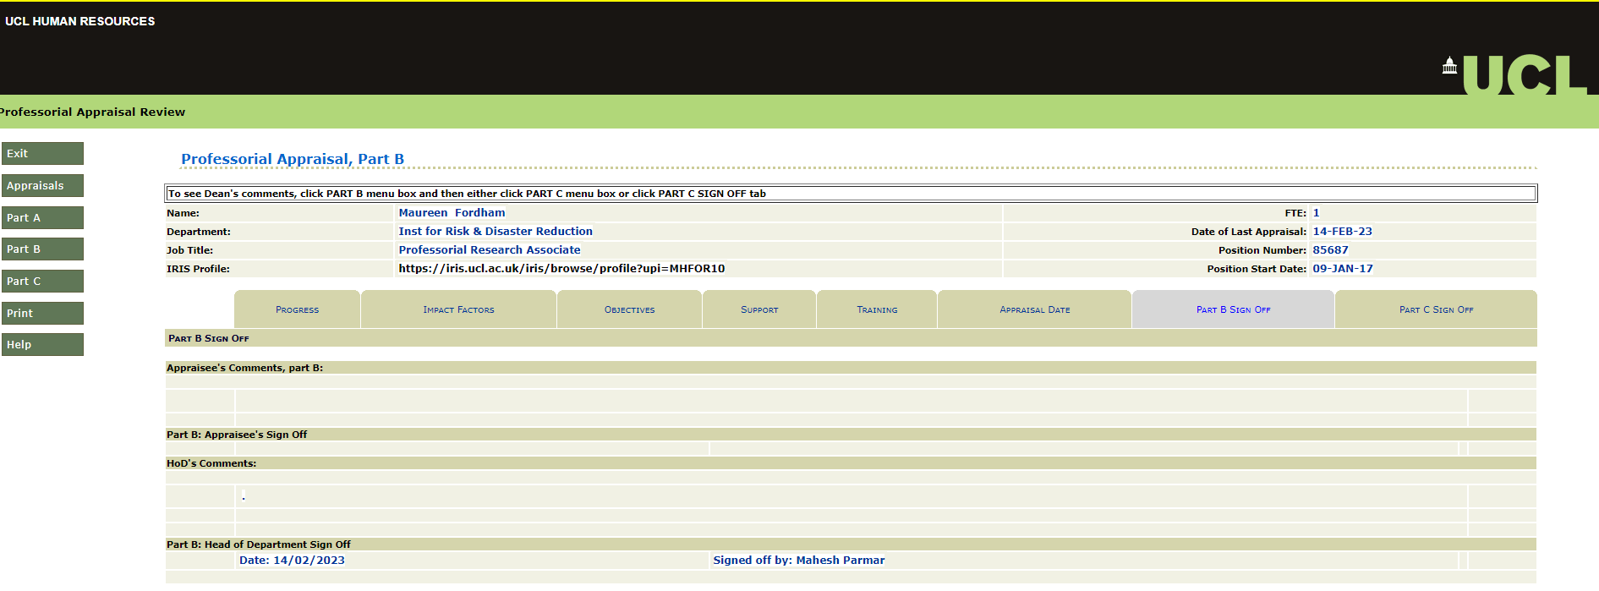
Part B tabs
Professorial Appraisal Review System
Part B tabs
If the user selects ‘OK’ the system will generate a new pop up message confirming the sign off has been successful. The user can click ‘OK’ to close the message and will be taken to the ‘Professorial Appraisal, Part B’ screen and can see the date Part B was signed off.
Joe Bloggs
123456
John Doe
The user can either select ‘Exit’ to leave PAR or select the ‘Appraisal’ button on the left hand side menu to be returned to the Appraisal Selection screen, where the status of the appraisal can be seen in the ‘status’ section as highlighted below.
John Doe
123456
Joe Bloggs
Note: Once the Appraiser has signed off Part B, an e-mail notification will be sent to the Dean notifying them that the appraisal is ready for review.

Slide 10
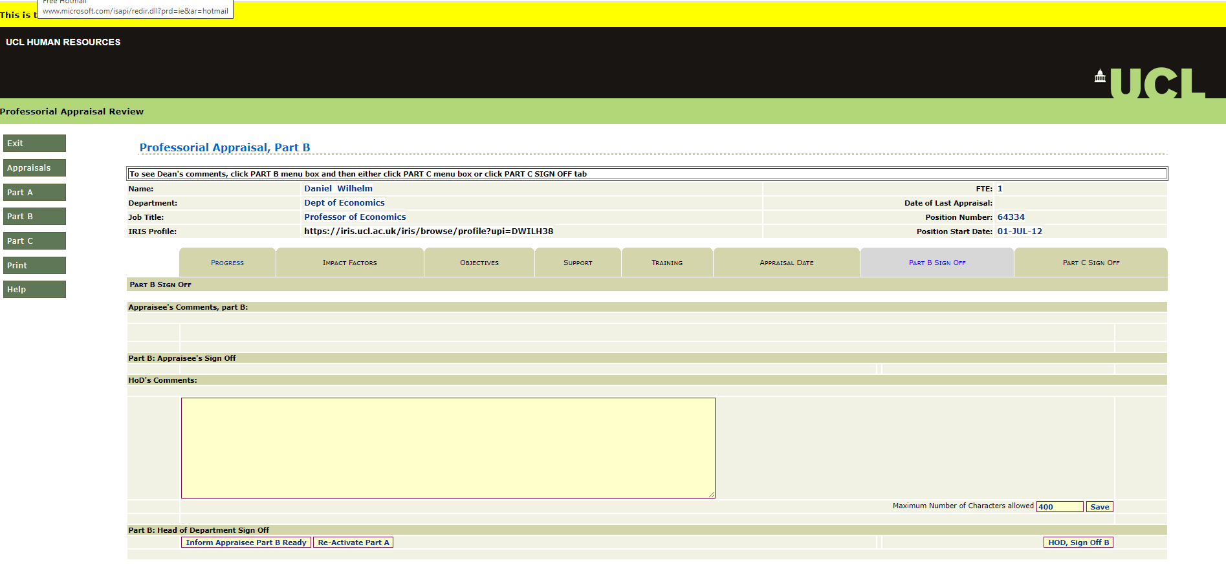
Part A reactiviation
Professorial Appraisal Review System
Part A Reactivation
Part A reactivation
If the appraisee has requested the Part A form is re-activated as they need to add additional information into the form, only the Appraiser can re-activate Part A (providing Part B has not been signed off). This can be done by logging into PAR and clicking ‘select’ button next to the relevant appraisee appraisal from the ‘Appraisal Selection’ screen.
John Doe
123456
Joe Bloggs
567891
Jane Doe
The user needs to select ‘Part B’ from the left hand menu and will be taken to the ‘Professorial Appraisal, Part B’ section.
Jane Doe
56781
The user needs to select ‘Part B Sign off’ tab of the Appraisee’s appraisal and clicking the ‘Re-Activate Part A’ button.
Jane Doe
56781

Slide 11
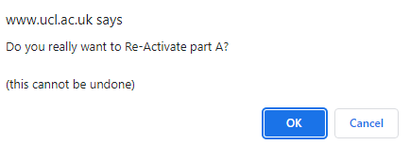
Part A Reactivation
Professorial Appraisal Review System
Part A Reactivation
The system will generate a warning message to confirm the user would like to re-activate Part A of the appraisal. If the user is happy to proceed they can click ‘OK’.
If the user selects ‘OK’ the system will generate a new pop up message confirming the reactivation has been successful. The user can click ‘OK’ to close the message and will be taken to the ‘Appraisal selection’ screen and can see the status of the appraisal has changed back to ‘New’. The appraisee will receive a notification via Outlook e-mail to advise them that Part A of their appraisal has been reactivated.
John Doe
123456
Joe Bloggs
567891
Jane Doe

Slide 12
PAR HIGH LEVEL PROCESS
Professorial Appraisal Review System
PAR HIGH LEVEL PROCESS

