Slide 1
Overview
Professorial Appraisal Review System
Quick Reference Guide - Appraisee
OVERVIEW
The Professorial Appraisal Review system allows members of the UCL professoriate to complete their appraisal online. The system uses an electronic, interactive form, which automatically draws data from UCL databases regarding a professor's publications, research grants, research students, honours and awards during the appraisal period. Please note that if publications or grants have been used in previous submissions, they will no longer be available for the next appraisal cycle.
This guide sets out an overview of how to navigate the Professorial Appraisal Review system as an appraisee, how to fill out each section and how to update data which is drawn in from UCL databases. A high level process map of the Professorial Appraisal Review (PAR) can be found here.
SYSTEM ACCESS
The Professorial Appraisal Review (PAR) system can be located using the following link:
https://www.ucl.ac.uk/par/
Users can log into PAR using their UCL user ID and password. Please note the username needs to be entered in capital letters (e.g. CCEARJF)
The page is split into a section for Appraisees and a section for Appraisers (HoD and Deans).
To access open appraisals, users should select the Open Appraisals hyperlink from the appropriate section based on the users role.
Access to PAR is restricted to professors, heads of departments (HODs) and Deans.
Only the professor and their line management have access to the appraisal record. Once an appraisal is closed at any stage the previous stages cannot be altered.

Slide 2
Support
Professorial Appraisal Review System
Quick Reference Guide - Appraisee
SUPPORT
If you experience any issues when creating your appraisal for the current academic year, and require support, please contact the One Desk team by sending an e-mail to hr-services@ucl.ac.uk and clearly indicate the problem area in the subject of your email e.g. “PAR – Incorrect Appraiser” (contacting this address will create a help ticket in RemedyForce allowing the issue to be tracked).
The helpdesk team will prioritise these requests and a member of the team will be in touch as quickly as possible to assist you.
Alternatively we have created a Frequently Asked Questions document that covers many of the trouble shooting issues you may experience. The FAQ document can be accessed on the Professorial Appraisal Review HR website page.
TERMINOLOGY
Appraisee
Individual professors on an academic contract who are responsible for creating & submitting their appraisal and associated stretch objectives in the PAR system (Part A), ensuring all data that is pulled from the databases mentioned above are accurate and up to date. The appraisee will need to sign off Part B once updated by the appraiser before it can be signed off
Appraiser
The Head of Department or those with delegated responsibility, who
will review the appraisal submission and add details on the appraisee’s progress (Part B) for the Appraisee’s final comments and sign off. Once the Appraisee has signed off Part B, the appraiser can sign off the appraisal (Part B) and submit to the Dean for final review and closure.
Dean
Once the appraisal review has been completed and signed off by the Appraisee and Appraiser, the Dean will receive notification to review and close the appraisal (Part C)

Slide 3
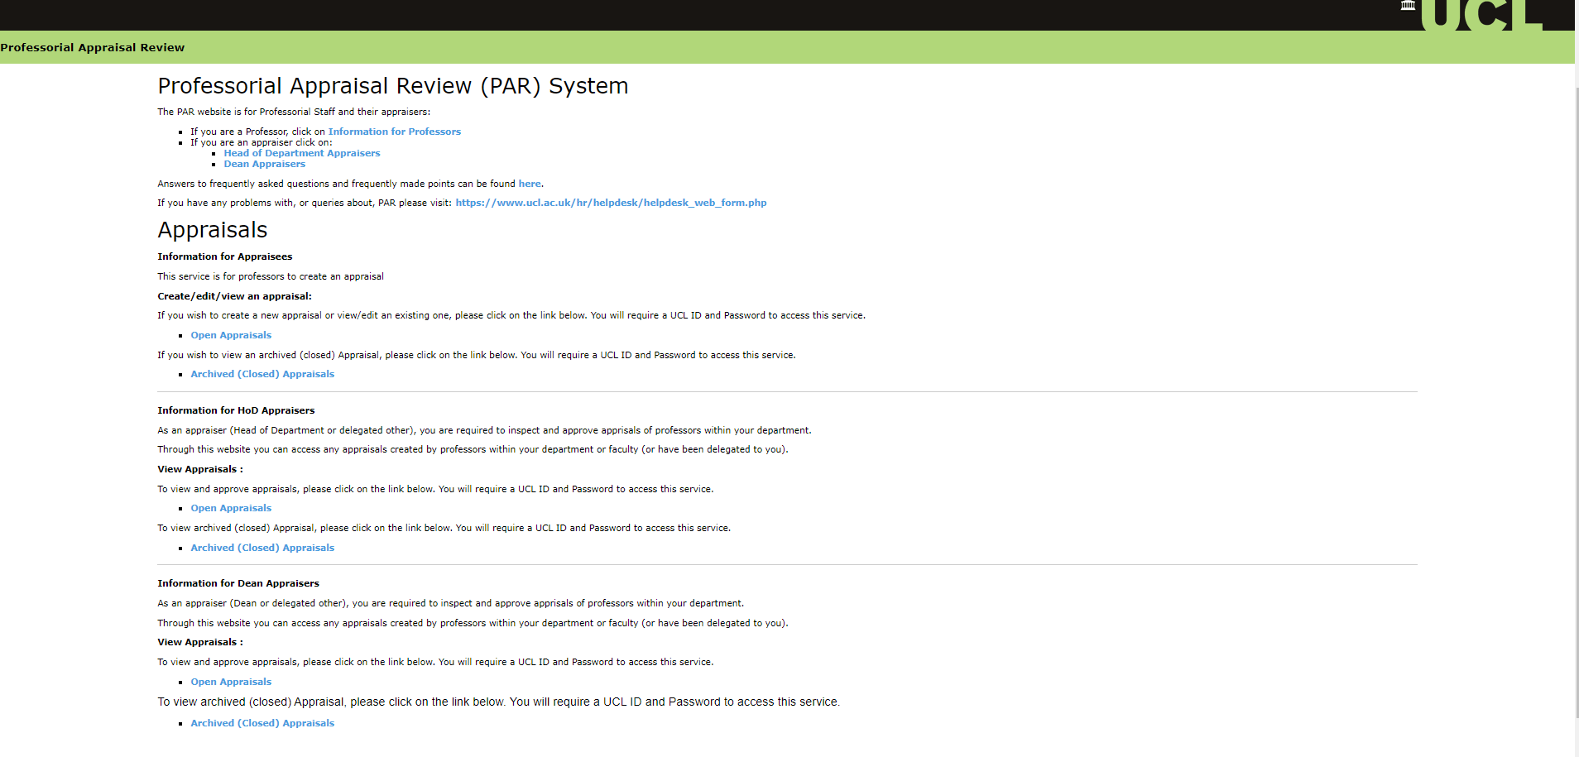
Access
Professorial Appraisal Review System
Quick Reference Guide - Appraisee
The Professorial Appraisal Review system web page is broken into multiple sections based on the role being performed, i.e. Appraisee, HoD Appraiser or Dean Appraiser. From this page, users can access either open or archived (closed) appraisals that they have permission to view. The user will be taken to the PAR system once they have selected either the Open or Archived appraisals link.

Slide 4
Creating an appraisal
Professorial Appraisal Review System
Creating an appraisal
Once the Appraisee has logged into the Professorial Appraisal Review system (PAR), they will be presented with the ‘Appraisal Selection’ screen. To start a new appraisal, select the button ‘Create New Appraisal’ button.
Joe Bloggs
Note: For first time users a new appraisal must be created. For professors holding more than one post, the system will default to your primary position by default as you can only create an appraisal against one post.
The user can now select the appraisal for the current appraisal cycle, by clicking ‘select’ button. If you have completed appraisals in previous years, there will be a list of previous appraisals.
Joe Bloggs
John Doe
123456
Once you have selected the relevant appraisal cycle, you will be presented with the ‘Professorial Appraisal, Part A’ screen. On this screen the appraisee will have access to multiple tabs that will enable the user to pull in information from various sources to support their appraisal. By default the screen is opened on the ‘Objectives’ tab. Users can navigate between the different tabs by clicking on the tab header to update the required information
Joe Bloggs
123456

Slide 5
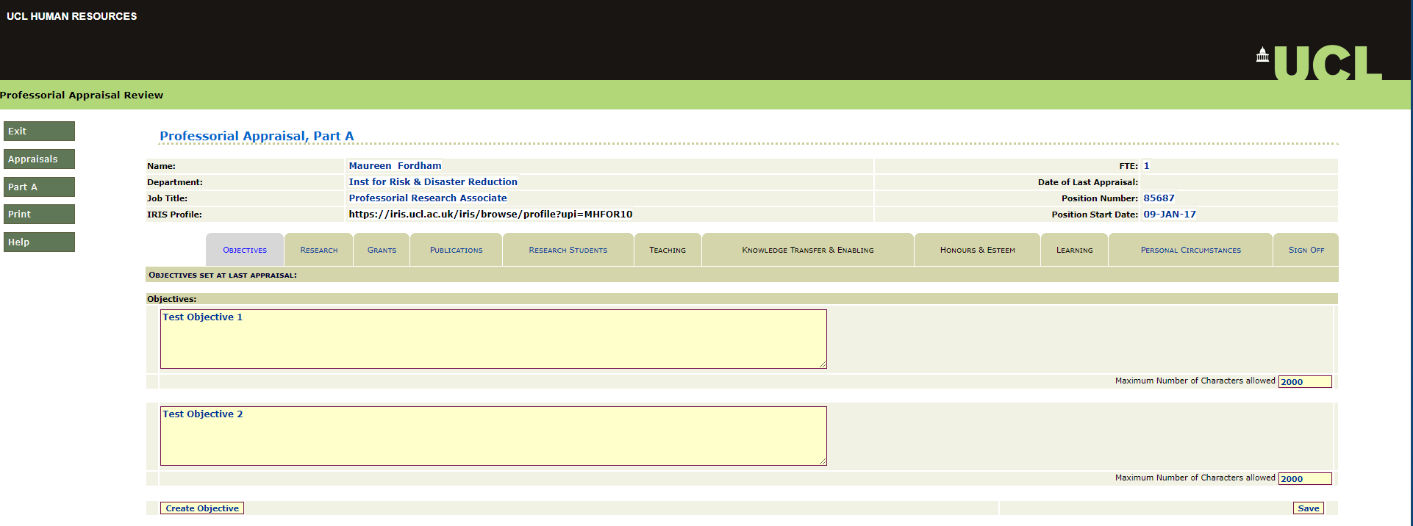
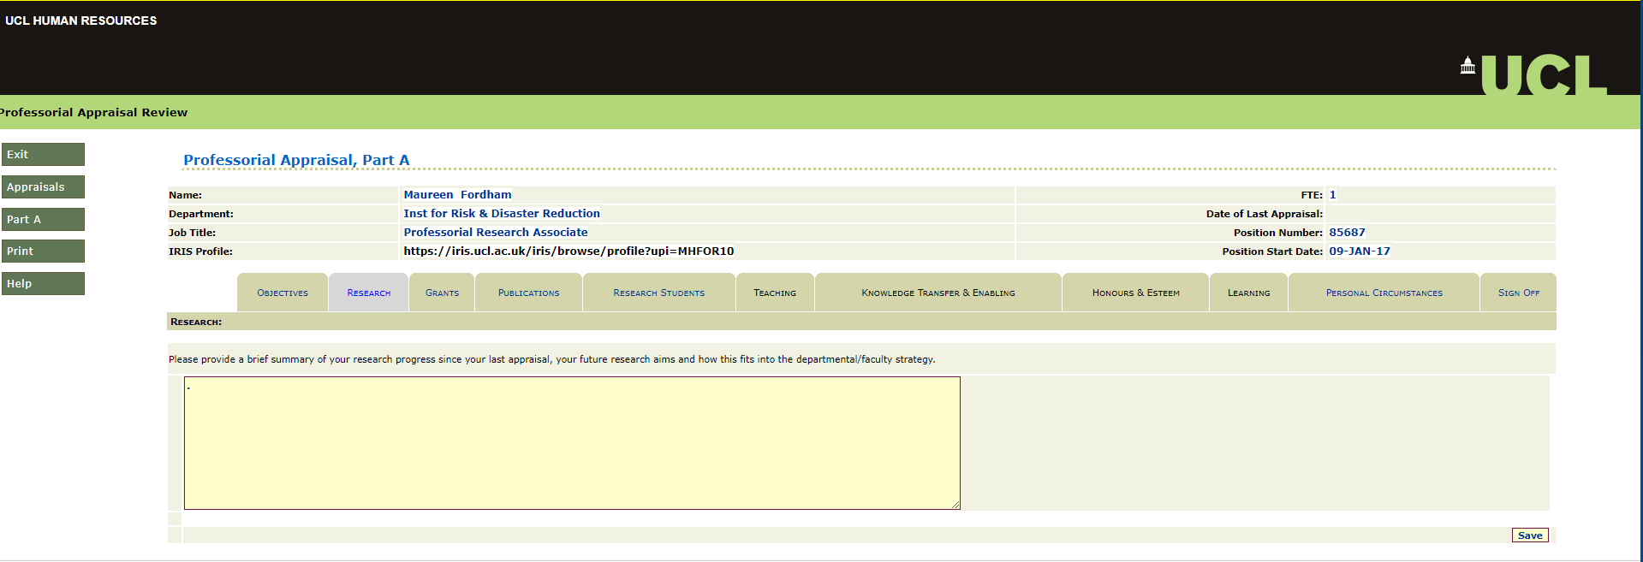
Part A tabs
Professorial Appraisal Review System
Part A tabs
Objectives
If the objectives were entered in the previous year’s appraisals, the objectives will be in the system and the tab populated automatically under the ‘Objectives’ section.
If this is your first appraisal, or no objectives were previously set in PAR, click ‘Create Objective’ button to enter each objective agreed at the last appraisal. Click ‘save’ once completed.
Joe Bloggs
123456
Research
The Research section allows the user to enter a brief summary of research undertaken since the last appraisal as well as future research aims. Users can add the information to the text box highlighted below and click ‘save’ once completed.
Joe Bloggs
123456

Slide 6
Part A tabs
Professorial Appraisal Review System
Part A tabs
Grants
This tab shows research grants that the appraisee is denoted as the Principal Investigator for in MyFinance. To request amendments to the Principal Investigator on grants please contact the MyFinance Help Desk team via e-mail at myfinancehelp@ucl.ac.uk (contacting this address will create a help ticket in RemedyForce allowing the issue to be tracked).
The appraisee is also able to record details of any research grants that they are a co-investigator on by clicking the ‘Create new Co-Investigator Grant’ button and completed the required fields. Click ‘save’ once completed.
Joe Bloggs
123456
Grant ABC
123456.00
Grant XYZ
987654321.00
Publications
This tab shows publications stored in the current UCL online publications system Research Publications Service (RPS). Information on how to update publications can be found here. If data in RPS is not showing in PAR, please contact the One Desk team by sending an e-mail to hr-services@ucl.ac.uk and clearly indicate the problem area in the subject of your email e.g. “PAR – Publications not showing” (contacting this address will create a help ticket in RemedyForce allowing the issue to be tracked).
Joe Bloggs
123456
Publication example 1
Publication example 2
123456
Publication example 3
Note: Any changes made on RPS will be updated on PAR overnight.

Slide 7
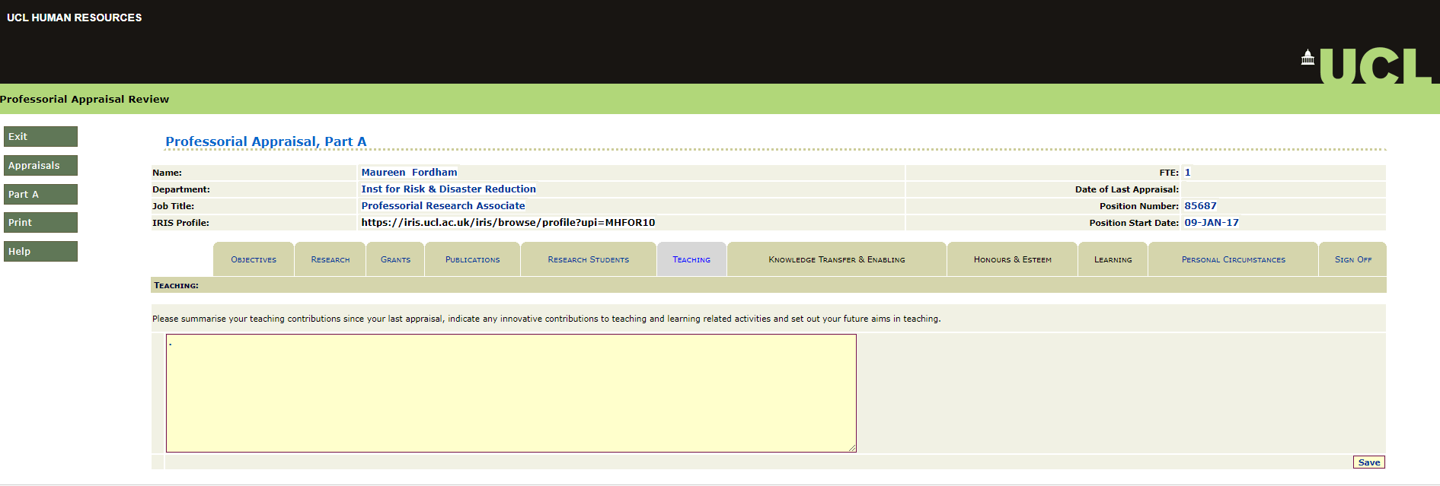
Part A tabs
Professorial Appraisal Review System
Part A tabs
Research Students
This tab shows research students recorded in the Students Information System (SITS). If you experience any issues or queries related to data displayed in PAR, contact the One Desk team by sending an e-mail to hr-services@ucl.ac.uk and clearly indicate the problem area in the subject of your email e.g. “PAR – Publications not showing” (contacting this address will create a help ticket in RemedyForce allowing the issue to be tracked).
Joe Bloggs
123456
Student A
Student B
Student C
Student D
Student E
Teaching
This tab allows the appraisee to summarise teaching contributions since the last appraisal. Users can add details in the text box highlighted below and click ‘save’ once completed.
Joe Bloggs
123456

Slide 8
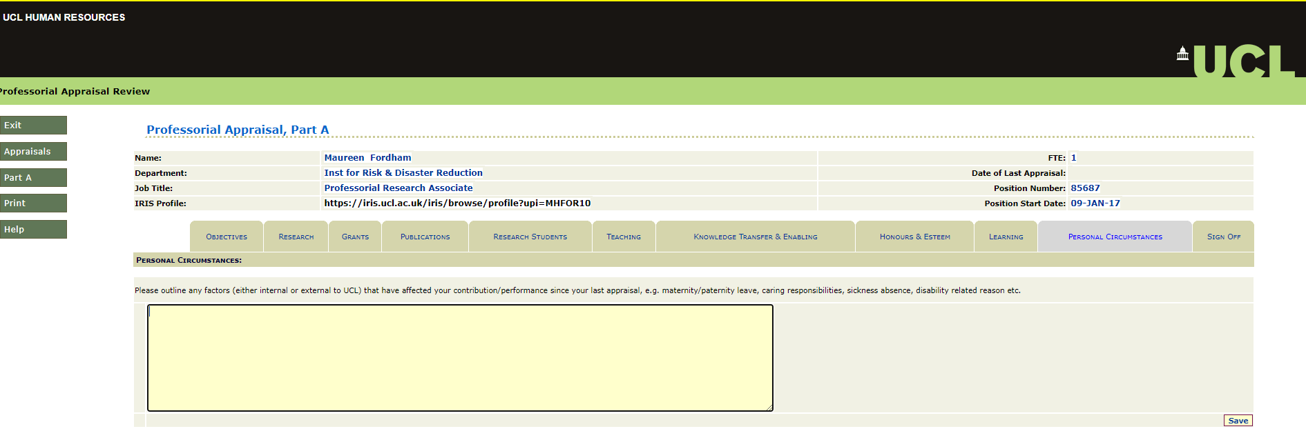
Part A tabs
Professorial Appraisal Review System
Part A tabs
Learning
This tab shows any learning events that the appraisee has attended since their last appraisal. Learning events are stored in the MyLearning System and can be updated in MyLearning at https://www.ucl.ac.uk/myhr/. If any courses do not appear in PAR, but have been completed and visible in MyLearning, please contact the One Desk team by sending an e-mail to hr-services@ucl.ac.uk and clearly indicate the problem area in the subject of your email e.g. “PAR – Learning event not showing” (contacting this address will create a help ticket in RemedyForce allowing the issue to be tracked).
Joe Bloggs
123456
Personal Circumstances
This tab allows the appraisee to outline any factors that have affected their performance in the period since their last appraisal. Users can add information in the text box section highlighted below and click ‘save’ once completed.
Joe Bloggs
123456

Slide 9
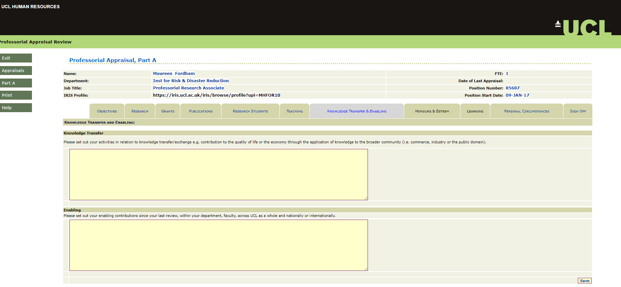
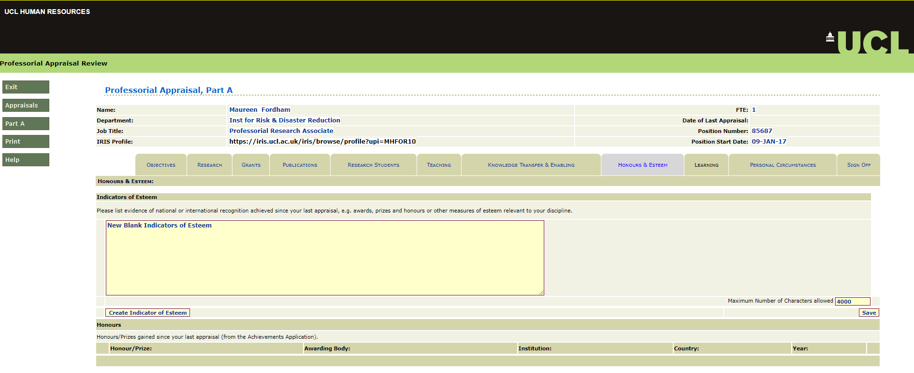
Part A tabs
Professorial Appraisal Review System
Part A tabs
Knowledge Transfer and Enabling
This tab allows the professor to enter a summary of their knowledge transfer/exchange and any enabling contributions made since their last appraisal. This data is broken up into two fields, one for Knowledge Transfer and the other for Enabling Contributions. Click ‘save’ once completed.
Joe Bloggs
123456
Honours and Esteem
This section allows appraisees to list evidence of substantial recognition achieved since their last appraisal by clicking the ‘Create Indicator of Esteem’ button and completed the required field. Click ‘save’ once completed.
Joe Bloggs
123456
The data feed for prizes and honours awarded to the appraisee is no longer connected to PAR, therefore these details will not be shown in this tab. We do recommend adding this information into IRIS and highlighting this to your Appraiser during your appraisal discussion.

Slide 10
Part A tabs
Professorial Appraisal Review System
Part A tabs
Once all the information has been updated and verified the user can sign off Part A. Prior to signing off part A, we recommend users check the Appraiser is correct to avoid any delays in the appraisal review.
To check this information, users can click on the Appraisals button on the left hand side menu when logged into PAR. The user will be returned to the ‘Appraisal Selection’ page and the Appraiser can be found under the ‘Head of Department’ section as highlighted below. If the information is incorrect please contact the HR Services helpdesk team by sending an e-mail to hr-services@ucl.ac.uk and clearly indicate the problem area in the subject of your email e.g. “PAR – Incorrect Appraiser”
Joe Bloggs
John Doe
123456
Sign Off
Once all required information has been added to support the appraisal submission, the appraisee can now sign off their submission by clicking the ‘Sign off A’ button. The Appraiser will be notified and they can view and complete the next section (Part B).
Note: Users should ensure the Appraiser linked on their appraisal is correct
Joe Bloggs
123456

Slide 11
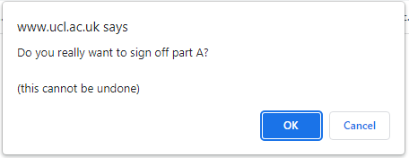
Part A tabs
Professorial Appraisal Review System
Part A tabs
The system will generate a warning message to confirm the user would like to sign off Part A of the appraisal. If the user is happy to proceed they can click ‘OK’ or alternatively click ‘cancel’ and make any necessary amendments.
If the user selects ‘OK’ the system will generate a new pop up message confirming the sign off has been successful. The user can click ‘OK’ to close the message and will be taken to the ‘Professorial Appraisal, Part A’ screen and can see the date Part A was signed off.
Joe Bloggs
123456
The user can select the ‘Appraisal’ button on the left hand side to be returned to the Appraisal Selection screen, where the status of the appraisal can be seen in the ‘status’ section as highlighted below.
Joe Bloggs
John Doe
123456
Note: Once the appraisee has signed off Part A, an e-mail notification will be sent to the Appraiser notifying them that the appraisal is ready for review.
Part A reactivation
If the appraisee signs off Part A and then remembers something they wish to add or change, then Part A can be re-activated by contacting their appraiser who can release the form back to them. Appraisees will receive an outlook e-mail notifying them when Part A has been reactivated.

Slide 12
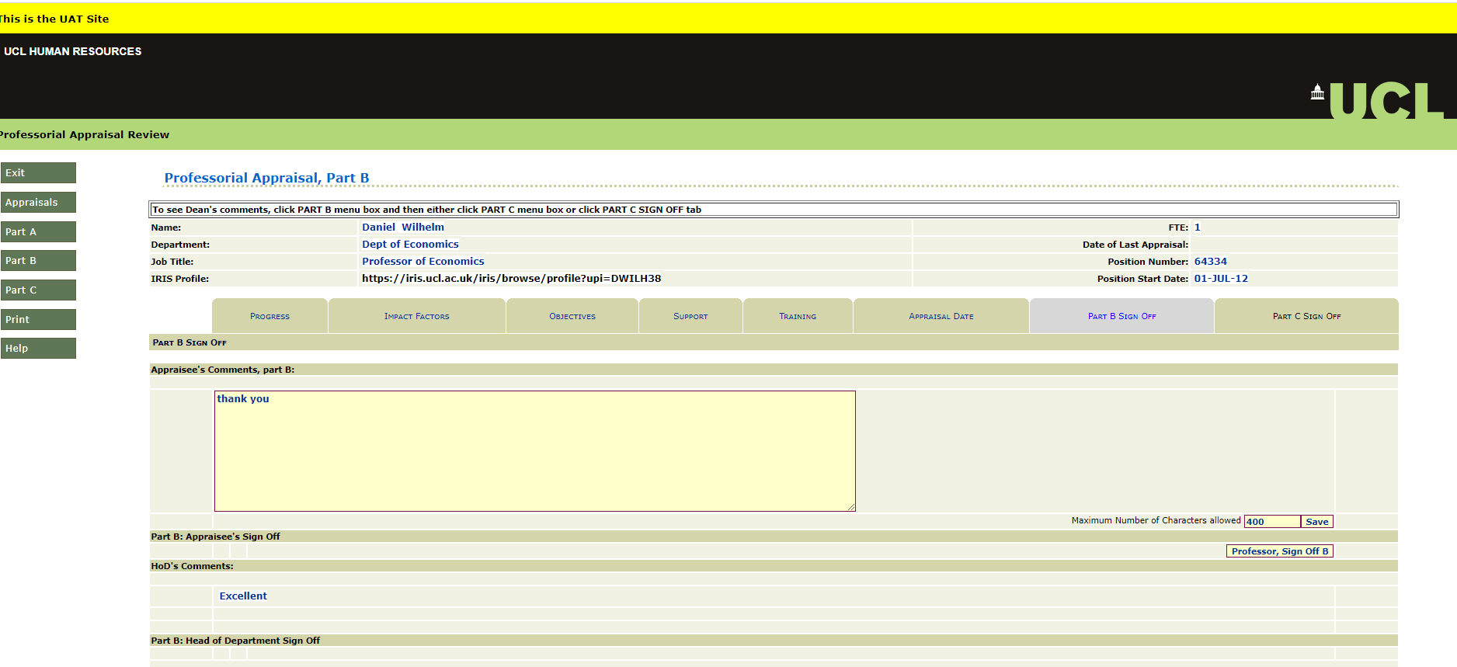
Part B tabs
Professorial Appraisal Review System
Part B tabs
Part B Sign Off
Once the appraisal has been conducted and Part B updated, the Appraiser can choose to notify the Appraisee and provide them with an opportunity to add comments and sign off Part B. An e-mail notification will be sent to the Appraisee when this occurs. To review feedback and information added by the Appraiser, the user can log into PAR and from the Appraisal Selection screen, click ‘select’ button next to the active appraisal.
Joe Bloggs
John Doe
123456
The user will be taken to the ‘Professorial Appraisal, Part A’ page as a default and can select the ‘Part B’ button on the left hand side menu to navigate to the Part B sign off tab.
Joe Bloggs
Professorial Research associate
123456
The user can navigate through the tabs within Part B to review information added by the Appraiser. The user can review any comments added by the Appraiser by selecting the ‘Part B Sign off’ tab. The user can add comments in the text box highlighted and click the ‘save’ button. The Appraiser can click the ‘Professor, Sign off B’ button to sign off the appraisal.

Slide 13
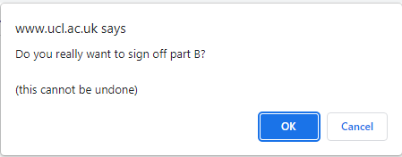
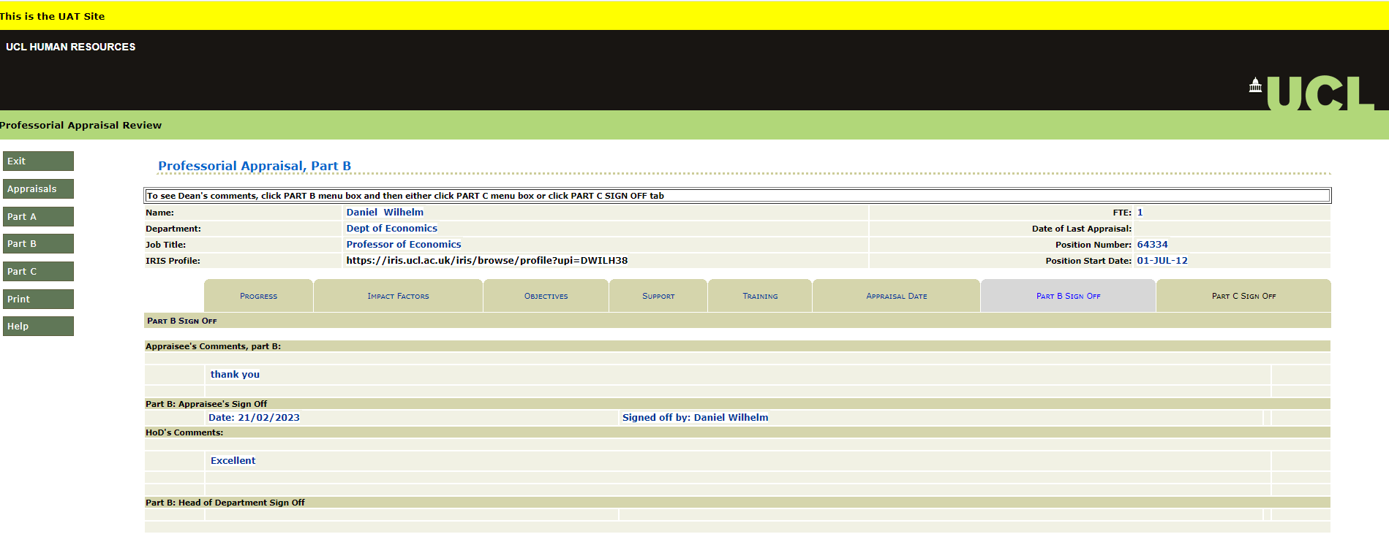
Part B tabs
Professorial Appraisal Review System
Part B tabs
The system will generate a warning message to confirm the user would like to sign off Part B of the appraisal. If the user is happy to proceed they can click ‘OK’.
If the user selects ‘OK’ the system will generate a new pop up message confirming the sign off has been successful. The user can click ‘OK’ to close the message and will be taken to the ‘Professorial Appraisal, Part B’ screen and can see the date Part B was signed off. The Appraiser will receive an outlook e-mail notification when Part B has been signed off.
Joe Bloggs
Professorial Research associate
123456
Joe Bloggs
The user can now either exit PAR by clicking the ’Exit’ button on the left hand side menu or return to the ‘Appraisal Selection’ screen by clicking ‘Appraisal’ button. Note: Once the Appraisee has signed off Part B, the Appraiser can no longer change any of the information within Part B. The only action they can perform is to sign off Part B.
Joe Bloggs
John Doe
123456
If the user selects the ‘Appraisal’ button, they will be returned to the ‘Appraisal Selection’ screen and can see the status of the appraisal has changed to ‘Part B Signed Off’. Note: Once the Appraisee has signed off Part B, the Appraiser can no longer change any of the information within Part B. The only action they can perform is to sign off Part B.

Slide 14
PAR HIGH LEVEL PROCESS
Professorial Appraisal Review System
PAR HIGH LEVEL PROCESS

