Slide 1

Doctoral Skills & Research Staff Development Programmes
22-23 Summary

Slide 2
Executive summary
Total 372 unique courses included in Doctoral Skills and Research Staff Development Programmes, with over 1000 sessions throughout 22-23 academic year.
- 329 synchronous courses with limited seat capacity
- 43 self-paced or synchronous courses without maximum seat capacity
6,335 distinct doctoral researchers and research/teaching/academic staff attended one or more synchronous courses in the Programmes, with 16,207 overall attendance.
Over 19,000 training points (TP) logged by doctoral researchers throughout 22-23 academic year.
Average 69% faculty population attended the Programmes, with overall better attendance from doctoral researchers.
308 places (55%) on our Leadership Programmes were attended by researchers, teaching staff or academics.
Overall Doctoral Skills and Research Staff Development Programmes have achieved the Net Promoter Score (NPS) of 8.29, in line with the NPS score of our flagship Leadership Programmes (8.6).
Note: data snapshot of HR and Student Registry record from 11th July 2023.

Slide 3
Reach & attendance by faculty

Slide 4
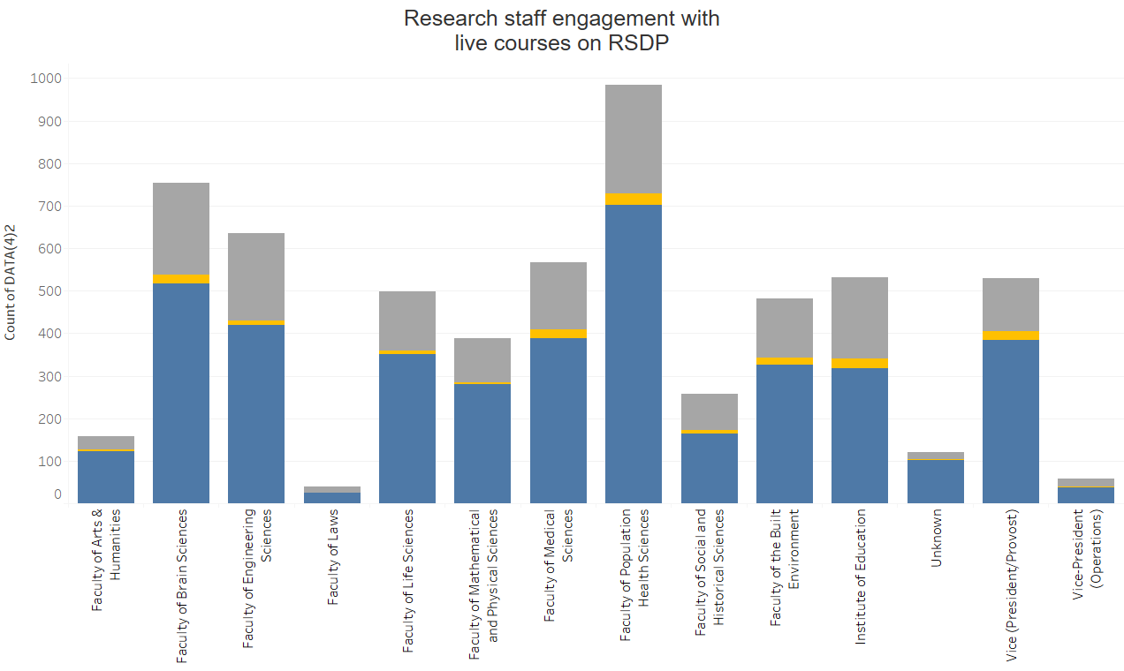
Research staff engagement with RSDP
Faculty | Attended | Waitlisted | Cancelled
Faculty of Arts & Humanities | 123 | 32 | 3
Faculty of Brain Sciences | 518 | 215 | 20
Faculty of Engineering Sciences | 419 | 206 | 11
Faculty of Laws | 25 | 14 | 0
Faculty of Life Sciences | 351 | 139 | 9
Faculty of Mathematical and Physical Sciences | 280 | 104 | 4
Faculty of Medical Sciences | 389 | 156 | 21
Faculty of Population Health Sciences | 702 | 256 | 26
Faculty of Social and Historical Sciences | 163 | 86 | 9
Faculty of the Built Environment | 327 | 140 | 15
UCL Institute of Education | 317 | 191 | 24
Unknown | 101 | 18 | 2
Vice (President/Provost) | 385 | 126 | 19
Vice-President (Operations) | 38 | 20 | 1
Total | 4138 | 164 | 1703
% increase from 21/22 | 81% | -27% | 361%

Slide 5
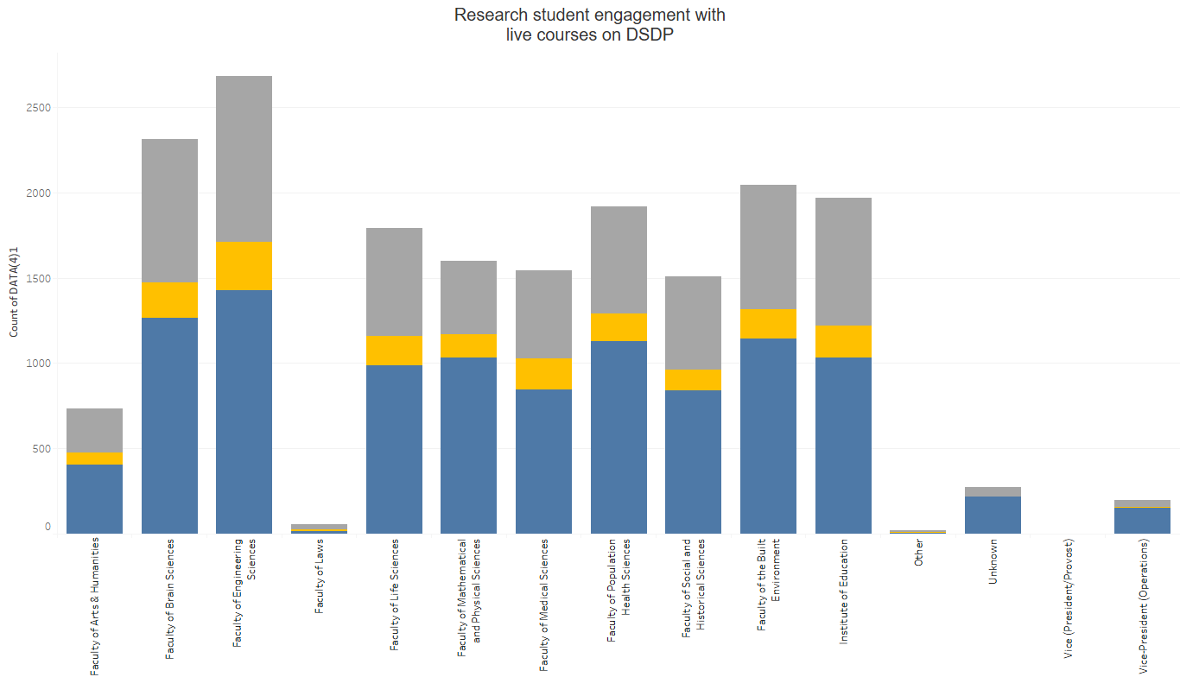
Research student engagement with DSDP
Faculty | Attended | Waitlisted | Cancelled
Faculty of Arts & Humanities | 404 | 71 | 261
Faculty of Brain Sciences | 1265 | 206 | 843
Faculty of Engineering Sciences | 1427 | 282 | 975
Faculty of Laws | 17 | 8 | 31
Faculty of Life Sciences | 989 | 172 | 629
Faculty of Mathematical and Physical Sciences | 1033 | 138 | 426
Faculty of Medical Sciences | 846 | 182 | 514
Faculty of Population Health Sciences | 1128 | 163 | 626
Faculty of Social and Historical Sciences | 842 | 121 | 543
Faculty of the Built Environment | 1143 | 173 | 730
UCL Institute of Education | 1030 | 188 | 752
Unknown | 238 | 5 | 67
Vice (President/Provost) | 1 | 0 | 1
Vice-President (Operations) | 150 | 8 | 37
Total | 10,513 | 1717 | 6435
% increase from 21/22 | 4% | -37% | 282%
Notes:
Staff category not applicable- unknowns cant be matched to staff cate

Slide 6
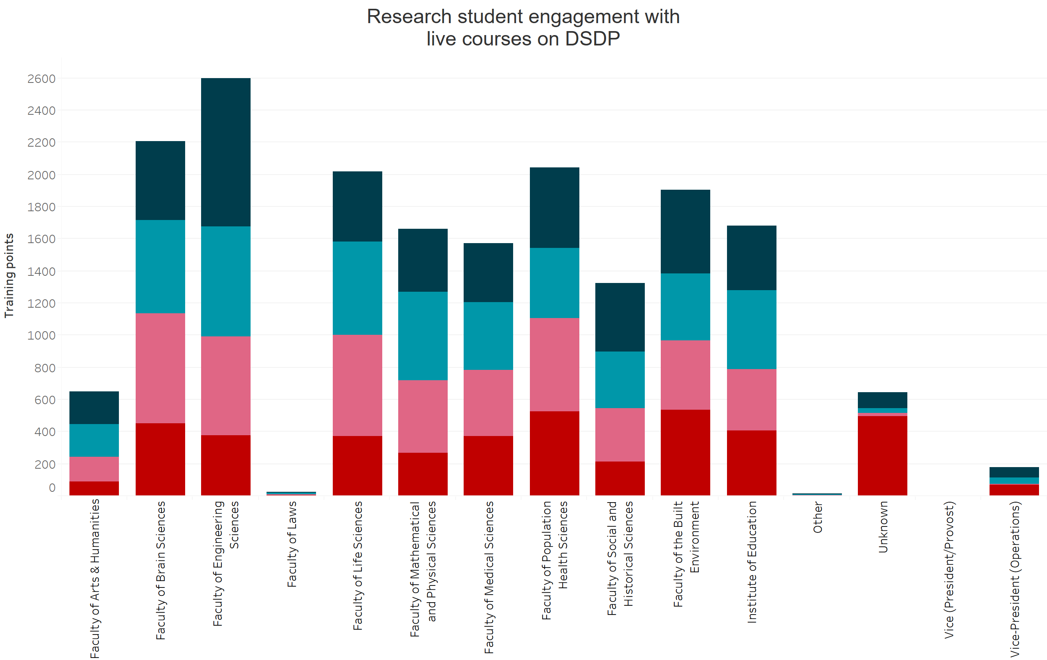
Total training points logged from DSDP courses
Primary RDF
A. Knowledge and Intellectual Capabilities
B. Personal Effectiveness
C. Research Governance and Organisation
D. Engagement, Influence and Impact
Faculty | Total TP | % increase from 21/22
Faculty of Arts & Humanities | 682 | 26%
Faculty of Brain Sciences | 2,272 | 44%
Faculty of Engineering Sciences | 2,674 | 68%
Faculty of Laws | 24 | 85%
Faculty of Life Sciences | 2,054 | 94%
Faculty of Mathematical and Physical Sciences | 1,701 | 93%
Faculty of Medical Sciences | 1,620 | 100%
Faculty of Population Health Sciences | 2,142 | 40%
Faculty of Social and Historical Sciences | 1,358 | 99%
Faculty of the Built Environment | 1,964 | 31%
UCL Institute of Education | 1,717 | 73%
Unknown | 661 | -80%
Vice (President/Provost) | 1 | N/A
Vice-President (Operations) | 179 | N/A
Total | 19,049 | 32%
Figure indicates Training Points (TPs) logged from synchronous courses with limited seat capacity in Doctoral Skills Development Programme (DSDP), self-paced courses or courses with unlimited seat capacity are not included.
Roughly ~647 TPs logged cannot be assigned to faculties, either because individuals could not be identified on student or HR record, or the unique identifier were not applicable.
Notes:
Lump them in together add TP % increase per faculty compared to 21/22?

Slide 7
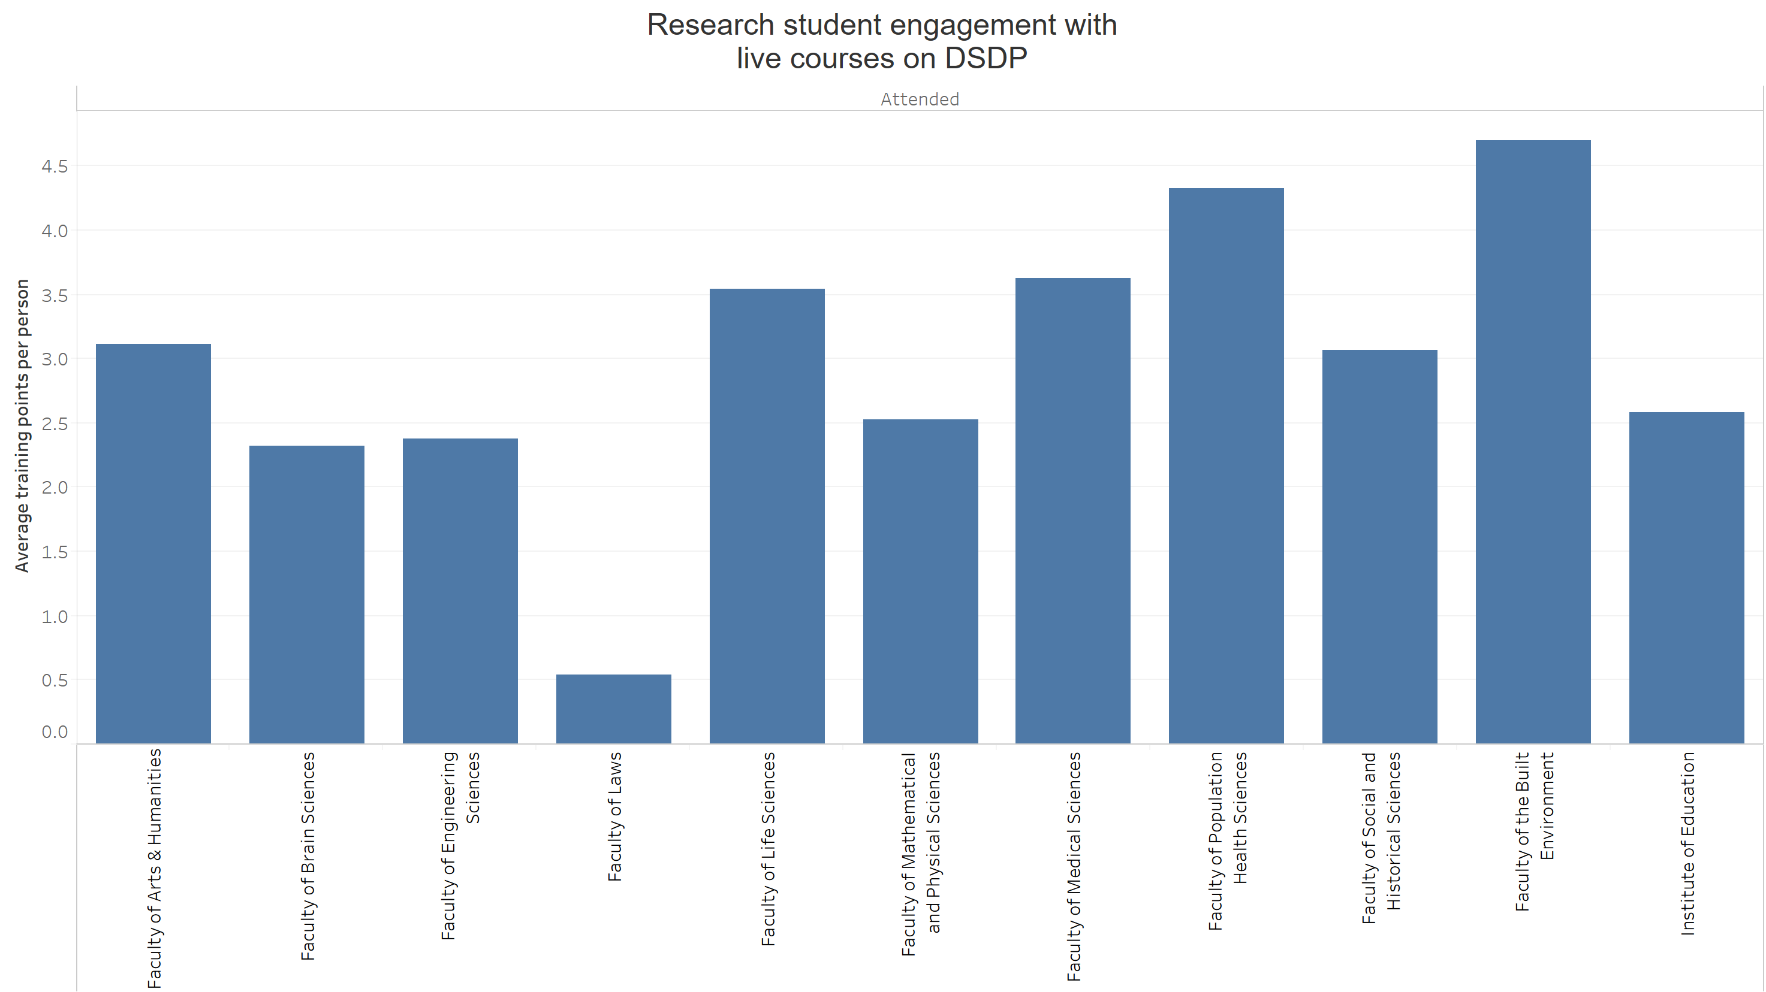
Average training points (TP) logged per research student from DSDP courses
Faculty | Average TP
Faculty of Arts & Humanities | 3.11
Faculty of Brain Sciences | 2.32
Faculty of Engineering Sciences | 2.37
Faculty of Laws | 0.54
Faculty of Life Sciences | 3.54
Faculty of Mathematical and Physical Sciences | 2.53
Faculty of Medical Sciences | 3.62
Faculty of Population Health Sciences | 4.33
Faculty of Social and Historical Sciences | 3.07
Faculty of the Built Environment | 4.70
UCL Institute of Education | 2.58
Average | 2.97
Figure indicates Training Points (TPs) logged from synchronous courses with limited seat capacity in Doctoral Skills Development Programme (DSDP), self-paced courses or courses with unlimited seat capacity are not included.
Roughly ~647 TPs logged cannot be assigned to faculties, either because individuals could not be identified on student or HR record, or the unique identifier were not applicable.
Notes:
no population numbers for vp, put the vp ones it in the notes chhnage table

Slide 8
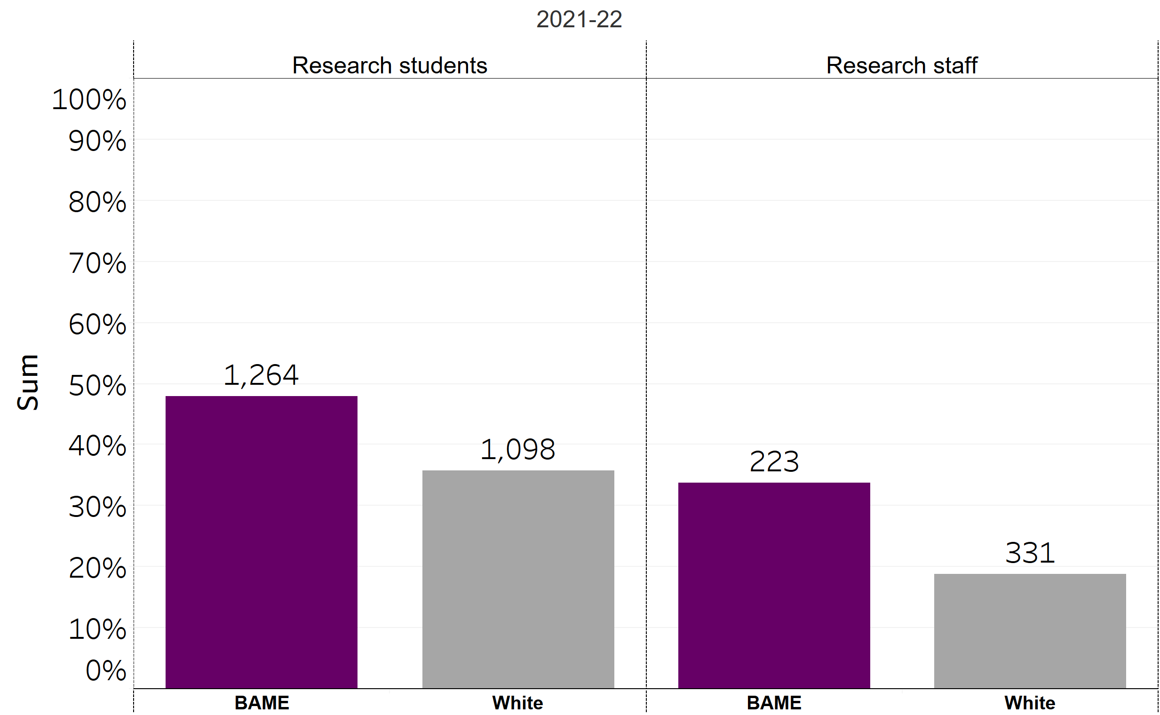
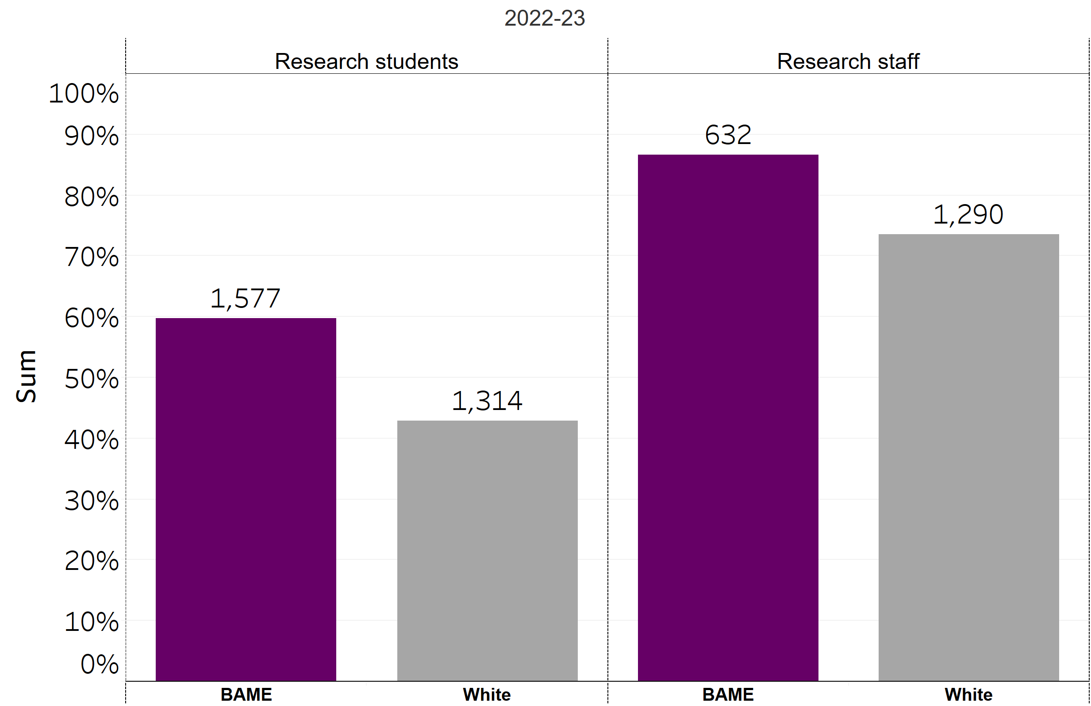
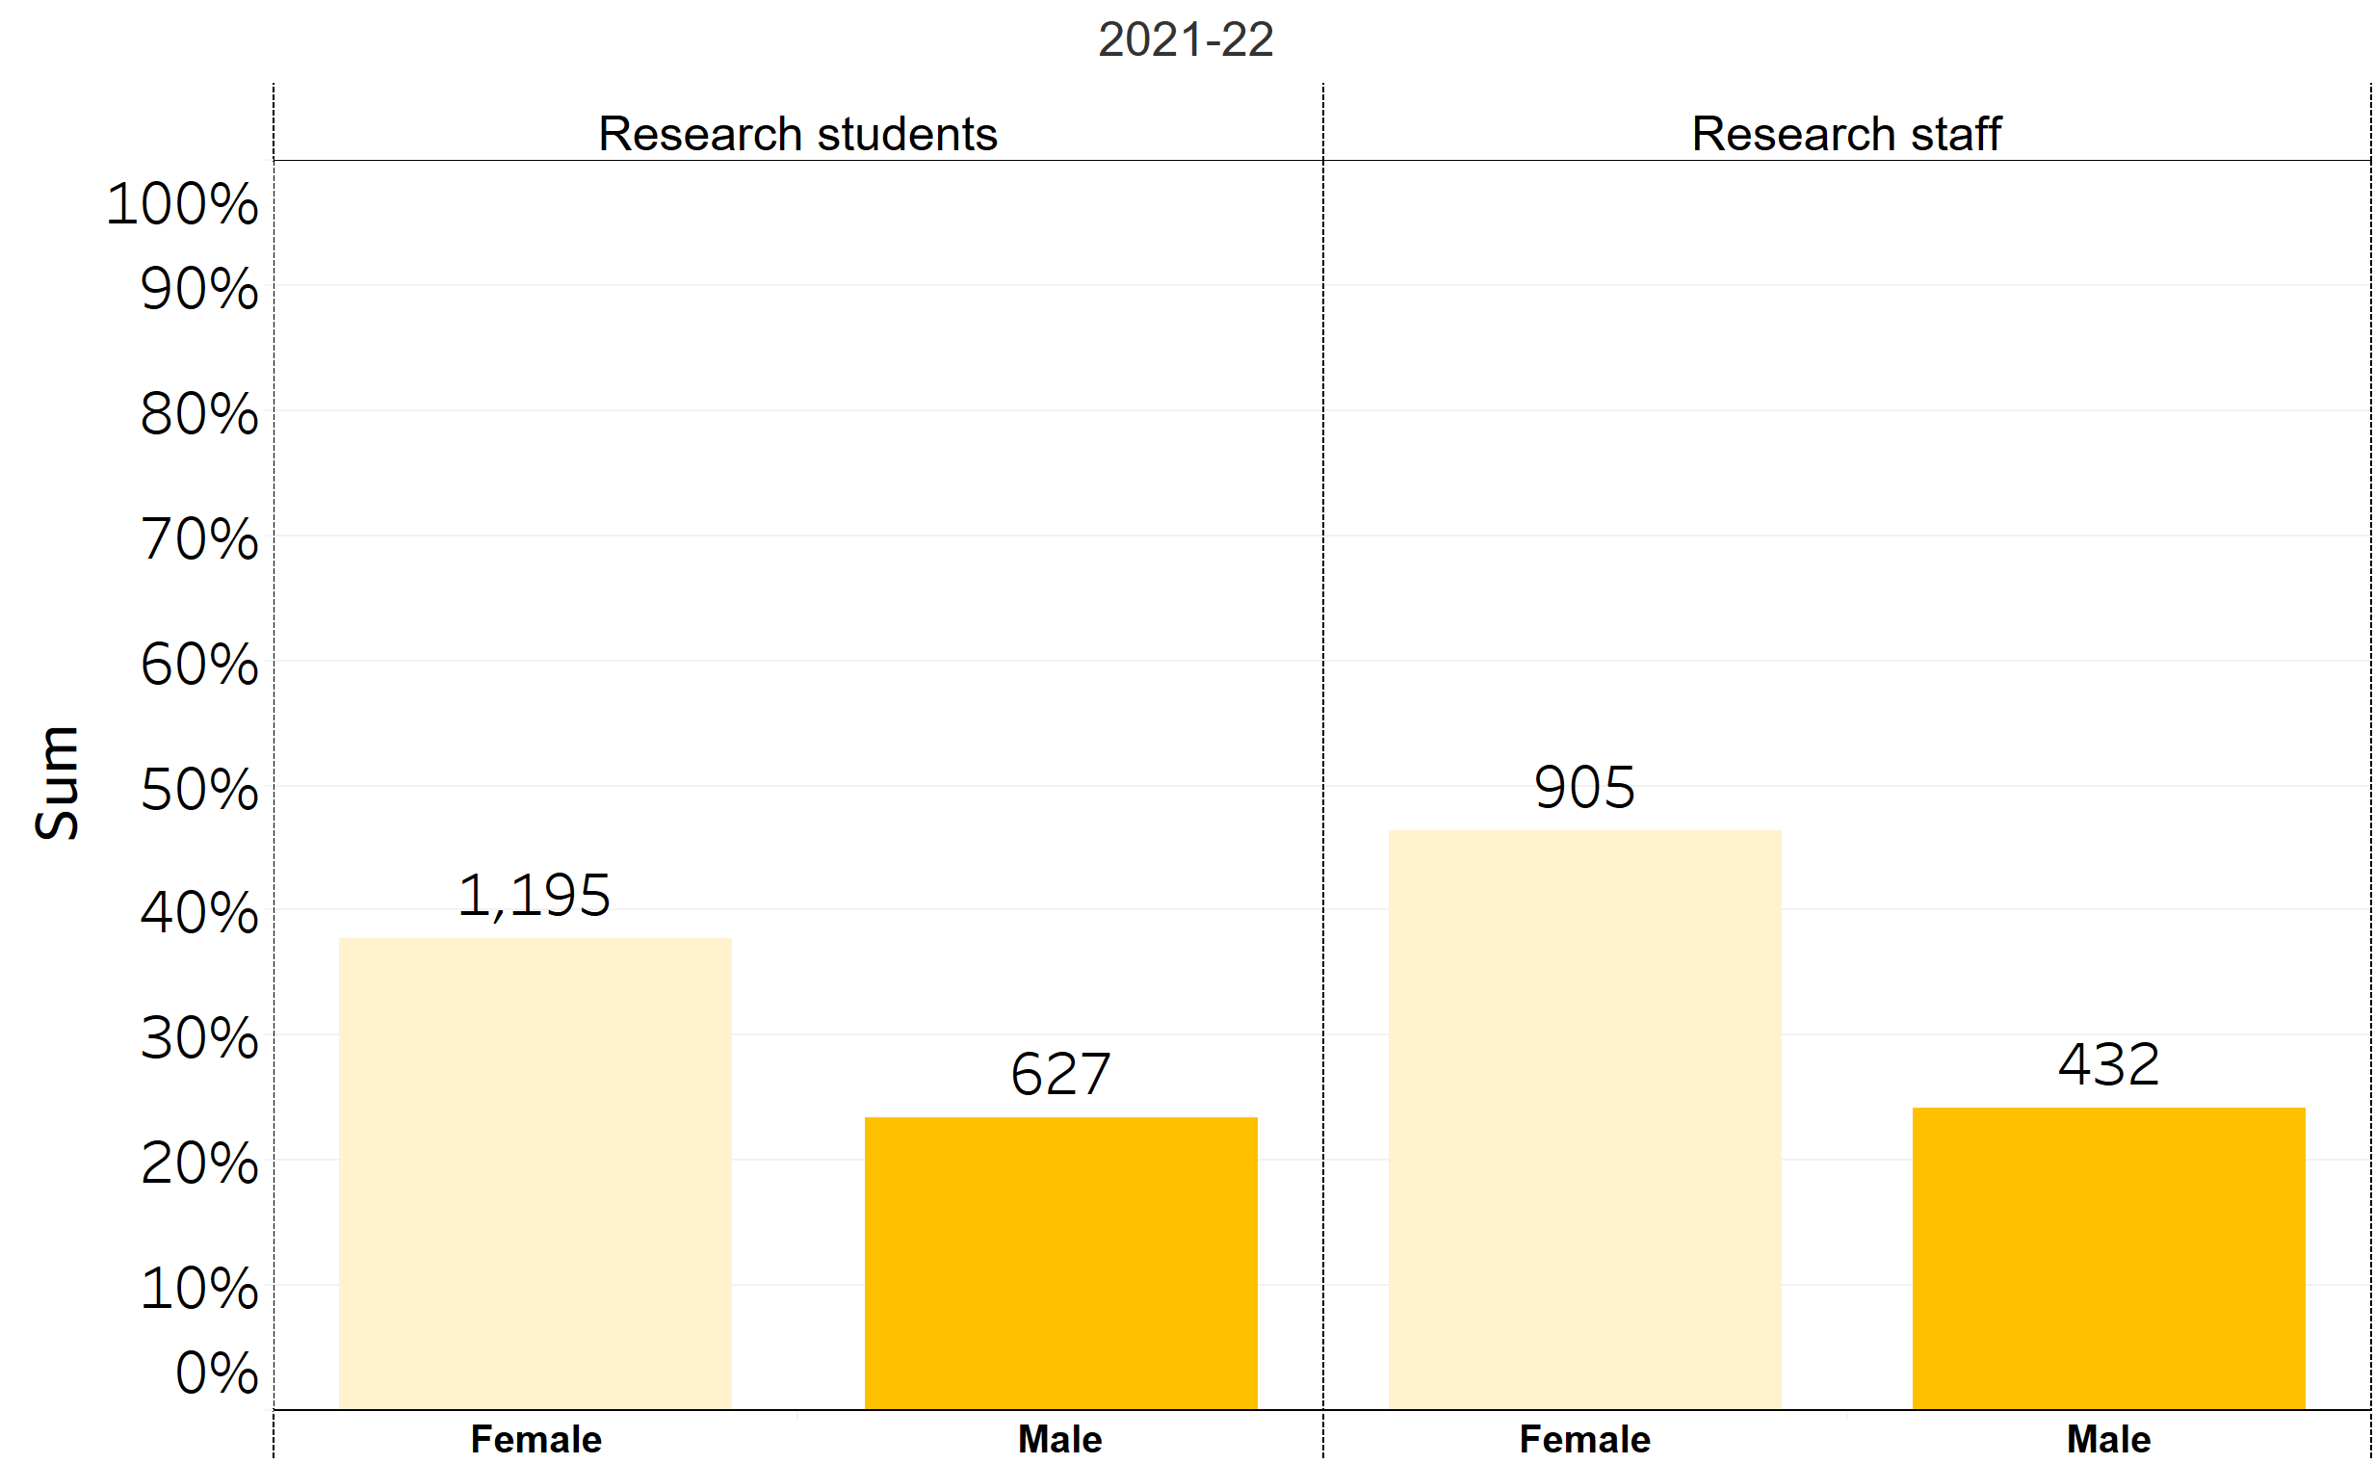
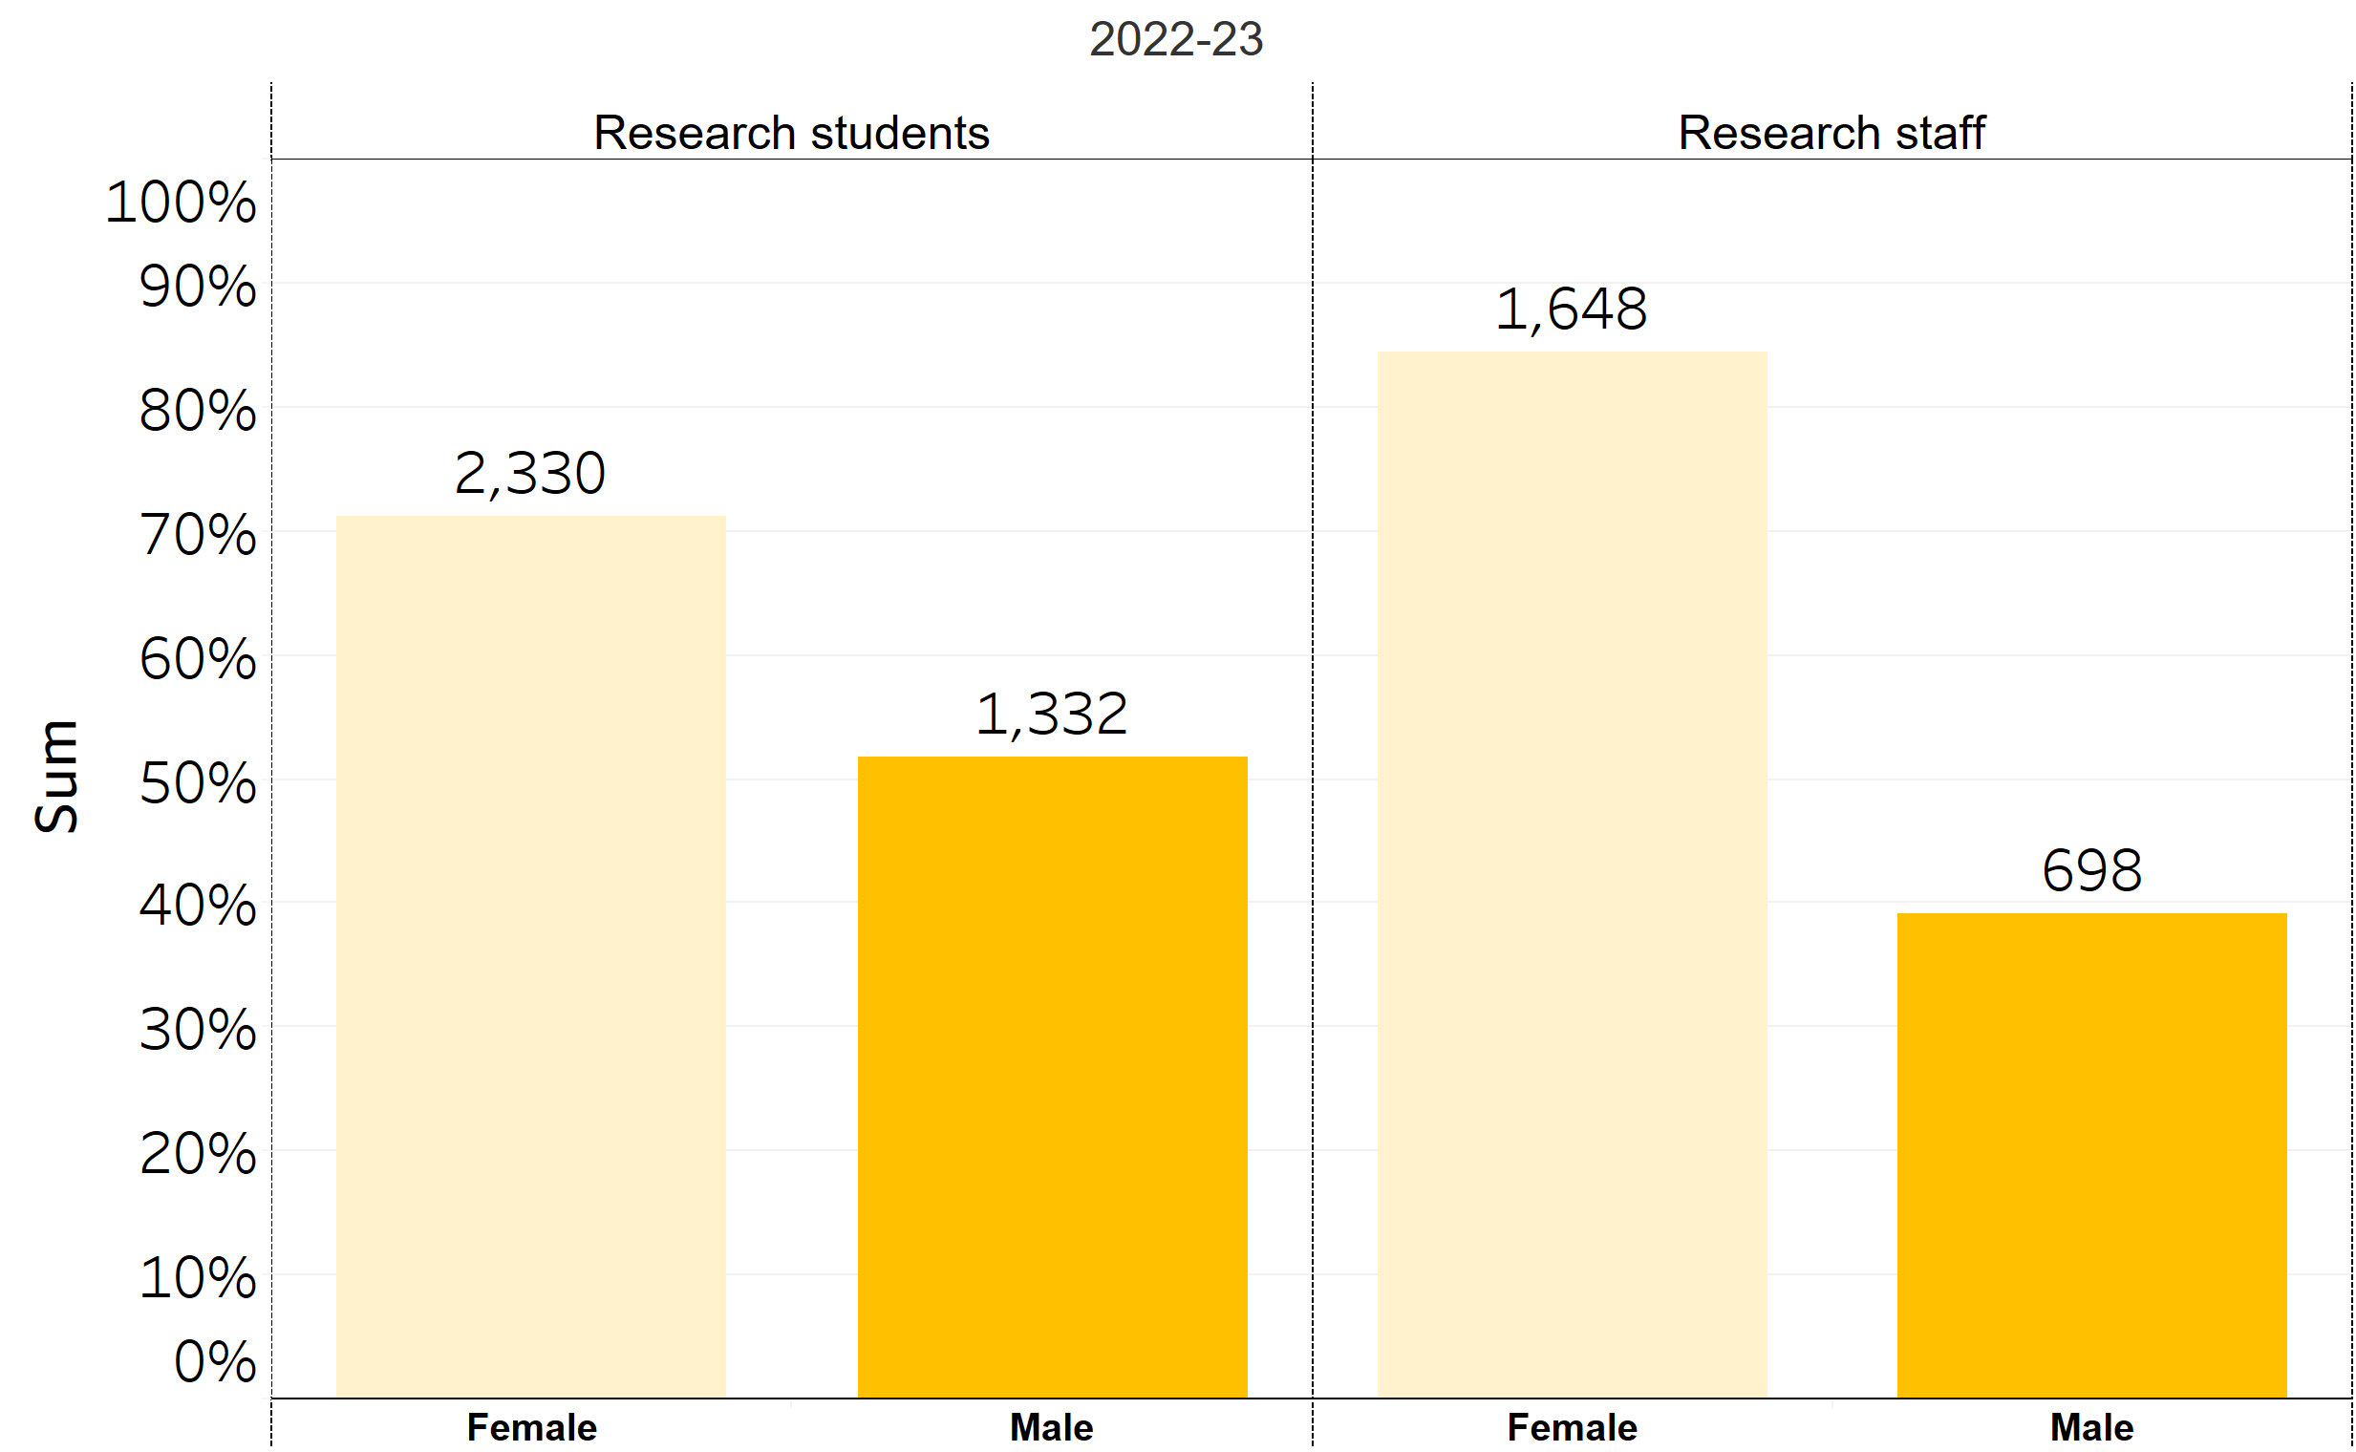
Attendee equity & diversity data
EDI data is self-disclosed on HR/student record; undisclosed/unknown records have been omitted
Notes:
For both gender and ethnicity, there were other categories as well as unknowns where they were either undisclosed or they could not be found on the records system
Just reseachers
+++There are gaps in the ethnic and gender demographics, where a large portion were unknown or couldn’t be found on our records systems.

Slide 9
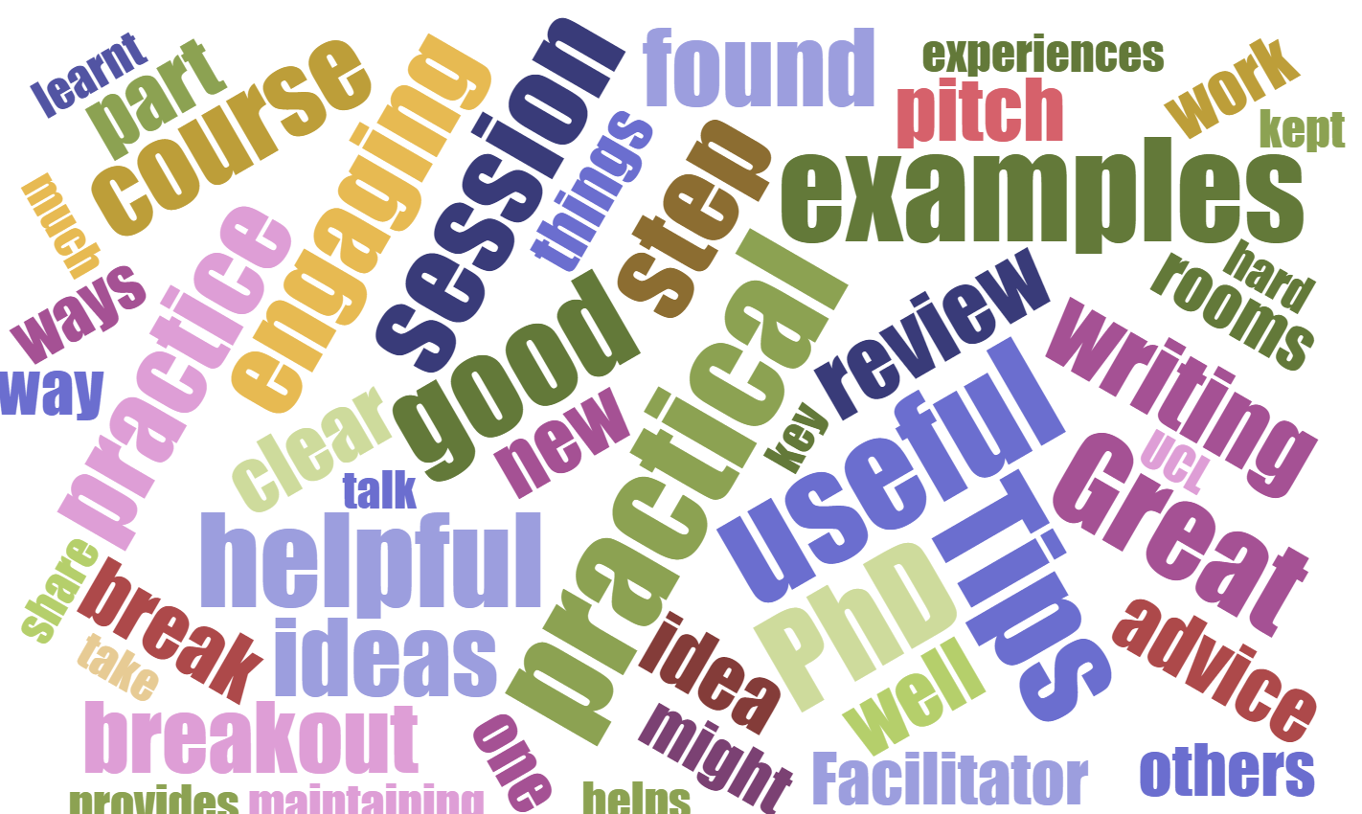
Feedback themes across all courses
The Good
Overall NPS = 8.29
93% agreed that they found the course admin and communication timely, efficient and well-managed.
96% of learners felt their knowledge has improved, based on the learning objectives.
Practical and useful information provided and clear explanations on topics.
Reflection at the end of the sessions.
Helpful and insightful, fantastic sessions.
Things to Develop
More interaction, through discussions.
More face-to-face sessions.
Allow more time for sessions.
Course description not always reflective of course level.
Notes:
Perentages only diff

Slide 10
Top 20 attended courses
Course Title | Attendance | Audience | RDF | Training Provider
DSD: An Introduction to R with Rstudio - Part 1 (Remote classroom) | 1507 | Research Staff only | A | UCL Digital Skills Development (ISD)
Arena for PGTAs: Gateway | 679 | PGR only | D | UCL Arena
Introduction to Research Integrity & Support | 523 | PGR only | C | UCL Research Integrity
Applying for an Early Career Research Fellowship | 440 | PGR and Research Staff | C | UCL Careers
Spero introduction: How to think entrepreneurially about your career | 417 | PGR and Research Staff | B | UCL Innovation & Enterprise
Introduction to Doctoral Skills Development and the Research Log | 358 | PGR only | C | UCL Organisational Development
Developing as a Doctoral Supervisor | 347 | Research Staff only | D | UCL Arena
Getting started with your systematic review | 272 | PGR and Research Staff | A | UCL Library Services
Academic Career Planning for PhD students | 270 | PGR only | B | UCL Careers
Researchers Professional Careers Beyond Academia Conference - Life and Health Sciences | 261 | PGR and Research Staff | B | UCL Careers
The Writing Series: Literature Review | 238 | PGR only | A | UCL Organisational Development
Marketing Yourself Online: LinkedIn Lab | 229 | PGR and Research Staff | B | UCL Careers
SPERO 1: Develop your entrepreneurial knowledge, skills and mindset | 215 | PGR and Research Staff | D | UCL Innovation & Enterprise
How Do I know What I'll Like? Identifying your Motivators, Strengths and Interests | 215 | PGR and Research Staff | B | UCL Careers
Effective Academic Applications | 213 | PGR and Research Staff | B | UCL Careers
The PhD journey: Reading and literature review | 174 | PGR only | B | UCL Organisational Development
The PhD journey: Producing thesis and reports | 173 | PGR only | B | UCL Organisational Development
Effective Academic Interviews | 169 | PGR and Research Staff | B | UCL Careers

Slide 11
Direction for 23-24 academic year
Actions Now
To achieve
Commissioning decisions:
- Increased repeats on courses of high interest and reduced courses of low interest.
- Stopped contracting externals where a similar session is being delivered by UCL internal department or function.
- Stop courses with low NPS scores (NPS < 7.5).
More focused course collections:
- New course collections mapped to RDF which may span multiple training providers.
- Communications focused on ‘themes’ rather than individual sessions.
Clearer developmental pathways:
- Continued developmental pathways for research staff vs doctoral researchers.
- Develop skills through experiences.
Improve overall NPS 8.29 to 8.6.
less volume, better quality, clearer pathways.
Research staff development distinct to that of doctoral researchers.
Notes:
Perentages only diff

Slide 12
Researcher attendance on all centrally-run training programmes
Faculty | Doctoral Students on DSDP (All course formats) | Research Staff on RSDP (All course formats) | Research Staff on All-Staff Courses (with PS Staff) | Researchers (including Academics and TAs) on Leadership Programmes
Faculty of Arts & Humanities | 432 | 126 | 0 | 7
Faculty of Brain Sciences | 1406 | 542 | 0 | 69
Faculty of Engineering Sciences | 1565 | 433 | 1 | 32
Faculty of Laws | 20 | 26 | 0 | 1
Faculty of Life Sciences | 1115 | 361 | 1 | 13
Faculty of Mathematical and Physical Sciences | 1134 | 292 | 0 | 28
Faculty of Medical Sciences | 948 | 413 | 2 | 41
Faculty of Population Health Sciences | 1241 | 751 | 5 | 40
Faculty of Social and Historical Sciences | 912 | 170 | 4 | 15
Faculty of the Built Environment | 1239 | 344 | 4 | 31
Other or Unknown | 240 | 101 | 0 | 0
UCL Institute of Education | 1112 | 325 | 1 | 24
Vice (President/Provost) | 1 | 397 | 0 | 0
Vice-President (Operations) | 150 | 38 | 0 | 7

Slide 13
Appendix: UCL population for EDI data
21/22
Demographic | Research students | Research staff
BAME | 2408 | 714
White | 3136 | 2038
Female | 3050 | 1956
Male | 2635 | 1848
22/23
Demographic | Research students | Research staff
BAME | 2640 | 622
White | 3066 | 1755
Female | 3164 | 1953
Male | 2673 | 1785
Notes:
+++There are gaps in the ethnic and gender demographics, where a large portion were unknown or couldn’t be found on our records systems.

Slide 14
UCL Careers Researcher Programme Review: 2022 - 2023

Slide 15

What we offer www.ucl.ac.uk/careers/researchers
One to one appointments
CV/Application Checks, Career Exploration, Mock Interviews
Specialist Careers Consultants
Workshops at UCL Careers
For academic and beyond academic careers
Employers Events
Forums, smaller talks, conference (Invited speakers have PhDs)
Employer–led skills training
Internships & Jobs
myUCL CAREERS – sourcing posts where PhD is desirable / essential
Post-PhD Career Case studies
http://www.ucl.ac.uk/careers/resources/case-studies/researchers
  Researchers blog and Twitter
  http://blogs.ucl.ac.uk/ucl-researchers/
  Twitter - @uclresearchers

Slide 16
2022-23 Executive Summary
Researcher Attendances
  820 one-to-one researcher careers appointments attended (99% satisfied)
  1280 attendances across 54 careers workshops (96% satisfied)
  663 attendances across 12 employer careers events (98% satisfied)
  264 researcher-relevant vacancies advertised, including 30 exclusive to UCL
Successful new sessions introduced: What’s the Story with Narrative CVs? and Navigating Race and Identity in Academic Careers (100% positive feedback received for both)
Improved communication through regular newsletters initiated in spring appeared to increase engagement (summer term attendance up 27% for appointments and 66% for workshops compared with 2021-22)
Improved feedback process introduced in summer term increased feedback response rate (183 responses collected in 2023 summer term alone, compared with 114 responses collected across entire 2022-23 year)

Slide 17
2023-24 Future directions
Split Life Sciences Careers Beyond Academia Conference into three smaller conferences addressing a wider range of sectors
  Appeal to broader audience with three separate varied events: Data Science, Careers in the Commercialisation of Research, Careers in Drug Discovery and Development
  Allow more time for popular networking/careers fair portion
  Spread workload across year to allow for fact we do not have a large conference team (only one Events Officer)
Diversify work experience opportunities to include shorter duration work-projects with employers
  In addition to continuing to broker exclusive formal internships, to reach more researchers, we will run three one-day hackathons where researchers work in groups on problems with external employers, and one week-long Consultancy Challenge with commercial sector partners in 2023-24

Slide 18
2022/23 in numbers

Slide 19
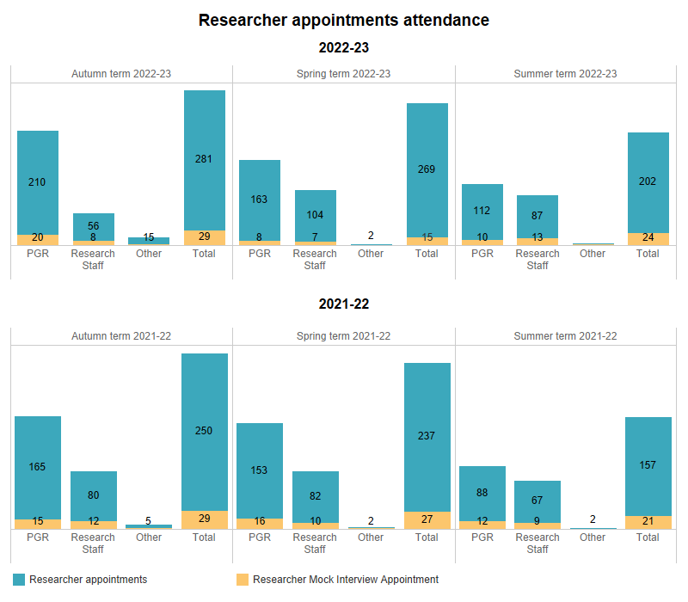
2022/23 attendances = 820 (99% satisfied; 99% would recommend)
Starting our own regular PhD newsletter, and the improved research staff mailing list likely accounts for much of this increase on last year
2021/22 = 721
NB: ”Other” includes PhD graduates and BPSN PhDs

Slide 20
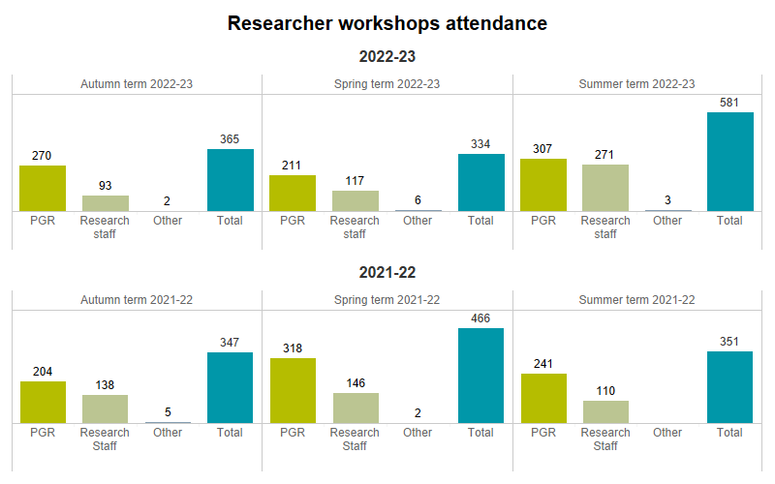
54 workshops;
18 per term
2022/23 places attended= 1280
Steep increase in attendance seen once we initiated our own PhD newsletter and accessed the improved Research Staff mailing list in late Spring.
54 workshops;
18 per term
2021/22 = 1164

Slide 21
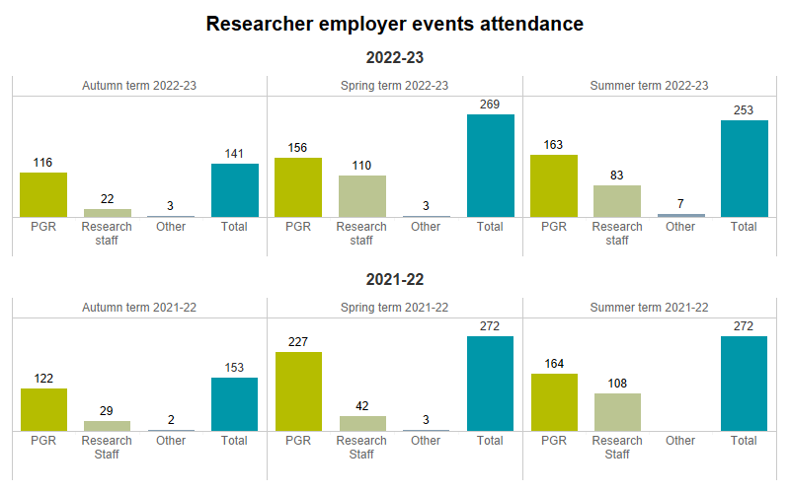
12 events in 2022/23. Attendance = 663
Reduced events output was due to Events Officer post going unfilled (despite recruitment efforts) for several months. Despite this reduced event output, 2022/23 overall attendance was similar to last year’s. We attribute this to improved marketing with dedicated newsletters.
19 events in 2021/22. Attendance = 697

Slide 22
2022/23 researcher vacancies
Vacancy type | Number advertised
Researcher-relevant internships/part-time roles | 151 (30 exclusive to UCL)
Other researcher-relevant roles advertised | 113
Total | 264 (321 in 2021/22)
Roles received 21411 views and 2783 “apply” clicks

Slide 23
Case studies from 2022/23

Slide 24
New feedback process
Piloted new feedback form for summer term, moving away from UCL Careers system to allow more flexibility of questions and collection
Old feedback process: 141 responses across all workshops and events in 2021/22
New feedback process: 183 responses across workshops and events – for just one term, Summer 2023
Workshops: 159 responses – 96% satisfied (91% in 2021/22) – Net Promoter Score 8.25
Employer events: 24 responses – 100% satisfied (93% in 2021/22) – Net Promoter Score 9.08
73% of respondents heard of our events through our dedicated newsletter, highlighting the importance of this marketing channel
Will continue with new process in 2023/24

Slide 25
New 2022/23 Event: Navigating Race and Identity in Academic Careers
Panel of established researchers of colour discussing experiences within academia
2022/23 researchers of diverse heritage focus group participants unanimously pleased to see this in programme
Postponed due to strikes, and encountered technical issue with booking, nevertheless, 104 sign-ups (49 UCL, 55 Edinburgh), 45 attendances (21 UCL, 24 Edinburgh)
100% satisfaction with event (Were you satisfied with today’s session?)
Net promoter score 9
Qualitative feedback:
“More events like this please centring the experiences of racially/ethnically minoritised people”
“Very open discussion about important topics”
“Hearing directly from people of colour their direct lived experiences in academia and understanding how it differs from my experience as a white person. Really excellent panel with really diverse experiences.”
Will be repeated in 2023/24

Slide 26
New 2022/23 event: What’s the Story with Narrative CVs?
Online talk covering the Narrative CV format increasingly used by funders
110 researcher bookings, 54 attendances
100% satisfaction (Were you satisfied with today’s session?)
Net promoter score 8.3
Qualitative feedback:
  “The session was excellent because it provided plenty of examples of narrative CVs (good format) and generated an engaged discussion in the group about how to enhance applicants’ strengths (well run!). I also think the concepts it explored are useful beyond the scope of narrative CVS, since today we're expected to "tell" (and "sell") our stories, come up with elevator pitches, and so forth.”
  “I found the information about something I had never heard of before very useful. I now feel that if I encounter this CV type asked, I will be more prepared to deal with it. I also appreciated the critical comments on this type of CV.”
Will be repeated twice in 2023/24

Slide 27
UCL Sustainable Development Goals (SDG) Consultancy Challenge 2023
Collaboration with VSU following last year’s successful pilot
Funded by UCL’s UN SDGs: Pathways to Achievement scheme 2022-23 and OD
One-week experiential learning opportunity in consultancy for UCL’s UGs, PGTs and PGRs
Students worked in 8 teams of 6-8 mixed disciplines and level of study (each team had at least 1 PGR student), each team with a different charitable organisation on a real-world problem
4 PGRs recruited (out of 34 applicants) for paid Consultant Coordinator positions to work with charities to develop initial ideas into a project brief, then each to supervise 2 teams of student volunteers
PGR Consultant Coordinators received two training sessions (Consultancy Skills and Volunteer Management), and student volunteers also two training sessions (Consultancy Skills and Project Management)

Slide 28
UCL Sustainable Development Goals (SDG) Consultancy Challenge 2023
Mixture of UG, PGT and PGR volunteers participated in the Challenge week
  195 students applied, including 24 PGRs.
  64 students were offered a place; 61 participated, including 16 PGRs (26%)
Overwhelmingly positive feedback from the participants, indicating:
  top skills improved were consultancy skills and teamwork (both 81% respondents), and problem solving, project management and communication (all at 72%)
  100% of PGR respondents felt they learned more about charities and not-for-profit sector, 82% learned more about the UN's SDGs, and 73% felt that their work made a sustainable impact.
Consultancy Challenge will run next year (2023-24), with financial support from UCL Student Life and OD.

Slide 29
Life Sciences Conference
First in-person conference since 2019
Three panels (“Careers in the Life Sciences sector”, “Charities and not-for-profit careers”, “Careers in the commercialisation of research”) and a lunchtime mini careers fair with employer networking at stands
261 sign-ups, 126 attendances
100% satisfaction (Were you satisfied with today’s session?)
Net promoter score 9.1
Positive qualitative feedback:
  “[Enjoyed] Panel speakers’ personal experience navigating non-academic job.”
  “Really enjoyed the panels”
  “The panel discussions with commercialisation professionals.”

Slide 30
Life Sciences Conference: drawbacks
Event fatigue across long day – First panel had 126 attendees, last one 65
When spread across multiple days attendance was higher (199 in 2021/22)
People loved the Fair element, but felt there wasn’t enough of it. Difficult to get people to stop networking at lunchtime and head to next panel
  “I found it quite time pressured to network during the break while also trying to have lunch! Would have liked to have spoken to some more of the speakers as well.”
  “The lunch time networking - visitors on stalls should be asked to limit 5 mins per student asking questions. Some students were hogging guests meaning that others ran out of time to ask their question.”
  “Have more employers to talk to during lunch”
  “Have more booths for the breaks”
Organisation of a conference requires a larger team than we have. We have one Events Officer, who had to recruit the entire team plus 7 additional volunteers to help on the day, and this recruitment was not easy!
A few researchers complained there was too much focus on Life Sciences – without equivalent resource spent on other researcher areas

Slide 31
Changes for 2023/24

Slide 32
2023/24 conference plans
Split Researcher Careers Beyond Academia into three separate in-person events, each containing a panel and longer and larger networking jobs fair element, spread across the year to create a broader appeal
  Data Science – Autumn
  Careers in the Commercialisation of Research - Spring
  Life Sciences Careers in Industry – Drug Discovery and Development – Summer

Slide 33
2023/24 focus on experiential learning
Move away from advertising longer term vacancies (many of which are not ring-fenced for researchers, and can be found on other platforms) towards running tailored work-based learning tasters specifically for research students and staff. Shorter term opportunities will allow us to reach more researchers.
Continue to broker exclusive short-term workplace opportunities for researchers, but also focus on curated experiential learning opportunities:
  Summer 2024: Consultancy Challenge (with commercial sector), building on the success of VSU Consultancy Challenge, but ring-fenced for researchers, including research staff, and working with industry
  One a term: Hackathons (with commercial sector) – one-day hands-on experiences working in groups on industry problems with an external employer

