Slide 1
MyHR Update
HR User Group
20th June

Slide 2
Agenda Items
MyHR – The benefits
Scope – a quick reminder
Oracle System Profile nominations
MyHR Timeline
Detail HR & Payroll process mapping
Future Activities

Slide 3
MyHR – the benefits…
A fully integrated HR and Finance system
Standard, streamlined processes with half the complexity of what we do currently
More control for local administrators with less checking and approval steps by central
functions
Reduce manual processes and the overall administrative burden
Faster, accurate processing with visibility of progress
Improved analytics to enable high quality and real-time management reporting to inform
decision making
A platform for future enhancements

Slide 4
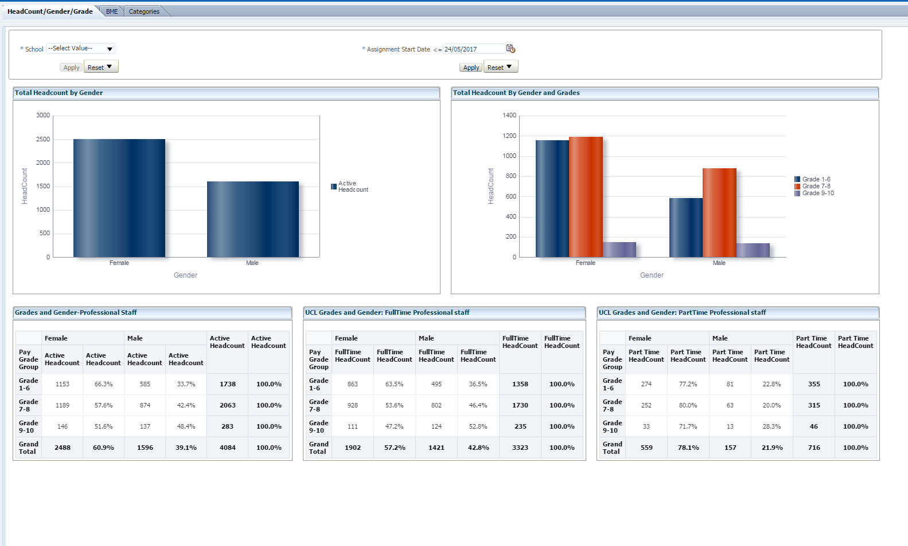
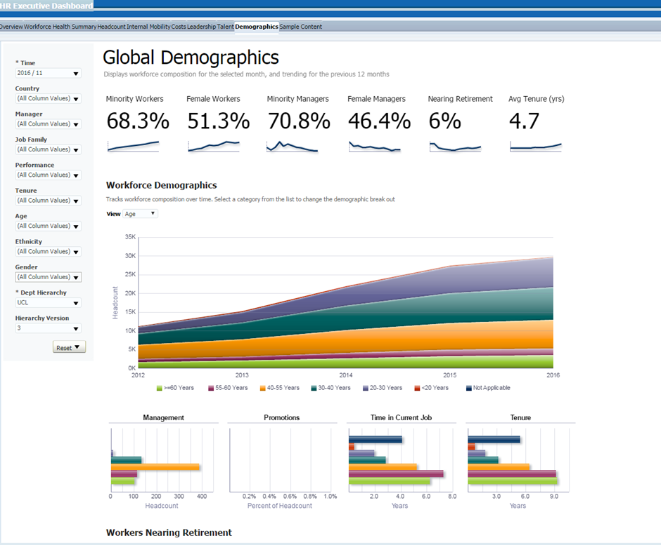
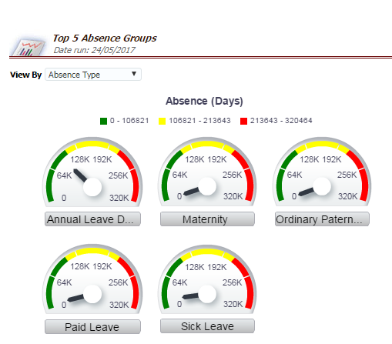
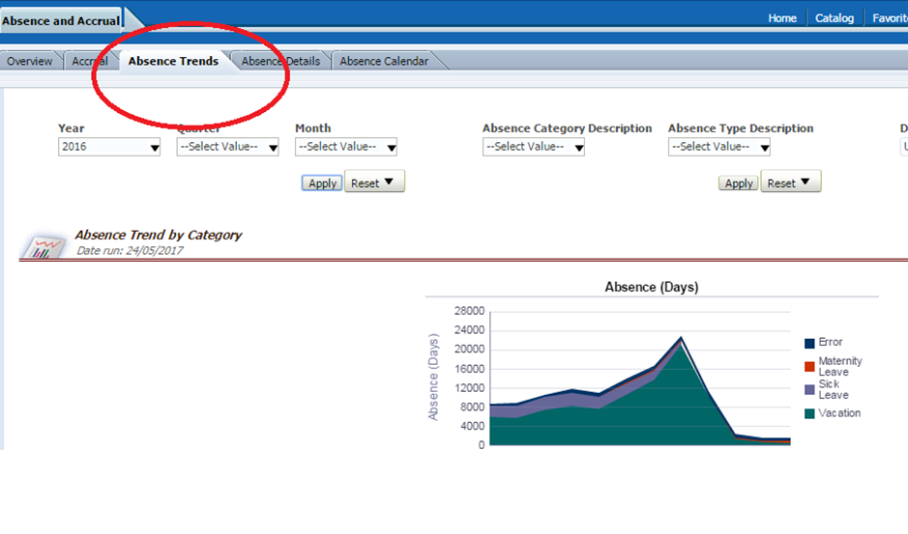
MyHR Reporting Suite – 130+ Reports
OBIEE Capabilities:
- Interactive dashboards
- Ad hoc queries
- Notifications + alerts
- UCL-wide reporting
- Financial reporting
et al.

Slide 5
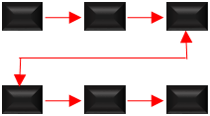
MyHR – a reminder of the scope
SYSTEM
PROCESS
PEOPLE
Replaces legacy systems:
Service in Partnership(SiP)
Resource Link (RL)
HR, Payroll & MyView
Learning Electronic Records
System (LERS)
Transforms current processes:
Manager + Employee Self-
Service (ESS + MSS)
HR Process Review outputs
Standard, streamlined and
simple processes across UCL
Empowers people:
HR Processes initiated and
approved within Depts.
Dept. System Profiles:
Payments, Contract
Changes and New Starters

Slide 6
MyHR Scope – Replacing Legacy Systems with Oracle HCM
Service in Partnership (SiP)
A workflow tool used by depts., HR + Finance for Contract Changes, Employee Lifecycle essentials and Payments
Resource Link (RL)
Processes HR records, Payroll; training data; MyView Employee + Manager Self Service
MyView
Manager + Employee Self-Service
Departmental Administrators Module (DAM)
Reporting suite – Absence, Ethnicity, Cost Analysis et al
Learning Electronic Records System (LERS)
Training events + course bookings
Single Training Booking System
SYSTEM
Out of Scope
(Future phases?)
Recruitment On Line Made easy (ROME) – Upgrade or TALEO
Professorial Appraisal Review (PAR) – Oracle eBusiness Suite

Slide 7
MyHR Scope – Transforming current processes
Change Leadership
the Project Board comprised of Faculty Managers from each school, Finance, and HR
Business Engagement
30 consultation workshops conducted with key stakeholder – DAs, ECA, Payroll and Finance
Process Redesign
26 new streamlined processes were designed based on UCL requirements aligned where possible to Oracle eBusiness suite functionality
Design Principles
minimise, approval steps + hand-offs and empower the skilled user
System Build
these new standard, streamlined and simple process are incorporated into the system build
PROCESS

Slide 8
MyHR Scope – Empowers People and Departments
Manager & Employee Self-Service (MSS + ESS)
Defined System Profiles (Oracle roles) within each Department
Payments:
Overtime
One-Off Duties
Honorary
Higher Duty Allowance, Regrades
PEOPLE
Contract Changes:
Update assignment details
Assignment Costing
Salary Changes
Ending Assignments (Contracts)
Submission & Approval within Departments by skilled users
New Starters:
Creating Multiple Assignments
Assignment Costing
Transfers
Rehire Employee/Contingent Worker

Slide 9
Oracle System Profile Nominations
New Starters:
Creating Multiple Assignments
Assignment Costing
Transfers
Rehire Employee/Contingent Worker
Contract Changes:
Update assignment details
Assignment Costing
Salary Changes
Ending Assignments (Contracts)
PEOPLE
Payments:
Overtime
One-Off Duties
Honorary
Higher Duty Allowance, Regrades

Slide 10
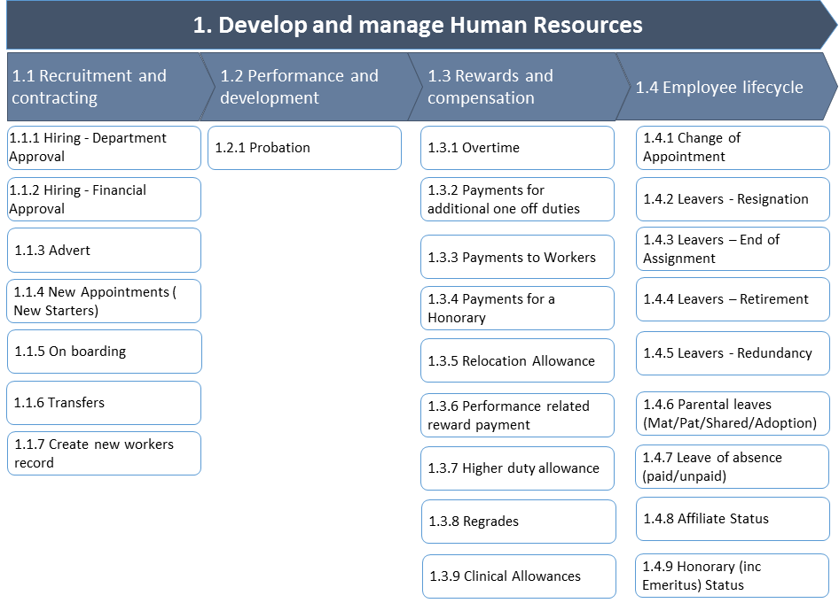
HR Processes are now mapped to level four
Level four: helps to provide a detailed understanding of process inputs, outputs, associated steps and decision points.
Change Impact Analysis
People & Roles
System, Process and policy
Training Needs Assessment
Learning Outcomes
Course Outlines
Off-System Processes
Checklists
Reference Guides + Job Aids

Slide 11
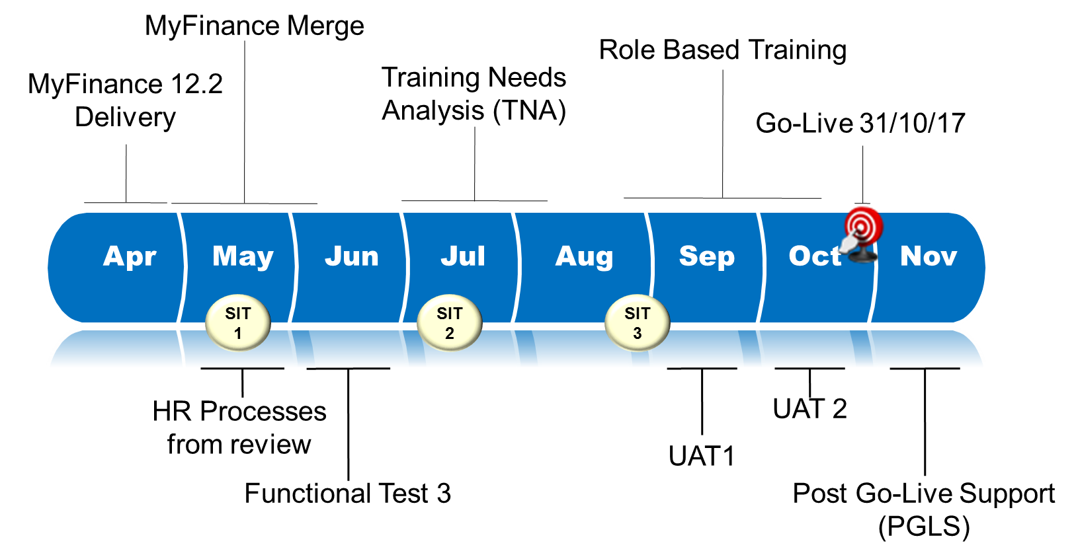
MyHR Timeline
Now subject to MyFinance Regression Testing following BPR acceptance!
(1.) System Integration Test
To check that all the system modules work properly together and with other systems.
(2.) Functional Test
A quality assurance (QA) process that verifies that our software application performs and functions correctly according to design specifications.
(3.) User Acceptance Testing
Users from across UCL test the software to ensure it can handle required tasks in real-world scenarios, according to specifications. In other words…
“It does what it says on the tin”
Subject to comprehensive + robust testing
(1.)
(3.)
(2.)
Pre-UAT
Training

Slide 12
Future Activities
MyFinance Regression Testing – Finance User Group
Oracle Trainers correlating process maps + system
Data Cleanse 2 – Personal details for ESS
Training Needs Analysis
Workshop design
Departmental Oracle Profiles – nomination validation with FMs
Oracle Reporting Workshops
UAT Testing – Identify UAT testers for training prior to August testing
Change Network 2 Planning

Slide 13
My HR
For more information please go to the MyHR website @
https://www.ucl.ac.uk/myhr
Any questions? Please contact us via the MyHR Mailbox @
myhr@ucl.ac.uk
Thank you for your time
MyHR is much more than a technology initiative, technology alone does not deliver benefits – people do!

