Slide 1
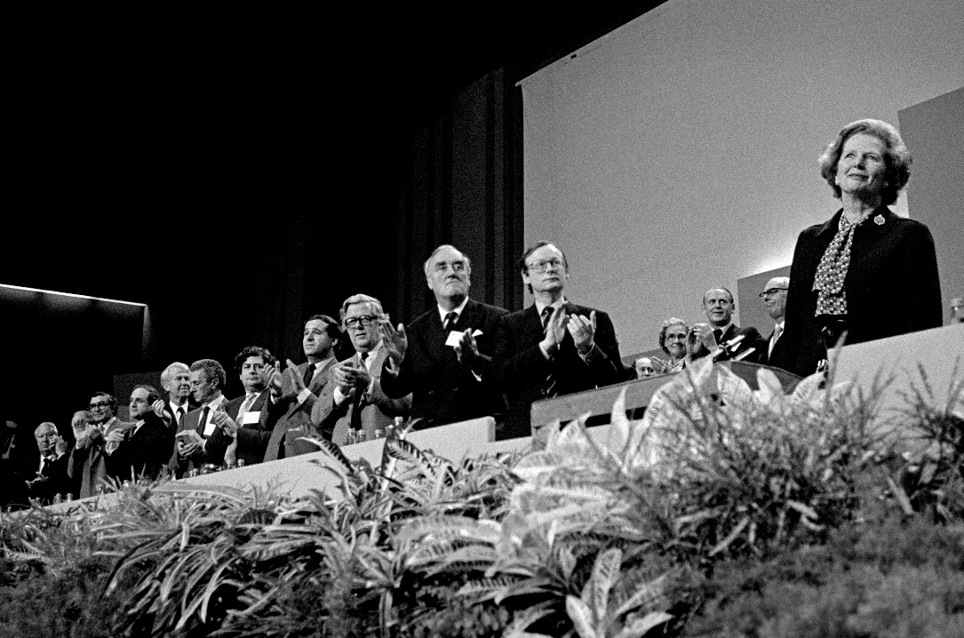
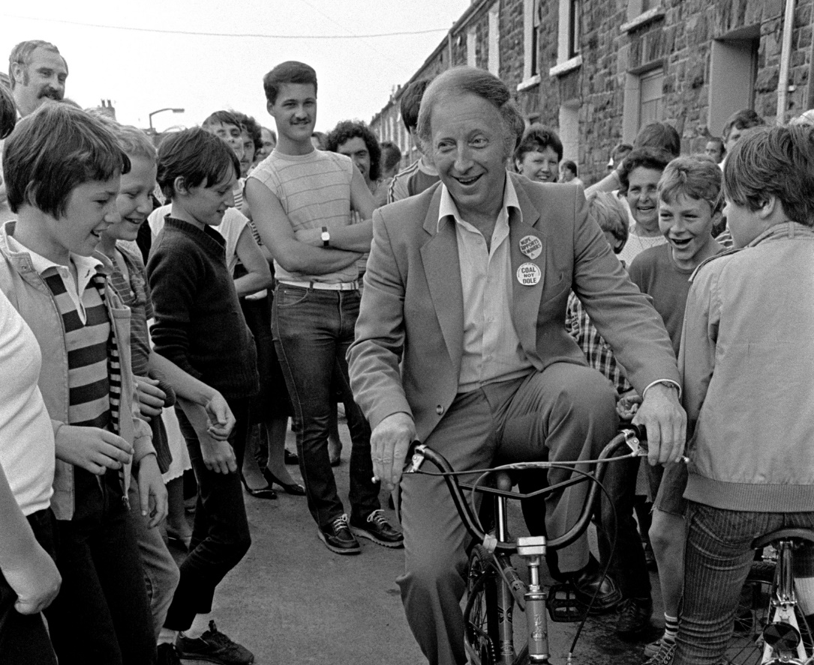
Remember that established narrative?
How long did the strike last?
Who were the two people in the photographs?
What did the NUM stand for?
Put these events in the right order:
a. Plans are announced to close 20 coal mines (the NUM reveals it was 70).
b. Fights break out between strikers and the police
c. Margaret Thatcher becomes Prime Minister.
d. Thatcher calls the union leaders the ‘enemy within’
e. Arthur Scargill calls a national strike of miners, despite not calling for a national vote
f. The strikes come to an end with the Conservative Party victorious
Images copyright Martin Shakeshaft

Slide 2
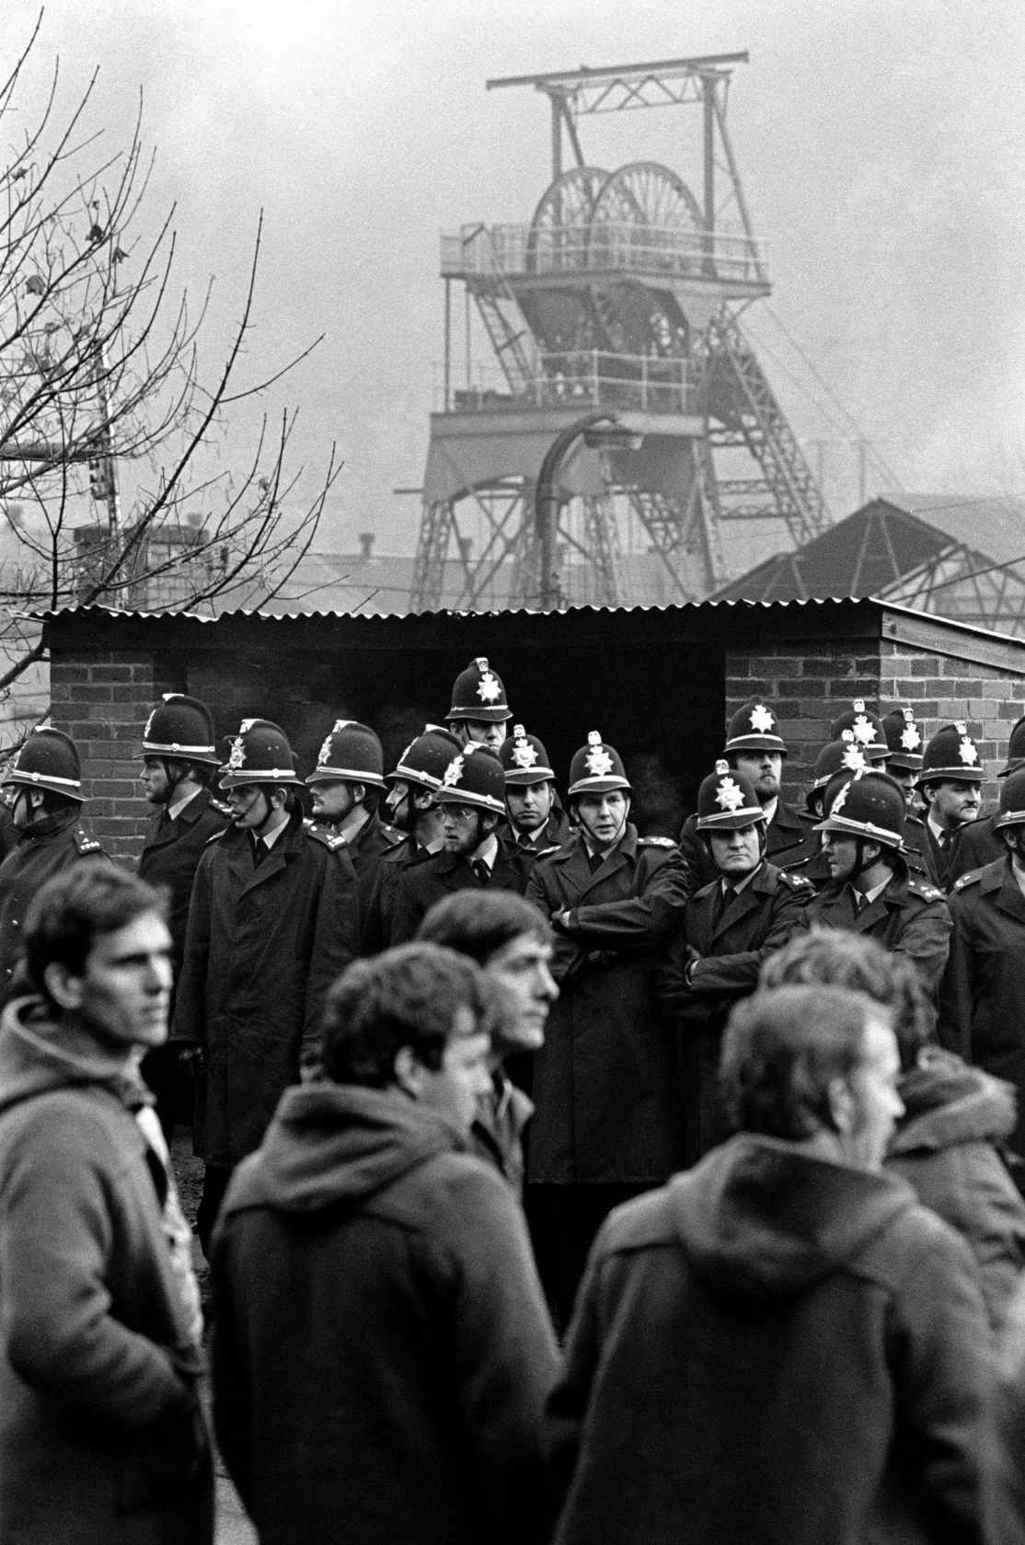
Remember that established narrative?
How long did the strike last? One year – 26,000,000 working days!
Who were the two people on the cover of Time magazine? Arthur Scargill and Margaret Thatcher
What did the NUM stand for? National Union of Miners
Put these events in the right order:
a. Margaret Thatcher becomes Prime Minister.
b. Plans are announced to close 20 coal mines (the NUM reveals it was 70).
c. Arthur Scargill calls a national strike of miners, despite not calling for a national vote
d. Fights break out between strikers and the police
e. Thatcher calls the union leaders the ‘enemy within’
f. The strikes come to an end with the Conservative Party victorious
Image copyright Martin Shakeshaft

Slide 3
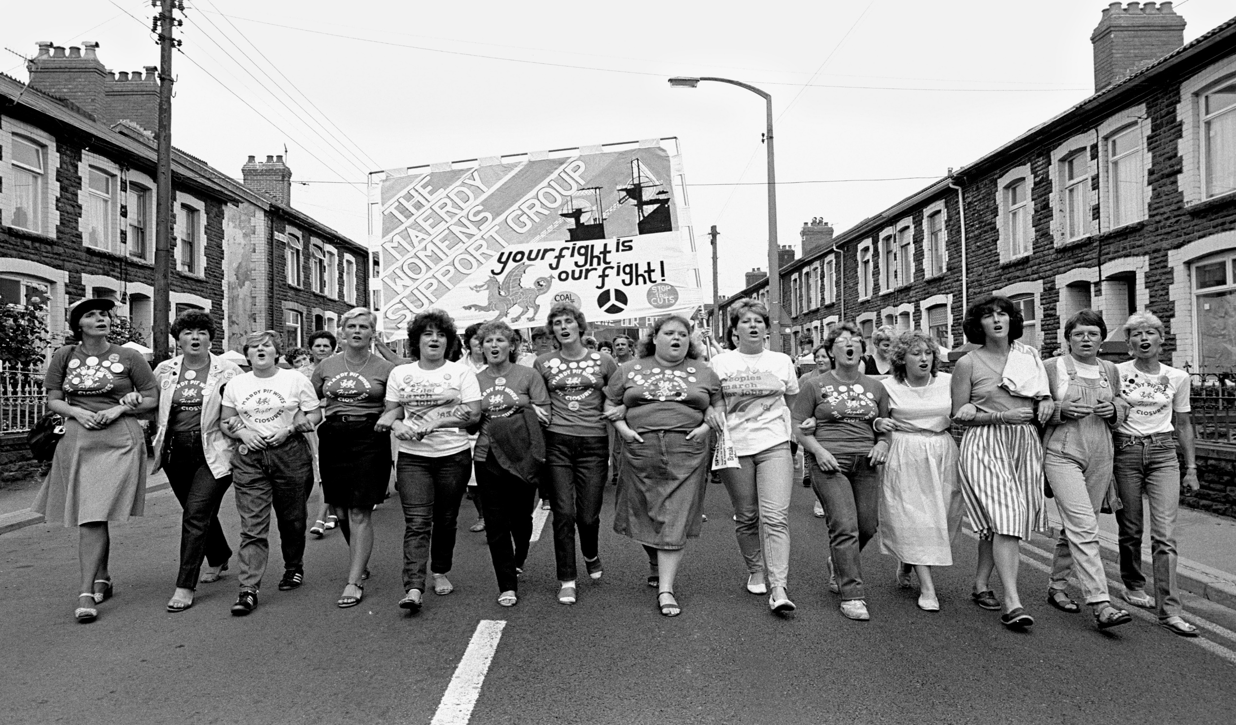
But remember - we are investigating how oral history can challenge the established narrative! What does oral history add to our understanding of the Miners’ Strike?
Image copyright Martin Shakeshaft

Slide 4
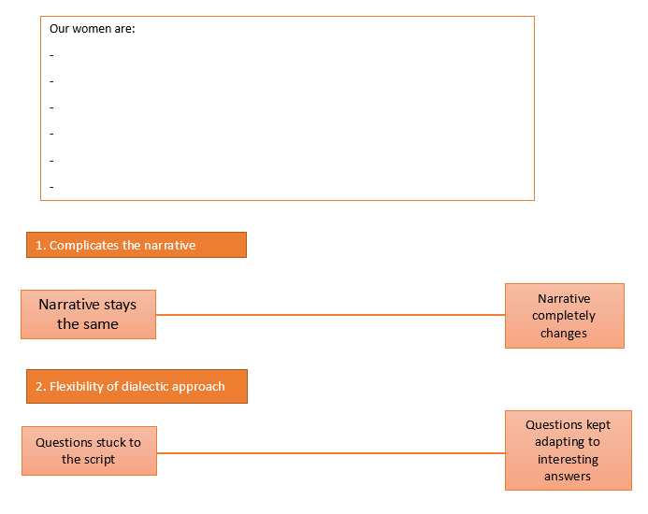
Sharing what you found
You need to be in groups of 5-6.
You are going to tell the group:
Who you interviewed
What you expected to learn
What you discovered and the questions you asked
Any ways this has influenced your understanding of the Miners’ Strike.
Copy their name onto the lesson work sheet

Slide 5
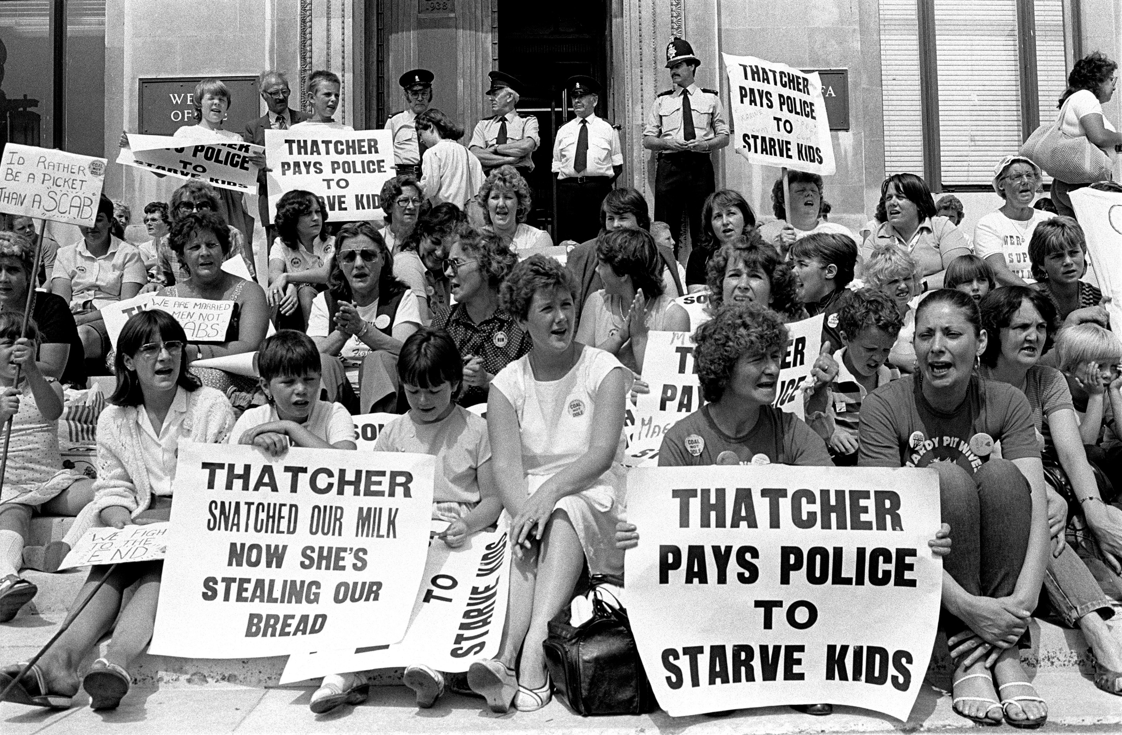
It is really exciting to add these women’s stories to your understanding of the past.
But when historians examine interviews, they need to apply a method to analyse them:
Oral historians ask how the interview complicates the established narrative
Oral historians use an intersubjective approach to see which questions were asked and when
Oral historians analyse the fallibility of the interviewee in a positive way to see what issues of memory, perspective, context tell us about what they are saying.
Image copyright Martin Shakeshaft

Slide 6
Analysing oral history
In your groups you are going to rank your interviews against these three criteria that oral historians use. You need to write the woman’s name onto the spectrum. We can do the first one together:
Complicates the narrative
Narrative stays the same
Narrative completely changes
Notes:
Really emphasise the need for them to be secure with the established narrative (men, politics, violence, legality, police on horses, defeat for the Yorkshire miners) when evaluating how far their interview complicates this narrative.

Slide 7
Analysing oral history
Complicates the narrative
Narrative stays the same
Narrative completely changes
Flexibility of intersubjective approach
Questions stuck to the script
Questions kept adapting to interesting answers

Slide 8
Analysing oral history
Complicates the narrative
Narrative stays the same
Narrative completely changes
Flexibility of intersubjective approach
Questions stuck to the script
Questions kept adapting to interesting answers
Fallibility of interviewee
Issues of memory, perspective and time told me nothing
Issues of memory, perspective and time changed my understanding of her words
Notes:
Crucial to emphasise that ‘fallibility’ does NOT mean they are looking for weaknesses or flaws, but rather what issues of memory, perspective, context tell us about what they are saying.

Slide 9
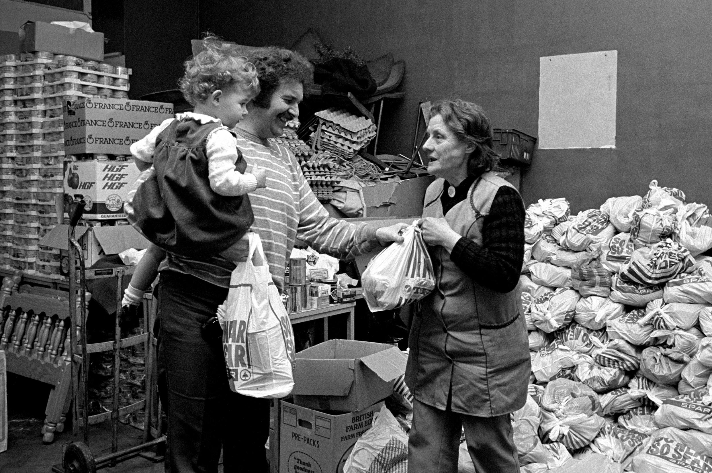
Bringing our lessons together…
What does oral history add to our understanding of the miners’ strike?
In your books, we want you to write down an answer to this question. Try to be as complex, as thoughtful, and as much like a historian as possible.
Image copyright Martin Shakeshaft

Slide 10
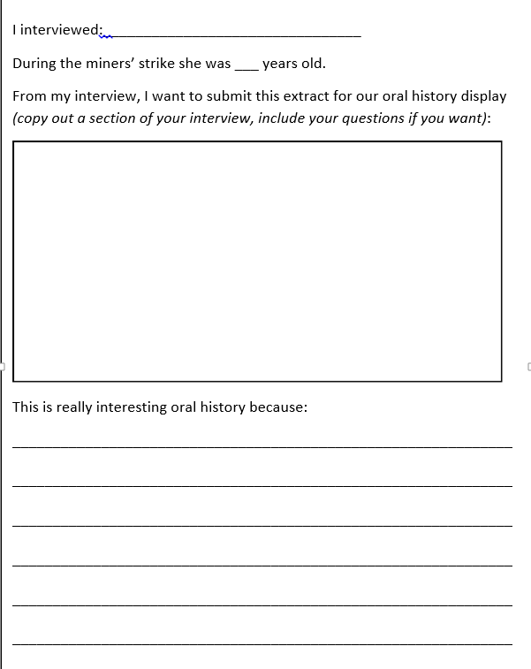
Setting up a display
If we set up a display of the 1984 – 5 miners’ strike…what evidence from your interview would you like to contribute?
Explain your reasoning, trying to consider the oral history process:
Complicating the narrative
Flexibility of intersubjective approach
Fallibility of interviewee

