Slide 1
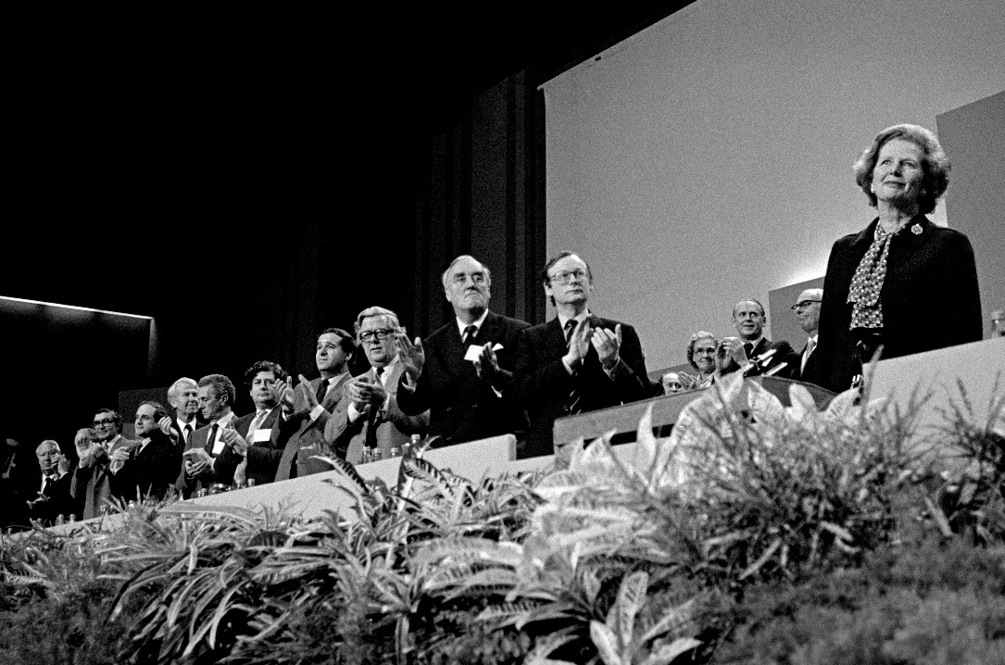
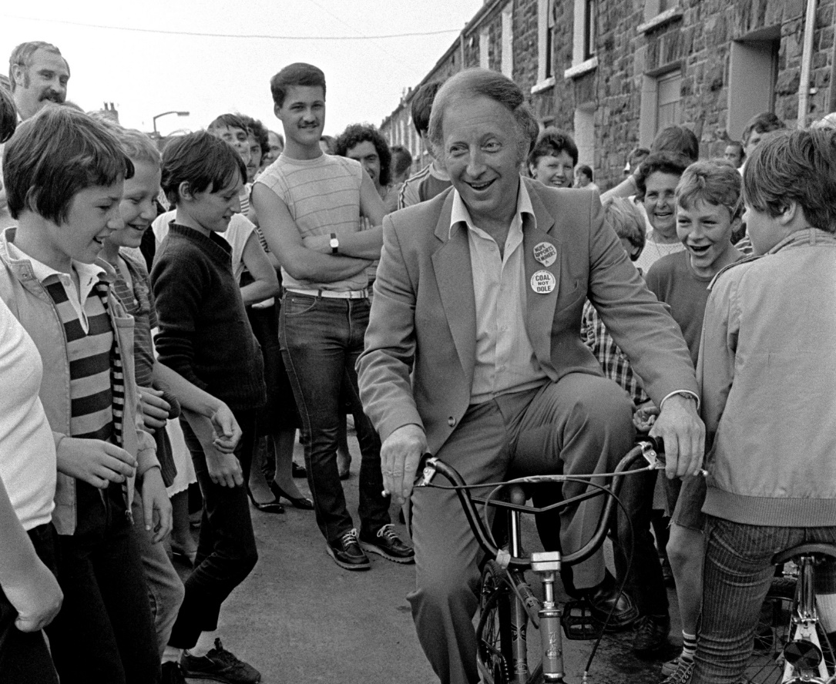
Remember that established narrative?
How long did the strike last?
Who were the two people in the photographs?
What did the NUM stand for?
Put these events in the right order:
a. Plans are announced to close 20 coal mines (the NUM reveals it was 70).
b. Fights break out between strikers and the police
c. Margaret Thatcher becomes Prime Minister.
d. Thatcher calls the union leaders the ‘enemy within’
e. Arthur Scargill calls a national strike of miners, despite not calling for a national vote
f. The strikes come to an end with the Conservative Party victorious
Images copyright Martin Shakeshaft

Slide 2
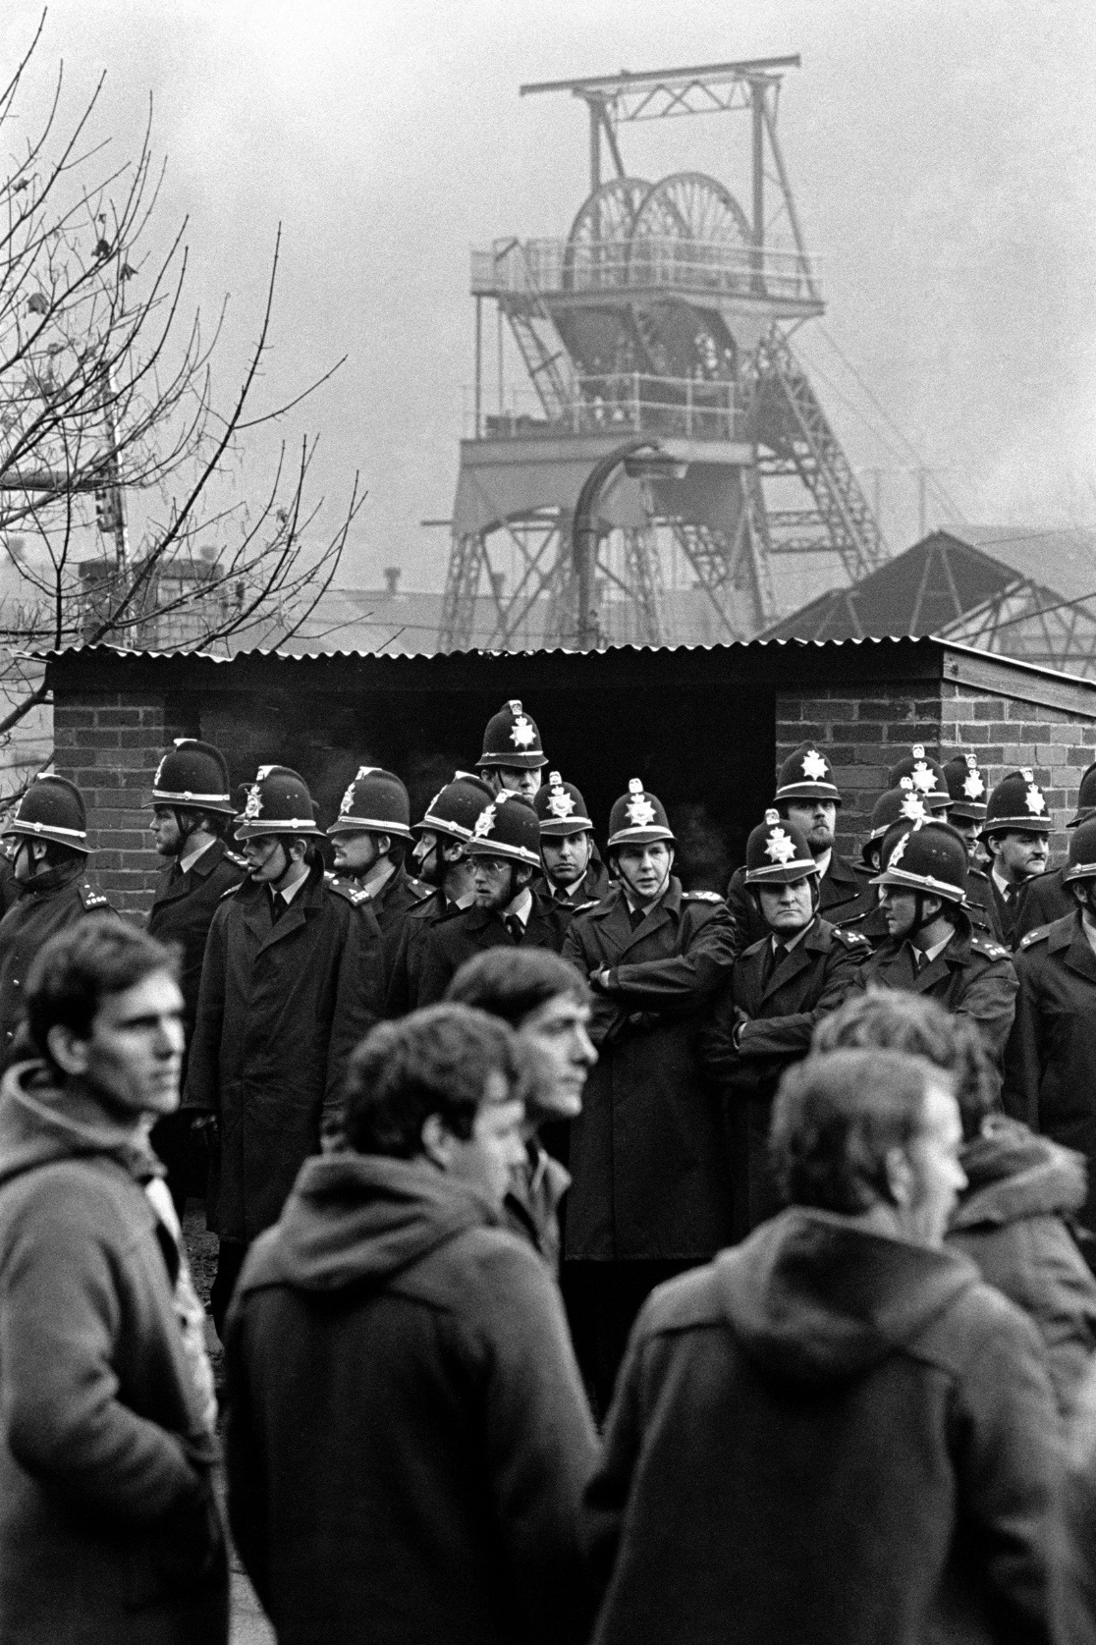
Remember that established narrative?
How long did the strike last? One year – 26,000,000 working days!
Who were the two people in the photographs? Arthur Scargill and Margaret Thatcher
What did the NUM stand for? National Union of Miners
Put these events in the right order:
a. Margaret Thatcher becomes Prime Minister.
b. Plans are announced to close 20 coal mines (the NUM reveals it was 70).
c. Arthur Scargill calls a national strike of miners, despite not calling for a national vote
d. Fights break out between strikers and the police
e. Thatcher calls the union leaders the ‘enemy within’
f. The strikes come to an end with the Conservative Party victorious
Image Copyright Martin Shakeshaft

Slide 3
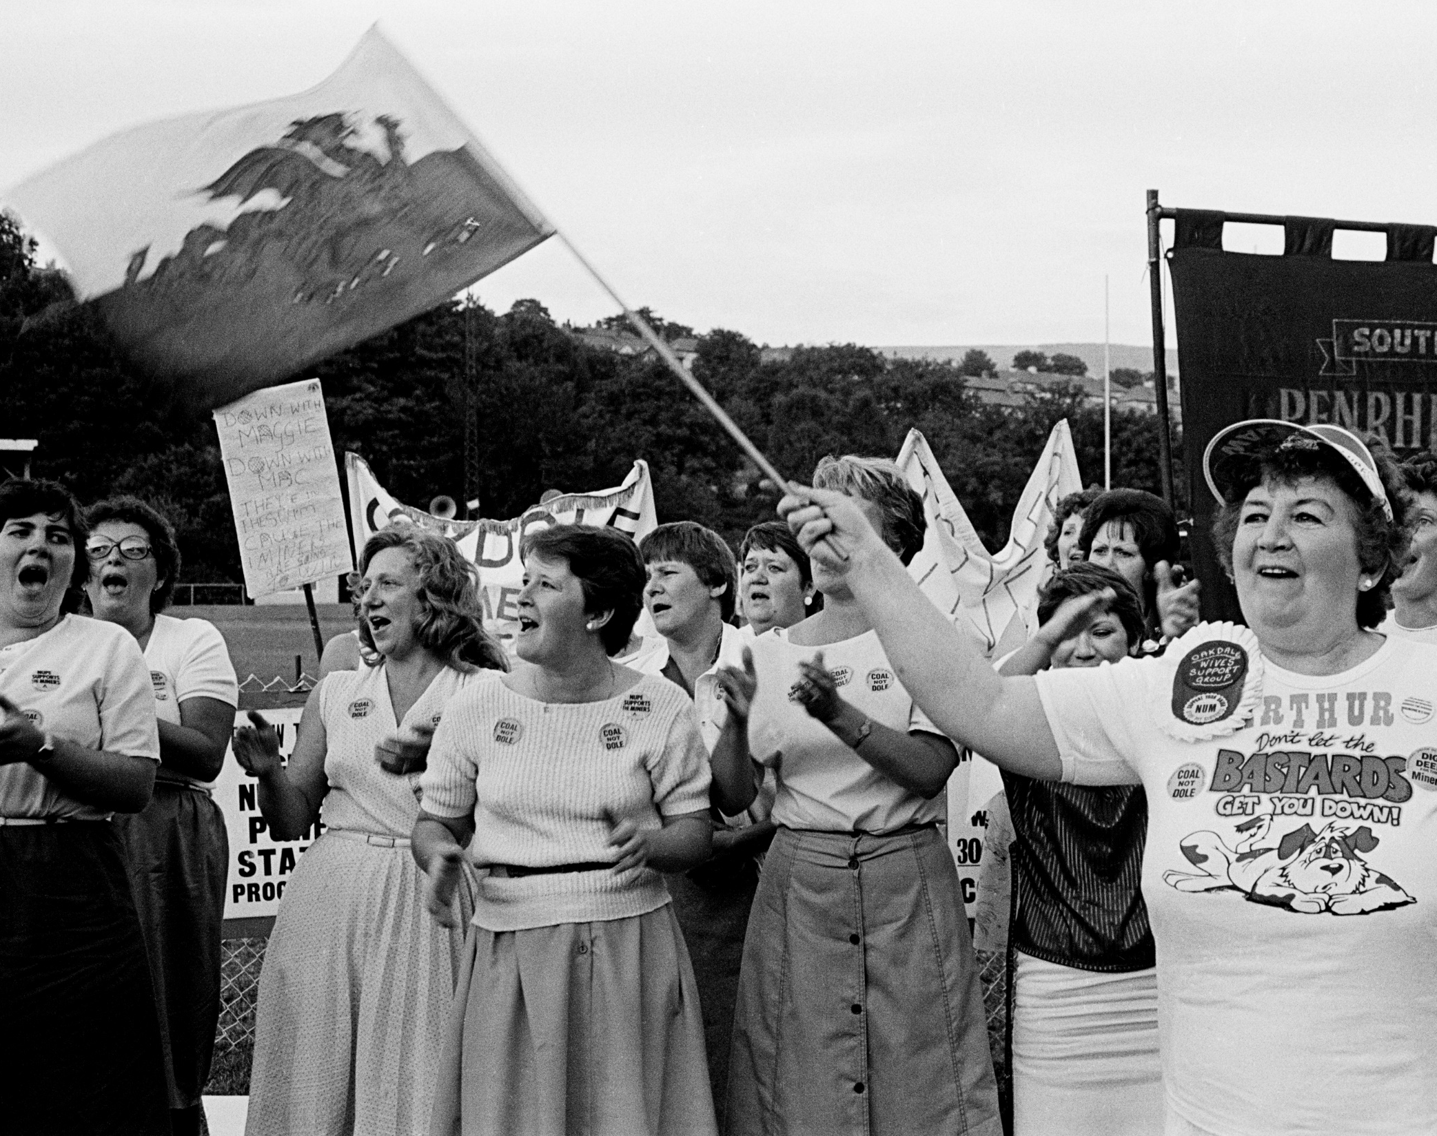
Whose history?
This pivotal point in British history is remembered for:
The politicians
The trade union leaders
The strikers who were violent towards police and other miners.
This is what the national newspapers and tv stations reported.
But what about people who weren’t miners but still connected to the strike? How can we learn about their history and see how it complicates that established narrative?
Image Copyright Martin Shakeshaft
Image Copyright Martin Shakeshaft

Slide 4
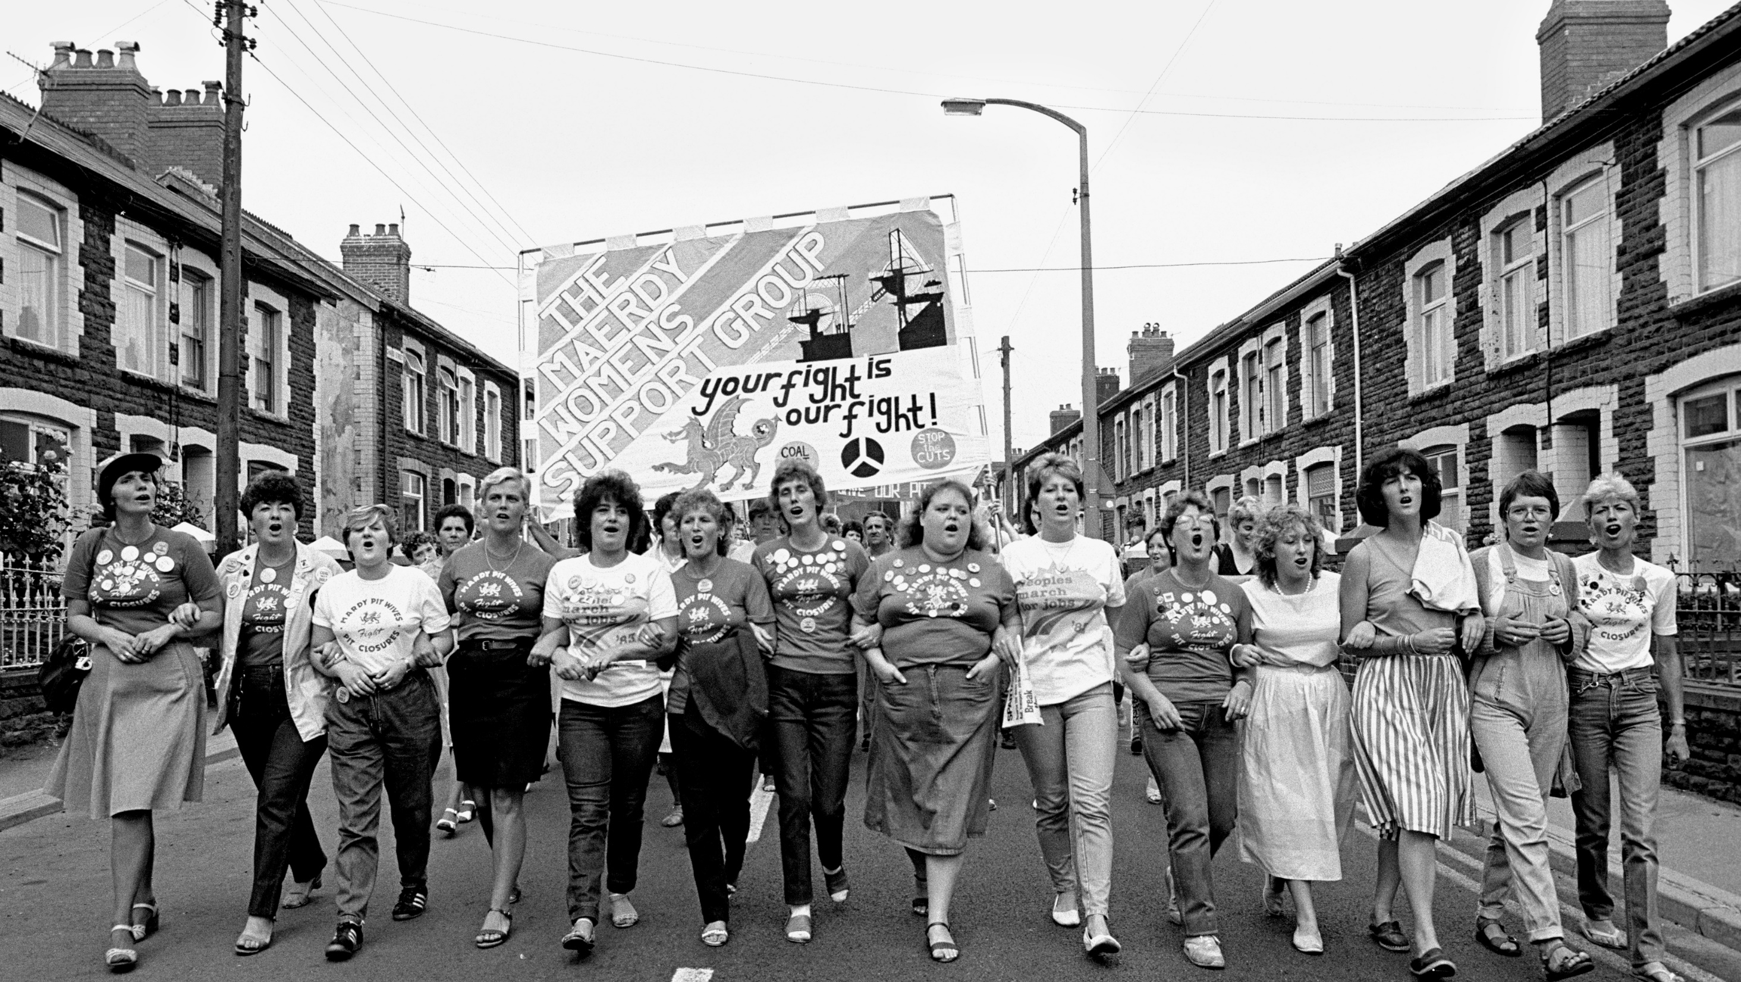
What does oral history add to our understanding of the 1984-5 Miners’ Strike ?
Image Copyright Martin Shakeshaft

Slide 5
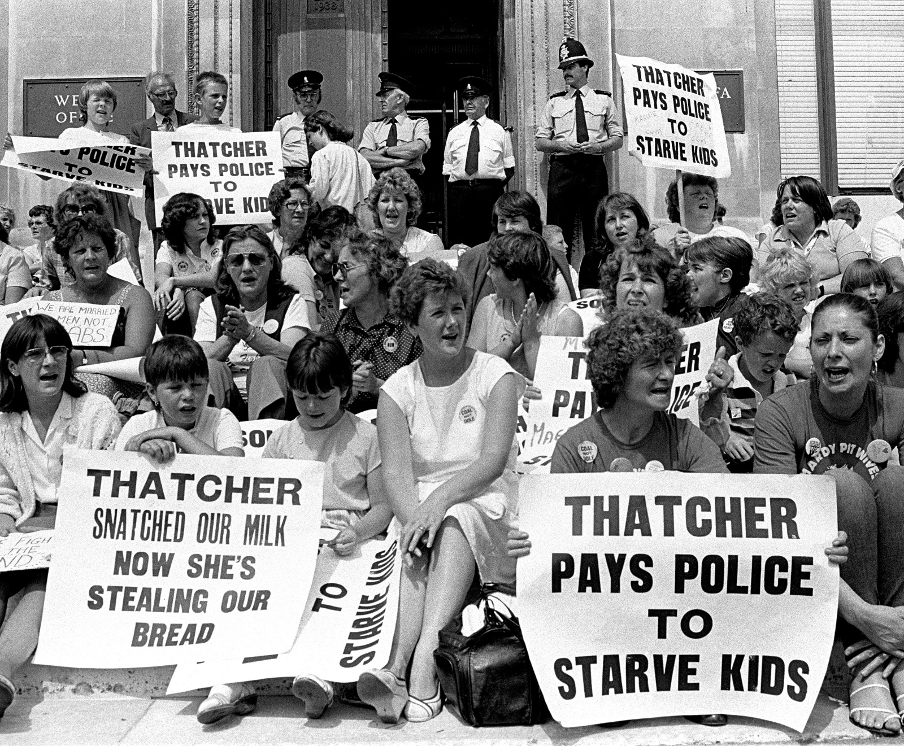
Oral history can challenge the established narrative
Image Copyright Martin Shakeshaft
Recently, several historians have started interviewing women from the local area, and using other sorts of evidence, to discover their stories.
Here is one of them, Dr Natalie Thomlinson, talking about oral history interviews :
https://www.youtube.com/watch?v=_jBg3mTFjnk
Image copyright Martin Shakeshaft Martin Shakeshaft

Slide 6
Dr Natalie Thomlinson’s interviews
https://www.youtube.com/watch?v=IsNOy5rskGs

Slide 7
But an oral historian listens, pieces together and forms arguments about the past…
Here Dr Natalie Thomlinson has analysed her interviews for us: https://www.youtube.com/watch?v=gf9cS46tO-8

Slide 8
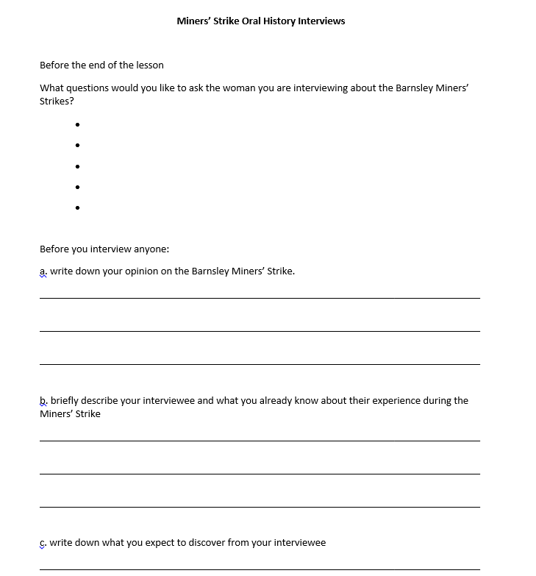
You are going to become the oral historians!
Before next lesson you are going to interview (in pairs if you want) a woman who was an adult during the 1984-1985 Miners’ Strike.
Discuss now:
What questions would you like to find out the answers to?
-
-
-

Slide 9
You are going to become the oral historians!
Before next lesson you are going to interview (in pairs if you want) a woman who was an adult during the 1984-1985 Miners’ Strike.
Instructions:
Complete the front side of the worksheet BEFORE you interview.
Ask friends and family if you can’t think of anyone.
Arrange an interview for maybe 5-10 minutes. It can be on the phone.
Record the interview on your phone.
Have a list of questions – but also don’t be afraid to ‘freestyle’ and ask questions based on what they tell you!
Write a transcript of the interview on the worksheet.

Slide 10
Final words of advice from our oral historian:
https://www.youtube.com/watch?v=8YpJZTRDOGQ
And for next time: bring in your completed worksheet and any photos of images or materials the interviewee shares with you.

