Slide 1
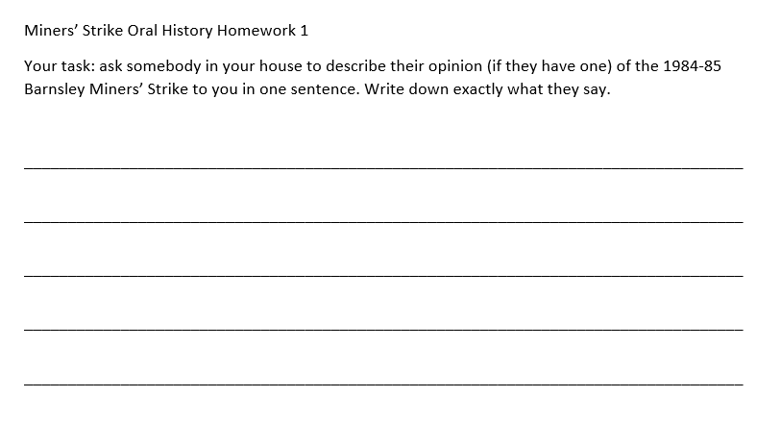
What did you find out?
Share with the person next to you:
Who did you ask?
What was their opinion on the miners’ strike?
(If they had a strong opinion) Did you know this was their view before you asked?

Slide 2
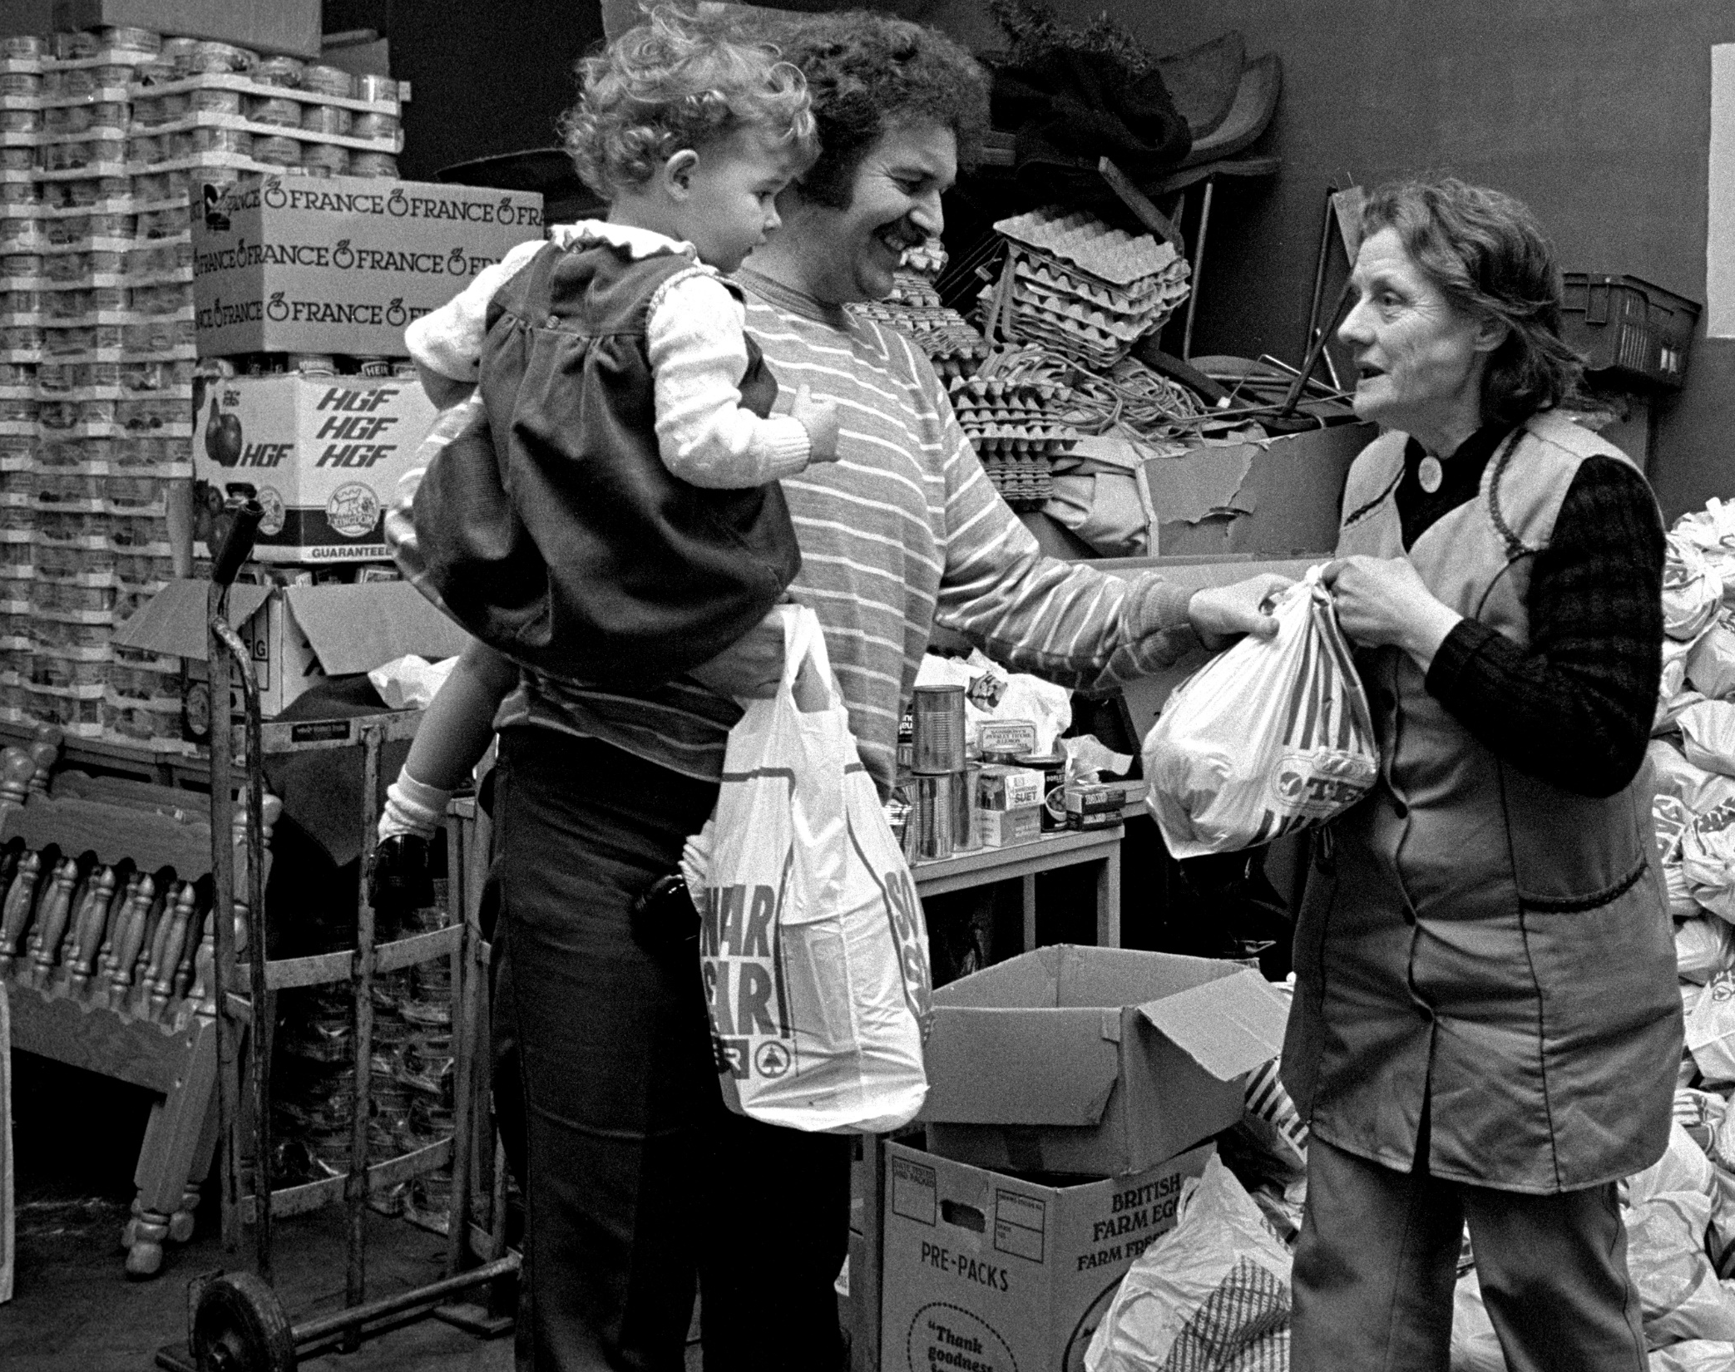
What does oral history add to our understanding of the 1984-5 Miners’ Strike?
Image copyright Martin Shakeshaft

Slide 3
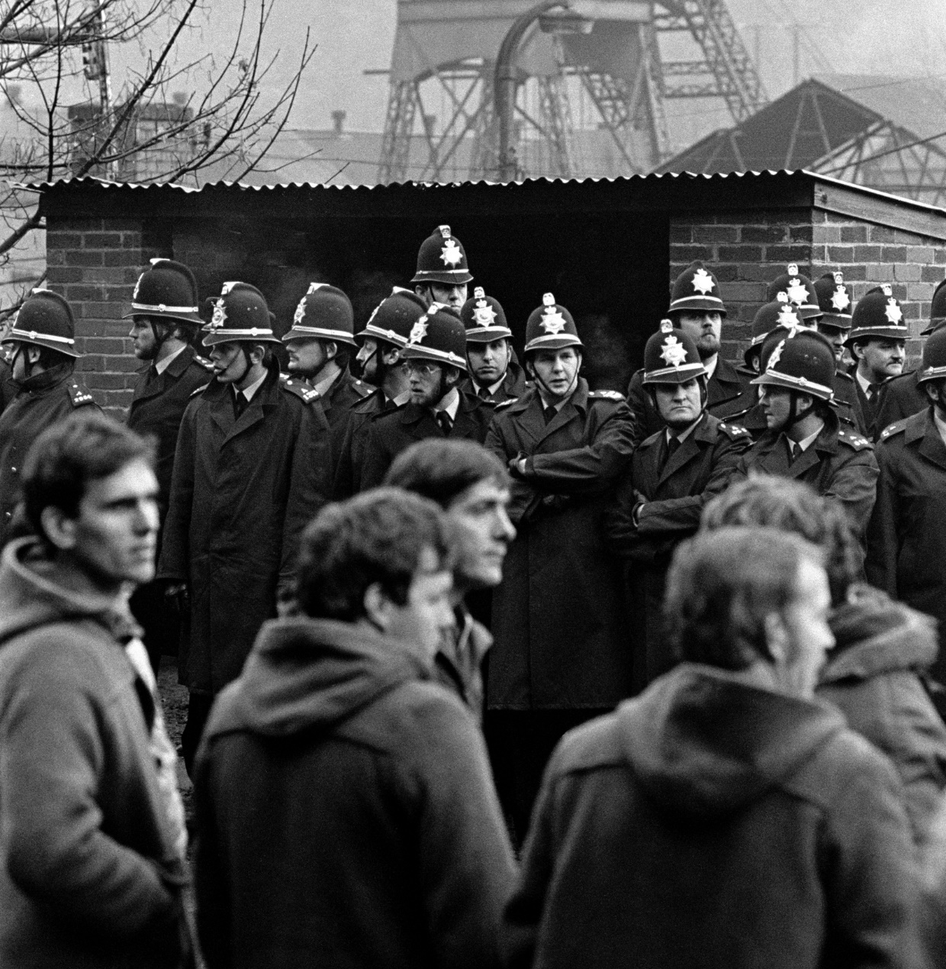
The established narrative of the strike
In March 1984, many miners in Britain went on strike (they didn’t go to work and didn’t get paid). This strike lasted over a year, affecting everyone in the county, and changing the community forever. But only some people ever really get remembered…
Remember - everyone in the past had a story…but we only know about some and we only choose to remember a tiny number.
Image copyright Martin Shakeshaft

Slide 4
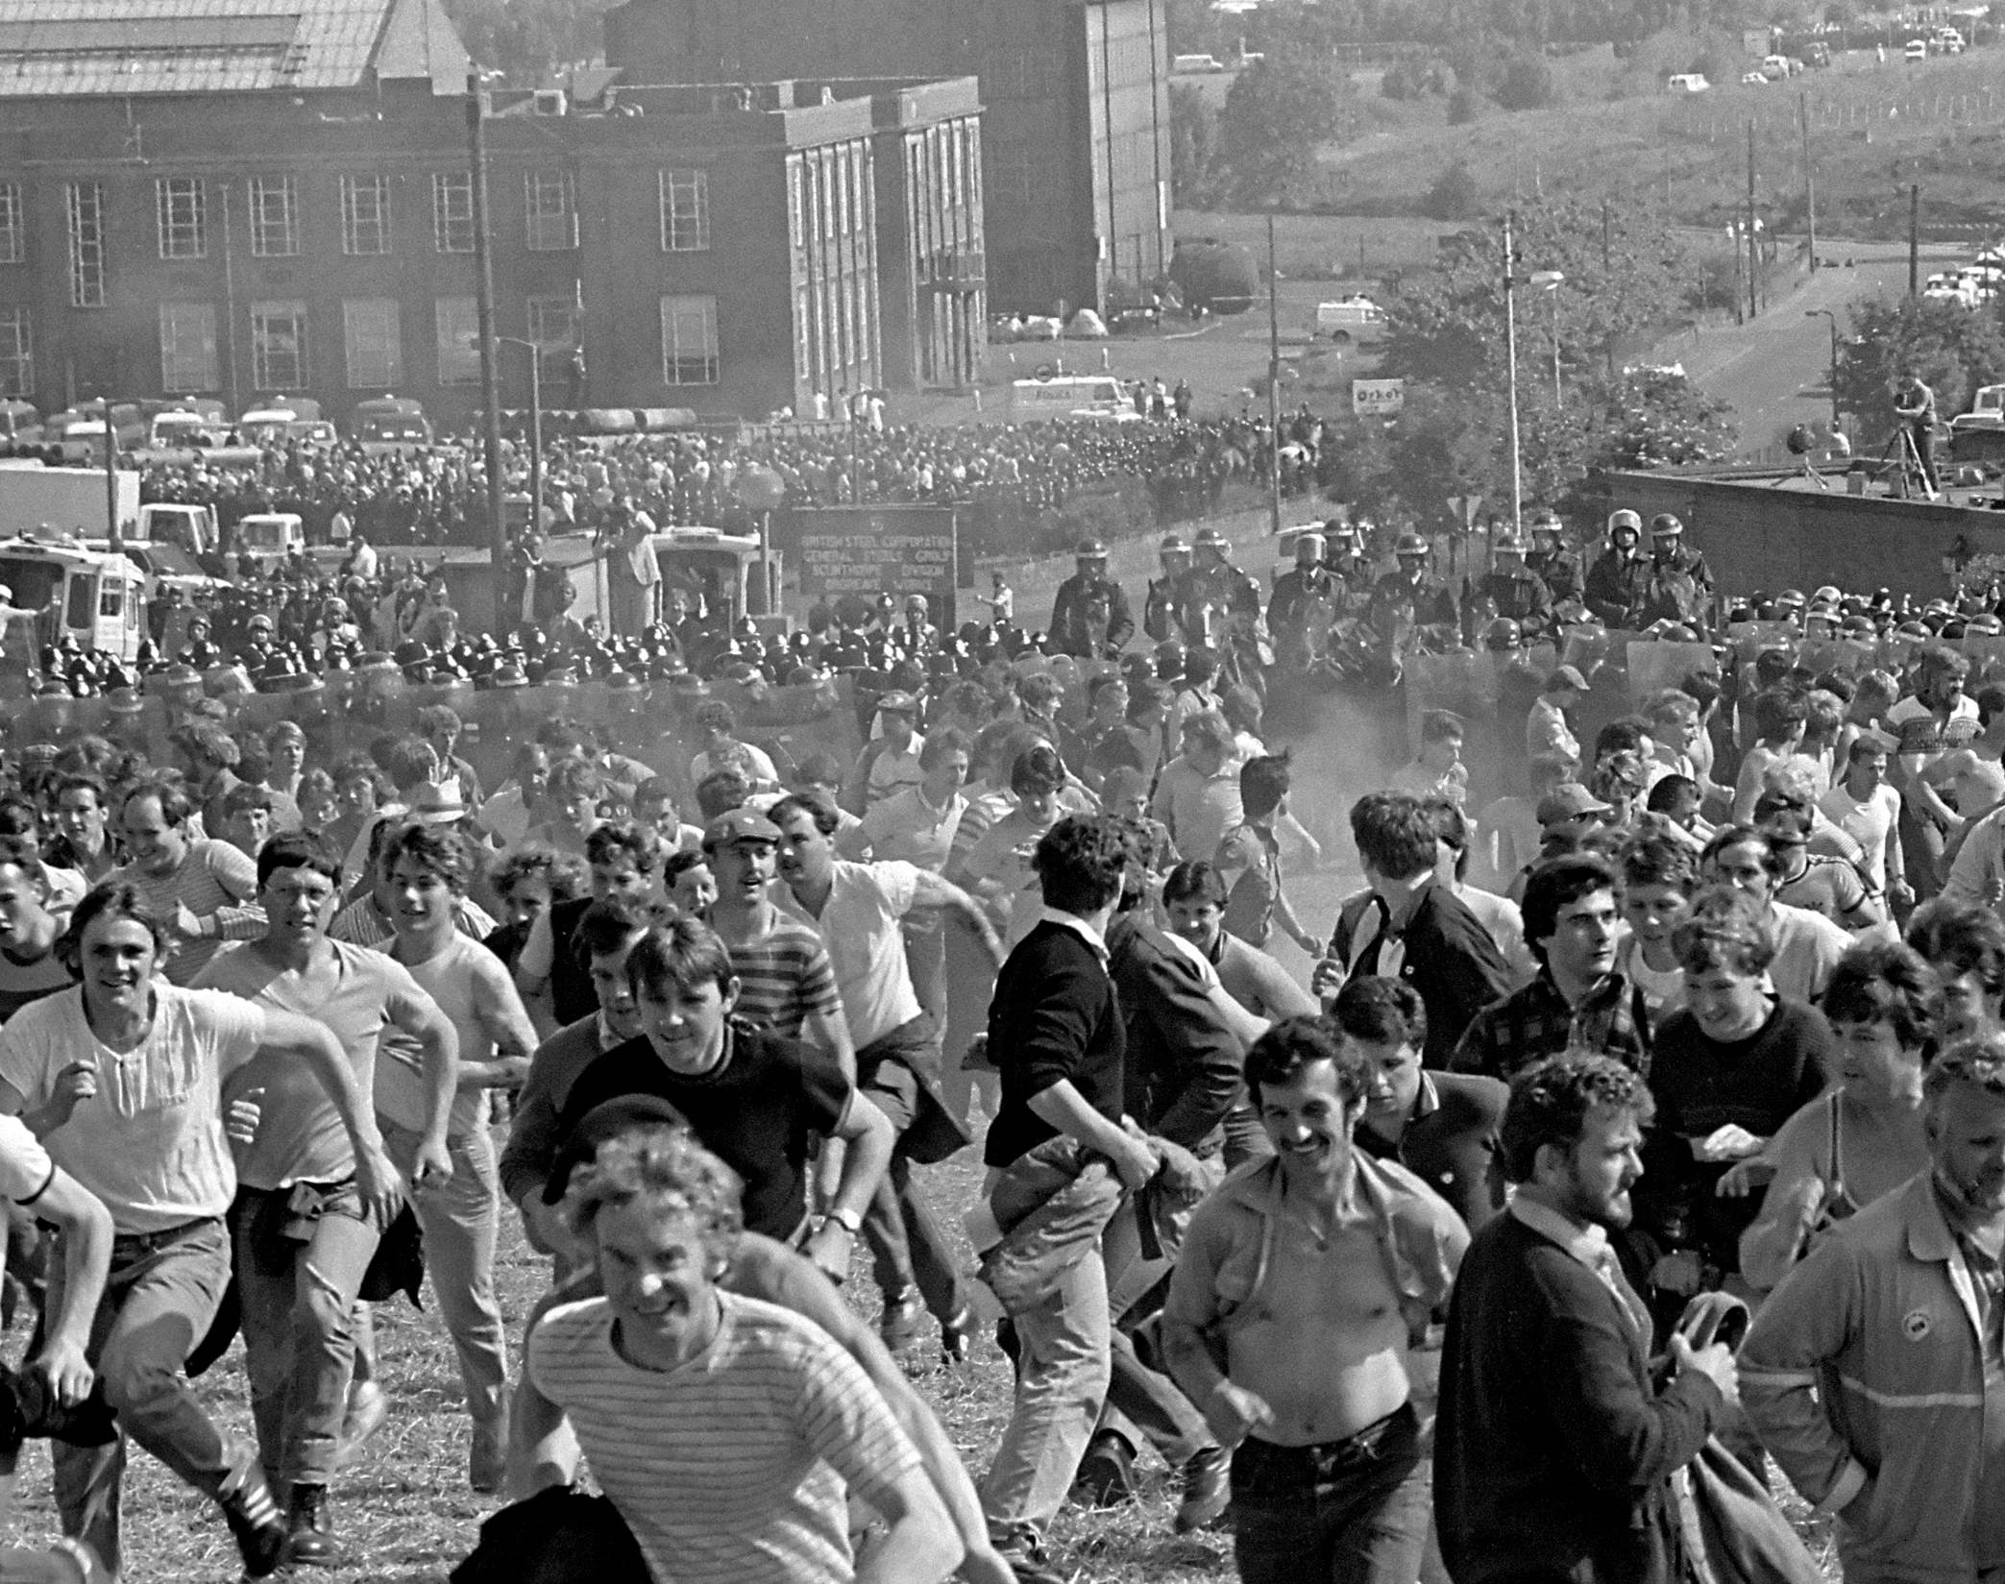
What does google remember about the 1984-5 Miners’ Strike?
Image copyright Martin Shakeshaft

Slide 5
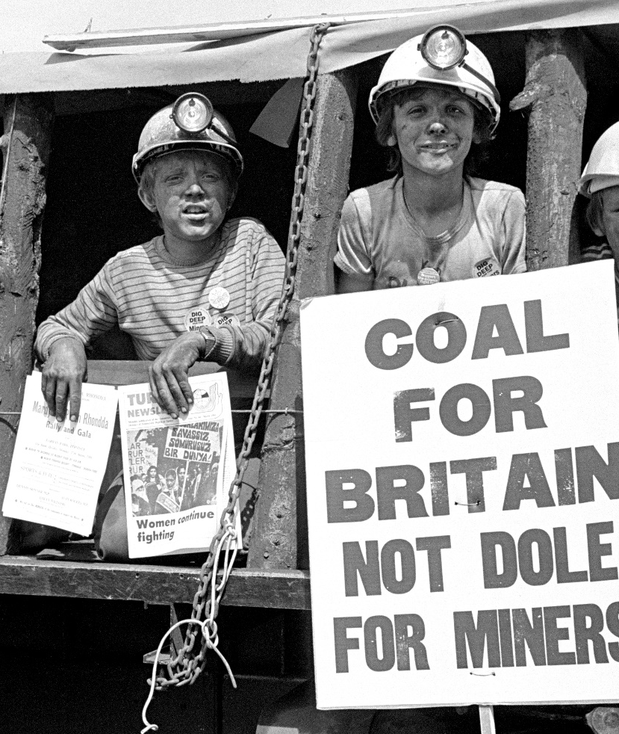
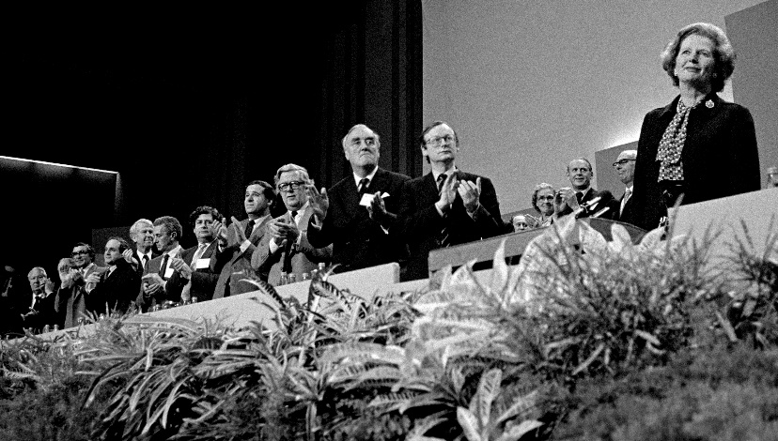
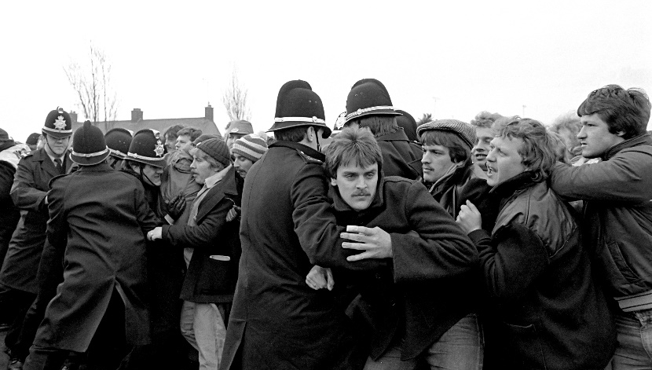
You might see pictures like this:
Picket lines
Fights between miners and police
Banners (‘coal not dole’)!
Margaret Thatcher
Not many men (apart from Thatcher)
All photographs by permission of Martin Shakeshaft.

Slide 6
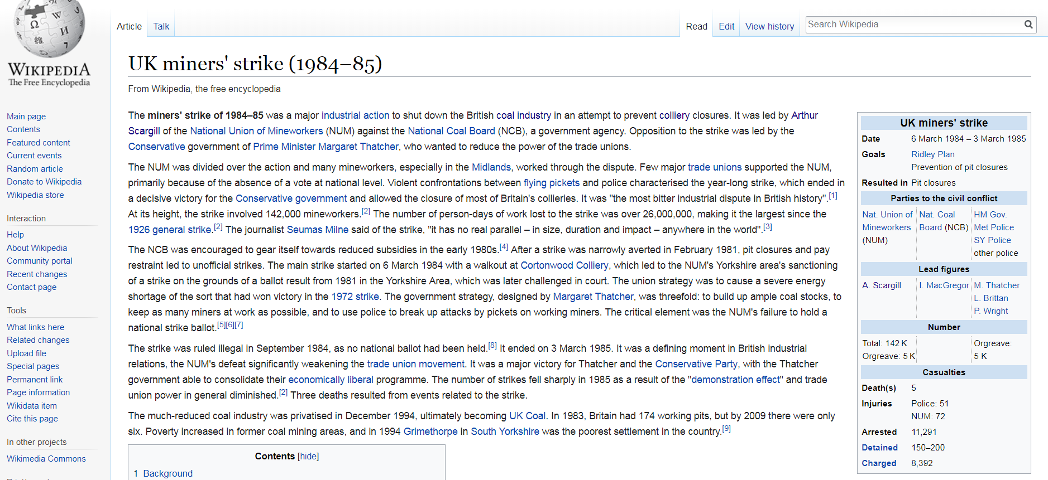
Wikipedia’s narrative: what does Wikipedia’s intro emphasise about the Yorkshire Miners’ Strikes?

Slide 7
Wikipedia’s narrative: what does Wikipedia’s intro emphasise about the Yorkshire Miners’ Strikes?
It was a strike to stop pit closures
The government beat the striking miners – the main consequence was political
26,000,000 working days lost
Trade unions never recovered their power
There were lots of arrests and even five deaths

Slide 8
Back to your homework…
Is the traditional narrative similar or different to what you learnt from speaking to people at home?
Why do you think that was?

Slide 9
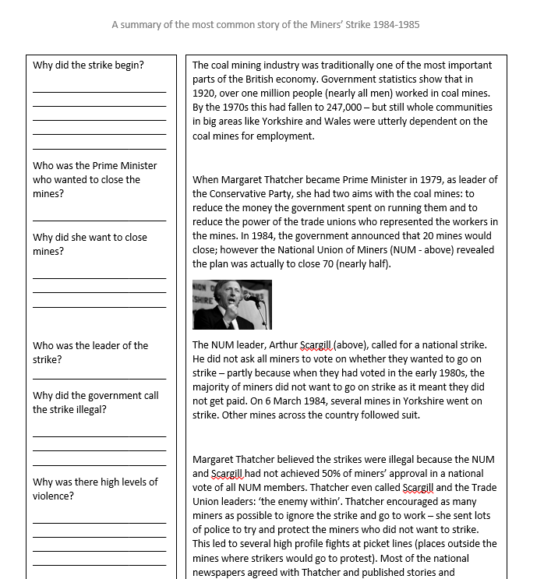
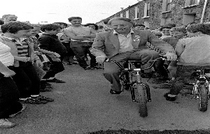
So let’s briefly find out the specifics of this established narrative…
We are going to read this overview of the 1984-85 Miners’ Strike
And answer these questions to check the key points are secure.

Slide 10
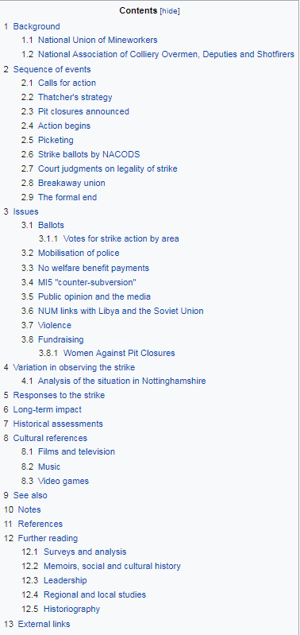
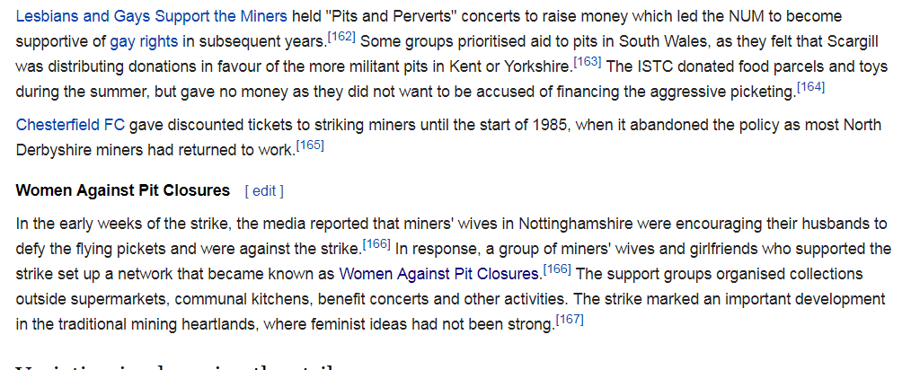
As an extension, what does this slide tell us about the way the Miners’ Strikes are remembered?
Any consideration of anyone not in this traditional narrative appears here on Wikipedia…

Slide 11
Whose history is it?
This pivotal point in history is remembered for:
The politicians
The trade union leaders
The strikers who were violent towards police and other miners.
This is what the national newspapers and tv stations reported.
Image copyright Martin Shakeshaft

Slide 12
For next time:
You next homework will involve an interview of a women who lived in your area during the miners’ strike.
You need to ask you household/relatives/neighbours if they know a woman who was an adult during the miners’ strike.
You can start to ask if an interview will be possible after next history lesson.

