Slide 1
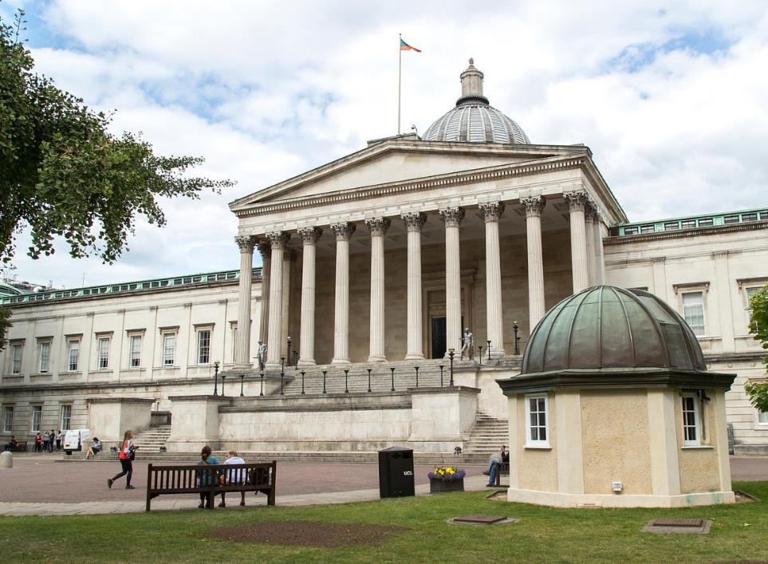
LONDON’S GLOBAL UNIVERSITY
Delivering global impact
Date
Name
Title

Slide 2
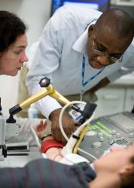
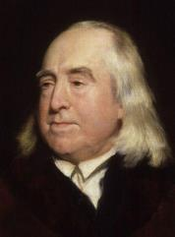
^{Main Headline,} ^{Helvetica} ^{28pt}
^{2nd Headline,} ^{Helvetica} ^{28pt}
UCL’s history and ethos
Founded in 1826 to open up higher education in England to those previously excluded
By 1878, first English university to admit female students on equal terms with men
Our founding principles - academic
excellence and research addressing real-world problems - continue today
Houses auto-icon of famous philosopher and jurist Jeremy Bentham – UCL’s “spiritual founder”
Images: UCL Institute for Women's Health by Matt Clayton; Jeremy Bentham, by Henry William Pickersgill

Slide 3







Top 20
global university

Slide 4


1st
29
1,137
ranking UK university
for research strength
(Research Excellence Framework, 2014)
Nobel Prize winners
(13 non-UK)
professors
(over 1/4 non-UK)
10th
More than
12,000
Awarded
both
in the world’s
top 10 universities
(QS World University Rankings, 2019)
academic and professional services staff
(over 1/3 non-UK)

Slide 5
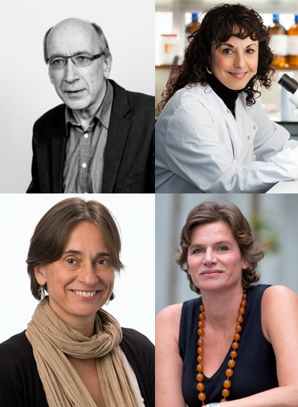
UCL’s global impact
Recent examples:
Professor Richard Blundell (UCL Dept of Economics), awarded Nemmers Prize in Economics in 2016
Professor Sarah Tabrizi, Director of the UCL Huntington's Disease Centre, received the 2017 International Leslie Gehry Brenner prize for Innovation in Science
Professor Christiana Ruhrberg won the 2018 Judah Folkman Award in Vascular Biology from the North American Vascular Biology Organization
In 2018, UCL Institute for Innovation and Public Purpose Director Professor Mariana Mazzucato’s mission was announced as the core of a €100bn EU research and innovation programme.

Slide 6
UCL’s global students
200,000+
Our students come from
19,232
150
countries
alumni
(in over 190 countries)
speaking
undergraduates
140
(47% non-UK, of which 16% EU)
countries
1:10
Our students speak
22,307
More than
4,500
140
postgraduates
academic to student ratio
(42% non-UK, of which 10% EU)
EU students
languages

Slide 7
UCL’s Faculties
Laws
Arts & Humanities
Social & Historical Sciences
(SLASH)
Brain Sciences
Life Sciences
Medical Sciences
Population Health Sciences
(SLMS)
Built Environment (Bartlett)
Engineering Sciences
Mathematical
& Physical Sciences
(BEAMS)
Institute of Education
(IoE)

Slide 8
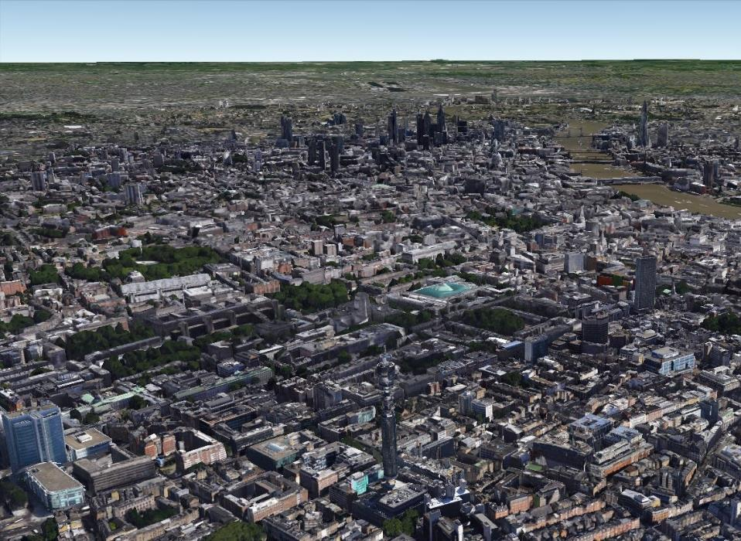

^{Main Headline,} ^{Helvetica} ^{28pt}
^{2nd Headline,} ^{Helvetica} ^{28pt}
Our central location
UCL Portico
Image: Google Earth
Notes:
Our main campus is in the heart of Bloomsbury, central London.
This central location gives our staff and students unrivalled access to academic resources and networking opportunities, as well as access to government and international NGO networks, a means of increasing our domestic and international policy influence.

Slide 9
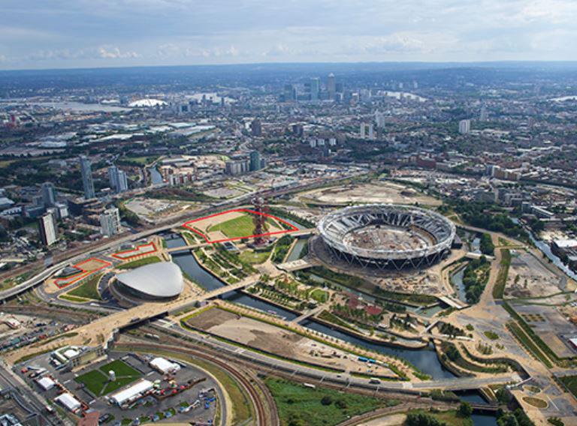
UCL East: opening 2021
Project timeline:
2015-2017 – Masterplanners shortlist announced; design and town planning
2019 - Mayor of London Sadiq Khan breaks ground as construction begins
September 2022 - First academic year to begin at Pool Street West
September 2023 - First academic year to begin at Marshgate, with a phased opening of the building
Notes:
UCL will build a new campus at Queen Elizabeth Olympic Park, following the Government’s announcement in 2014 that it would commit £141m to create a world class education and cultural district there.
Site will cover 11 acres and provide at least 125,000m² of space.
First facilities will open during the 2019/20 academic year.
In 2016 UCL agreed a £280m loan with the European Investment Bank to develop our campuses: the largest sum ever lent by the bank to a university.
A Business Academy, Culture Lab and Global Future Cities Co-Labs are among activities proposed to form part of the new campus.

Slide 10

UCL Press
The UK's first fully Open Access University Press
Launched in 2015, by 2019, it had reached 1.8 million downloads worldwide.
A total of 229 countries have downloaded from UCL Press, everywhere from Australia to Zambia.
Most popular book so far: How the World Changed
Social Media by UCL Professor of Anthropology
Daniel Miller.
Notes:
UCL will build a new campus at Queen Elizabeth Olympic Park, following the Government’s announcement in 2014 that it would commit £141m to create a world class education and cultural district there.
Site will cover 11 acres and provide at least 125,000m² of space.
First facilities will open during the 2019/20 academic year.
In 2016 UCL agreed a £280m loan with the European Investment Bank to develop our campuses: the largest sum ever lent by the bank to a university.
A Business Academy, Culture Lab and Global Future Cities Co-Labs are among activities proposed to form part of the new campus.

Slide 11
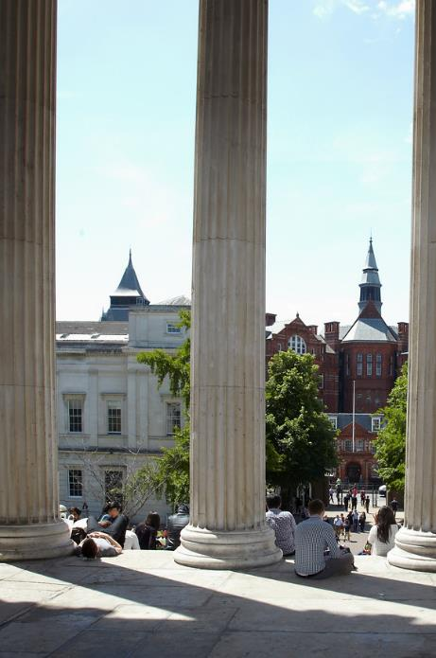
UCL 2034: our institutional
20-year strategy
Six Principal Themes:
Academic leadership
Integrating research and education
Addressing global challenges
Publicly-engaged organisation
London’s Global University
Delivering global impact

Slide 12
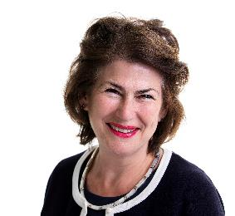
Global Engagement Strategy (GES)
“London’s Global University, working with partners to achieve fair solutions to global challenges.”
Encourages UCL’s reflex to “Think global: act together”
Partnership principle
Five strategic drivers
UCL has been intensifying its global engagement – at home in London and with partners in Europe and around the world – following the EU referendum result
Dr Dame Nicola Brewer
UCL Vice-Provost (International)
Former British High Commissioner
to South Africa (2009-2013)
Notes:
Nicola Brewer - a former senior British diplomat, not an academic – was appointed through an external competition as Vice-Provost (International), to give UCL a distinctive new international strategy.
Dame Nicola heads up the Global Engagement Office, a team which helps put UCL’s knowledge and ideas to work in the world.
GEO supports UCL academics to collaborate with others who share their dedication to excellence and passion for knowledge, irrespective of where they are in the world.
We do this by developing and strengthening partnerships with other global institutions in four main ways: running seed-funding programmes; organising inbound and outbound delegation visits; profiling the world-leading research and education carried out by UCL academics with their partners; and monitoring and mitigating risks to UCL’s international outlook and activity.
In light of Brexit, UCL is committed to working harder than ever to implement UCL’s Global Engagement Strategy: London’s Global University will continue to work with partners across Europe and around the world to achieve fair solutions to global challenges.

Slide 13
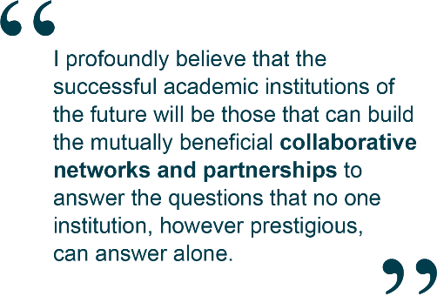

Partnerships principle =
partnerships of equivalence
Central aspect of the GES
Reciprocal relationships of mutual trust and respect
Sir John Tooke
Former UCL Vice-Provost (Health)
Notes:
The Global Engagement Strategy is based on a commitment to international partnerships of equivalence and the belief that bringing together different perspectives and diverse experience accelerates the process of discovery and global impact.
UCL academics are collaborating in many ways with partners around the world to help address the challenges facing society.

Slide 14

Global Engagement
Strategy (GES):
Five strategic drivers
Result of comprehensive, UCL wide consultation with academics, staff and students (70+ meetings) – understanding what is important for our global engagement
The drivers shape the right kind of GES for us – helping UCL to create lasting good, putting knowledge and ideas into action, enabling our thinking and discoveries to go further and creating positive impact for people all around the world.
Notes:
A new round of university-wide consultation is currently underway ahead of the current strategy’s conclusion in 2020.

Slide 15
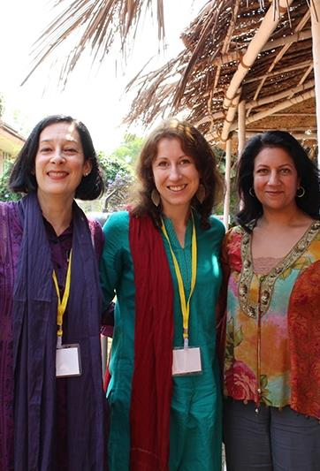
GES strategic drivers
Cultivating our global outlook to offer our students the best possible preparation for global lives and careers
Co-creating wise solutions to global challenges and problems
Increasing independent research capability around the world
Marshalling our expertise in enterprise, innovation and translational research to deliver long term solutions for society
Strengthening our position as London’s Global University by amplifying our achievements and engaging more effectively
UCL academics at the Difficult Dialogues conference in India
Notes:
Strategic drivers i. and v. reflect our global aspirations and were updated as part of the 2016 ‘Brexit testing’ of the GES. They recognise that, post-Brexit, UCL will need to work harder to cultivate our global outlook and to draw more explicitly on and from our location in the world’s most global city.
Strategic drivers ii. and iv. derive their strength from something we believe is our unique selling point: interdisciplinarity.
Strategic driver iii. speaks to our particular ethos and founding values.

Slide 16
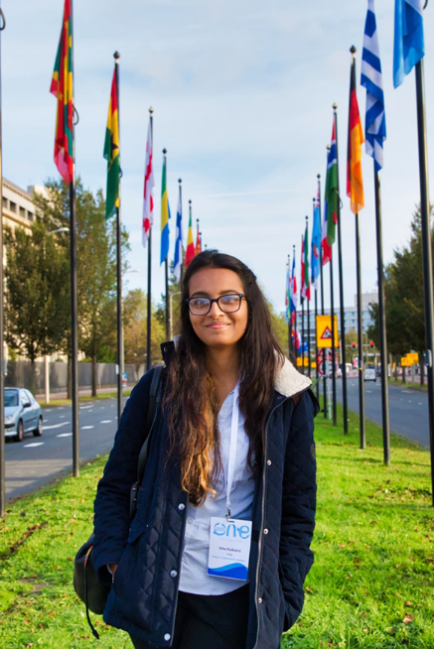
Cultivating our global outlook to offer our students the best possible preparation for global lives and careers
Some examples at UCL:
Global Citizenship Programme
Global Ambassadors
UCL Summer School
Student mobility opportunities
Connected Curriculum
Global Internships Programme
MSc Engineering student Isha Kulkarni at the 2018
One Young World conference
Notes:
Student mobility opps: In 2016/17, 1,164 undergraduate students (26.3% of the graduating cohort) experienced one week or more abroad, while 23.8% experienced four or more. At least 800 students will take part in such programmes during 2017/18.
UCL’s Connected Curriculum (CC): a creative and strategic whole-institutional approach to embedding research-based education and assessment into programmes of study. It enables students to make connections across subjects and out to the world, developing research integrity, social responsibility and global citizenship.
CC incorporates the UCL ChangeMakers programme, supporting students and staff working in partnership on educational enhancement projects.

Slide 17
Global Citizenship Programme
Two-week, post-exam intensive course for undergraduates
Strands relating to UCL’s Grand Challenges
UCL Summer School
Runs in July and August in two blocks spanning three week
Launched in 2016. In 2018, 526 students from around took part - 85% of whom would consider returning to UCL for a grad degree.
Global Ambassadors
12 students who have studied abroad or are international students
Provide fellow students with support as they prepare to study abroad
Student mobility opportunities
Includes Erasmus programme
1,164 students (26.3% of the cohort) experienced one week or more abroad in 16/17, while 23.8% experienced four or more.
Notes:
UCL’s Global Citizenship Programme
Encompasses all aspects of UCL education, including degree programme content, extra-curricular activity, study abroad and language requirements
Helps produce graduates who look beyond their individual and local interests, see the complexity of an interconnected world and are ready to work together to change it for the better
Several strands to the programme focus on UCL’s Grand Challenges of Global Health, Sustainable Cities, Intercultural Interaction and Human Wellbeing, helping students consider how their work relates to global issues
Global Ambassadors
Founded 2015
Team of student Global Ambassadors provide fellow students with additional support whilst they prepare to study abroad
Cover a range of regions across the globe and bring a host of international experiences that they are keen to share
UCL Summer School
UCL welcomes students from around the world to its Summer School each year
Offers a wide range of modules and students can choose the subject best suited to their academic or personal interests
500+ students took part in 2018
Modules are taught on our Bloomsbury campus in the heart of London and include lectures, seminars, group work as well as visits to local areas of interest.

Slide 18
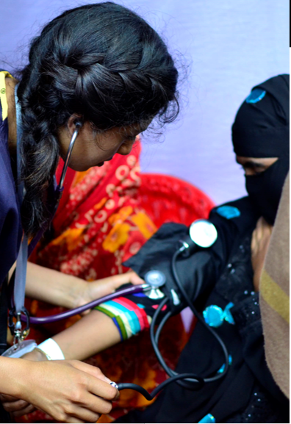
2. Co-creating wise solutions to global challenges and problems
Some examples at UCL:
UCL Grand Challenges
Research partnerships with universities, organisations and industries
  International co-authorship results in higher citation rates (*1); impact increases the further the geographical distance between collaborators (*2)
UCL medical student Yasmin Abedin volunteering with
the Maternal Aid Association in Bangladesh
* 1: Glanzel, 2001 / 2: Nomaler, Frenken, Heimeriks, 2013.
Notes:
In the 19th century, ‘multiple discoveries’ – made at the same time, by people not working together - were more likely than the international research collaboration that is common today.
For example, a UCL Medical School collaboration with the University of Zambia, established by Professor Alimuddin Zumla (UCL Division of Infection and Immunity), won the Outstanding Research Team Award during the eighth European and Developing Countries Clinical Trials (EDCTP) Partnership Forum, in recognition of its equitable partnership model for conducting research into poverty-related diseases.
Slides 20 and 21 give more detail of these examples at UCL.

Slide 19
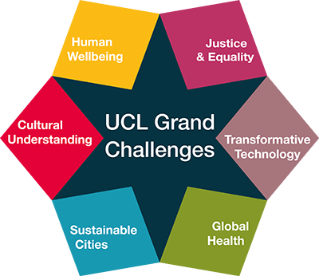
2 (i) UCL Grand Challenges
Bring together expertise from across UCL to address the world’s problems
Key part of UCL Research Strategy, cultivating leadership founded in excellence and fostering cross-disciplinarity
Catalyst for the "disruptive thinking" that the world needs to tackle urgent issues
In 2019, UCL will host a major UCL-Japan conference on ‘The Super-Ageing Society’ jointly with Kyoto University and other Japanese universities.

Slide 20
2 (ii) Examples of UCL partnerships with universities, organisations and industries:
Peking University (multi-disciplinary, cross-faculty collaborations, e.g. UCL School of Management and PKU’s National School of Development running the Beijing International MBA)
The University of Toronto (UCL-U of T joint funding scheme to support collaborative research and education initiatives)
Alliance4Tech (UCL Engineering created ‘campus without borders’ with leading technical institutions in Italy, France and Germany)
Africa Health Research Institute (UCL is significant academic partner to new institute in South Africa researching TB and HIV)
Santander Universities (e.g. Research Catalyst Award collaborations in Latin America)

Slide 21

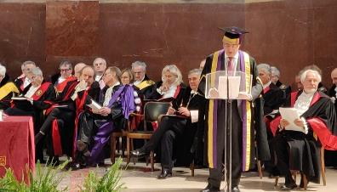

UCL Cities
Partnerships Programme
Initiative which supports, funds and promotes academic collaborations in research and teaching with partners in global cities.
Activity began in Rome, followed by Paris, under the leadership of two Academic Directors.
Offers seed funding over the three years of the programme in each city.
UCL academics are currently invited to propose a third city for the next cycle.
Notes:
The programme’s distinctive focus on a city rather than a specific partner means that UCL academics from across the university will work with the partners they feel are the best in their particular field. This may include existing institutional partners in the relevant city, and may include new ones.
Academic Directors have been appointed from within the UCL community:
Dr. Florian Mussgnug from The School of European Languages, Culture and Society oversees our work in and with Rome.
Dr. Claire Colomb from The Bartlett School of Planning for the second cycle in Paris.
The call is now out for a UCL academic to become Director for a new city.

Slide 22
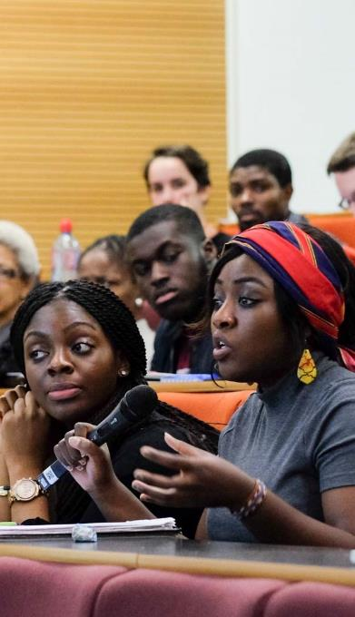
3. Increasing independent research capability around the world
Some examples at UCL:
  South Africa Studentships (2018)
  Funding was made available via the Division of Infection and Immunity for South African students to study at UCL
  Three MSc studentships are available - one a year from 2018/19 - and one PhD studentship starting in 2018
  Council for At-Risk Academics (Cara)
  Supported by UCL since 2006, enabling at-risk academics to continue research when no longer safe in their home country
African Voices “Question Time” event
(Image: Jacqueline Lau)

Slide 23
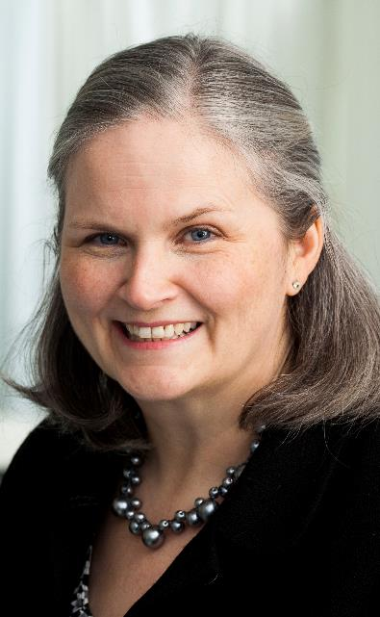
4. Marshalling our expertise in enterprise, innovation and translational research
Some examples at UCL:
UCL Consultants
  broker consultancy opportunities for UCL staff – and now some post-doctoral students – globally.
  581 international projects have generated c.£29.3m since UCLC’s inception (March 2018)
The Medical School Education Consultancy
  training medical educators from China and a major collaboration with New Giza University in Egypt; also involves Eastman Dental Institute and School of Pharmacy
Professor Deborah Gill,
Director UCL Medical School
Notes:
Professor Deborah Gill: “UCL’s Medical School Education Consultancy has been breaking boundaries in supporting high-quality, scientifically rigorous and patient-focused education and training for doctors around the world. Working with partners in China to Egypt, it’s so rewarding seeing the difference our work is making on the ground.”

Slide 24
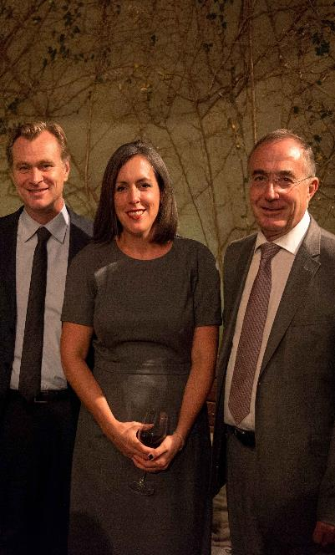
5. Strengthening our position as London’s Global University by amplifying our achievements and engaging more effectively
Some examples at UCL:
Attracting the very best students and staff to come to UCL and help solve global challenges.
15,741 students enrolled from international markets in 2017/18.
Enabling our research to have more global impact
  UCL’s School of Public Policy acts as a bridge between research and policy-making community internationally
  It’s All Academic campaign
    Philanthropic fundraising campaign to raise awareness of UCL globally
Los Angeles Fundraiser hosted by Christopher Nolan and Emma Thomas as part of UCL's It’s All Academic campaign.
Image: UCL Alumni Flickr

Slide 25
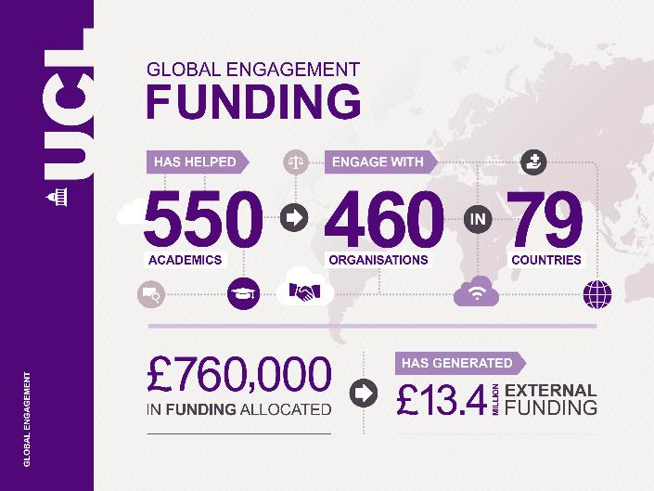
    Global Engagement Funds
Notes:
Annual internal seed funding supporting UCL academics to collaborate with colleagues based in other countries
Between £500 - £2,000 is available for activity in any Faculty (£4,000 for applicants in Faculties of Social & Historical Sciences or Arts & Humanities)
Activities supported include visits, workshops, collaborations and conferences
The funds have supported projects in countries including Mauritius, India, Thailand, France and Sierra Leone

Slide 26

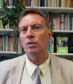




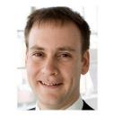
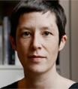
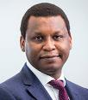
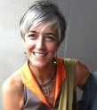

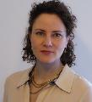
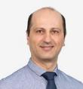
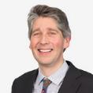

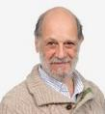
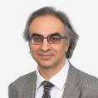
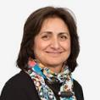
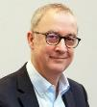
Pro-Vice-Provost (International)
Global academic network
Pro-Vice-Provosts (Regional)
Prof Dame Hazel Genn
Europe
East Asia
SE Asia & Australasia
Latin America
Africa & M.East
South Asia
North America
Prof Stephen Hart
Prof Ijeoma Uchegba
Prof Monica Lakhanpaul
Prof Claudio Stern
Prof Brad Karp
Prof Uta Staiger
Katharine Carruthers
Vice Deans (International)
Pop Health
Sciences
Laws
MAPS
The Bartlett
Medical Sciences
Prof Ibrahim Abubakar
Prof Adriana Allen
Prof Claudia Mauri
Dr Kimberley Trapp
Prof Nikolaos Konstantinidis
SHS
Engineering
IOE
Brain Sciences
Life Sciences
Arts & Humanities
Prof Patrick Haggard
Dr Ruth Mandel
Prof Claudio Stern
Prof Sonu Shamdasani
Prof Eli Keshavarz-Moore
Dr John O’Regan
Notes:
The Regional Pro-Vice-Provosts each chair regular Regional Network Meetings, which are open to academic and professional services staff from departments across UCL with an interest in a region.

Slide 27

How to get involved with the GES
Sign up to UCL’s Global Update and Regional Networks: bit.ly/GEONews
Follow us on Twitter and Instagram: @UCL_Global
Visit our website: www.ucl.ac.uk/global
Interested in discussing UCL’s global partnerships? Contact our Global Partnerships Team (www.ucl.ac.uk/global/contact-us)

