Slide 1
UCL Research Data Repository: Archiving data and other research outputs at UCL
LIBRARYSKILLS@UCL
Dr Christiana McMahon, UCL Library Services
May 2020
Notes:
The slide with no banner or footer can be used if you wish to have a slide that is just an image.
It can also be used if you want to have an image going under the banner so it shows through the UCL logo, or sliding behind the footer.
It is not ideal to insert the banner and footer like this as it has issues for accessibility. Screen readers will see the header and footer as images.
Pictures must have alternative text. To add alt text:
Right click picture and select ‘Format picture’. A menu should appear to the right of your screen.
Click on the third icon along, ‘Size and properties’ and then click on ‘Alt text’.
Enter text to describe the image in the Description box. Please note, some screen readers ignore the Title box so the alternative text should be in the Description box. If your image is purely for decorative purposes, you can just type Decorative. You do not need to include ‘picture’ or ‘graphic’ as screen reader software will automatically identify it as a picture.
Where you have lots of images or shapes making up a larger diagram, it may work better to group the pictures and then save the group as a single image to which you can apply alt text. Although you can add alt text to a group, when I tested with NVDA screen reader software, it did not read the group alt text. To group images together, select all the relevant images, right click and select Group and then Group. To save a group as a picture, right click the group, select Save as Picture. You can then delete the group from your slides, insert the saved picture and add alt text to it.
If you have inserted an image under the banner / footer by copying and pasting the header / footer, you must also give alternative text to the header and footer. If you have copied the header / footer from this slide, they will already have alternative text.
Do not use images with transparency included as any transparent areas will display as black when converted to an accessible PDF.
It is a good idea always to check reading order:
In the Home tab, under the ‘Drawing’ section, click on ‘Arrange’ and select ‘Selection Pane’.
You can drag or drop items to the correct reading order, or select the item and use the up and down arrows to move it.
This order also determines the order the items sit in layers on the screen, so be a bit careful.
The items are read in the order from the bottom of the list upwards

Slide 2
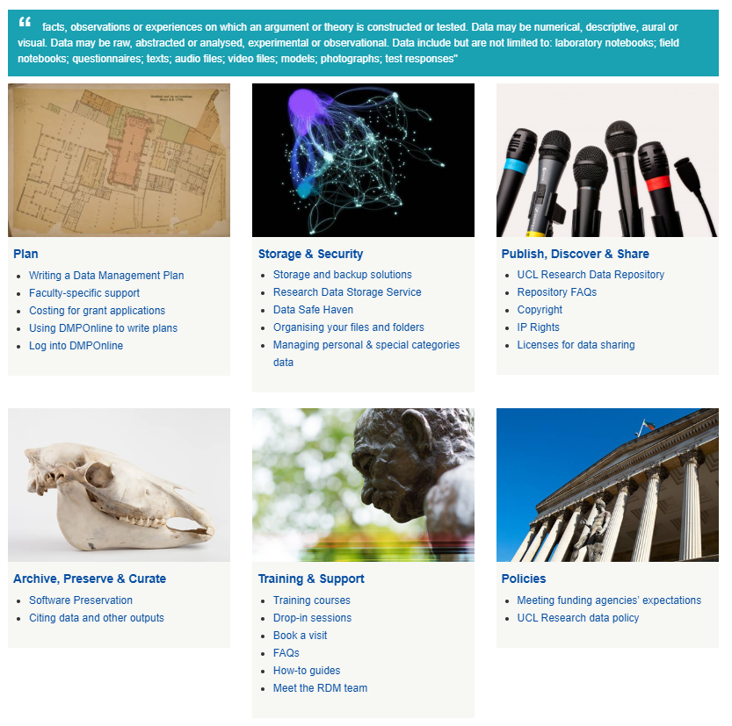
Meet the RDM team
Kirsty Wallis | Head of Research Liaison; Dr Christiana McMahon & Dr James Houghton | Research Data Support Officers
RDM covers all of the decisions made during the research lifecycle to handle research data, from the planning stage of your project up to the long-term preservation of your data and other outputs.
https://www.ucl.ac.uk/library/research-support/research-data-management
Notes:
Note that only title slides have a full UCL banner, other slides just have a narrow colour banner
You may change font size if you wish, but be consistent, and do not use more than 3 font sizes on one slide and have a minimum font size of 24pt.

Slide 3
How can we help?
Discover, access & share
Plan
Active research
Archive, preserve & curate
Writing data management plans
Adopting Open Science practices
Using the new UCL Research Data Repository
Meeting UCL and funders’ RDM expectations
Archiving, preserving and curating research outputs
Facilitating the discovery, access and sharing of research outputs
Notes:
Pictures must have alternative text. To add alt text:
Right click picture and select ‘Format picture’. A menu should appear to the right of your screen.
Click on the third icon along, ‘Size and properties’ and then click on ‘Alt text’.
Enter text to describe the image in the Description box. Please note, some screen readers ignore the Title box so the alternative text should be in the Description box. If your image is purely for decorative purposes, you can just type Decorative. You do not need to include ‘picture’ or ‘graphic’ as screen reader software will automatically identify it as a picture.
Where you have lots of images or shapes making up a larger diagram, it may work better to group the pictures and then save the group as a single image to which you can apply alt text. Although you can add alt text to a group, when I tested with NVDA screen reader software, it did not read the group alt text. To group images together, select all the relevant images, right click and select Group and then Group. To save a group as a picture, right click the group, select Save as Picture. You can then delete the group from your slides, insert the saved picture and add alt text to it.
Do not use images with transparency included as any transparent areas will display as black when converted to an accessible PDF.
It is a good idea always to check reading order:
In the Home tab, under the ‘Drawing’ section, click on ‘Arrange’ and select ‘Selection Pane’.
You can drag or drop items to the correct reading order, or select the item and use the up and down arrows to move it.
This order also determines the order the items sit in layers on the screen, so be a bit careful.
The items are read in the order from the bottom of the list upwards

Slide 4
Training and support
Research Data Management (https://moodle.ucl.ac.uk/course/view.php?id=19607&section=13)
Data management for research projects
Writing data management plans
Practical data management
Sharing and archiving
Open Science and Scholarship (https://moodle.ucl.ac.uk/course/view.php?id=19607&section=17)
Introduction
The underlying eight pillars
Open publishing – sharing results and ideas
Platforms, tools, technologies and software
Best practice - how to guides
https://www.ucl.ac.uk/library/research-support/research-data-management/best-practices/how-guides
Notes:
Note that only title slides have a full UCL banner, other slides just have a narrow colour banner
You may change font size if you wish, but be consistent, and do not use more than 3 font sizes on one slide and have a minimum font size of 24pt.

Slide 5
How does UCL define ‘data’?
According to the UCL Research Data Policy, data are:
“facts, observations or experiences on which an argument or theory is constructed or tested. Data may be numerical, descriptive, aural or visual. Data may be raw, abstracted or analysed, experimental or observational. Data include but are not limited to: laboratory notebooks; field notebooks; questionnaires; texts; audio files; video files; models; photographs; test responses”.
UCL Research Data Policy: https://www.ucl.ac.uk/isd/sites/isd/files/uclresearchdatapolicy_2018.pdf
Notes:
Note that only title slides have a full UCL banner, other slides just have a narrow colour banner
You may change font size if you wish, but be consistent, and do not use more than 3 font sizes on one slide and have a minimum font size of 24pt.

Slide 6
Summary of UCL’s RDM expectations
Which data should I keep?
Archiving, preservation and curation
Publishing, access and sharing
Create a data management plan
Data created as part of the research process
10years+ following publication or public release
Data should be “as open as possible, as closed as necessary”
General advice for researchers
When data are archived for long term preservation, these data will be made available in the most open manner appropriate
Be aware of any applicable legislation eg data protection laws
Encouraged to get an ORCID or any equivalent unique identifier
Notes:
Note that only title slides have a full UCL banner, other slides just have a narrow colour banner
You may change font size if you wish, but be consistent, and do not use more than 3 font sizes on one slide and have a minimum font size of 24pt.

Slide 7
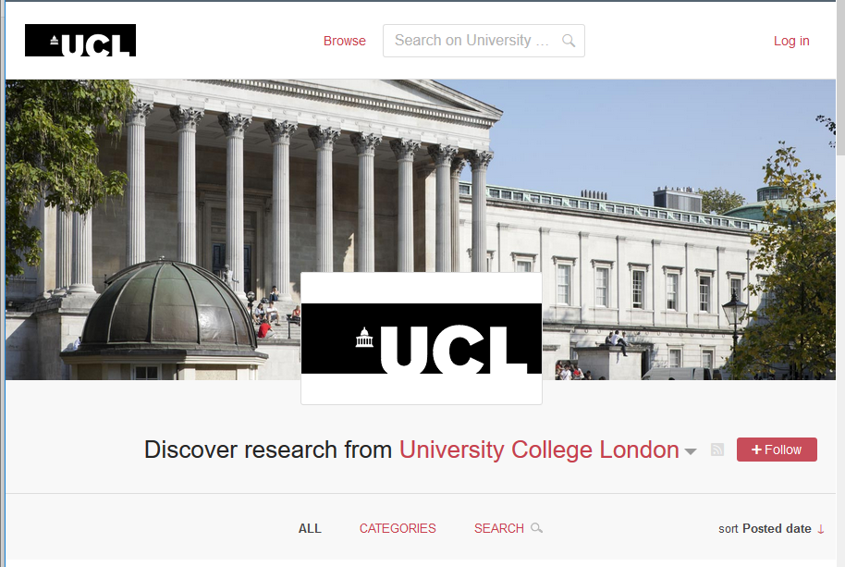
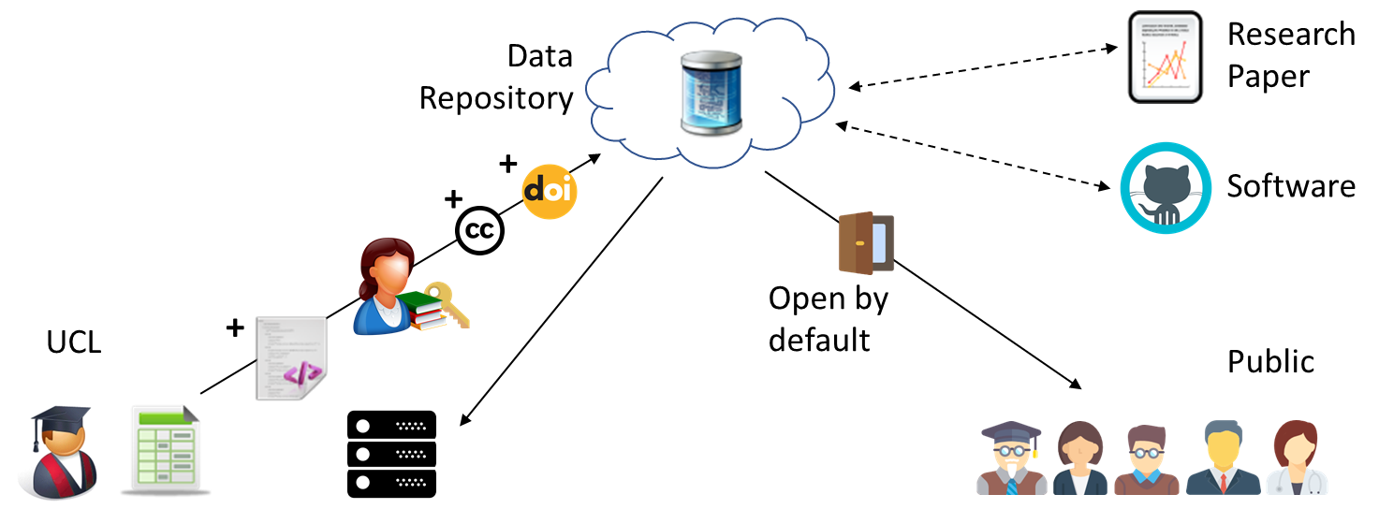
UCL Research Data Repository
Data, software code/syntax, figures, posters, presentations, data management plans, workflows and models
Helps researchers to meet UCL / funders' requirements for FAIR data
Supports almost all file types
All published items can have a DOI
Items can be embargoed where necessary
Helps provide access and data sharing
Allows researchers to securely preserve and curate outputs for medium to longer-term
Facilitates discovery of research outputs
https://rdr.ucl.ac.uk
Notes:
This is the UCL RDR.
We will publish Data, software code/syntax, figures, posters, presentations, data management plans, workflows and models - so pretty much everything except published manuscripts like papers, conference proceedings, monographs etc. These must go into UCL Discovery.
Benefits include:
If I click this link, we can take a quick look at the live system…

Slide 8
Useful links
Research data management https://www.ucl.ac.uk/library/research-support/research-data-management
Meeting funders’ expectations
https://www.ucl.ac.uk/library/research-support/research-data-management/policies/research-funders-research-data-policies
UCL Research Data Repository https://www.ucl.ac.uk/library/research-support/research-data-management/ucl-research-data-repository
UCL Research Data Repository FAQs https://www.ucl.ac.uk/library/research-support/research-data-management/ucl-research-data-repository-faqs
UCL Research Data Repository User guide https://www.ucl.ac.uk/library/sites/library/files/ucl_repository_brief_user_guide_v3.pdf

Slide 9
Contact us
christiana.mcmahon@ucl.ac.uk
lib-researchsupport@ucl.ac.uk
Notes:
Pictures must have alternative text. To add alt text:
Right click picture and select ‘Format picture’. A menu should appear to the right of your screen.
Click on the third icon along, ‘Size and properties’ and then click on ‘Alt text’.
Enter text to describe the image in the Description box. Please note, some screen readers ignore the Title box so the alternative text should be in the Description box. If your image is purely for decorative purposes, you can just type Decorative. You do not need to include ‘picture’ or ‘graphic’ as screen reader software will automatically identify it as a picture.
Where you have lots of images or shapes making up a larger diagram, it may work better to group the pictures and then save the group as a single image to which you can apply alt text. Although you can add alt text to a group, when I tested with NVDA screen reader software, it did not read the group alt text. To group images together, select all the relevant images, right click and select Group and then Group. To save a group as a picture, right click the group, select Save as Picture. You can then delete the group from your slides, insert the saved picture and add alt text to it.
Do not use images with transparency included as any transparent areas will display as black when converted to an accessible PDF.
It is a good idea always to check reading order:
In the Home tab, under the ‘Drawing’ section, click on ‘Arrange’ and select ‘Selection Pane’.
You can drag or drop items to the correct reading order, or select the item and use the up and down arrows to move it.
This order also determines the order the items sit in layers on the screen, so be a bit careful.
The items are read in the order from the bottom of the list upwards

