Slide 1
UCL International Conference: Access to Justice London, June 2018
‘What Works in Social Justice:
Questions and Answers from Advice Service Reform.’
Lindsey Poole, ASA Director

Slide 2
The ‘What Works’ Story
Robert Martinson 1927-1979
‘What Works in Juvenile Justice: Questions and answers from Prison Reform’
Michael Martinson
‘the question was not meaningless, it was loaded’

Slide 3
What works in advice services?
We don’t really know, but can identify
Drivers towards more outcomes measurement
Problems with advice outcomes research
Relationship between access to justice and outcomes
Some answers for the sector and academics

Slide 4
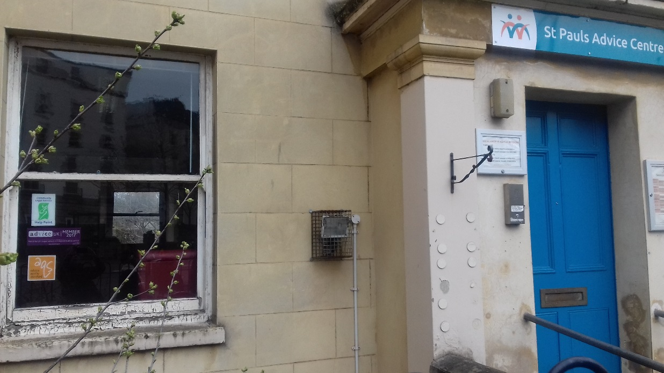

Slide 5
Drivers of outcomes measurement
Commissioning buys a ‘product’
Accountability for public spending
Government hostility/suspicion of voluntary sector
Service redesign and shift in access
Generates knowledge to support funding
Practitioner curiosity

Slide 6
Problems with advice outcomes
What outcomes to measure, what is positive?
How to measure, valid and reliable tools
When to measure to capture outcomes
Attribution of outcome to advice
Resources and skills required by services
Perverse consequences of counting things

Slide 7
Access to Justice and Outcomes
Treats the client as passive vessel for our wisdom
Ignores brutal policies and appalling administration
Good advice often preventative- nothing happened
Assumes advice is purely instrumental
Remember why we exist and who we exist for
Threatens independence of the sector
Take back control of the narrative

Slide 8
Access to Justice 1970’s style

Slide 9
Answers for the sector and academics
Large scale research on outcomes with robust methods (including control/comparison groups)
Repeat Ipsos-MORI 2015 Research
Demonstration projects
Challenge funders and commissioners on use of outcomes
Carefully consider value for the sector of small evaluations
Monitor resources spent in delivering outcomes
Sector and academics strengthen relationships

Slide 10
In an ideal world….
Large, robust research to evidence what works for whom and how
Individual advice services all routinely collect:
Local/client advice needs data
Service level data- number of clients, medium, problems presented
Client profile (to check that meets those with most need)
Quality assurance processes including independent file reviews
Dip sampling of cases and mapped against evidence base
Routine sharing of research between sector and academia

