Slide 1
More Than a Zero Sum Game
The Service Contributions of Clinical Legal Education
Professor Jeff Giddings

Slide 2
Introduction
Clinical legal education – growth & challenges
Service and student learning
Importance of effective supervision
Integrative approaches
Clinics as sites for connection and engagement
Particular service contributions

Slide 3
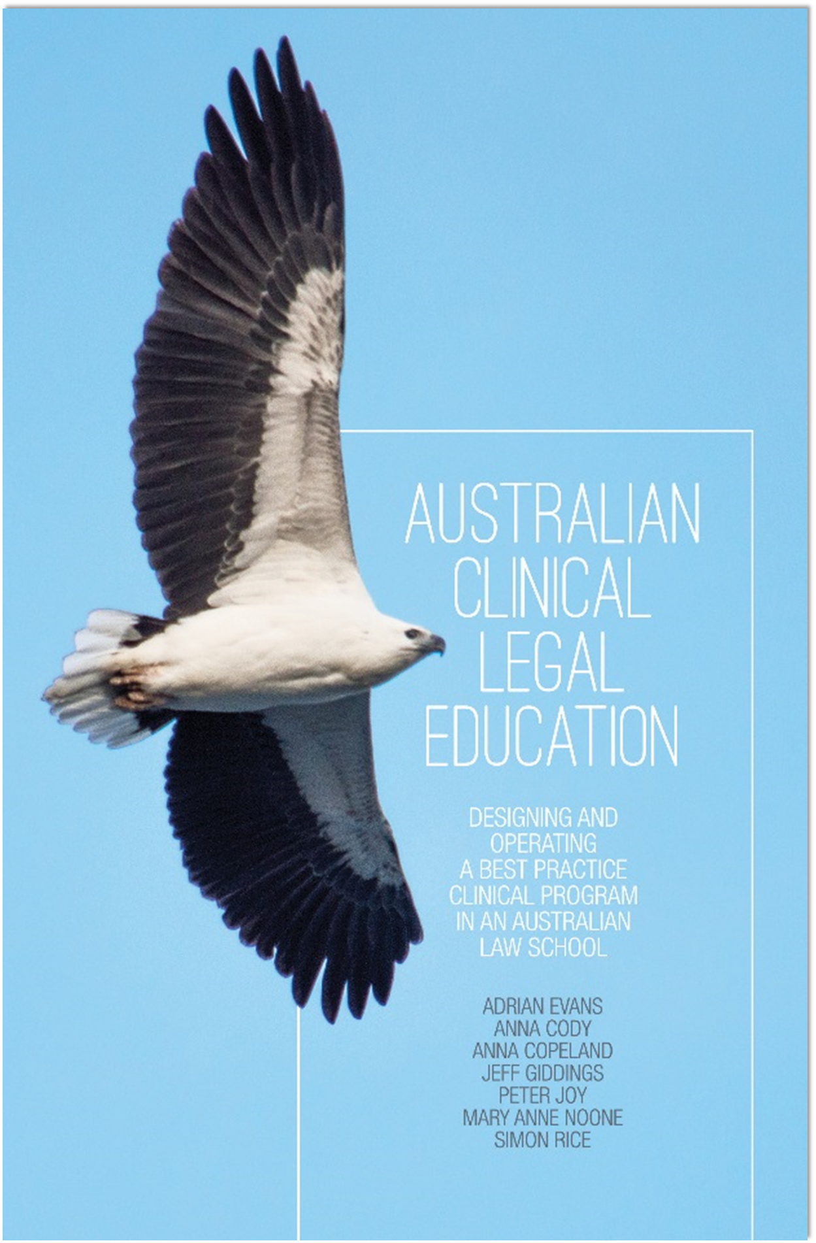
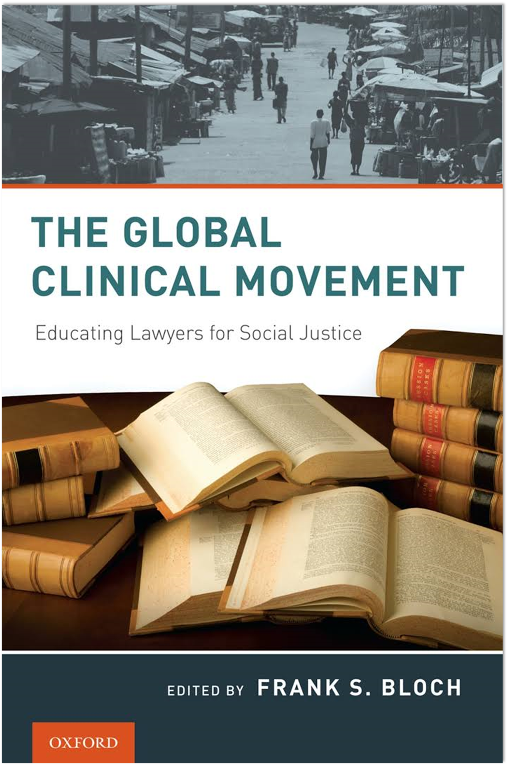
Introduction
Drawing on a range of sources

Slide 4
Clinical Legal Education
Significant aspect of legal education in a range of countries
USA, Australia, South Africa, Canada, India
Close connections to legal aid service provision
Student volunteer involvement in early legal service providers – Monash, early US programs.
Increasing prominence across Europe
Australia - Partnerships between legal aid providers and law schools
Legal aid commissions
Community legal centres
Relationships matter – you need key people to make the connections

Slide 5
Service and Student Learning
2 sides of the ‘clinical coin’
Program design is a key to enabling students to learn through work on cases
Continuity of service is critical to moving beyond the delivery of preliminary advice
Central importance of effective supervision that goes beyond delegation
Emerging university priorities – Work-integrated learning, development of graduate attributes

Slide 6
Integrative Approaches
Looking for complementarity and collaboration
Recognise different types of interests
Substantive, process, relationships
Principles – what’s fair, right, ethical, acceptable, consistency
People and organisations often have multiple interests
Interests can change over time
Effective communication designed to understand the interests and priorities of others
Are firm on primary interests & needs
Are flexible on how those interests & needs might be met

Slide 7
Integrative Approaches
Traits of integrative negotiators
Honesty & integrity
Abundance mentality
Maturity
Systems orientation
Superior listening skills
See Lewicki et al, Essentials of Negotiation
Huxham & Vangan, Managing to Collaborate
Gary Furlong, The Conflict Resolution Toolbox

Slide 8
Particular Service Contributions
Energy
Legal profession reform in Victoria
Involvement of experienced students – deepening their knowledge
Leverage
Murdoch
Monash – critical mass
Cross-disciplinary collaboration
La Trobe – West Heidelberg Community Legal Service
Monash
Fostering accessibility
Street Law - South Africa & elsewhere

Slide 9
Particular Service Contributions
Connections
The clinic as a bridge
Harnessing the substantive expertise of academics – human rights, environmental justice, social justice dimensions of commercial and property law
University of Newcastle work on police accountability, coronial inquiries
Volunteers at clinics and in other community legal centres

Slide 10
Particular Service Contributions
Ethics
Modelling and fostering effective practices
Sensitisation
Legal aid is a people business – developing the legal aid practitioners of the future
Different client types
‘Social justice radar’
Pro bono ethos
Reflective practice
Building the capacity of lawyers to address the policy and reform challenges of the future

Slide 11
Time to fly
Feel free to contact me - jeff.giddings@monash.edu

