Slide 1
Online Courts and A2J Providing Support for the Digitally Defaulted

Slide 2
CIVIL JUSTICE
September 2016 - Lord Chancellor, Lord Chief Justice, and the Senior President of Tribunals released a joint vision for the future of Courts and Tribunals
New online courts and court services to form part of a £700 million courts and tribunals reform package
Virtual hearings
A shift to a greater number of decisions ‘on the papers’
Digitisation of the probate system
Digitisation of the process of making an application for divorce
Full digitisation of applications for Lasting Powers of Attorney
The introduction of court video-link into the Police station
A new online process for resolving civil claims
Digitisation of the Social Security and Child Support Tribunal

Slide 3
Our central principles are enduring – the system must be just, proportionate and accessible to everyone – but to give them life we must take the opportunities offered by the modern world to administer our system better, and to offer wholly new, more convenient, fleeter routes to justice.
HMCTS (2018) Fit for the Future: Transforming the Court and Tribunal Estate

Slide 4
Déjà vu….
Money Claim Online first launched in 2007.
Video plea and directions-hearings for Crown Court matters were previously piloted in 2006,
‘Possession claim online scheme’ to enable individuals to instigate possession proceedings for residential properties for non-payment of rent or mortgage was initially proposed in 2006.

Slide 5
HMCTS
As of March 2018, online services are available for:
Divorce Proceedings
Online Probate Applications
Money Claim Online for small civil claims (MCOL)
Applications for Personal Bankruptcy
Online Tax Tribunal Appeals
Employment Tribunal Claims
Online Plea for Traffic Offences
Landlord Possession Claims (PCOL)
So now what…?

Slide 7
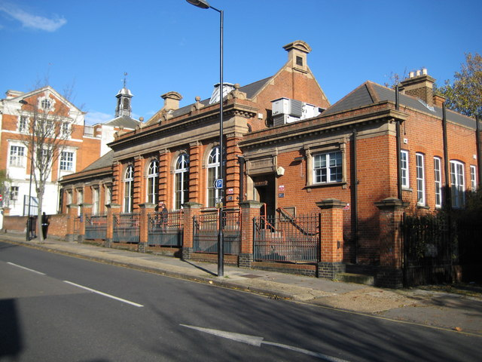
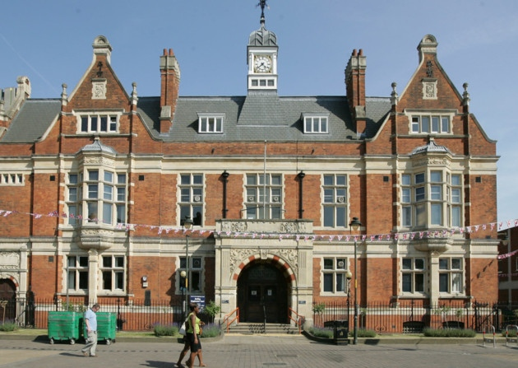
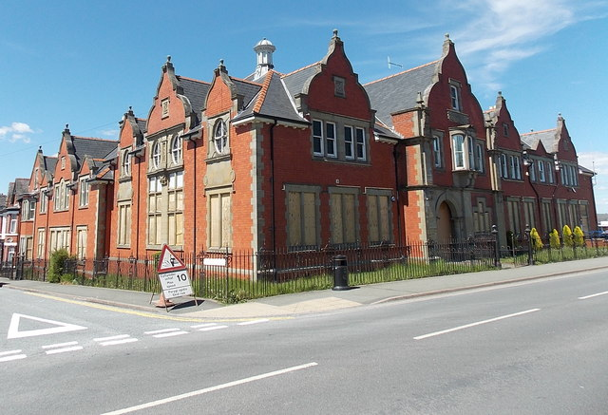
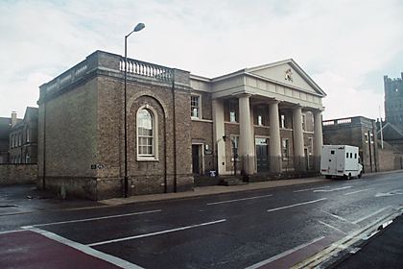
SOLD FOR £1
SOLD FOR £505,000
SOLD FOR £1,171,650
SOLD FOR £34,400
Ely
Llandrindrod Wells
Barking & Dagenham
Acton

Slide 8
GDS OVERVIEW
2011 – GDS Established
Overseen a wide-scale programme of cross-government digital change
Promote a more cohesive approach to service design
Govern the development of new services & assess services
Oversee cross-government commitment to the ‘digital-by-default’ strategy in transactional public services announced in 2012

Slide 9
GDS APPROVAL
Discovery
User needs researched & identified
Alpha
core service is built to meet the main user needs
Beta
the service is improved, then tested in private and public
PASS
PASS
Requires evaluation of the assisted digital support intended to accompany the service
LAUNCH!

Slide 10
ADS
Departments/Agencies are responsible for determining the nature and scope of assisted digital support and estimating take-up rate
HMCTS - “providing people with greater access to online services”
as well as recognising the importance of supporting individual needs, even among those who may be confident and familiar with websites
DWP – part ‘digital coaching’ and part ‘needs identification’
Assisted Digital Support
The support accompanying the rollout of digital services, provided “to those people who need it...”…
Ministry of Justice, 2018

Slide 11
GDS GRADING Top 5 Reasons for Failure
Between 26-Point & 18-Point
A number of items relating to ADS, channel shift, and success measurement were removed
PASS RATE
18-point scale
79% (n=79)
21% (n=21)
26-point scale
71% (n=99)
25% (n=35)
26-Point Standard | N | %
Criteria 10. Put in place appropriate Assisted Digital Support | 29 | 83
Criteria 9. Create a service that is simple and intuitive | 27 | 77
Criteria 2. Put in place a sustainable multidisciplinary team | 23 | 66
Criteria 13. Build a service consistent with the user experience of the rest of GOV.UK | 22 | 63
Criteria 1. Understand user needs. | 21 | 60
18-Point Standard | N | %
Criteria 1. Understand user Needs | 18 | 86
Criteria 12. Make sure users succeed first time | 17 | 81
Criteria 3. Have a multidisciplinary team | 15 | 71
Criteria 2. Do ongoing research | 12 | 57
Criteria 6. Evaluate tools and systems | 7 | 33

Slide 12
USER TYPOLOGIES
GDS User-Scale forms a cross-government benchmark against which services are assessed and against which the accessibility and complexity of an online service is evaluated.
MOJ Customer Segmentation

Slide 13
GDS GRADING
Across all 23 exemplar services evaluated, none were classified as requiring ‘expertise’ = 9.
 | Civil Claims | Employment Tribunal | Prison Booking | Lasting P.O.A
Rating | 8 | 8 | 7 | 8
User | Someone acting as a landlord or on their behalf wishing to evict tenants | Someone taking an employer to a employment related tribunal | Someone visiting a prisoner | Someone making a lasting power of attorney application
Specialist Knowledge | Some legal knowledge beneficial, not essential | Some legal knowledge beneficial, not essential | None | Some legal knowledge beneficial, not essential

Slide 14
MEASURING ADS DEMAND
Need is not a trivial matter to assess.
Estimates have tended to range considerably across services, with seemingly little consistency with regards to the measures used to determine ADS need
ACCESS
WILLINGNESS
CAPABILITY
Easy
Not Easy
Hard

Slide 15
ACCESS & WILLINGNESS
ACCESS
Data captured in CJSPS/LPRS
WILLINGNESS
GDS,CV2 & CSJPS/LPRS Data
Typically been considered a function of access
GDS research points to only 42% of non-users indicating that cost is a factor in their lack of access
Transactional digital government service use was 10% higher among those reporting a civil justice problem
Low recognition rate
Court fines (n=29), 56% obtained information from a website, yet only 36% of these went on to compete their transaction online.

Slide 16
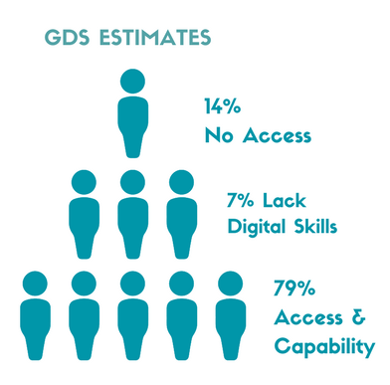
CAPABILITY
No universal definition of what constitutes ‘digital capability’
GoOnUK – definition produced in 2014 but revised 2015
Basic Online Skills = ALL of the following
Searching/Retrieving Information (Managing Information)
Sending Emails/Tweeting/Blogging (Communicating)
Buying Items from a Website (Transacting)
Complete online application forms, which include personal details (Creating)
Basic Digital Skills =
Basic Online Skills
+
The ability to 'verify sources of information found online
(Problem Solving)

Slide 17
MAPPING TO LPRS
Basic Online Skills (BOS) =
1+:
-Completing transactional government services online
-Buying goods or services
-Social Media/Blogging
-Online Banking and Managing Finances.
Basic Digital Skills’ (BOS) = ‘Basic Online Skills’
+
‘Very’ or ‘fairly confident’ in their ability to tell whether the information they find online is accurate
Not possible to directly map the aforementioned definitions of ‘Basic Online Skills’ and ‘Basic Digital Skills’ to the LPRS data

Slide 18
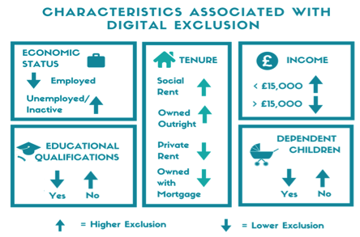
ACCESS
KEY FINDINGS
1 or more civil justice problem less likely to report digital exclusion, with the exception of those aged 75 or older
Debt, Injury/Illness and Neighbours reported higher levels of digital exclusion (stat sig only in comparison to Consumer matters)

Slide 19
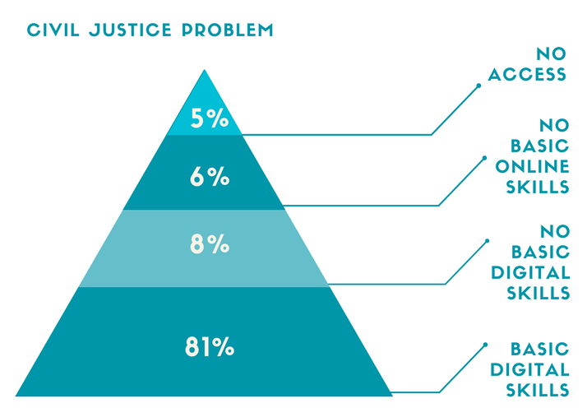
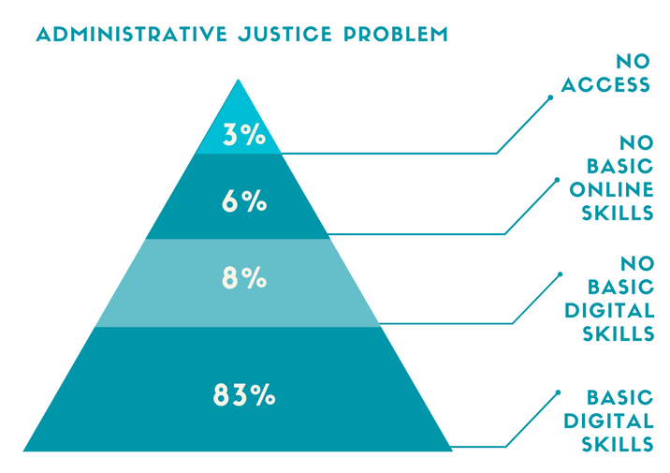
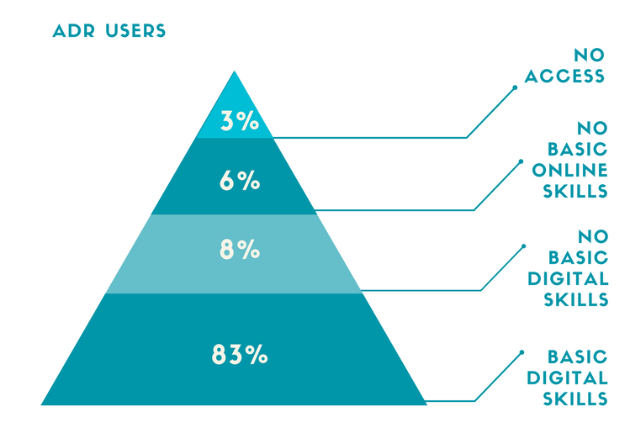
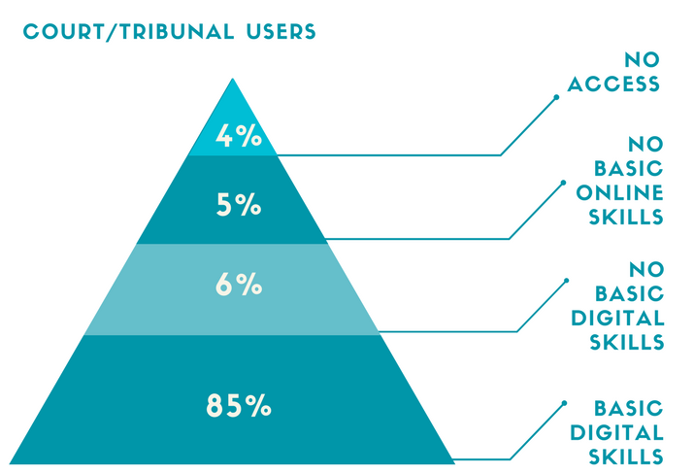
DIGITAL CAPABILITY
Those with civil justice problems routinely report higher rates of access
(Potential or actual) ADR users reported slightly lower levels of digital capability and higher levels lacking Internet access.
Those with administrative legal problems tended to have higher rates of Internet access and ‘Basic Digital Skills’ compared to those reporting civil justice problems (small & not sig).

Slide 20
£5,000,000- £9,000,000
per annum running costs of ADS

Slide 21
Includes…..
a data entry and scanning process for those who cannot engage with the online process, even with ADS
the cost of providing face-to-face ADS
the cost of advertising ADS services

Slide 22
£47,317,584
Proceeds of court sales
=
>5.2 to < 9.5 years of ADS

Slide 25
PROBLEMS
The general public is unlikely to understand the distinction between ADS and general advice services even where this distinction is made clear.
Civil Legal Advice Mandatory Gateway Review
Users expected Operators to be legally trained and offer legal advice, even although a pre-recorded introductory message informed users to the contrary.
MCOL study
Key call centre frustration:
“the inability of staff to offer advice and frustrations around what constitutes ‘advice’ as opposed to ‘legal advice’”
“the staff did not differentiate between the two and more often than not decided to give no advice rather than risk mistakenly giving legal advice

Slide 26
PROBLEMS
Understanding
Public unsure of what they are opting into
Triaging
Little has been said about the triaging process MoJ/HMCTS intends to implement for online courts, the information and guidance that will precede entry to the online court system
Disadvantage of Format
This has arisen in respect of MCOL as the character text input limitations of the online form, have resulted in a view that the paper form is often preferred.
Trust
User mistrust issues that arise out of questions asked within digital forms

Slide 27
MODELS
Web-chat, face-to-face appointments whilst avoiding use of paper solutions in general.
GDS encourages service developers to implement a triage service to establish if ADS is actually required, and to determine the type of ADS required
Universal Credit – DWP
Directs users to a point of access CABx, JobCentre, Libraries
If the user is unable to access services via these methods, then they may be given the opportunity to make a claim over phone, or arrange for a home visit
March 2017 – Digital Strategy
Those who require assisted digital must enter through a mandatory telephone gateway.
Users without Internet access are “oriented to the locally available public terminals
Help with Fees
Personal Support Units (PSUs) located inside courts were used as access points for the ADS
No findings published
Online Plea Service
Online Plea Service has a call centre
Users require an internet-enabled device to facilitate online completion
Home Office
For telephone support applicants are referred to a Migrant Help UK advisor.
For face to face support - book time with library staff or arrange a home visit from ‘We Are Digital.’
Nothing if you’re living overseas

Slide 28
WHAT WE NEED
Detail around how HMCTS intends to define those in need of/eligible for ADS
Impact on Court operations
Extent to which Courts will be charged with determining eligibility
The rationale for adopting a particular ADS mode
Increased transparency around how ADS services will be funded
An evaluation of how this aligns with projected reductions in court funding/staff numbers
More info re: how the current services deployed will seamlessly map together
Consistent approach to publishing service metrics on the performance dashboard, including rates of incomplete or erroneous digital form completion.

