Slide 1
A framework for the analysis and comparison of legal aid structures
Anna Barlow

Slide 2
Is there a better way to arrange the machinery of legal aid?
Is there a best way?

Slide 4
Money
Outcomes
Needs

Slide 5
The machinery of legal aid in the Nordic countries, the UK and the Republic of Ireland

Slide 7
 | Finland | Sweden
% eligibility | 75% | 43%
Contributions | 0 - 100% | All pay at least 60€ for mandatory advice, then 2 – 40%
Legal expenses insurance | Can’t get legal aid if have insurance which covers case, but LA may cover insurance excess and work needed beyond the limit of the insurance | Can’t get legal aid if have or ought to have had insurance which covers the case
Public defender or criminal legal aid? | Both | Public defender
Legal aid delivery | State Legal Aid Offices for all advice and over 60% of all matters. Private lawyers can undertake court cases or matters where there is a conflict | Private lawyers and non-lawyers

Slide 8
 | Finland | Sweden
Decisions-makers | Legal Aid Offices | Mostly courts; some decisions by Legal Aid Authority (government department)
Scope | Almost unlimited | Advice, unlimited; representation, list of excluded matters and further list excluded unless special reasons
Merits | Not covered if: minor importance to client; manifestly pointless in view of the benefit sought; abuse of process; or the right was assigned in order to obtain legal aid | Covered if the need for help cannot be met any other way and it is reasonable for the state to pay the legal costs, having regard to the type, importance and value of the case and the other circumstances of the case
Extent | 80 hours Appeals automatically included | 100 hours Appeals automatically included
Cost (2014) | 12€ per capita | 26.50€ per capita

Slide 9
Which is better?

Slide 10
Potential criteria for judging legal aid machinery:
fit for environment | does the scheme match its legal and cultural context?
coherent | do the rules demonstrate internal consistency and are they in accordance with the stated principles and policies of the scheme?
logical | are there elements of the scheme which make no sense?
lawful | do elements of the scheme breach domestic or international law?

Slide 11
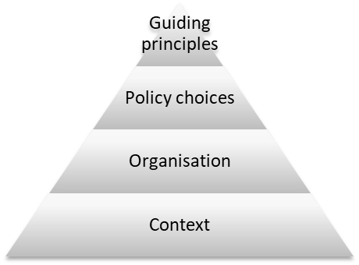
Potential framework for judging legal aid machinery:

Slide 12
Spectrum of positions of principle
Commitment to the rule of law and the principle of fair trial |  | Commitment to fulfilling only constitutional and international obligations concerning legal aid
Legal aid is a justice issue |  | Legal aid is a social issue
Legal aid is the main element of access to justice |  | Legal aid is a minor player in access to justice
Costs control is paramount |  | Independent decision-making is paramount

Slide 13
Choice on policy
Legal aid decisions by courts |  | Legal aid decisions by government
Focus on advice and assistance |  | Focus on court representation
Legal aid should cover all case types |  | Legal aid should cover few case types
Public defender scheme | or | Criminal legal aid
No reliance on merits test |  | Significant reliance on merits test

Slide 14
Amongst the organisational choices to be made are:
Access arrangements
Whether provision is to be through private practitioners or state-employed lawyers
Payment arrangements
The detail of scope restrictions,
The details of the merits test
Financial eligibility details

Slide 15
External to the justice system
Poverty levels
Public ‘litigiousness’
Availability of other sources of funding for advice or litigation (e.g. insurance)
Affordability of private lawyers
Within the justice sphere
Access to justice budget
Diversion of cases to non-court resolution mechanisms
Level of assistance for litigants from court during hearings
Complexity of laws
Nature of hearings

Slide 17
Thank you

