Slide 1
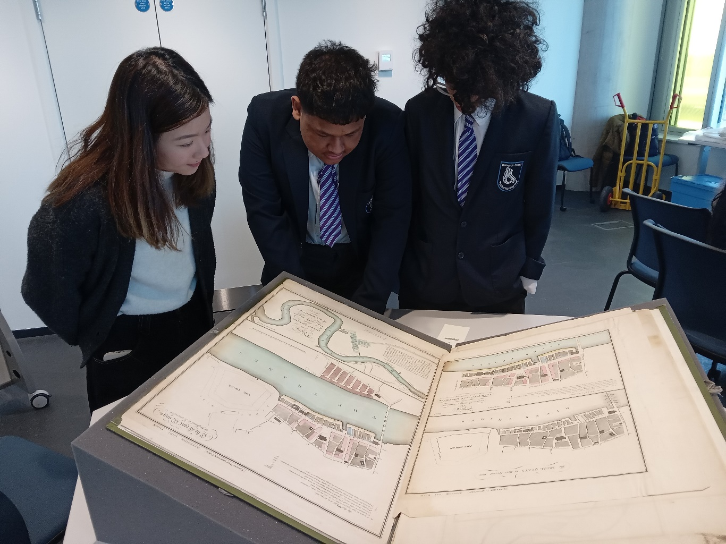
Creative Career Talk
Chelsie Mok
Teaching and Collections Coordinator
UCL Special Collections

Slide 2
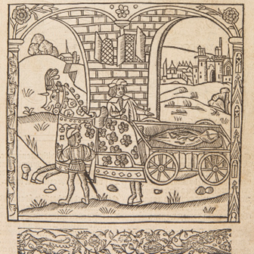
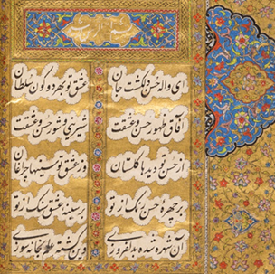
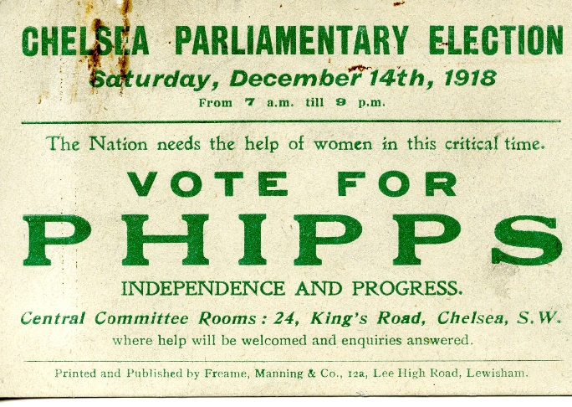
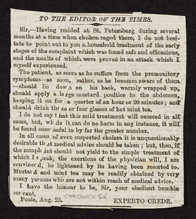
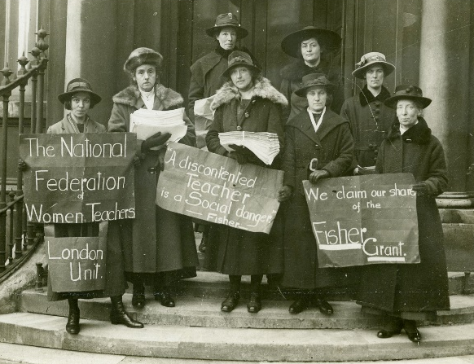
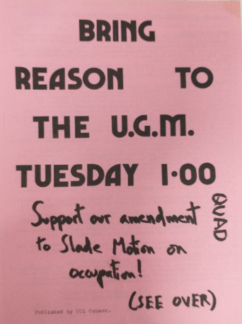
Plan for the talk
A bit of myself
What is UCL Special Collections?
Job hunting tips!

Slide 3
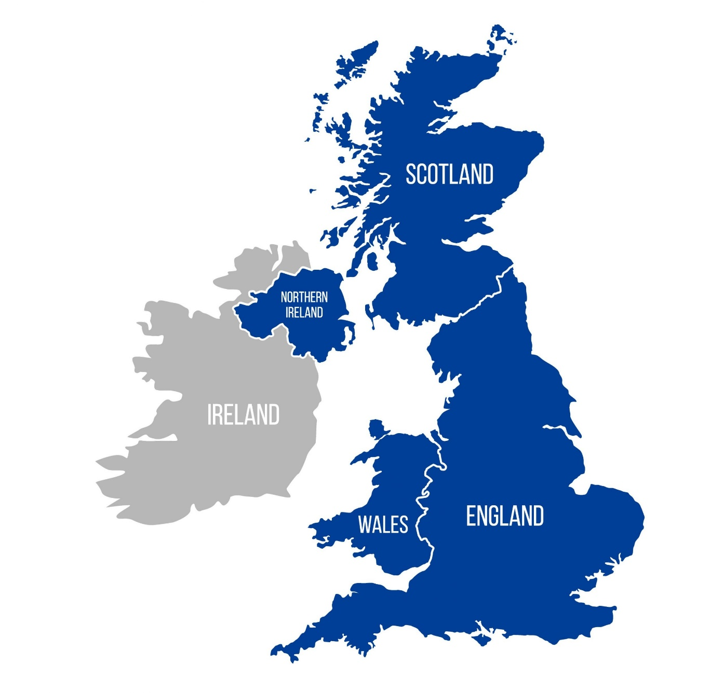
A bit of myself!
Visitor Experience Assistant
National Museum of Scotland
MA Cultural Heritage Management
University of Sheffield
Trainee Heritage Assistant
Suffolk Archives
Teaching and Collections Coordinator
UCL Special Collections

Slide 4
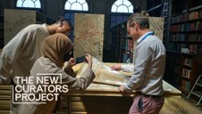
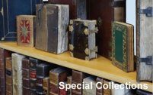
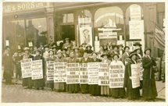
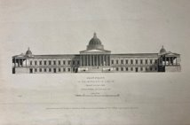
Teaching and Collections Coordinator
My role splits into three parts:
Support Outreach team in school visits and outreach activities
Support Academic Liaison Librarian/Archivist in teaching sessions
Manage collection item’s circulations between Bloomsbury and East

Slide 5
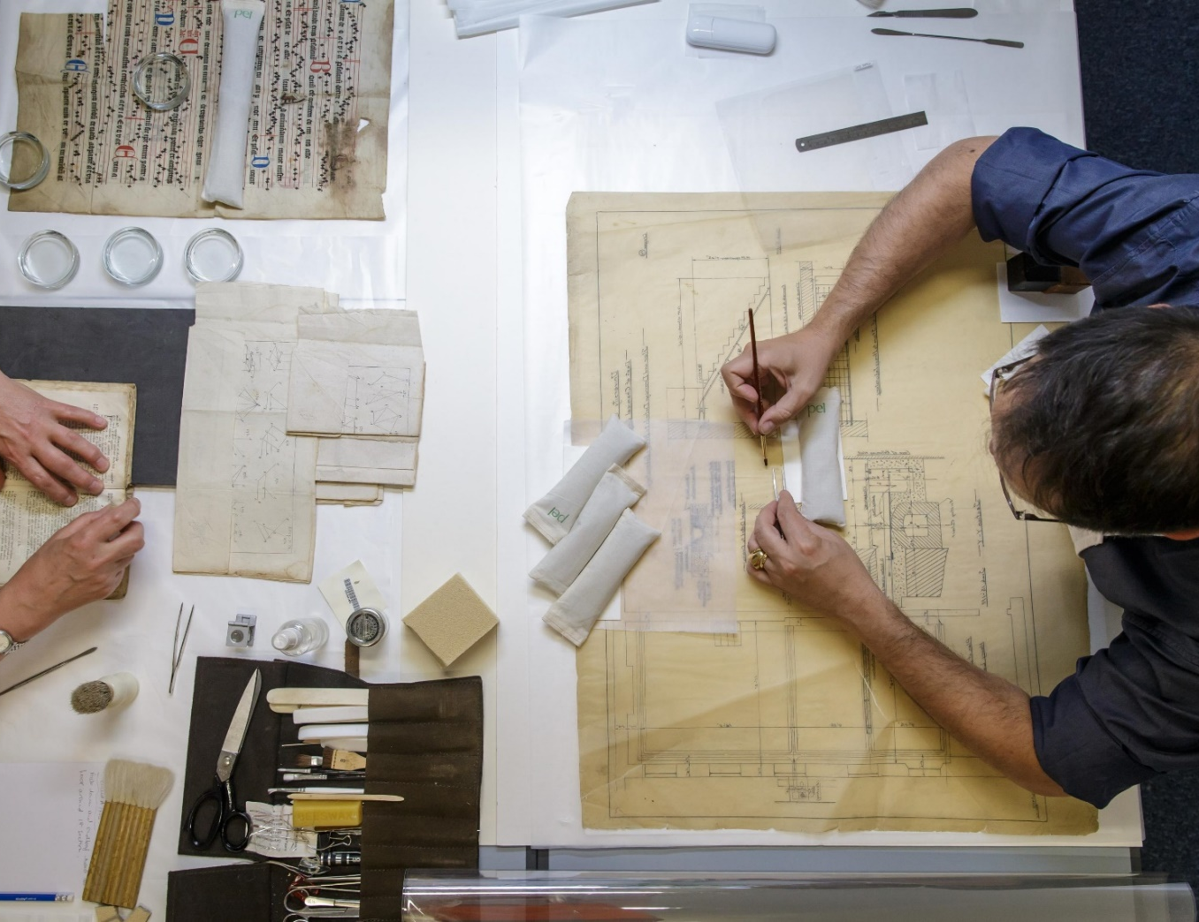
UCL Special Collections
Special Collections is a part of Library Services and School for the Creative and Cultural Industries
Archives
Photographs, maps, diaries and journals, UCL records
Manuscripts
Rare books

Slide 6
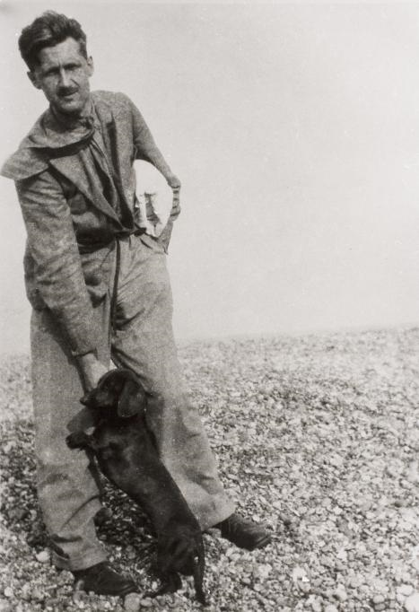
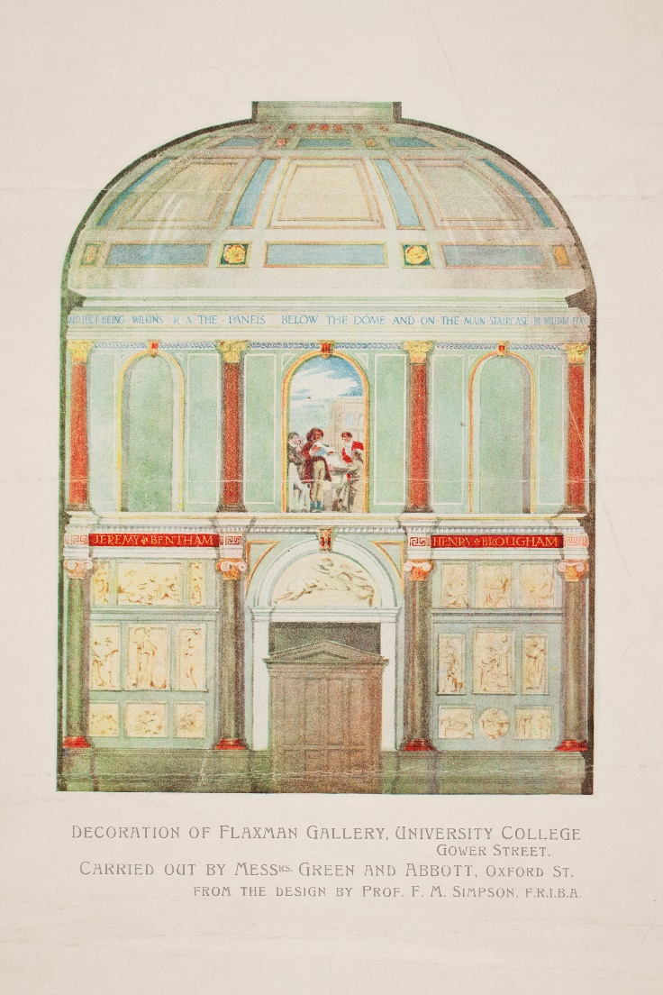
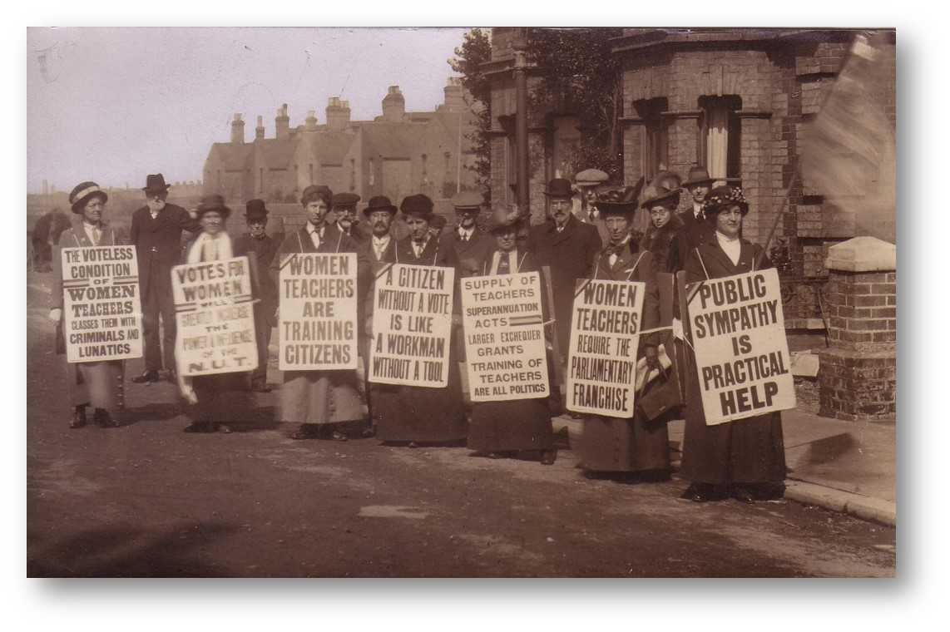
Archives

Slide 7
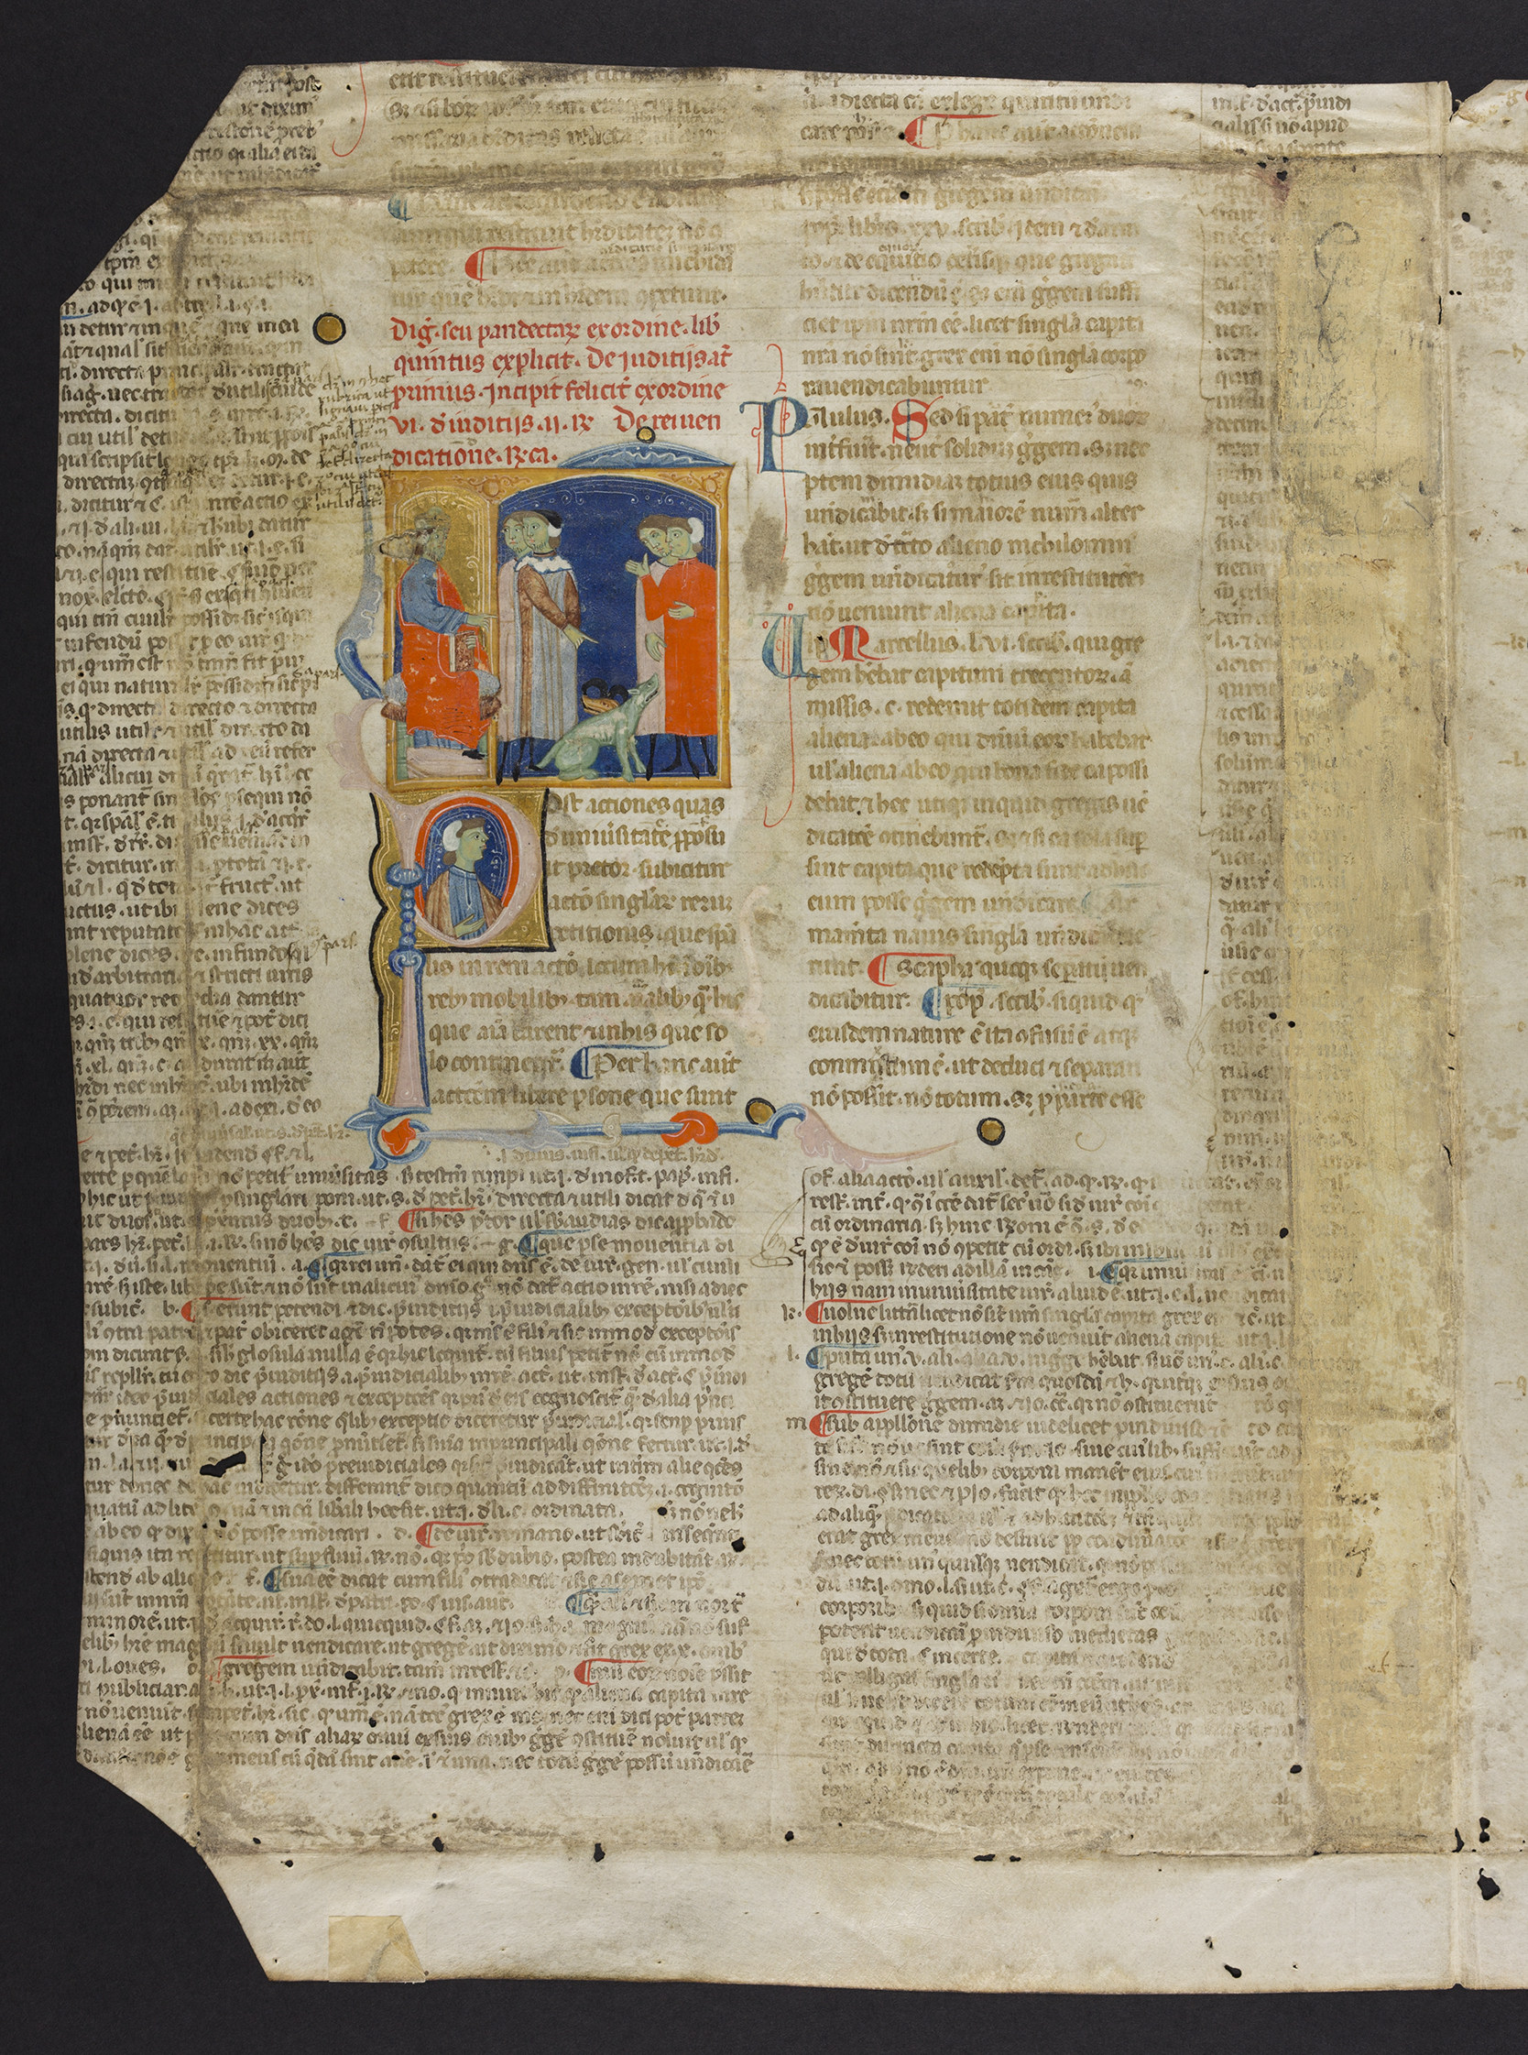
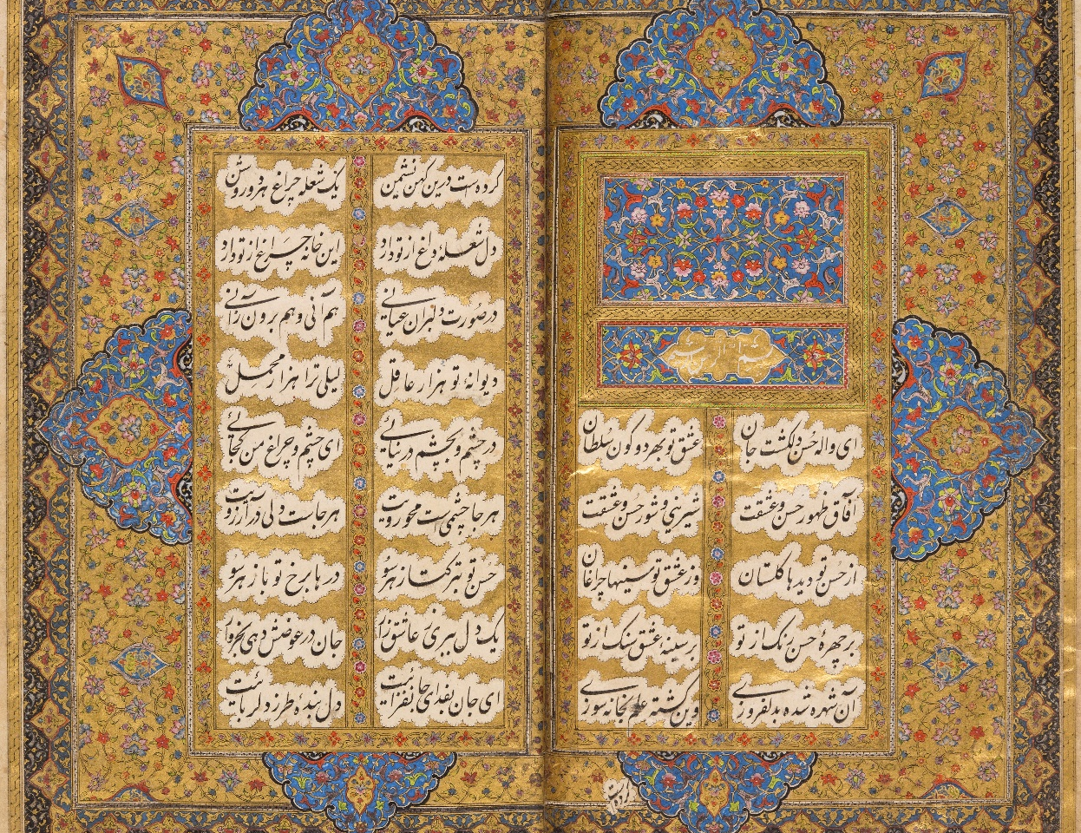
Manuscripts

Slide 8
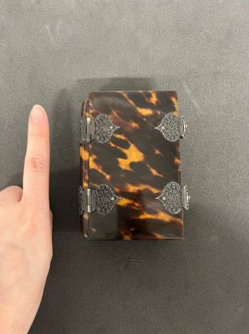
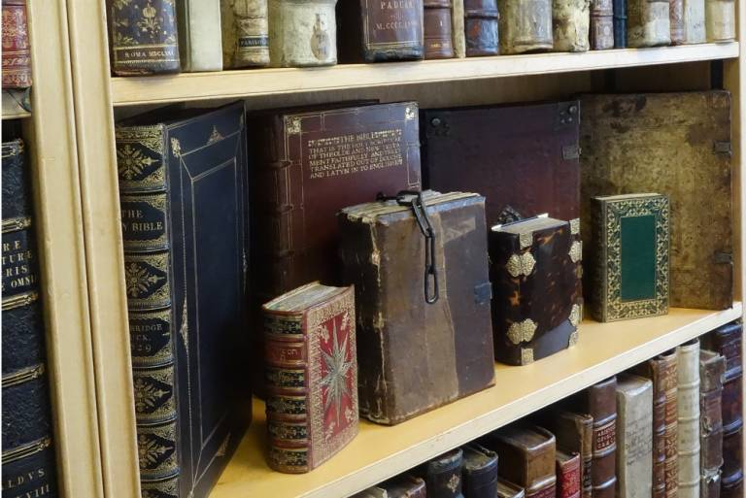
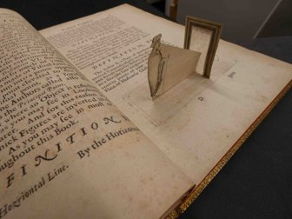
Rare books

Slide 9
Job hunting tips
Be open-minded and don’t be afraid to ask questions
Volunteering and trainings
Arrange chats with industry professionals and networking

Slide 10
Be open-minded and don’t be afraid to ask questions
Open to every opportunity and embrace challenges
The more you ask, the more you’ll know
Company can get a diversity of thoughts
Promote yourself and help your career

Slide 11
Volunteering and trainings
Volunteering
Learn new skills and improve sector knowledge
Keep up with industry trends
Get work experience
Free/paid short courses
FutureLearn
The Group of Education in Museums
Museums Association
Universities short courses

Slide 12
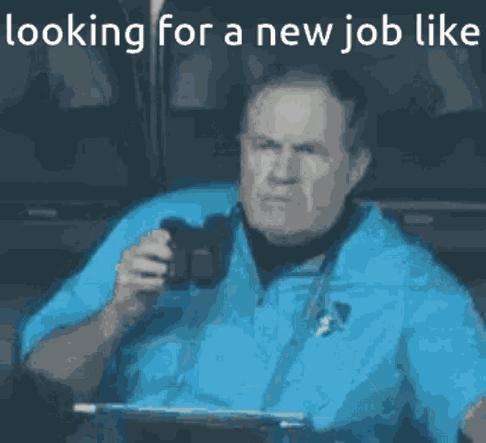
Arrange chats with industry professionals and networking
Chats with industry professionals
Seek career advice, support and even job opportunities
Networking
Build up industry connections
Gain fresh ideas and new information

Slide 13
Some useful links
Entering the Sector - Museums Association
University of Leicester Jobs Desk
Museum Jobs
National Museum Directors’ Council
Association of Independent
Museums
English Heritage
Historic England
Museums Galleries Scotland
Historic Environment Scotland
Myjobscotland
Archives & Records Association

Slide 14
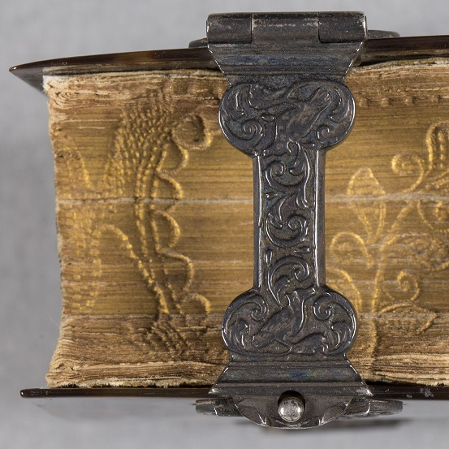
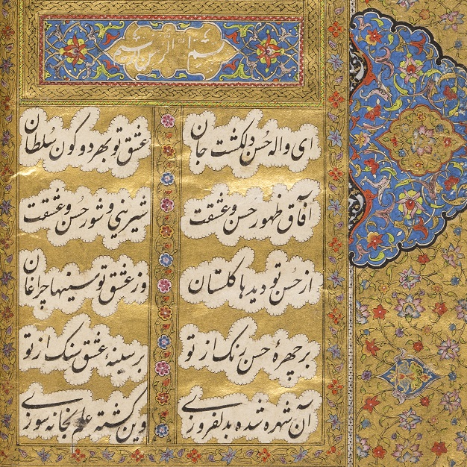
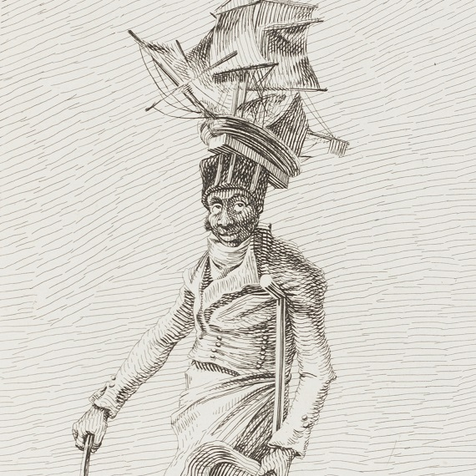
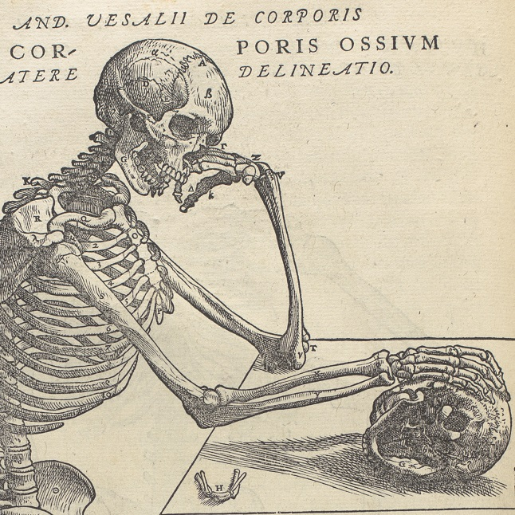
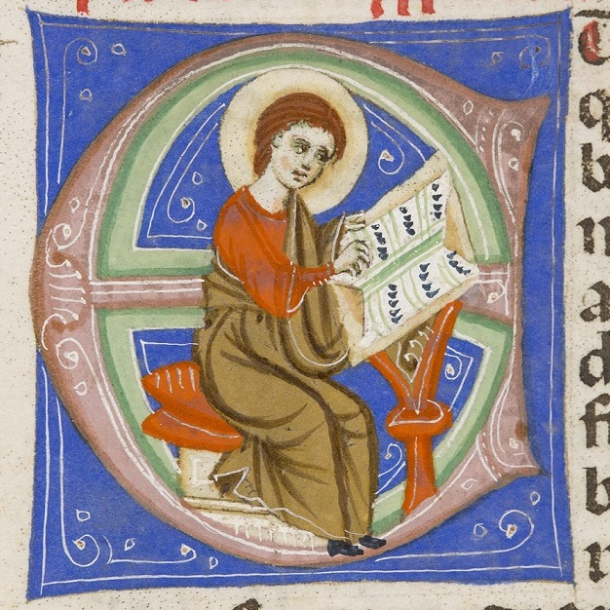
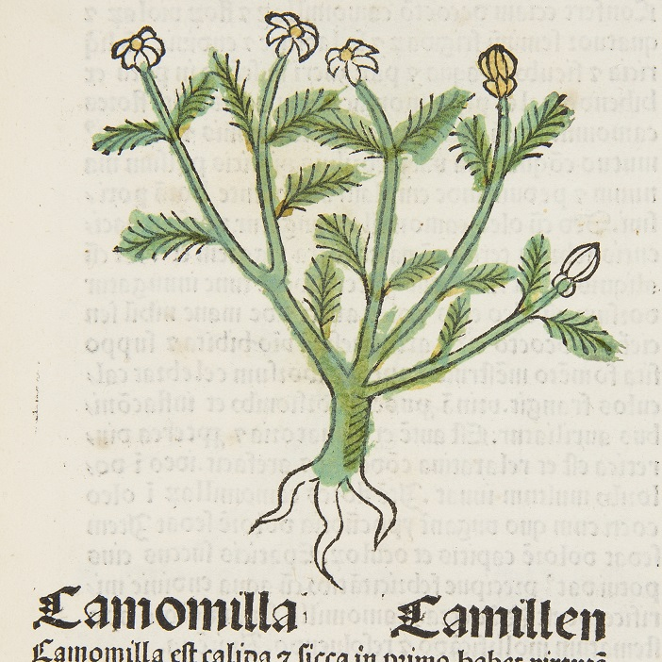
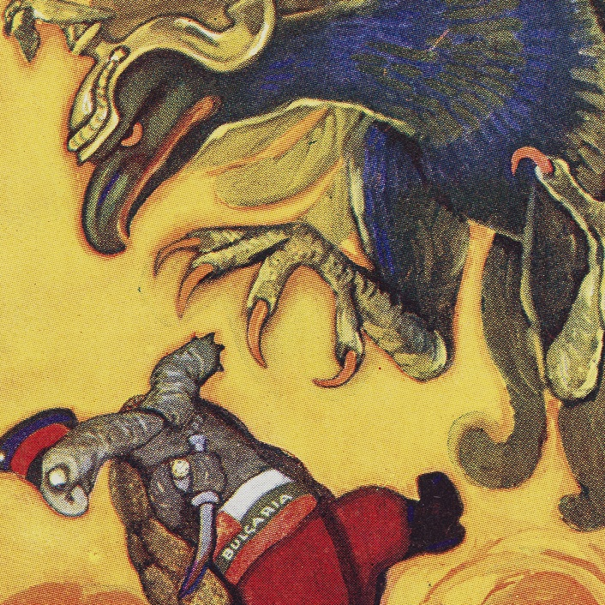
Thank you Good luck!
Any questions?

