Slide 1

INSTITUTE OF CLINICAL TRIALS AND METHODOLOGY
^{ICTM All Staff meeting}
^{Nick Thomas}
^{Institute Manager}
_{10 December 2018}

Slide 2
^{Agenda}
 | Welcome | Mr Nicholas Thomas, ICTM Manager
10.00 | MHRA Inspection | Max Parmar
10.05 | EDIT Update | Fleur Hudson
10:15 | MyHR Briefing | Helen Brown, HR Projects
10:40 | HR Update- Appraisals | Carole Booth, ICTM HR Manager
10.50 | HipVac Trial Results | Kate Bennett, CCTU
11.00 | ICTM Facilities | Rachel Martino, MRC Unit Manager
11.10 | Stampede Trial - the addition of a new arm for oligometastatic disease | Louise Brown, Statistician, Cancer
11.20 | Closing remarks | Nicholas Thomas, ICTM Manager

Slide 3
MHRA Inspection
An inspection of MRC CTU from the Medicines and Healthcare products Regulatory Agency (MHRA) has been confirmed
It will take place over 4 days from Monday 14 January to Thursday 17 January 2019

Slide 4
INSTITUTE OF CLINICAL TRIALS AND METHODOLOGY
^{EDIT update}
^{Fleur Hudson}
_{10 Dec 2018}

Slide 5
Staff Survey
Is now closed!
Thanks to everyone who found time to respond

Slide 6
Staff survey
231 people have responded overall.
86% completion rate
Up 12% on the last application survey

Slide 7
Timelines
Dec 2018
Analysis and review of survey data
First draft of application sections completed by Dec 14th
Inform UCL of intention to submit in April
Jan 2019
• Finalisation of draft application and action plan
• Send draft to central UCL for review by 30th January

Slide 8
Feb- Mar 2019
Mock Athena Swan panel review by central UCL EDI – early Feb
Amendments to the application based on feedback
Review of application by Director
April 2019
Final checks and edits
Sign off
Submit Application by 30th April
Late summer/early Autumn
Award results made public

Slide 9
Work still continues
May ask for additional focus groups or information if issues arise from the survey
Looking to the next award period and having new EDIT members- if you are interested in joining the committee or an associated group ( ECN, wellbeing, mentoring) raise this at your PDR
Plan a second Athena Swan week early in the Autumn 2019

Slide 10
INSTITUTE OF CLINICAL TRIALS AND METHODOLOGY
^{MyHR Briefing}
^{Helen Brown}
^{HR Projects}
_{10 Dec 2018}

Slide 11
MyHR Overview
Helen Brown
10 December 2018

Slide 12
What’s Going and What’s Coming from the 4th February
HR/Payroll Database (ResourceLink)
HR/Payroll Database
(Oracle HR/Finance integration)
MyView Self Service
MyHR Self Service
Course Booking (LERS/ STBS)
MyLearning Online Course Booking
SiP (Service in Partnership)
MyHR Workflow
Reporting (DAM / Infoview)
Oracle Reporting and Dashboards
Reminder systems
MyHR Notifications and Reminders
Notes:
Existing HR/Payroll database ResourceLink will be replaced with Oracle HR / Payroll
MyView Self Service will be replaced with Oracle self service – including accessing payslips and booking annual leave
Existing course booking systems – Learning Event Records System and the Single Training Booking System will be replaced with the Oracle training module (MyLearning)
Service in Partnership (SiP) will be replaced by Oracle functionality – MyHR Workflow … this training session. Training in each role (contracts, changes and payments is mandatory to receive a log on). No training no access!
The existing reporting tool (Departmental Administrator Module – DAM and Infoview) will be replaced with the Oracle reporting tool (OBIA). Dashboards that can be configured and reports refreshed by departments.
Existing reminder system (probation, appraisal reminders) will be replaced by notifications from Oracle.

Slide 13
MyHR
Employee and Manager
Self Service

Slide 14
Self Service - Changes to Absence
Changes to Absence
This relates to requesting and recording absence (annual leave)
What is changing?
Annual Leave will be deducted based on work pattern recorded for the days being booked
Annual leave will be recorded and visible in hours but bookable by day
Minimum period to be booked will be half a day
There will be automatically be a five day carry over for annual leave (it will no longer be at discretion of managers) . Policy will be changed to reflect this.
Manager/Absence administrator will record the start of the absence, but there is ability for individual to record themselves back

Slide 15
Employee and Manager Self Service Overview
What’s changing:
Employees will be able to:
Update and maintain equalities data (visible to employee only)
update and maintain professional and qualifications
Update bank details (and processed directly to Payroll)
Employees will be able to request absence, including annual leave - Enhanced functionality for annual leave including full automation of leave calculation for part timers (Managers and Self service administrators will be able to enter on behalf of the employee)
request changes to working patterns (within existing FTE) (Managers and Self service administrators will be able to enter on behalf of the employee) Includes approval process
View clinical contract information (visible to Managers and Self service administrators )
View, and update changes to clinical registration information (approval by Manager/self service administrator)
View DBS and Right To Work status
Update onsite and offsite locations
Managers will be able to:
manage changes to reporting lines (post to post reporting)
Record probation stages and outcomes (visible to employee)

Slide 16
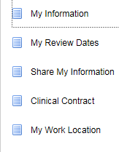

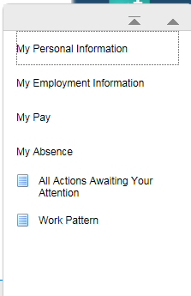
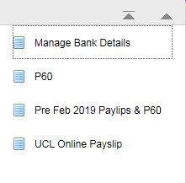
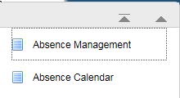
Employee Self Service
Employment Information
Personal Information
Pay
Absence

Slide 17
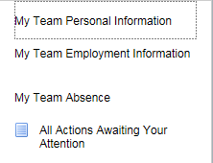
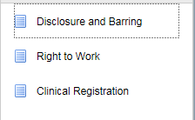
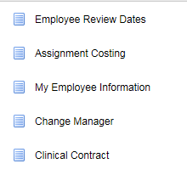

Manager Self Service
Personal Information
Employment Information
Absence
Notes:
Managers will be able to view info for all in-direct reports (anyone reporting to their direct reports)

Slide 18
MyLearning
What’s Changing?
Ability to create learning paths at individual or organisational level
Online course booking for multiple training providers and key courses
Course booking integrated with standard Oracle dashboard
Online course booking for non UCL employees

Slide 19
MyHR Workflow
(SiP replacement)

Slide 20
MyHR Workflow (SiP replacement) – What’s Included
Contract of Employment
New Contract
Change of Appointment
Change of Hours (FTE)
Payments and Allowances
One off payment to employee
Transfer of appointment
Additional appointment
Rehire
Change to funding
Extension of appointment
Change of working pattern
Termination of appointment
One off payment to non employee
Clinical allowances
Acting up allowance
Honorarium
Position Management (Financial Approval)
Notes:
Contracts – different way of submitting forms. Not one form per contract type but one form per type of action. For example transfer of appointment. The system works this way so that once the workflow is approved the necessary action is automatically taken and the record in Oracle created or updated.
Financial approval will be managed on a workflow and not via emails. A workflow will be submitted to Finance and once approved the position (post in ResourceLink) will be automatically created and a notification sent back to the contracts administrator. All Finance teams (NHS Billings, Research and School Finance) will also be providing positions prior to advert otherwise you cannot submit a contract request. The processes are being worked through to ensure this is a swift process.
Changes of appointment and payments / allowances will be covered in more detail at the appropriate training sessions.

Slide 21
Any Questions?
If you have any questions about the MyHR project please email us at MyHR@ucl.ac.uk
You can also find more information at the MyHR website

Slide 22
INSTITUTE OF CLINICAL TRIALS AND METHODOLOGY
^{HR update - appraisals}
^{Carole Booth}
^{HR Manager}
_{10 Dec 2018}

Slide 23
End of Year – Key Dates
Appraisals 2018/9:
Appraisal completion by 31 March 2019
Objectives in place by 31 March 2019
Support available:
Briefing sessions on appraisal process (19 Dec for people managers; 23 Jan for individuals)
Briefing sessions on managing challenging conversations – for people managers (30 Jan and 13 Feb)
ECN sponsored drop in session to support completion of documents (7 Feb)
Appraisal Toolkit, Career Development Toolkit and documents
https://www.ucl.ac.uk/clinical-trials-and-methodology/intranet/hr/appraisals-development-promotion
Academic/Research Promotion (to UCL Grades 7 & 8):
Applications in to ictm.hr@ucl.ac.uk by 8 Feb 2019
ICTM Committee on 25 Feb 2019
Faculty Committee in April 2019
Support available:
https://www.ucl.ac.uk/human-resources/policies-advice/academic-careers-framework-and-promotions-processes/academic-promotions-guidance#process-7-8

Slide 24
The HIPvac trial – Results
10th December 2018
Kate Bennett
Statistician
CCTU

Slide 25


Slide 26
What do we have in common?
Wealth? Status?
Taste in hats?
Annus horribilis
ER: 1992
Anus horribilis
KB: 2018

Slide 27
My Annus Horribilis
Or
The Final Analysis

Slide 28
The Trial
Human papillomavirus infection: a randomised controlled trial of Imiquimod cream (5%) versus Podophyllotoxin cream (0.15%), in combination with quadrivalent human papillomavirus (qHPV) or control vaccination in the treatment and prevention of recurrence of anogenital warts
(HIPvac Trial)

Slide 29
Background
Anogenital warts are the second most common sexually transmitted infection diagnosed in sexual health services in the UK.
Lack of evidence to guide choice of treatment; two most commonly used are self-administered topical agents, podophyllotoxin and imiquimod, have not been compared in a large RCT.
Recurrence after treatment is common; it has been suggested that imiquimod treatment leads to a lower rate of recurrence.
Quadrivalent HPV (qHPV) vaccination is effective in preventing HPV 6/11 infection, and disease, but its effect to prevent wart recurrence is unknown.
Notes:
Chlamydia is the most common

Slide 30
Objectives
To compare the efficacy of imiquimod (IMIQ) 5% cream or podophyllotoxin (PDX) 0.15% cream to treat anogenital warts
To determine whether qHPV vaccine (Gardasil®, Merck) increases wart clearance or prevents recurrence.

Slide 31
Methods (1)
Design: Multi-centre, partially-blinded 2x2 factorial design RCT, in 22 sexual health clinics in the UK.
  Topical treatment: open-label, 1:1 randomisation, stratified by gender, previous warts, HIV-status, to IMIQ 5% (for up to 16 weeks), or PDX 0.15% cream (for 4 weeks, but extended up to 16 weeks if warts persist).
  Vaccine: blinded, 1:1 randomisation to Gardasil® or saline control (3 doses at 0-2-6 months).

Slide 32
Methods (2)
Inclusion criteria: patients age 18+ with new or recurrent anogenital warts
Exclusion criteria: treatment for warts in the past 3 months; previous qHPV vaccine; contraindications to any of the products (previous intolerance, pregnancy, lactation); a total wart area in excess of 4 cm²; patients requiring topical steroids applied to the affected area, or on systemic immunosuppressive agents. Patients living with HIV were initially excluded but allowed, after a protocol amendment.

Slide 33
Methods (3)
Endpoints: Composite primary outcome of wart clearance at 16 weeks and remaining clear to 48 weeks; analysis carried out on multiply imputed datasets due to high rates of loss to follow-up.
Sample size: Planned sample size initially n=1000 but reduced to n=500 because of recruitment delays.

Slide 34
Key participant characteristics
506 participants randomised (of whom 3 excluded: n=2 not started; n=1 ineligible); 503 included in the analysis
Mean age 31 years
66% male (20% of males MSM)
50% previous warts
2% known HIV+

Slide 35
Results
Outcome | Topical treatment effect (IMIQ v PDX) | Vaccine effect (qHPV v placebo)
 | aOR (95% CI) | aOR (95% CI)
Primary outcome
Wart clearance by 16 weeks and remaining wart free until 48 weeks | 0.81 (0.54, 1.23) | 1.46 (0.97, 2.20)

Slide 36
Outcome | Topical treatment effect (IMIQ v PDX) | Vaccine effect (qHPV v placebo)
 | aOR (95% CI) | aOR (95% CI)
Clinically important secondary outcomes
Wart free by 16 weeks | 0.77 (0.52, 1.14) | 1.30 (0.89, 1.91)
No recurrences by 48 weeks following clearance by 16 weeks | 0.98 (0.54, 1.78) | 1.39 (0.73, 2.63)

Slide 37
Outcome | Topical treatment effect (IMIQ v PDX) | Vaccine effect (qHPV v placebo)
 | aHR (95% CI) | aHR (95% CI)
Time to complete wart clearance | 0.77 (0.60, 0.97) | 1.24 (0.99,1.56)
Time from wart clearance to recurrence | 1.07 (0.66,1.73) | 0.72 (0.42,1.24)

Slide 40
Outcome | Topical treatment effect | Vaccine effect
 | aOR (95% CI) | aOR (95% CI)
Wart free by end of treatment period (4 weeks or 16 weeks) | 2.92 (1.75, 4.87) | 1.13 (0.72, 1.77)

Slide 41
Conclusions
Effect of vaccine was not statistically significant in primary endpoint analysis, but the odds of clearance at 16 weeks, and remaining clear at 48 weeks were 46% higher with vaccine.
Effects seen in key secondary outcomes, i.e. wart-free at 16 weeks, and remaining clear at 48 weeks, were consistent with primary outcome.
IMIQ and PDX had similar efficacy at 16 weeks.

Slide 42
Clearance rate higher in the IMIQ arm at 16 weeks than in the PDX arm at 4 weeks (the licensed duration of each treatment).
There was no evidence of a lower rate of recurrence with IMIQ.
The study was limited by the need to reduce the sample size due to delays in initiating the study, fewer than expected sites able to participate, and delays in site set-up.

Slide 43
And finally…
Cervarix started in girls 2008; Gardasil 2012.
Between 2009 and 2017, diagnoses of genital warts declined by 90% in 15-17 year old girls and 70% in 15-17 year old boys.
In April 2018 the national programme was extended to MSM.
July 2018 announced that 12-13 year old boys to receive the vaccine.
Within ?? years HPV infections may be eradicated in this country and we can look forward to….

Slide 44

ANUS MIRABILIS

Slide 45
Acknowledgements
Macey Murray
Emilia Caverly
Carolina Estaveo
Caroline Dore
Andrew Copas
Tim Morris
Richard Gilson (CI)
Diarmuid Nugent

Slide 46
INSTITUTE OF CLINICAL TRIALS AND METHODOLOGY
ICTM Facilities Update
^{Rachel Martino}
^{Unit Manager, MRC CTU}
_{July 2018}

Slide 47
^{Key Items}
ICTM Accommodation Committee updates
Holiday Closure
Business Continuity test
Emergency contacts

Slide 48
^{ICTM Accommodation Committee}
^{Utilisation}
^{Desk expansion}
^{Desk zone review}
^{Agile guide – COMING SOON}

Slide 49
^{Desk expansion}
^{THANKS to all involved}
Additional 10 desks to 2nd floor
^{Nearly snag-free}
^{Final collection crates today}

Slide 50
^{Desk Zone Review}
^{All zones}
  Further move towards optimal utilisation
  More agile working practices where able**
  Make full use of available desks & offices

Slide 51
^{Agile guide – COMING SOON}
^{Highlights}
  Use of Red cards or Fortnightly desk plan across ICTM
  General etiquette for share-ready desk use
    ^{Keeping desk clean & welcoming}
    Be mindful of sound levels & marked chairs
    ^{Using your assigned desk}

Slide 52
^{Key Items}
ICTM Accommodation Committee updates
Holiday Closure
Business Continuity test
Emergency contacts

Slide 53

UCL wastes a large amount of energy from equipment being left on unnecessarily.
To help reduce this, we’re asking you to pledge that you will switch off all your appliances when you leave the office for the holidays.
This includes:
Switching off laptops
Unplugging laptop chargers
Unplugging phone chargers and other appliances
Switching off monitors
Why make a pledge?
UCL is offering a £100 prize for the Institute which gets the highest number of pledges.
We could spend this money on greening our office!
How to make a pledge?
Follow the link on the news item on the intranet.
It takes just 15 seconds…

Slide 54
^{Key Items}
ICTM Accommodation Committee updates
Holiday Closure
Business Continuity test
Emergency contacts

Slide 55
^{Business Continuity}
A plan to be used in the event of any major incident or disaster, which impacts the normal undertaking of our business with the aim to minimise disruption and maximise safety.

Slide 56
REMINDER - What you need to know!
^{Role of individual}
  ^{How to stay safe}
  How to contact your Line Manager & team
  ^{How to connect to email}
  ^{Plan in advance}
  Always have your badges on you!

Slide 57
^{Test PART 1}
^{SMS cascade test for ICTM}
  ^{Email last week}
  ^{SMS text message TODAY}
  ^{Email following text message}

Slide 58
^{SMS contact for BCP}
^{How & why?}
  ^{Duty of care & your safety}
  ^{Collection of data}
  ^{Use of your number}
  ^{Security & access}

Slide 59
^{Key Items}
ICTM Accommodation Committee updates
Holiday Closure
Business Continuity test
Emergency contacts

Slide 60

^{Emergency contacts}
^{Desk guide}
^{Kitchen}
^{First Aid Room}

Slide 61
^{Questions?}

Slide 62

INSTITUTE OF CLINICAL TRIALS AND METHODOLOGY
STAMPEDE: A new baby on the way…….
Comparison M
Testing the efficacy of metastasis-directed therapy for oligometastatic prostate cancer

Slide 63
The STAMPEDE Trial
A large phase III MAMS platform trial testing multiple therapies for locally advanced (M0) or metastatic (M1) prostate cancer
Running since 2005
Randomised >10,000 patients from >100 sites in UK and Switzerland

Slide 64
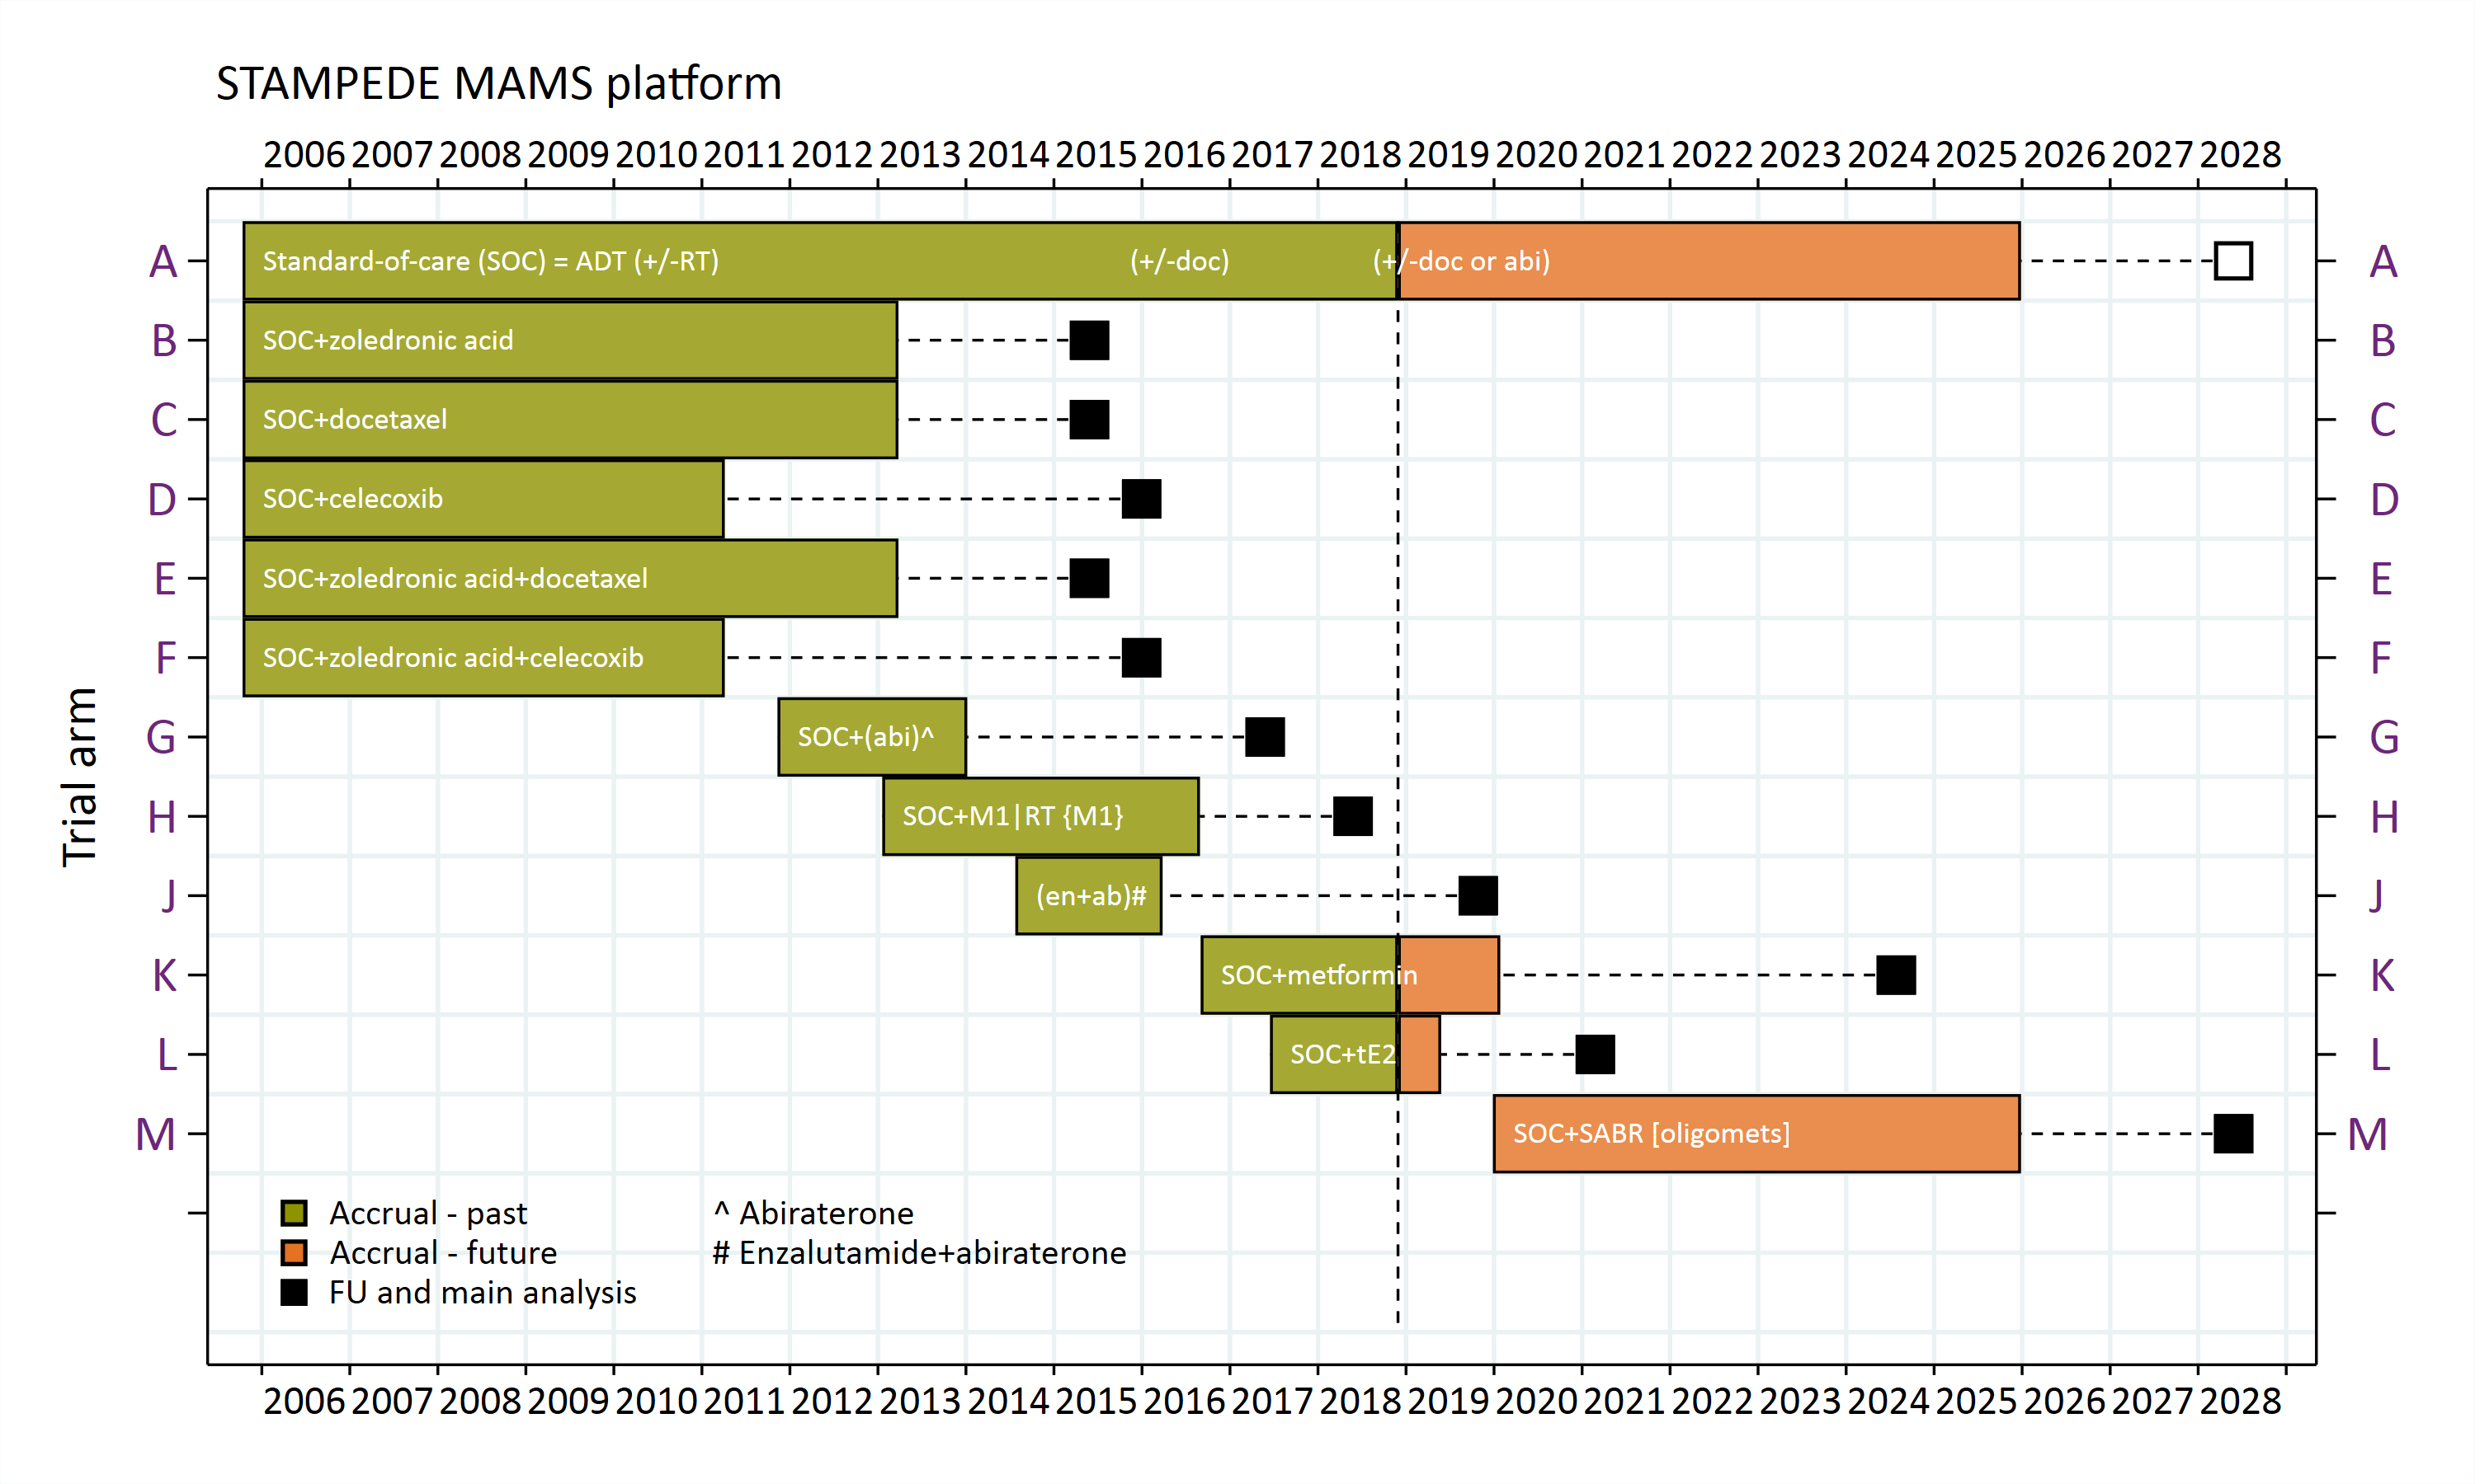

Current status of STAMPEDE Platform

Slide 65
M1|RT comparison H results: N=2061
Failure-free survival
Overall survival
SOC+RT
SOC
SOC+RT
SOC
HR: 0.76 (95% CI 0.68-0.84); p<0.001
HR: 0.92 (95% CI 0.80-1.06); p=0.266

Slide 66
Overall survival: metastatic burden subgroup analysis
Low burden (≤4 mets)
N=817
High burden (>4 mets)
N=1117
SOC+RT
SOC
SOC
SOC+RT
HR: 0.68 (95% CI 0.52-0.90); p=0.007
HR: 1.07 (95% CI 0.90-1.28); p=0.420
Test for interaction p=0.0098

Slide 67
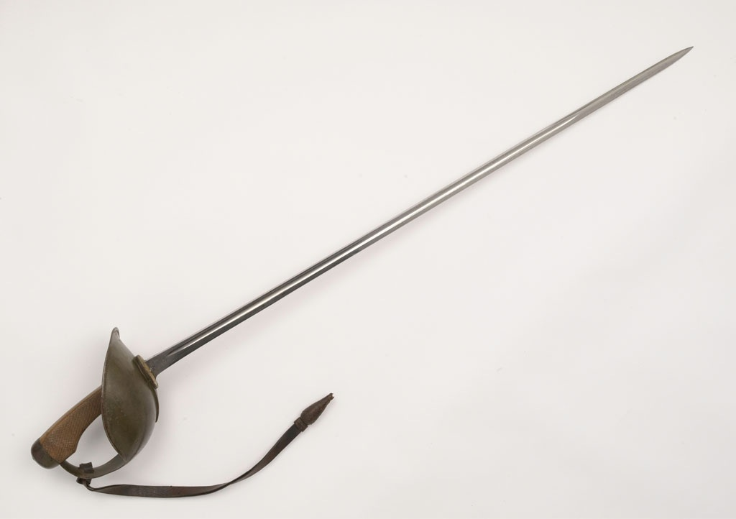
For men with oligometastatic prostate cancer:
Standard of Care becomes:
Androgen Deprivation Therapy (ADT)
± docetaxel (or abiraterone if available)
+ Radiotherapy (RT) to the prostate
What next?
Stereotactic Ablative Body Radiotherapy (SABR)
to treat the oligometastatic sites
Is it safe and effective?

Slide 68
New comparison M
M1 patients (60%): Baseline imaging using CT and bone scan
M1: High burden (non-oligometastatic disease) or no local therapy planned
Eligible for other comparisons
Confirmed oligometastatic disease and local treatment planned
Surgery Sub-Trial
(randomisation between SoC and SoC + SABR)
N~770
Surgery planned (30%)
RT planned (70%)
Informed consent and randomisation, N=1800
ARM A
SOC: ADT ± chemotherapy + local RT
N=900
ARM M
SOC: ADT ± chemotherapy + local RT
+ SABR to oligometastatic sites
N=900

Slide 69
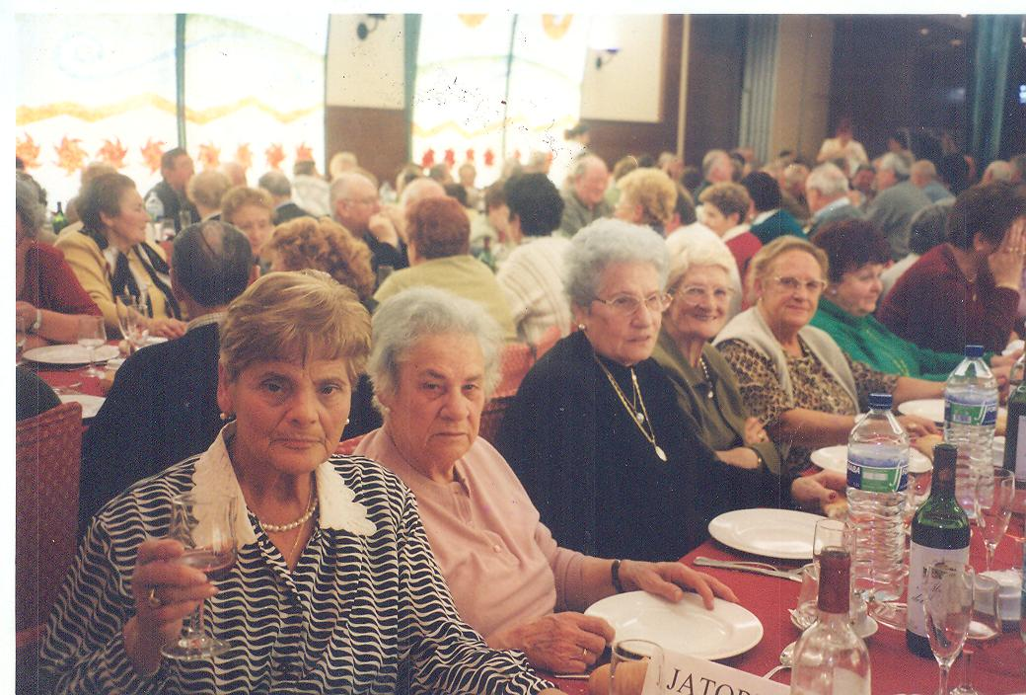
A long timescale……..
STAMPEDE team 2028…….

