Slide 1
Results from part 1 of ‘Understanding the healthcare needs of mothers involved in care proceedings’
Presented to Project Advisory Group – March 2023
UCL Legal Epidemiology Team: Georgina Ireland, Rachel Pearson,
Matthew Jay, Katie Harron, Claire Grant, Ruth Gilbert, Linda Wijlaars
Notes:
Our final presentation focusses on our planned work for 2021

Slide 2
Objectives for part 1
Linked CAFCASS to South London and Maudsley NHS Trust data to assess mental health burden and service use in women involved in family court proceedings.
Evaluate data linkages
Characterise women’s healthcare use before, during, and after care proceedings
Identify key healthcare-related risk factors for involvement in initial and recurrent care proceedings
Examine long-term health outcomes among women involved in care proceedings
Notes:
Project objectives from part 1

Slide 3
Overview of results from Part 1: 2017-2021
CAFCASS linkage to SLAM mental health data
Results are shown for information for the Advisory Group
This work will not be presented at the meeting but parts are relevant to Part 2. Please feel free to ask questions about Part 1.

Slide 4
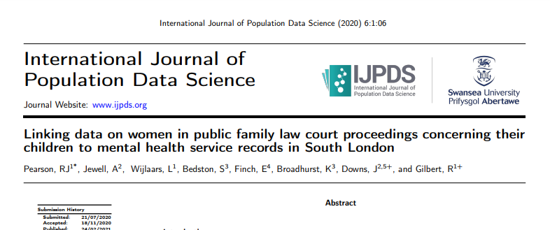
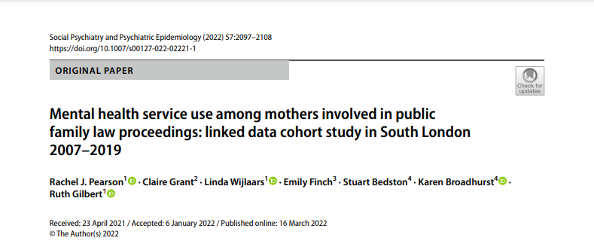
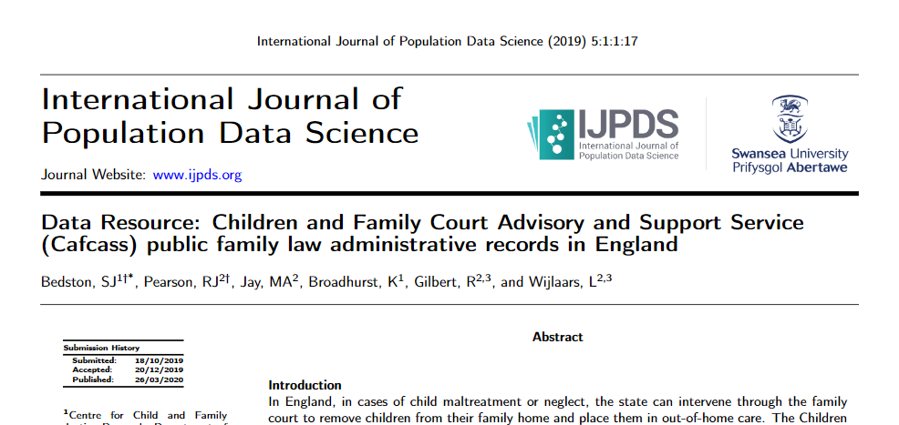
Publications
Bedston et al. (2020) Data Resource: Children and Family Court Advisory and Support Service (Cafcass) public family law administrative records in England. International Journal of Population Data Science
Pearson et al. (2021) Linking data on women in public family law court proceedings concerning their children to mental health service records in South London .International Journal of Population Data Science
Pearson et al. (2022) Mental health service use among mothers involved in public family law proceedings: linked data cohort study in South London 2007–2019. Social Psychiatry and Psychiatric Epidemiology
Pearson et al. (2021) Using longitudinal administrative data to characterise mental health problems and substance misuse among women whose children enter care in England. PhD
Notes:
There are 4 main publications from part 1 of the study, 3 peer-reviewed papers and 1 PhD

Slide 5
Mental health burden in South London
Among women who in care proceedings in South London between 2007 and 2019:
Two-thirds (66%) of women accessed mental health (MH) or substance misuse services at some point
the majority (79%) of whom were known to MH services before their first recorded set of care proceedings.
Around half (54%) of women had a mental health diagnosis recorded and one in three (34%) had 2 or more diagnoses
One in five (22%) had a record of substance misuse
3.6% had died by 31st March 2020
75% were under 48 years old

Slide 6
MH service Use
Unmet need for MH services
One in four (23%) had ever attended a IAPT appointment
One in five (18%) had ever required inpatient MH care
One in four (23%) had accessed perinatal psychiatric services
One in seven (13%) had ever been sectioned under the Mental Health Act
High proportion of women referred to MH services had a record of at least 1 rejected referral
9% for IAPT
23% for secondary and tertiary care
Once a referral is accepted there are high levels of non-engagement
76% of women ever referred to IAPT were recorded as having at least 1 discharge due to non-engagement
39% of women ever referred to secondary or tertiary services

Slide 7
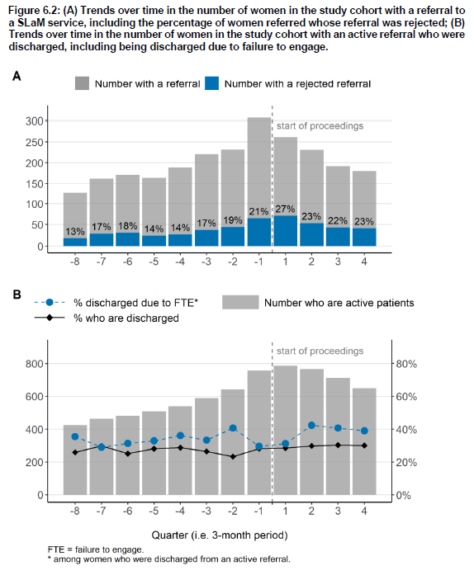
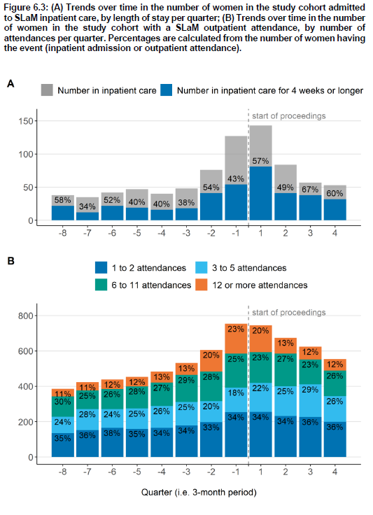
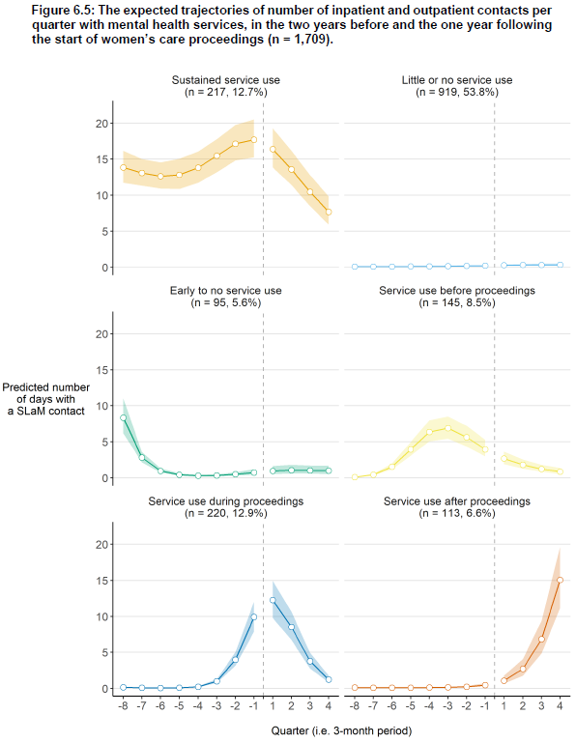
Trajectories of MH and SM services before and after onset of care proceedings
Referrals
Inpatient
Active referrals
Outpatient
Notes:
Overall: When look at service use in the 2 years prior to and 1 year following initiation of court proceedings, see increase in MH service use around the time of initiation.
When using trajectory analysis to characterise the different types of service use over this period we see 6 ‘types’ of service use.
Additional details on analysis:
Excluding women who didn’t link to SLAM patient record (Ie. SLAM referrals only)
Index care proceedings was between 1st April 2009 and 31st March 2019
3yr observation window = 2 years before index and 1 year after
Results notes:
number of women referred to SLAM service is highest in 3m before onset of proceedings
Referral rejection highest in 3m after onset of proceedings
17% inpatient at some stage, median stay=31 days, median no of stays=1
No of inpatient and outpatient appointments highest in 3m either side of onset
63% missed or cancelled at least one planned outpatient attendance in observation window: median of 15% of their appointments, attendance better 3 months either side of onset

Slide 8
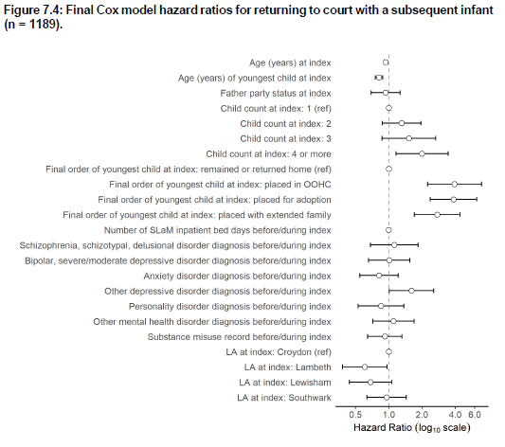
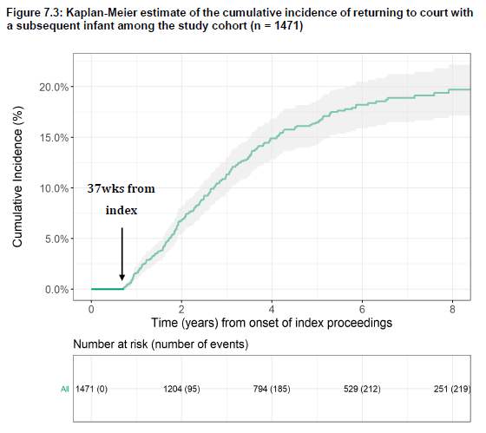
Who returns to court with a new child?
One in six (17%) returned to court with a child born from a subsequent pregnancy: 87% were infants
20% returned to court within 8 years of start
of index care proceedings
Notes:
Overall: saw a significant proportion of women who linked to a SLAM record return to court proceedings within 8 years of their first court proceedings.
Return to court was not associated with mental health diagnoses but instead:
- age at index case,
- age of youngest child on index case,
- having 4+ children on index case,
- outcome of index case and
- local authority within South London (ie some regional variation).
Additional details on analysis:
1471 women who had a SLAM referral, inpatient admission or outpatient attendance before or in the + or – 3 months from care proceedings onset
Index care between April 2008 and March 2018, followed up to March 2019
Women who returned to court within 37 weeks of onset were excluded- as wanting to inform preventative services (ie pregnant at proceedings onset)
Primary outcome: infant (<12m); Secondary Outcome: any child
1 in 6 return: with a subsequent child
Cumulative incidence: 7.5% at 2 years, 15% by 4 years

Slide 9
Objectives for part 2
To provide a systematic analysis of the interrelationship between healthcare need and use and family court trajectories for women in England, using data linkages.
To identify maternal characteristics associated with time to a subsequent birth (time to next birth)
To estimate differences in mortality risk, overall and due to avoidable causes, among mothers exposed/unexposed to care proceedings.
To describe regional variation in rates of:
Time to subsequent births,
return to court, and
increased mortality risk.
To evaluate linkage accuracy between CAFCASS and HES

Slide 10
Publication links:
Bedston et al. (2020) Data Resource: Children and Family Court Advisory and Support Service (Cafcass) public family law administrative records in England. International Journal of Population Data Science https://ijpds.org/article/view/1159
Pearson et al. (2021) Linking data on women in public family law court proceedings concerning their children to mental health service records in South London .International Journal of Population Data Science https://ijpds.org/article/view/1385
Pearson et al. (2022) Mental health service use among mothers involved in public family law proceedings: linked data cohort study in South London 2007–2019. Social Psychiatry and Psychiatric Epidemiology https://link.springer.com/article/10.1007/s00127-022-02221-1
Pearson et al. (2021) Using longitudinal administrative data to characterise mental health problems and substance misuse among women whose children enter care in England. PhD https://discovery.ucl.ac.uk/id/eprint/10139871/

