Slide 1
Career Essentials: Your Future & how to Work Towards it

Slide 2
Career Essentials programme 2019 - 2020
12 title lunchtime talks.
Small Group Work sessions (CV).
3 title workshops covering LinkedIn, Mock Assessment Centres and MBTI Personality Profiling.
6 module e-learning course.

Slide 3
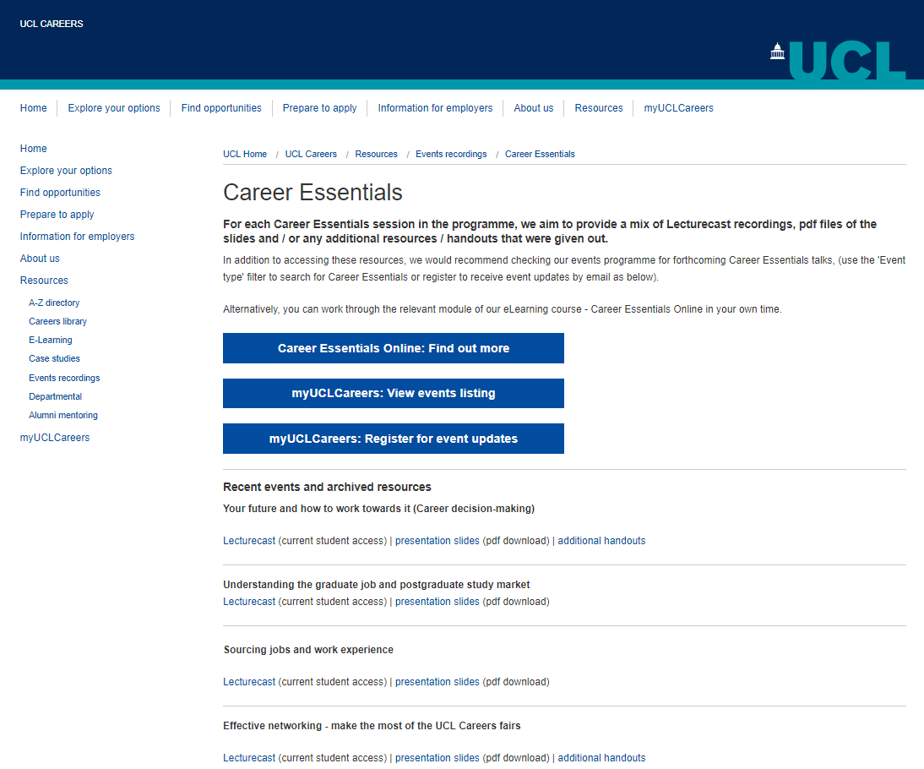
Slides and recordings
https://www.ucl.ac.uk/careers/resources/slides/career-essentials
Search ‘UCL Career Essentials’

Slide 4
Talks coming up Oct 2019
Make the most of the UCL Careers fairs | 1st, 8th, 16th
Cover letters & application forms | 3rd
Improve your CV | 4th
An introduction to the graduate job market | 7th
Find and fund a PhD | 9th
Your future and how to work towards it | 14th
Better PhD Applications | 15th
Notes:
All talks 1-2pm

Slide 5
Small group CV sessions
New this year
Work on your CV in a group of up to 6 students, with an Applications Advisor
October 3rd, 17th, 31st
November 14th, 28th, December 12th
1.00 – 1.50pm, UCL Careers

Slide 6

What we’ll be covering
Where are you now?
Myth-busting: graduate futures
Moving forward: Generating options
What are you looking for?
Making decisions
Your Actions
How UCL Careers can support you

Slide 7

Where are you now?

Slide 8

First things First…
  In pairs…
  Introduce yourself
  What issues, concerns or frustrations do you have when considering your future career?
  Let it all out!
Notes:
Elicit feedback
67% of UCL students are worried about their future (Trendence University Report 2018)
Doesn’t have to be your feelings, but why do you think so many people are concerned /frustrated about their future?

Slide 9
The Career Thinking Scale: Where are you now?
Complete Confusion
Some idea of what I want for my next step
Strong ideas of what I want and potential options
Some Concrete Ideas but undecided
Strong Clear focus
Notes:
How many UG finalists?
How many PGs do we have in the room?
How many considering further study?
Where are you now…?
Hands up if…
You have a very clear idea of where you want to be when you graduate
Some concrete options, but undecided
…..etc
That’s a fairly typical response

Slide 10

Myth Busting

Slide 11
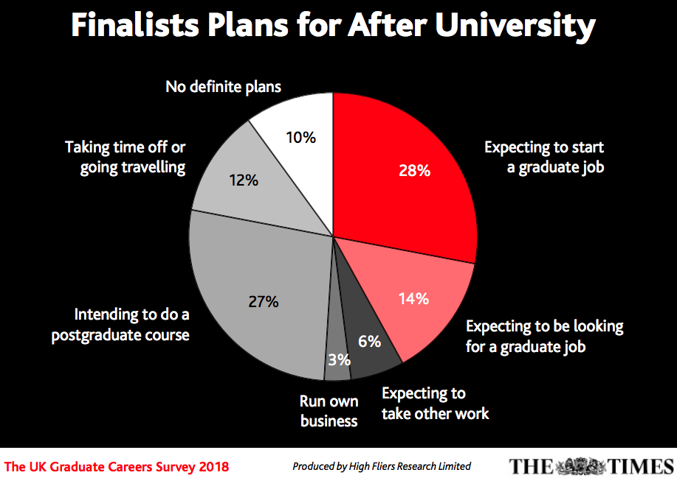
Finalist plans for after university
Notes:
Here’s some data…
Survey from High Fliers: Graduates from the ‘Class of 2018’
A total of 19,147 final year students were interviewed in February for the 2018 survey.
Increase in postgrad study by 3% since 2015 survey
Perhaps their experiences will be similar to yours….?
Only (just over) 50% seem to have clear idea
> ¼ pretty sure they have a job lined up
> ¼ pretty sure they will do a Masters
42% No clear plan, will be looking for work, or going travelling!

Slide 12
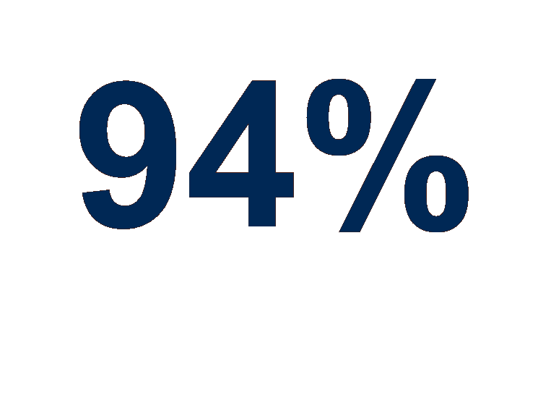

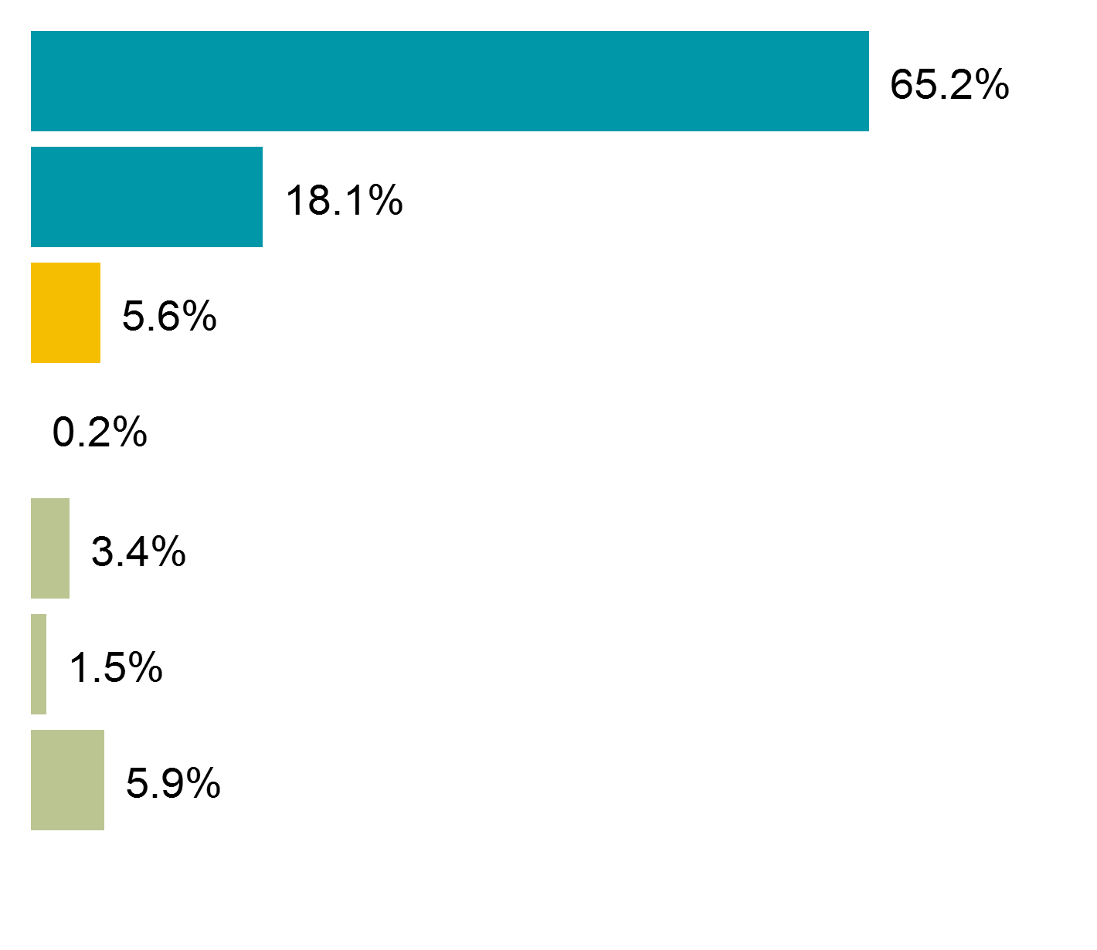
Destinations of UCL Leavers
Graduate Level work
or study
(Graduate Employment + Graduate Study + Other study) / Total in work or study x 100
Graduate Employment
Graduate Study
Other Employment
Other Study
Unemployed
Due to start work
Other
Notes:
BUT don’t worry…
2016 graduates were surveyed six months after graduating

Slide 13


Mythbusting: Now
1. In the UK, what course you study does NOT dictate what you go on to do afterwards…….
2. You have multiple ‘selves’ – unlikely to be a single path that is right for you. Likely to be many…..
Notes:
UK almost unique in that what you’ve studied often in no way determines what you could potentially go onto do – different to many other countries around the world
Accountancy – history/ languages/ - many organisations can teach you what you need to know or conversion courses
So if you’re enjoying your course, and ideally want to move into a career that will utilise specialist knowledge skills and enthusiasm you have that’s great BUT if not, whole world of opportunity out there move away and do something completely different – overall between 50 to 60% not degree subject dependent.
For some, incredibly liberating so much choice and freedom – for others, can seem a little daunting, so much choice, difficult to know where to start – more than 6 or 7 potential choices difficult to make sense of
Talk about narrowing this down later

Slide 14
Mythbusting: Future
It can take time to figure out who you are and what you want
Most of you will be working until you are 70+
Today’s graduates will likely have ‘multiple’ careers during their working life
FYA* predicts young Australians leaving education now likely to have 17 jobs spanning over 5 careers
most graduates will change roles/employers within 3 years of graduating
work is changing rapidly: many of today’s most sought after jobs didn’t exist 10 years ago - technology is changing everything – need to remain ‘agile’
* FYA: The Foundation for Young Australians New Work Order report 2015
Notes:
THE REALITY IS…
Normalise the idea – careers is just another decision in a lifetime full of DM , George Osbourne recent statement likely to be working til you are 70 plus – many of you will equate to 50 years of work.
43 now – longer to work than have already worked.
Foundation for young people in Australia – 17 jobs over 5 careers.
Lots of grads come back use gradclub after a year – learn’t more themselves and what they want
Take time to figure out – especially not had a great deal of opportunity to try on jobs and learn more about yourself and what you want.
who knows what world of work will look like in 10 years, changed so much in the last decade. Big data analytics, social media, environment and sustainability are all areas that didn’t really offer opportunities on anything like the scale they do today. Who knows what next 10 years look like? Recent article (publicity stunt)/ drones delivering Amazon packages – 10 years time reality – logistics/ flight operators – who knows

Slide 15

Moving Forward

Slide 16
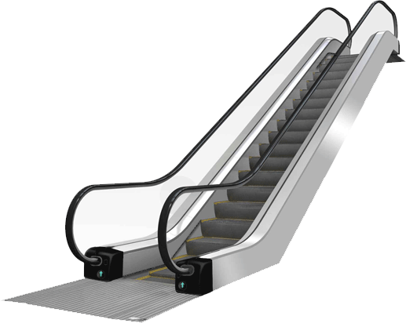
Starting Out
“Most of my friends seem to know what they want to do and are getting on with it!”
“What if I get it wrong?”
“I just don’t know where to start!”
Notes:
Thinking about your career can feel daunting…
Many of you have been on an escalator: high school / university / postgrad…
And wondering what to do when you get to the top…
You may feel worried

Slide 17


Going forward
This is a decision about your NEXT STEP - not necessarily the rest of your life
Your career is a journey - jobs are just places you visit along the way
Try not to be daunted and put if off
Engage and be proactive
Take manageable small steps to move forward
Notes:
My message to you is the following…….
Don’t disengage/ bury head in hand – lots of grads potentially run away from issue
shame so much you can do to help yourself and resources to call on whilst here
Try not to panic, very anxious – longer term exhausting
I don’t want to blind you with enlightened quotations…..2 particularly apt
Take the career decision – How am I going to decide on the route to my 1st or next step.
This image of taking this big daunting problem and making it smaller.
Career as stepping stones – lots of little steps
Think about how we’re going to do it – take 1 step at a time – end of the week action plan for how to move you are 1 step a time to where you want to go.
Ultimately, your decision, your future – all support along the way, you ultimately in control, power to make things happen or not -

Slide 18
Take the next small step towards…
…a strong, clear focus
Complete Confusion
Some idea of what I want for my next step
Strong ideas of what I want and potential options
Some Concrete Ideas but undecided
Strong Clear focus
Notes:
Remember this?
Taking small steps can really help…

Slide 19




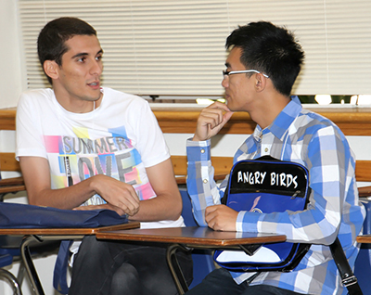
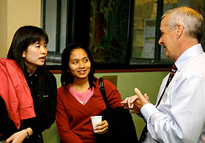

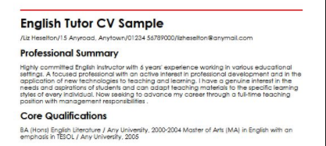

Process: Taking the careers ‘shortcut’
Decide
Plan
Compete
Your next step – Is this you?
Notes:
Whilst I think there is definitely merit in taking inspiration from lots of sources, wherever you can – some examples of where this has worked for others – if this is you and you’re looking for some fresh ideas and inspiration, some may benefit from a little more process for example. Take you through some of the steps that might help.
Work with lots of recent leavers looking at the job market – in some cases for the first time…..
For me, always surprising that people spend more time considering where go on next holiday or deliberating about what tablet computer to buy than their longer term career options, what want to do with themselves for the short/ longer term future. Surveys suggest most are in wrong job, move from one job wrong with them to another.
Typical characterised by……
Flash of inspiration, wake up one morning and bolt lightning
Talk to peers find out what they’re planning – want to stay in academia and do a PhD – sounds good (destinations previous students) even though may be completely unsuitable for them, go along with it, lecturers or family give you their idea (accountancy – pass the DM problem to someone else relinquish control),
very common at UCL- pick up employer directories (CS), pinpoint big organisations like to work for no real u/standing of realities what roles involve
Careers like most things in life – more you put in, more get out and important you understand how to make decisions

Slide 20
But How? A Process…
Evaluate & Research
Self Awareness
Generate Options
Decide
Plan
Compete
Notes:
Whilst I think there is definitely merit in taking inspiration from lots of sources, wherever you can – some examples of where this has worked for others – if this is you and you’re looking for some fresh ideas and inspiration, some may benefit from a little more process for example. Take you through some of the steps that might help.
From thinking more about what you are looking for through self-awareness, having a variety of tools at your disposal to generate options, knowing how research those options appropriately. Interplay between all 3 not linear, every time you discover something about yourself and what you want – link to the options and research you carry out.
You guys are an expert in research, so you may find it useful to approach the whole issue as you would a research project.
Each of the steps informs and effects others steps especially between Self and opportunity awareness stages.
So, this model is very much a dynamic process. So let’s look at how you might go about this in practice

Slide 21

Choosing a Holiday
Relinquish Control
Passive/ negative approach
Goes with the flow, even if not what you want
Can’t be bothered
Choice interested in doesn’t seem possible
Dissatisfied and unhappy
Resenting fact not your choice
Grumbling at home because not going on holiday
Take Control
Take ownership of research
Investigate options
Talk to others for recommendations
Set time aside to research
Influence factors above
Extra hours to increase budget
Adapt to availability
Likely more enjoyable experience
Your choice, more likely to try and make the best of it

Slide 22
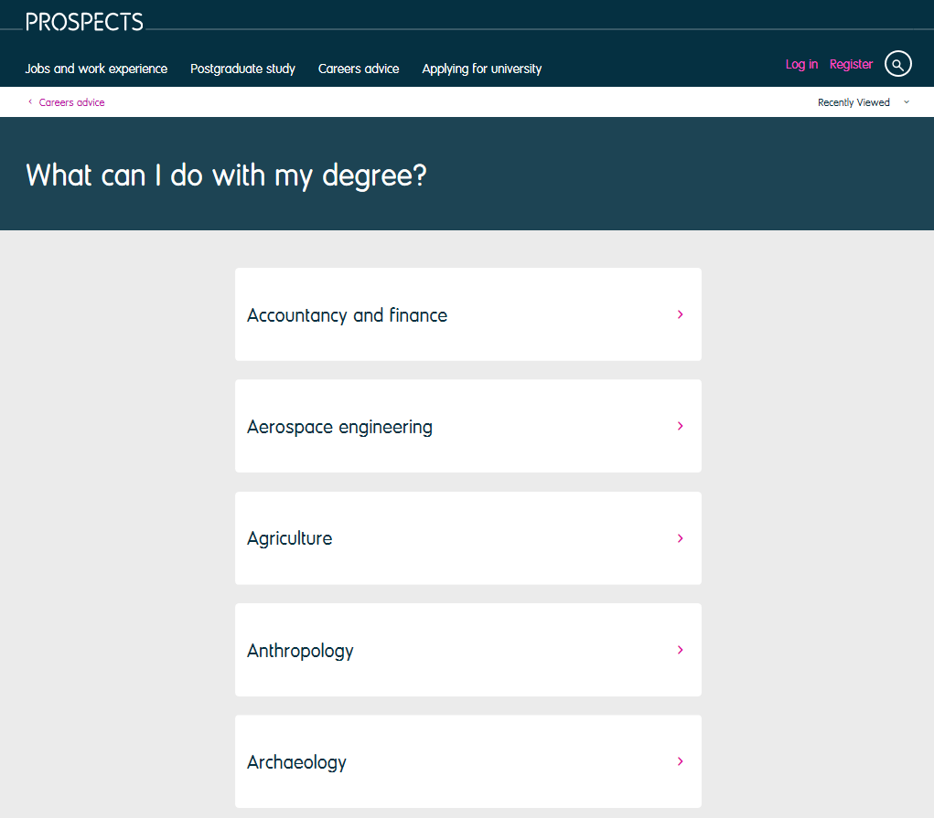
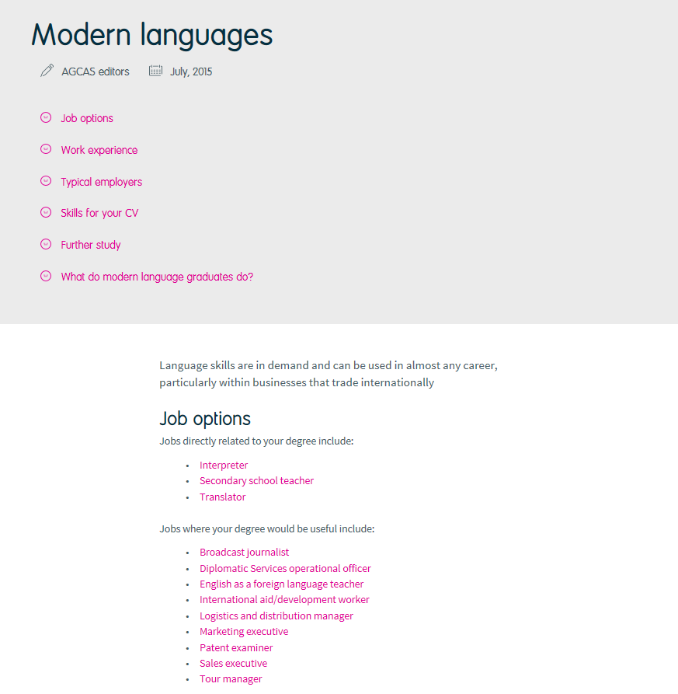
What can I do with my degree?
Visit the prospects website: www.prospects.ac.uk

Slide 23
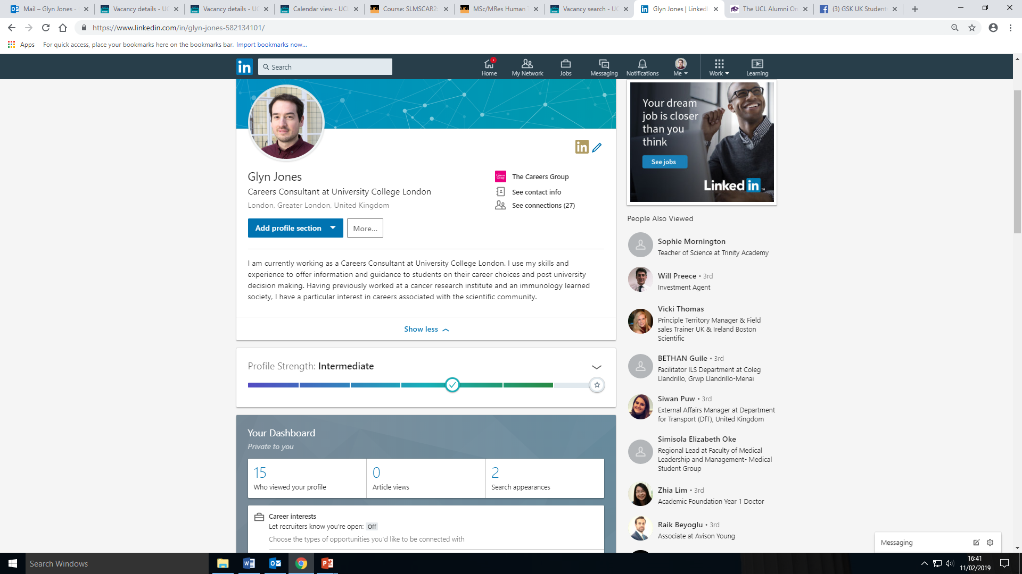
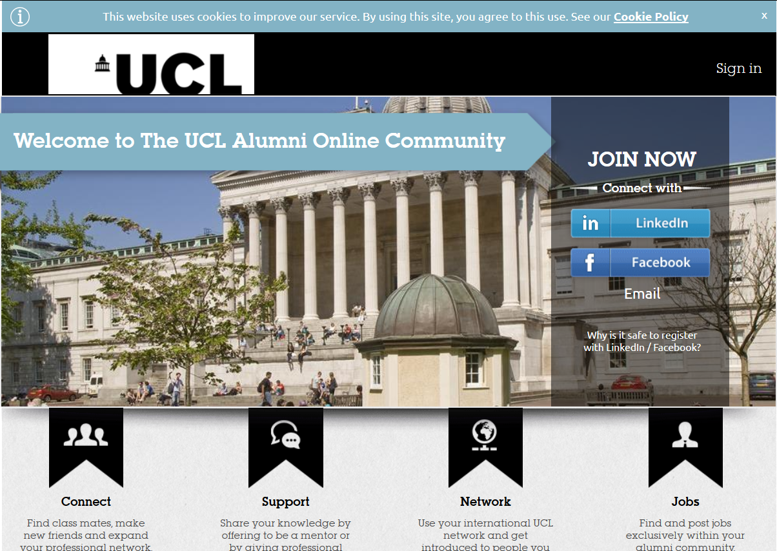



Get on LinkedIn and access the UCL Alumni community
23

Slide 24













Over 800 employers on campus last year…

Slide 25






Sector Themed Careers Week programme
Government & Policy: 21st- 25th October
Museums, Arts and Cultural Heritage: 11th-15th Novemberr
Media: 25th-29th November
Charities & NGOs: 27th-31st January
International Development: 3rd-7th February
Careers in Health:10th-14th February
Sustainability Fortnight: 24th February- 6th March
Careers in Life Science– 9th-14th March

Slide 26
Sector themed Careers Fairs
Management Consultancy: Wednesday 2nd October
Banking and Finance Day 1: Tuesday 8th October
Banking and Finance Day 2: Wednesday 9th October
IT and Technology Day 1: Wednesday 16th October
IT and Technology Day 2: Thursday 17th October
Engineering and Built Environment: Monday 21st October
Life and Health Sciences: Monday 28th October
Law Fair Day 1: Monday 28th October
Law Fair Day 2: Tuesday 29th October
Notes:
Attend a careers fair, even if its not your field… there are more roles than you might imagine…
Around a 1000 employers visted UCL Campus last year.

Slide 27

Increase your exposure…
Don’t wait for lightning to strike!
The more pro-active you are…
…the more you expose yourself to different options…
…the more likely that you’ll find opportunities of interest

Slide 28
12 ways to generate options
What Do Graduates Do on Prospects’ ‘what can I do with my degree?’
Prospects Planner or Target Jobs Career Report
Attend Careers Events
Societies and institutions
Talk to people
Collect vacancy adverts
Watch Video Profiles on icould.com
Careers Tagged.co.uk
Use social media
Notice when something interests you
Who are your role models?
Research job profiles on Prospects.ac.uk
Notes:
Online/Desk ---- And in person by talking to people (Alumni, Friends, Family, Fairs/Events)
[mention Times Top 100 & Guardian UK 300 & Inside Careers]
Keep a career idea notebook
Read trade press / relevant news

Slide 29
So what do I do with all these options?
Search for themes / consistencies and reflect on what you have found most appealing
Consider common elements in:
The events you are attending
The news you are reading
Your past experiences and choices
Job profiles / descriptions / adverts you like the sound of - ask yourself why this job looks interesting
All of the above increases your self awareness
Notes:
Sometimes its about testing it out / giving it a try
Contribute to particular agenda; e.g. public, private, charity (values)
Be a small cog in a large wheel, or vice versa (environment)
Stay in the UK or go abroad (location)
Using your subject knowledge / skills developed during your degree
Doing what I am good at and enjoy, e.g. my strengths
And so on…

Slide 30

Self awareness: Your career ‘drivers’
What am I interested in?
Degree subject/knowledge base
Specific interest in X
News/ projects/ interests
Environmental issues
What am I interested in?
Economics and financial markets
Legal issues and the Law
Social issues, e.g. disadvantaged children
Politics and international relations
What's important in a job?
Work for a big prestigious employer/ status
That I can really develop and progress
Salary (affordability)
Work / life balance
Location and / or travel
Work environment, e.g. fun and causal
What am I good at and enjoy?
Influencing and collaboration
Presenting, disseminating, communication
Organisation and time management
Creativity and problem solving
Research and analysis
Languages
Notes:
Ask yourself the following questions….
Take a minute to read them by yourself…
Visit UCL Careers for a Skills Audit.

Slide 31
Use these ‘factors’ to generate and filter options
Research and Analysis
Social issues, e.g. disadvantaged children
Policy
Fundraising
Campaigns
Training others
Therapy
Advocacy
Programmes
& Projects
Influencing and collaboration

Slide 32
Policy options
Impact on children
The Education Foundation
Centre For Skills Development
Fabian Scoiety
Smith Institute
Centre for the Economics of Education
Policy jobs
Government Departments
Think Tanks
Charities
Local Government
NGOs
Impact on children
Save the Children
Care Int
NSPCC
Children’s Society
Rainbow Trust
Unicef
Kids
Barnardos
Islamic Relief
Etc.etc.

Slide 33
Exploring options through Information Interviewing
Interviewing the ‘opportunity’ | Questions to find the answers to…..
Details of the work | What does a typical day look like? What did you learn in your course that has really helped you in what you do? Do you get the opportunity to use ‘X’ skills
Motivation | Why do people do this job? What are their motivations? What are the biggest rewards/ challenges?
Prospects | What are the typical training opportunities involved. What is the typical progression timeline?
Notes:
If you have the opportunity to network with potential employers, consider using information interviewing…

Slide 34
Information Interviewing continued
Interviewing the ‘opportunity’ | Questions to find the answers to…..
Culture | What proportions of the time are you working on your own or as part of a team? How important is the role of a supervisor? Is there a particular type of person who works in this field?
The sector | How is the industry changing? What are the most important current issues in this sector that are likely to affect the job?
Vacancy sources | Where are opportunities for this type of role advertised? How else do vacancies get filled? What is the typical recruitment process involved?
Notes:
If you have the opportunity to network with potential employers, consider using information interviewing…

Slide 35
In summary
Many students, graduates and professionals struggle for direction
This is a decision about your next step – not the rest of your life
Concept of ‘multiple selves’ – you are more than your course
TAKE ACTION
Be proactive
Increase your ‘exposure’
Try using more ‘structured’ option generating ideas
Use reality checks to ‘test’ potential options
Engage with UCL Careers 1to1 support to help you with your journey
The more you put in, the more you’ll get out of the process

Slide 36
Your Actions

Slide 37
Over to you…
  In pairs…
  What 3 actions will you take to move forwards in your career thinking?
  When?
  Challenges?

Slide 38
UCL Careers 1 to 1 Support
Applications advice (20 minutes)
Short guidance (20 minutes)
Practice Interview (60 minutes, on condition of real employer interview)
Book online in advance using myUCLCareers

Slide 39
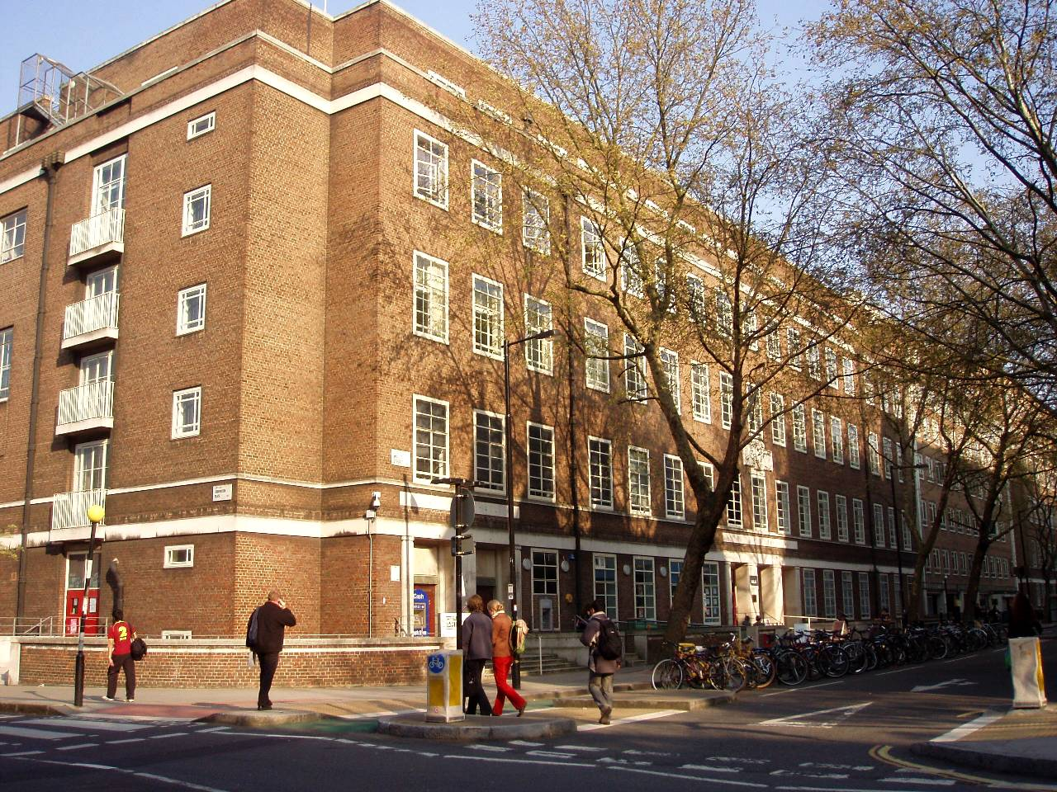
Find us
4th Floor, Student Central Building, Malet Street
Mon-Thurs 9:30 - 17:00
Fri 11:00 -17:00
careers@ucl.ac.uk
020 7866 3600

Slide 40

Questions?

