Slide 1
Just a Reformation? Time for a Copernican Revolution in Economics
www.patreon.com/profstevekeen
www.profstevekeen.com

Slide 2
Neoclassical Economics after the Crisis
Some admit problems:
Kocherlakota 2016, “we simply do not have a settled successful theory of the macroeconomy.”
Romer 2016, “For more than three decades, macroeconomics has gone backwards.”
Blanchard 2016, “DSGE models are based on unappealing assumptions… profoundly at odds with what we know about consumers and firms.”
Others are defiant:
Christiano, Eichenbaum & Trabandt 2017: “The only place that we can do experiments is in dynamic stochastic general equilibrium (DSGE) models.”
Reis (LSE) 2017: “If macroeconomics was in a crisis, journals would, at least slowly, publish fewer and fewer articles on macroeconomics…
A more anecdotal piece of evidence comes from the 2012 survey by Brunnermeier, Eisenbach and Sannikov (2013) on macroeconomics with financial frictions…”
Non-equilibrium modelling is impossible?
Finance as a friction (slow down return to equilibrium) rather than a lubricant?

Slide 3
Neoclassical Economics after the Crisis
Can’t change a paradigm if you don’t realise you’re in one
Methodological individualism: Derive macro from micro
Methodological equilibrium: Impose equilibrium even on unstable models
Methodological barter: No essential role for banks, debt, money, money creation
“Rather, policy is best described as deficits almost all the time, which does not match normative macroeconomics” (Reis)
It does match MMT, a paradigm mainstream economists don’t know exists
Ignorance of complex systems research:
“Comparing macroeconomic forecasts to forecasts of average temperature or precipitation over the next 1-5 years, as opposed to over the next few days, it is far from clear that economics forecasting is doing so poorly.” (Reis)
Lorenz 1963: “When our results concerning the instability of nonperiodic flow are applied to the atmosphere ... prediction of the sufficiently distant future is impossible by any method, unless the present conditions are known exactly.”
Reis’s comparison would be laughed at by Meteorologists

Slide 4
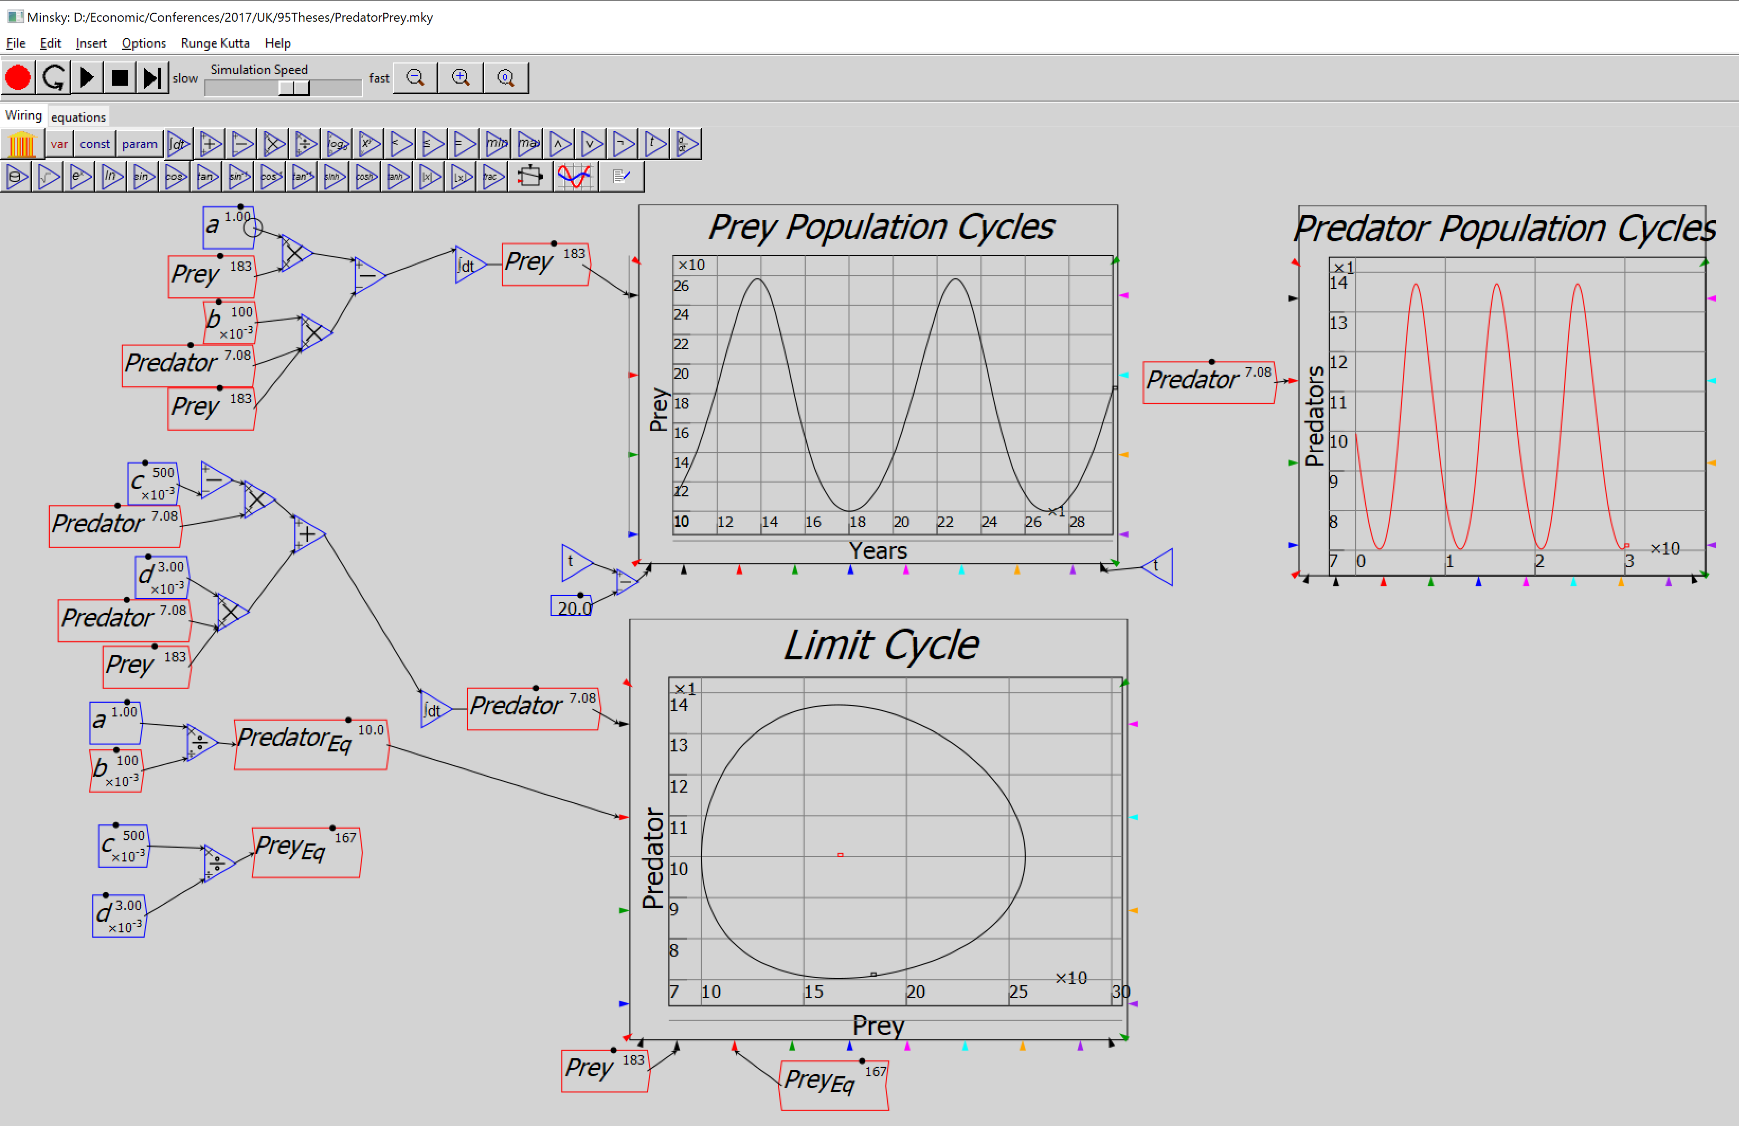
Modern non-equilibrium modelling
Biologists developed models with neutral/unstable equilibria a century ago:
Predator-prey models to explain change in fish/shark catches during WWI:

Slide 5
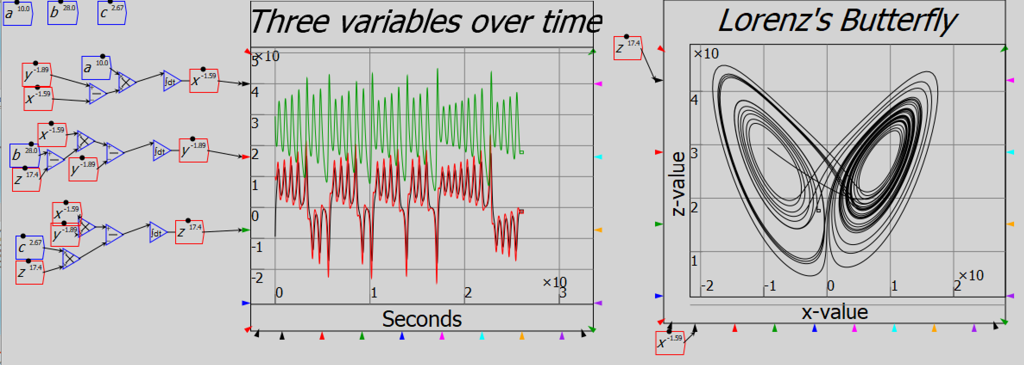
Modern non-equilibrium modelling
Aperiodic deterministic cycles discovered by meteorologists fifty years ago
Beginning of complex systems modelling: simple systems, complex behaviours

Slide 6
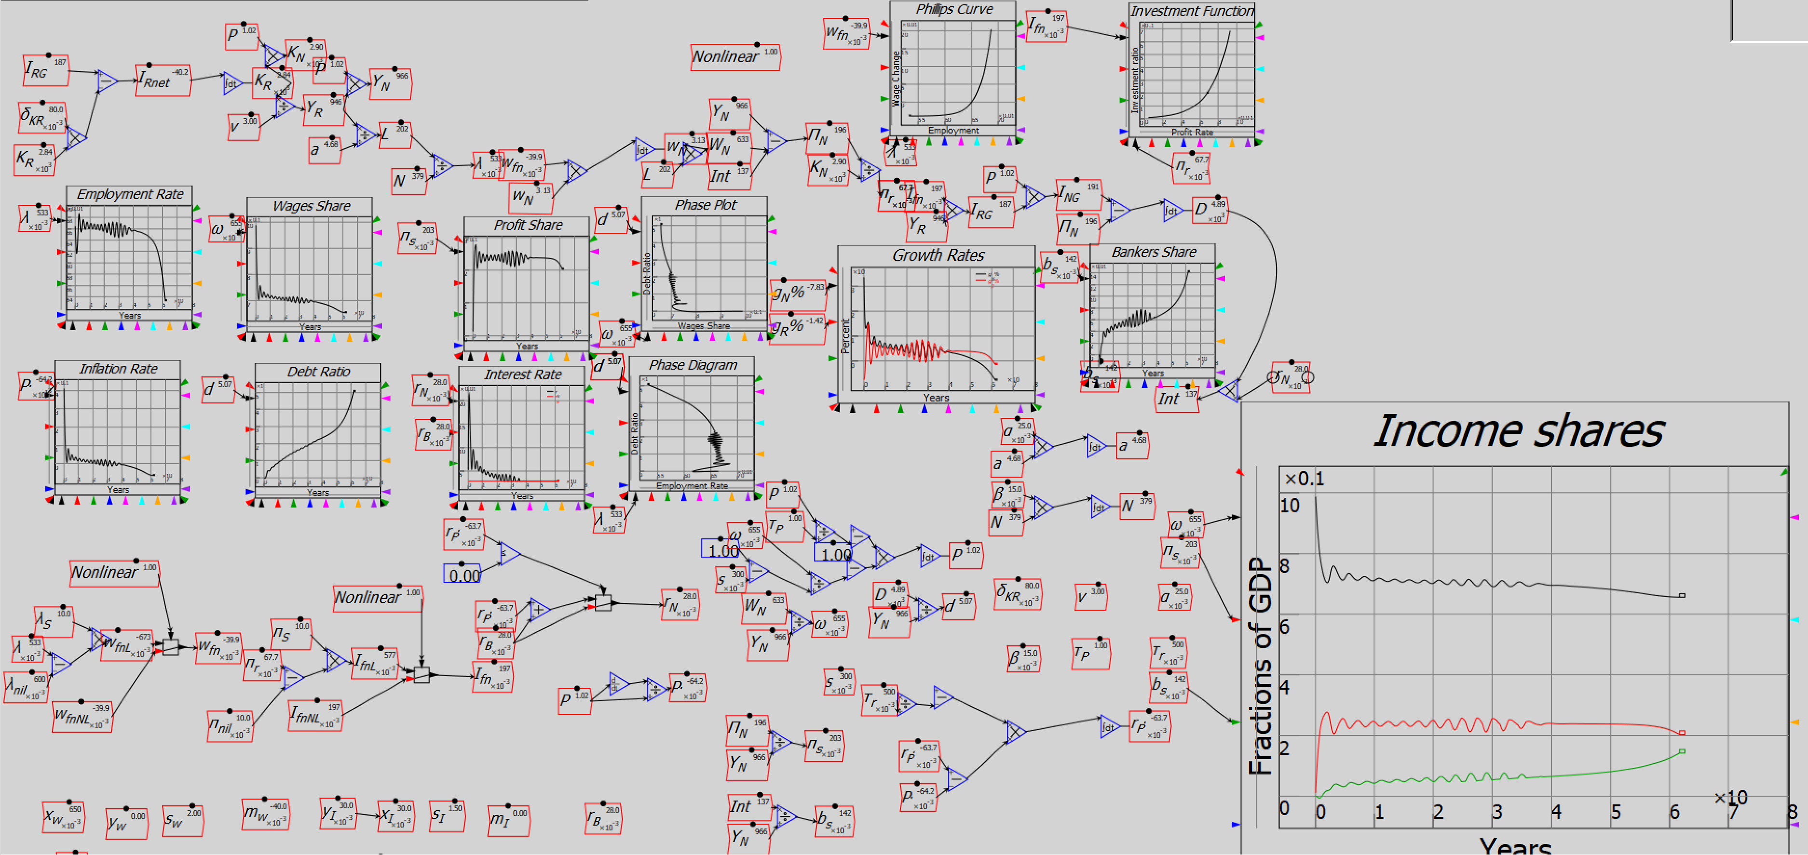
Modern non-equilibrium modelling
Complex systems & strictly monetary modelling are possible in economics
Mainstream economists don’t even know there are alternatives
How can they be expected to develop them? A Reformation is needed…

