Slide 1
BSEER Partnerships
doing enterprise differently

Slide 2




Our Partnerships model operates across Research, Teaching and Consulting
Stakeholders
Partnerships responsible for managing relationships to:
Develop a strategic approach to relationships
Strengthen links between stakeholders and all areas (teaching, research and consulting)
Ensure long-term relationships
Minimise duplication and avoid gaps
Partnerships
Research
Teaching
Consulting

Slide 3
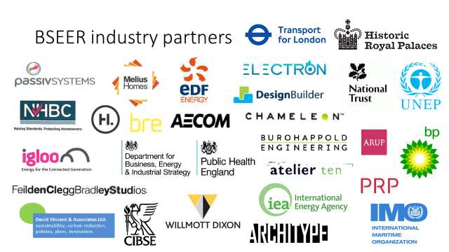


Slide 4
Team
David Shipworth
Director of Partnerships
(from autumn 2018)
Paul Ruyssevelt
Director of Partnerships
2013-2018
UCLC
Elinor Kruse
Partnerships Manager
Carlos Huggins
Consultancy Manager
Kim Novelli, Administration Lead

Slide 5
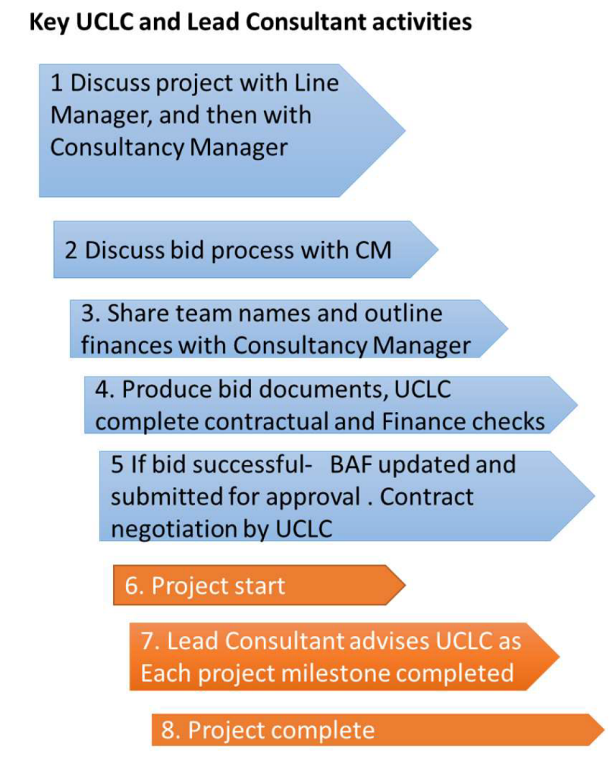
Our Consultancy Framework benefits all staff
Flexibly motivates staff to engage in enterprise activity
Work closely with a UCL-C Business Manager, embedded in the School since 2013
Provides transparent costing models which provide a financial return to the School
Contributes to BSEER Development Fund open to all
Provides administrative support, monitoring and reporting
Provides REF Impact Case studies

Slide 6
Research Consultancy
For projects that don’t fit the definition of Research at UCL but will produce research outputs:
Covers research staff salaries and overheads using the Worktribe full economic costing system
Provides funding to bridge contracts for staff employed on grants
Part of our research agenda, and counts towards career progression
Can lead to the development of research proposals
Provides opportunities to work with non-academic partners

Slide 7

BSEER Development Fund
(funded by consultancy income)
Open to all staff, especially those without discretionary accounts
Transparent and simple application process
Supports early career researchers with career development
Funds conference trips and training courses
Since 2016, funded £80,000 in development opportunities to 25 research and admin staff

Slide 8
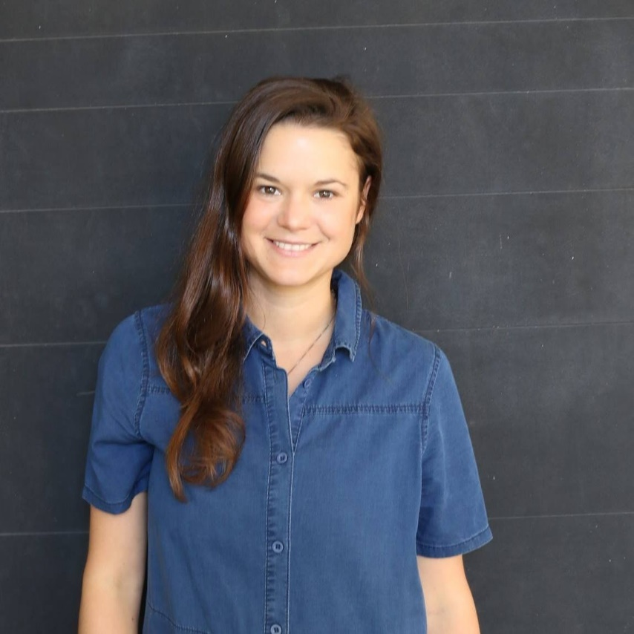
Partnerships Manager
Role created to support partnerships across our four institutes
Specific support to the Centre for Doctoral Training in Energy Resilience and the Built Environment (ERBE)
Ensures that links with industry are maintained and nurtured.
Elinor Kruse, Partnerships Manager

Slide 9
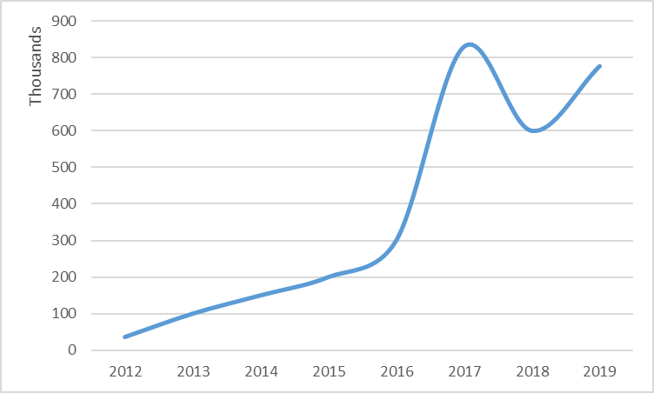
BSEER Consultancy Income

Slide 10
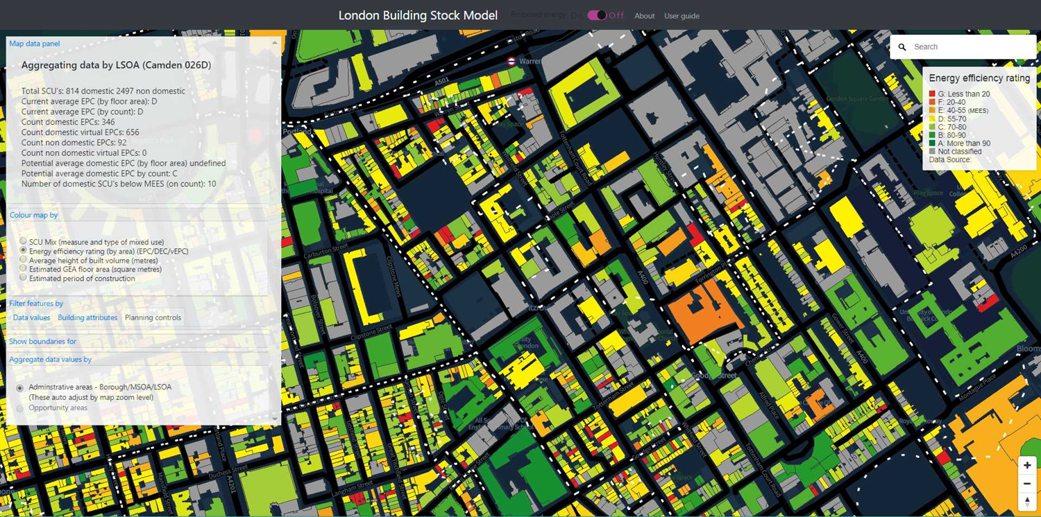
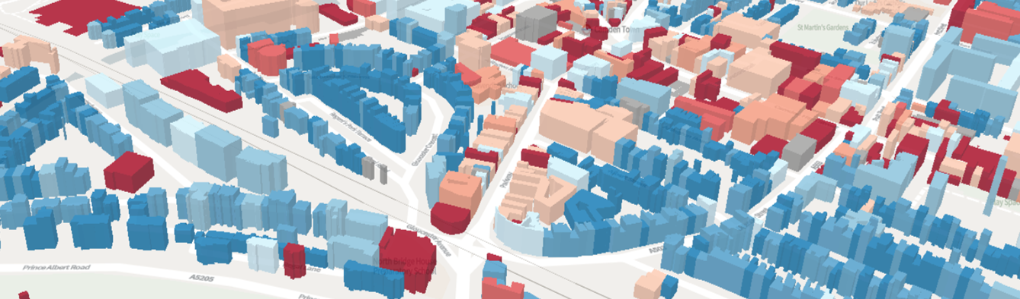
Consultancy Projects
Projects range in Value from £10k to £200k
Repeat projects for government departments, GLA and many large consulting practices such as IPSOS Mori and AECOM.
The London Building Stock Model (under development for the GLA)

Slide 11
BSEER Partnerships
Social media accounts:
@UCL_IEDE
@UCL_ISH
@UCL_ISR
@UCL_Energy

