Slide 1

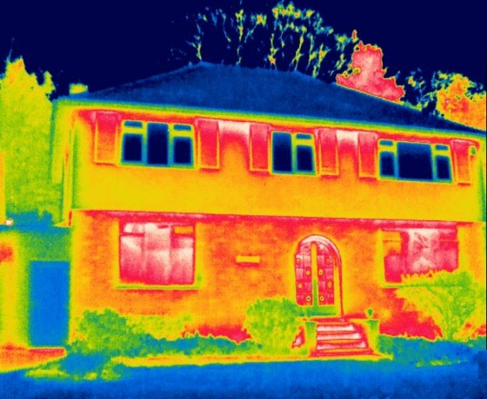
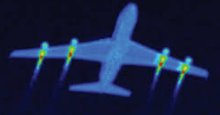

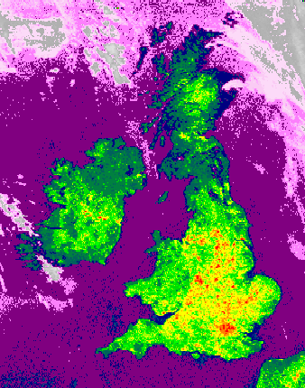
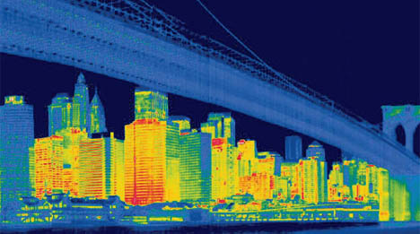
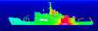
Swimming in the energy and environment river
Mark Barrett
6 June 2017
Notes:
Simulates the system on any time steps. Demand for heat, light, appliances, power. It looks at the supply of the energy tech on the same time step and traces the flow of energies from primary to demand through the network of energy transformation and store. It calculates carbon emiss. And cost. It can be run for any period between 10 and 50 years and produce scenarios.

Slide 2
0 to 2500 AD
Smart control
renewables========================================> fossil => renewables ====>
Notes:
Humans ~ 2 My.
Development of exosomatic systems: agriculture, food storage, shelter.

Slide 3
History
UK energy mix
Elec primary
Gas
Oil
Coal

Slide 4
Environment

Slide 5
Past to future

Slide 6
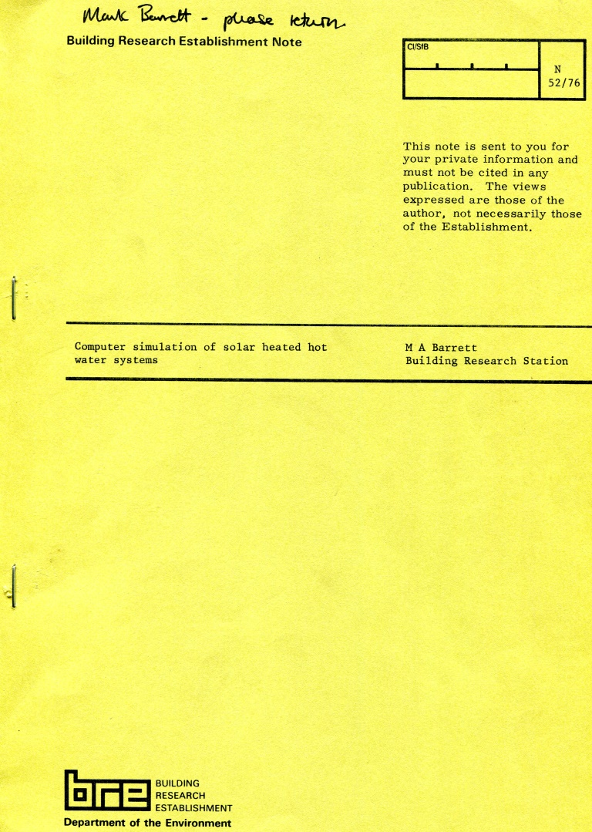
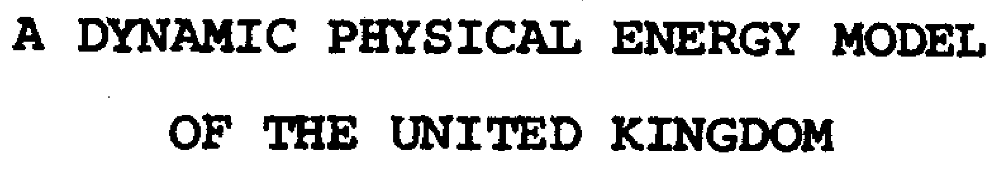
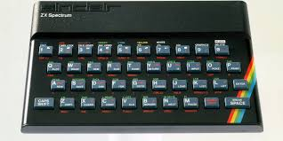

Method or madn…
World
Some questions
Will systems work?
How much will they cost?
What is the best design?
What impacts will they have?
Computer models required for
Simulation
Optimisation
Understanding
Models
1975 my first FORTRAN programme.
BRE solar heating simulation.
PhD 1981 DYPHEMO: a much longer FORTRAN programme. Hourly simulation of all energy demands and supplies.
Computing
1981 64K RAM 3.5 MHz => x 1 million => 2017 32 Gb RAM 3 GHz

Slide 7
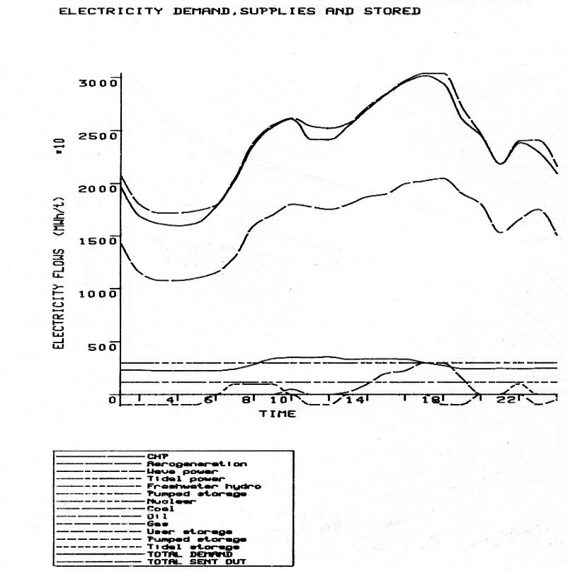
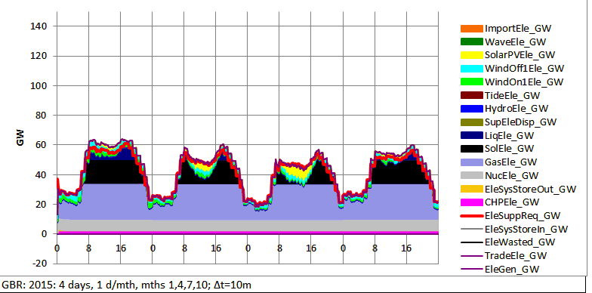
Plus ça change?
No new energy technologies since nuclear power
But (apart from nuclear) their costs reduce – partly because bigger is better.
So no need for much change to models?
Progress – from black and white stills to colour cartoons
DYPHEMO 1980 DynEMo 2015
Winter Spring Summer Autumn

Slide 8
Modelling people
Population uncertainty
Population: ageing
More energy and carbon per person in small households
Households - smaller
Notes:
The demography model also projects households number and households are mapped onto dwellings types. This is important because the carbon per person is much higher in small households.

Slide 9
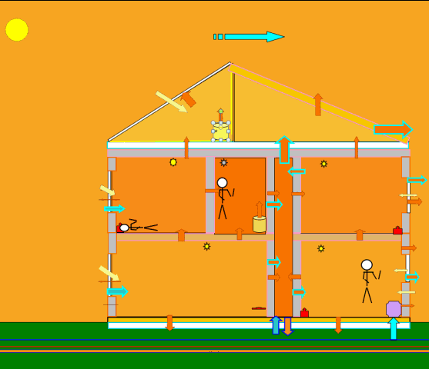
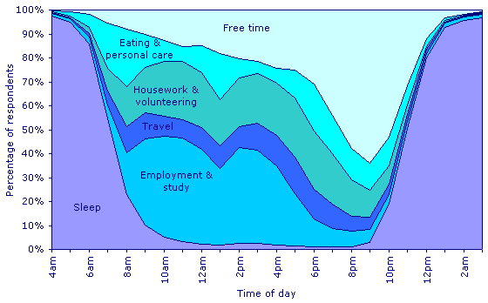
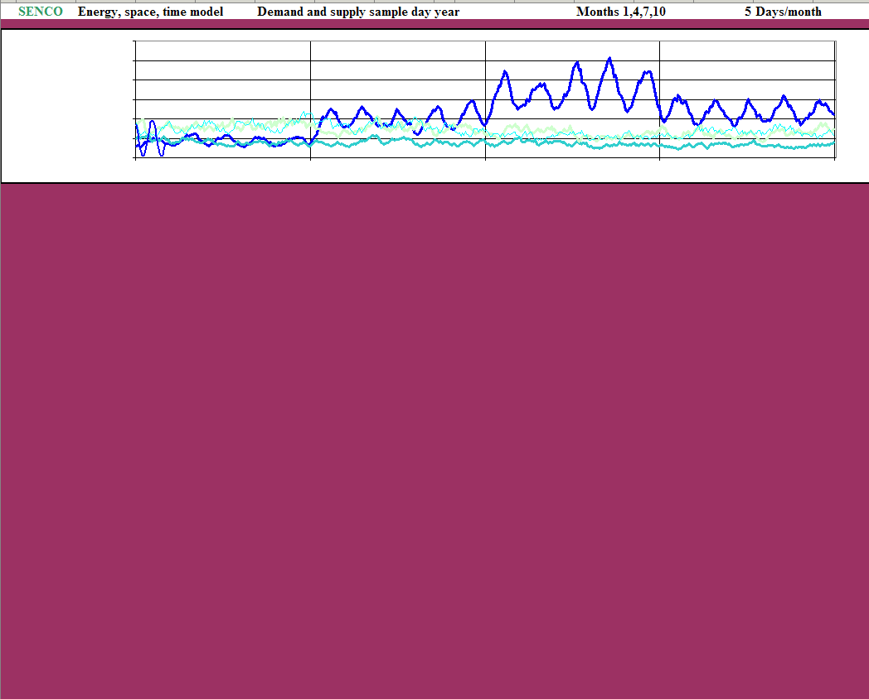
  Weather and Renewables
People in energy systems
Human use of time – UK
Quite invariable across the years – we’re a diurnal mammal!
Though the French have much longer lunches than us.

Slide 10
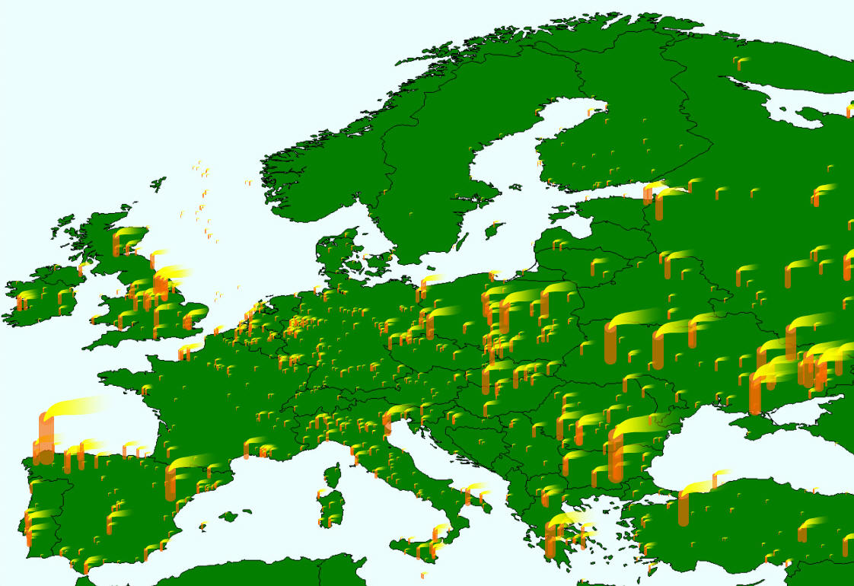

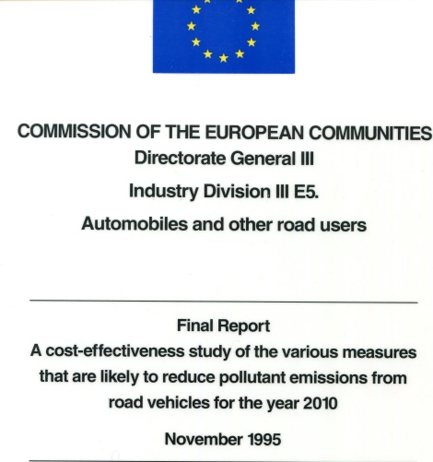


Air pollution
Acid rain
Air pollution
Long range transport air pollution
1994 Auto-oil programme to set Euro standards to reduce diesel petrol vehicle emissions and meet air quality standards.
TransOpt model to find least cost measures

Slide 11

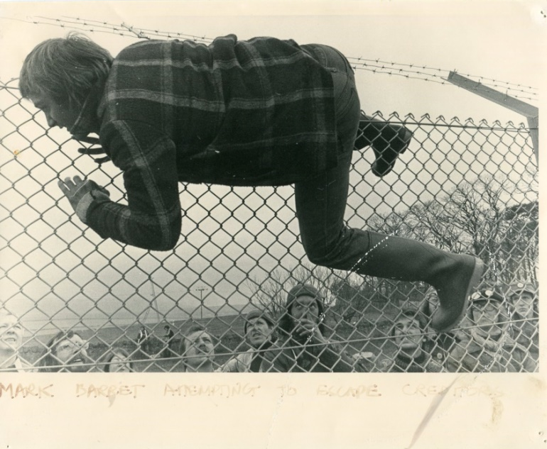
Civil nuclear power
Sizewell B PWR Public inquiry 1983
Modelling alternative projects providing same energy services:
CPRE - efficiency improvements to electricity demand
GLC - district heating for London
The Inspector concluded that the PWR would be in the national interest. Sizewell began generation in 1995.
Its economics were poor compared to alternatives. Carbon down, nuclear risk up.
Hinkley C Inquiry 1988
Government decided to put nuclear on hold.
Why? Post-Chernobyl concern about risk of accident, couldn’t privatise nuclear because economics so poor, no acceptable waste strategy…?
Now all these problems have apparently been solved so justifying the proposed huge public subsidies.
Public Inquiries are opportunities for public engagement in infrastructure projects having potentially major impacts.
Modelling isn’t the only method

Slide 12
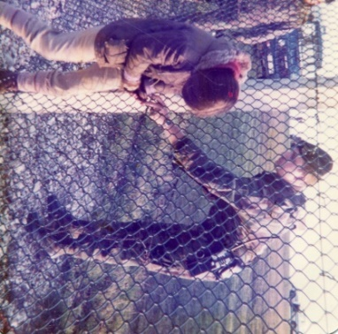
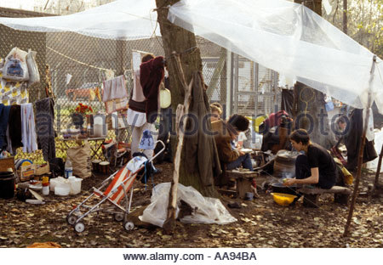
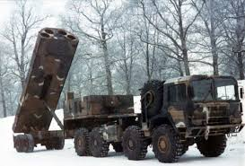

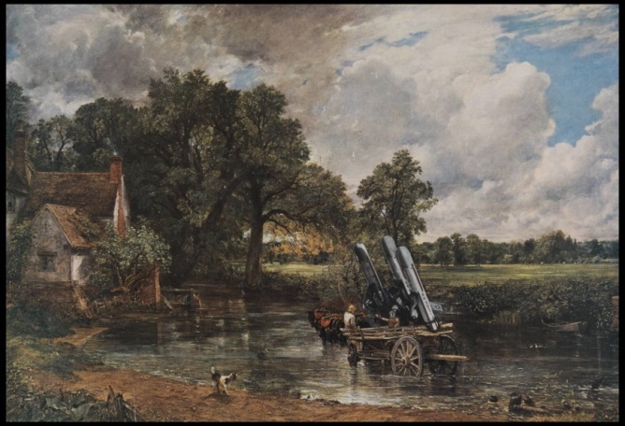
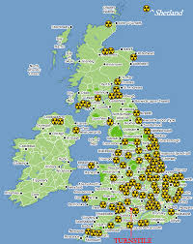
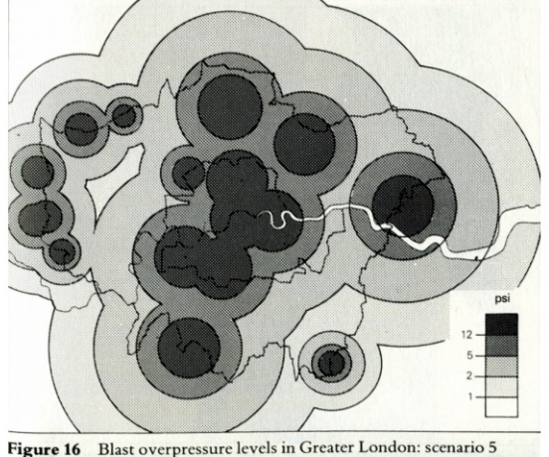
1985 Nuclear war civil defence planning
The Home Office refused to provide a planning basis of attack effects. So the GLC funded a study to meet the statutory requirement to plan for nuclear war.
There were these tasks:
Compile UK 1 km2 spatial database of people and infrastructure
Assume (Soviet) attack scenarios across whole UK
Model effects on people (death), infrastructure (destruction), agriculture (destruction) - blow everything up
Construct defence plan (go to New Zealand)
Thanks largely to women, the missiles went.
Protest and Survive.
1983-1992 Cruise missiles melting into the landscape

Slide 13

The sky’s the limit
Global aviation scenarios for Worldwide Fund for Nature 1990-96.
5%/a growth, 60% increase in 10 years
Technology measures inadequate to control emissions
Constraining demand growth is necessary
Impact of aviation research on trend

Slide 14
Energy scenarios
Constructing energy system designs that meet objectives at least cost.
Behavioural measures critically important.
UK scenario
Europe
Energy: how much biomass can we get?
Maximum technical measures
Aircraft global warming
Plus behaviour

Slide 15
Implementation
We know solutions to most energy and environment problems (but not aviation.)
To aid development, we need institutions to work with.
These institutions include NGO, central and local governments, and industry.
Working with these people is a great education.
For example, working with the Energy Saving Trust, we are providing online models for industry, decision makers and other stakeholders to use:
National Grid electricity demand model
Western Power Distribution electricity demand model
City energy and environment model

Slide 16

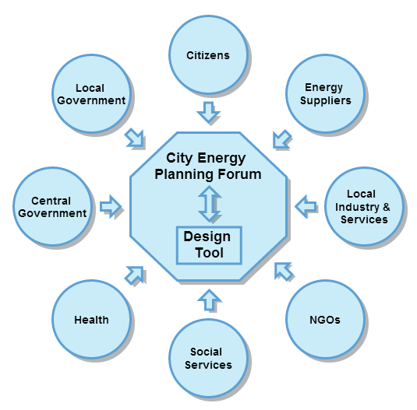
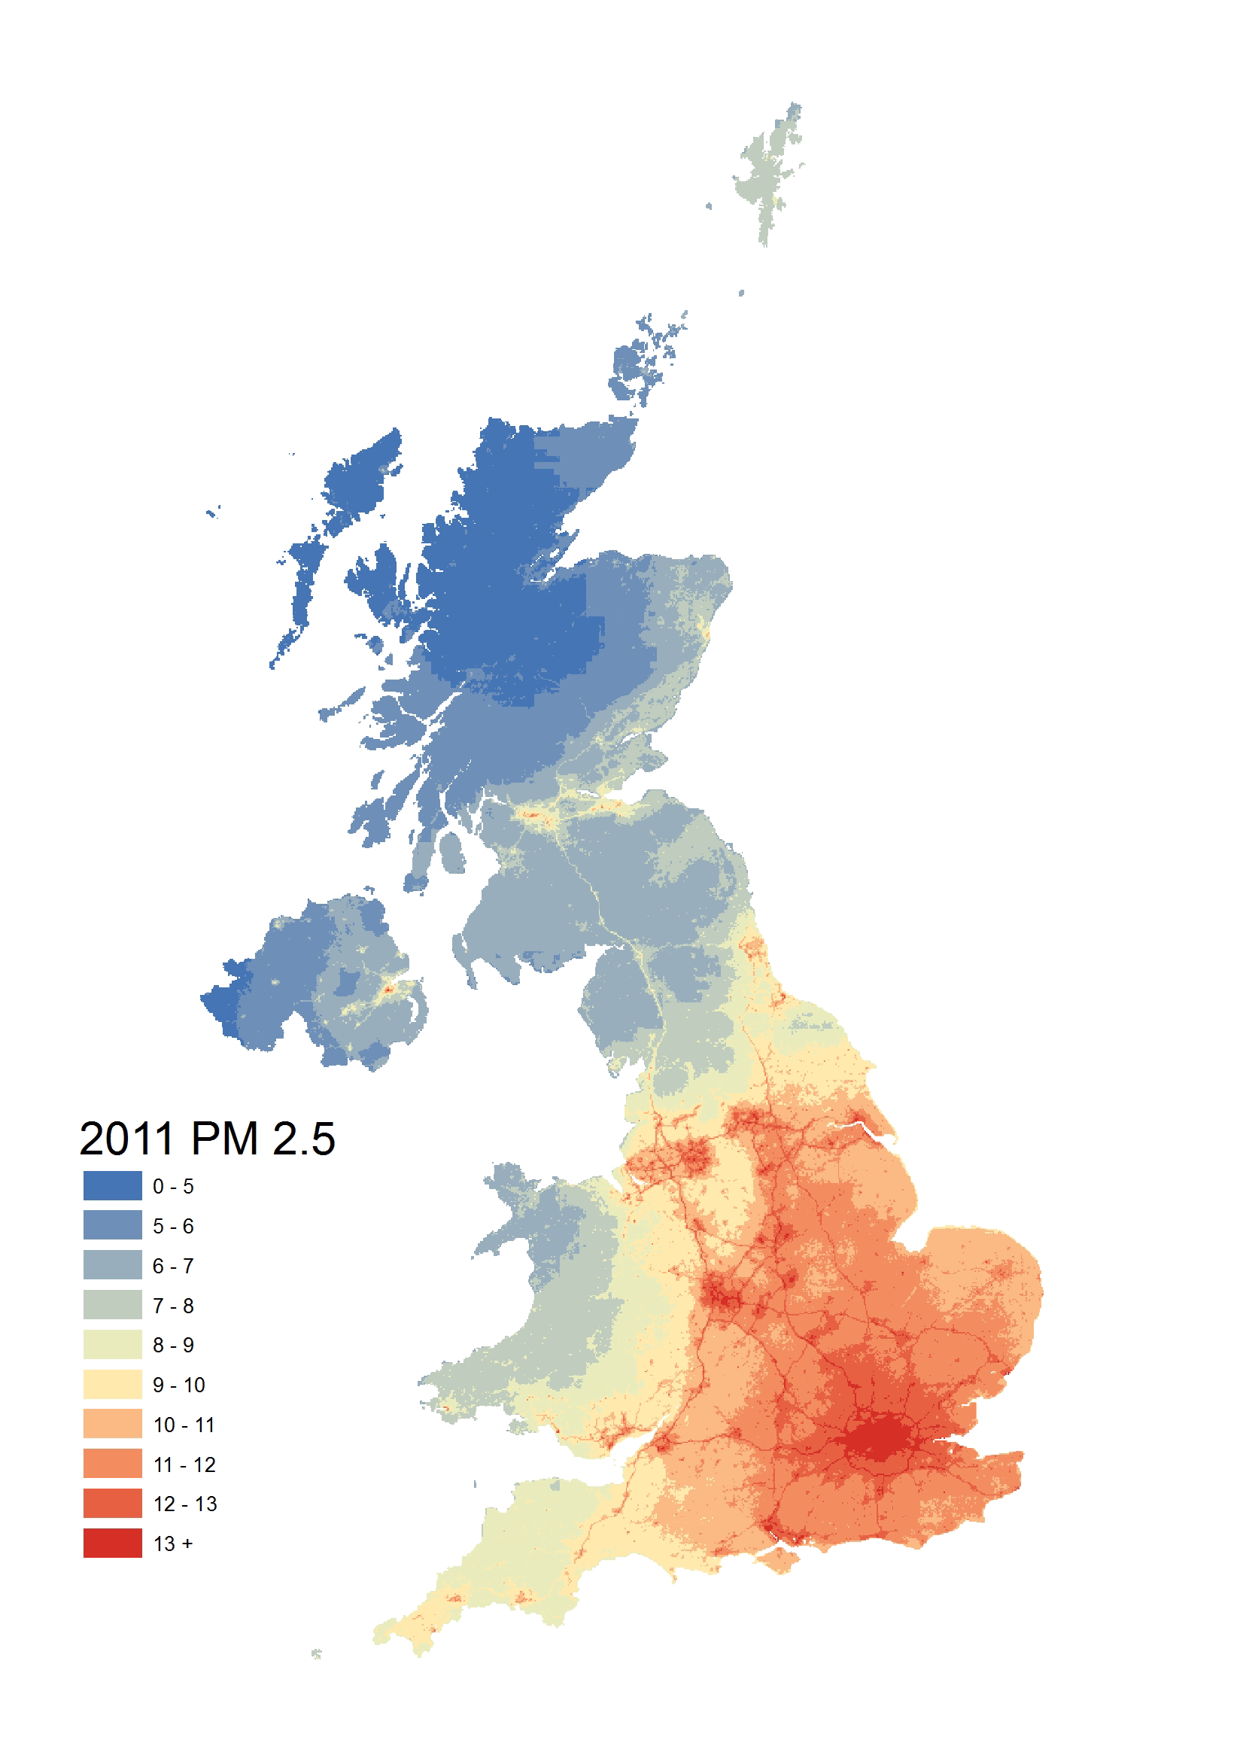
City energy and environment model
City population will grow by about 2.5 billion by 2050
Cities have pollution problems
SiCEDS model to calculate:
Energy demands in buildings and transport
City supply – district heating, solar, CHP
Costs
Pollution emission and concentration
Health
Being used in Birmingham and Exeter

Slide 17
Qualitative aspects of supply options
Qualitative aspects are major drivers of social and political technology choice, as exemplified by concerns about nuclear power, shale gas and carbon sequestration.
Can’t quantify everything
Mass produced renewables are the reversible, low risk, low cost option.
Relative subjective marks: 10 – good

Slide 18
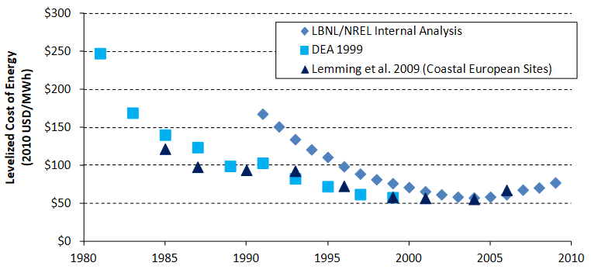
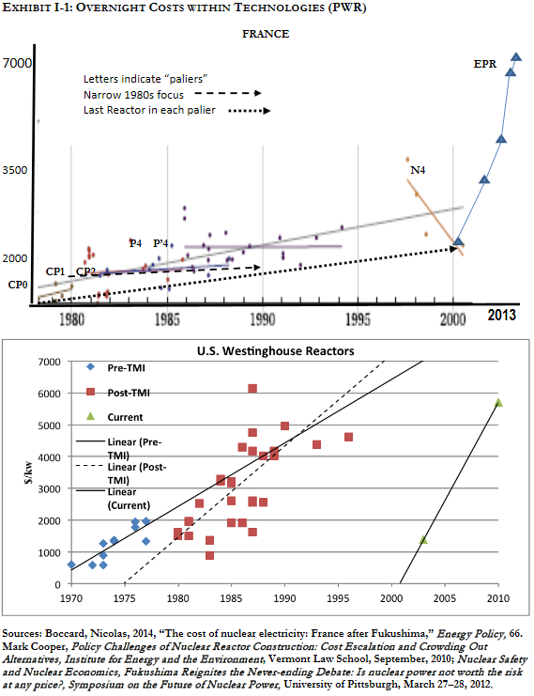
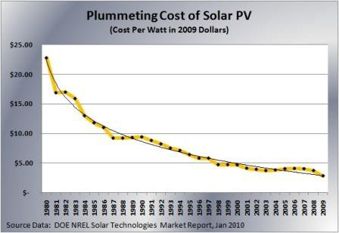
Zero carbon generation historic cost trends
For most technologies, costs fall with time through mass production; not nuclear.
Nuclear
Costs country dependent and opaque, but rising in Europe and USA. The penalty for learning about a dangerous technology.
Nuclear waste/decommissioning costs largely unknown
Wind ~ 75% reduction 1980-2010
Solar ~90% reduction 1977-2013

Slide 19
Demand and supply dynamics
5 days/month: Winter Spring Summer Autumn

Slide 20

International trade
Transmission evens out the variations in demands and renewable supplies
Means more interdependence and so promotes peace
What is the best balance between storage, transmission and trade?

Slide 21
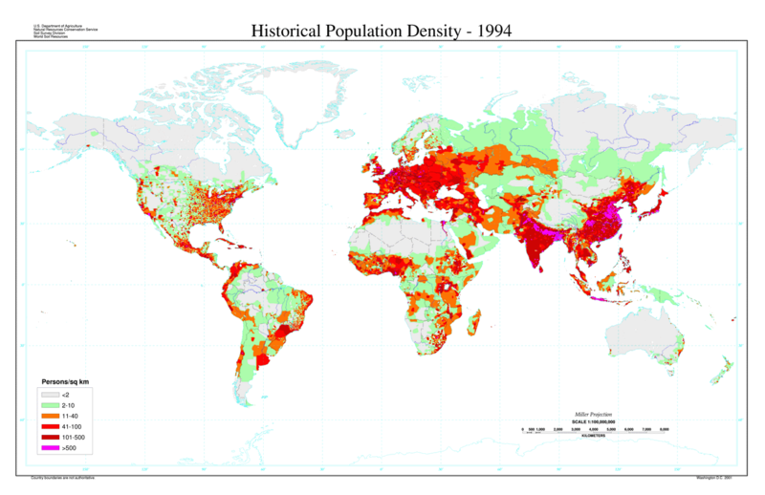
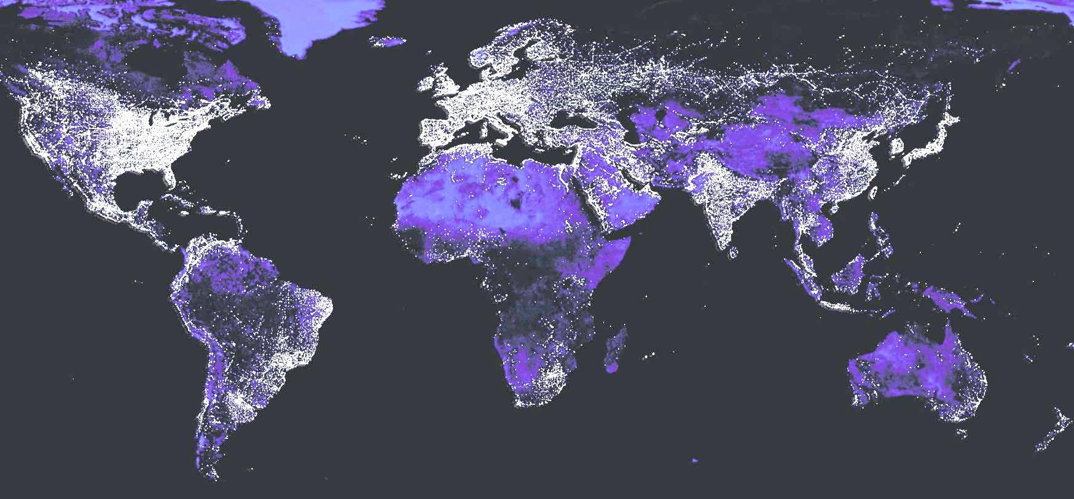
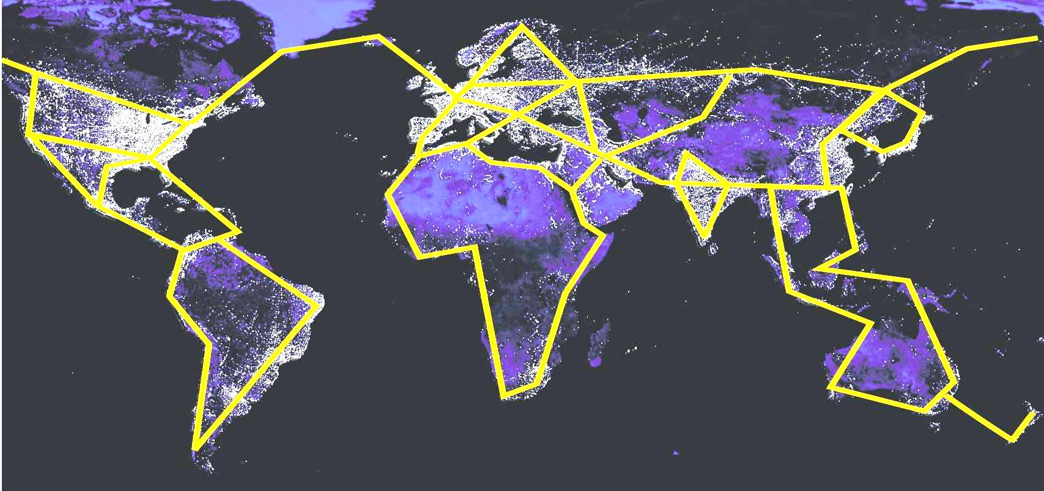
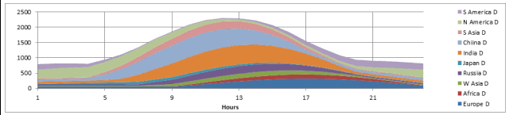
Global electric future?
Regular east-west diurnal, and seasonal north south, variations in demands and renewables
Match varying demand and supply with transmission as well as storage
Could high speed rail links follow similar routes to replace aviation?

Slide 22
Ending
Known solutions
100% renewable energy systems can supply any foreseeable demands in buildings, industry, land and sea transport
Things to avoid
Irreversible, risky nuclear is expensive, and has no waste solution
Fossil carbon sequestration has risks and is insufficient for near zero carbon
Outstanding problems
Growth in stratospheric jet travel is incompatible with climate change mitigation targets
Biomass energy has complex impacts and may be insufficient for aviation
???? ????

Slide 23

Genetics (no model!)
It is fifty years since the genetic basis of life was discovered.
Will this knowledge bring salvation or doom?
Will they eat of the apple and be banished from the garden?
Last Fall by Mark Barrett
(on Amazon)

Slide 24
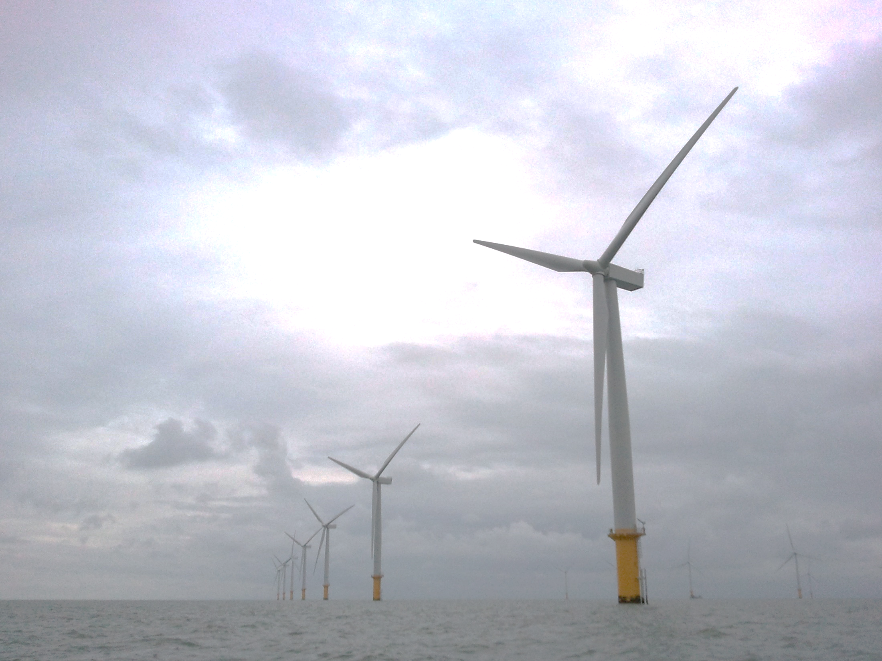
History is not cyclical
UK wind often generates more than nuclear
Solar recently supplied 25% of total demand
Thank you for listening

Slide 25
Some models built

Slide 26
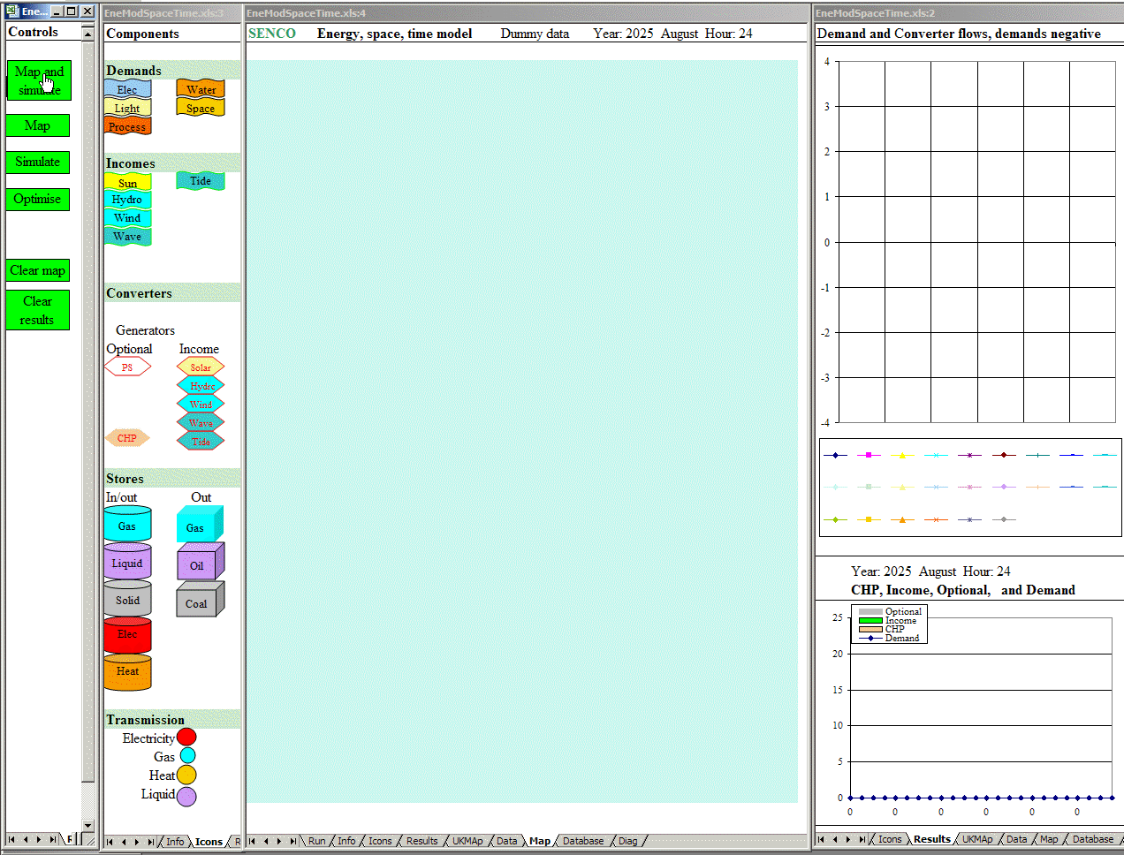
UK energy, space and time

Slide 27
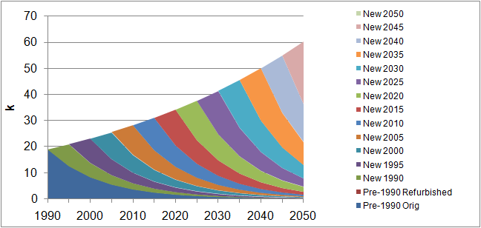
Lifetimes and rates of stock change
People ~80 years Dwellings ~ 100 years
Aircraft, ships, power stations ~ 35 years Cars, appliances ~15 years

Slide 28
Homo multicellulus – a life in boxes
People congregate in shelters and transport boxes where most of their energy services are delivered

Slide 29
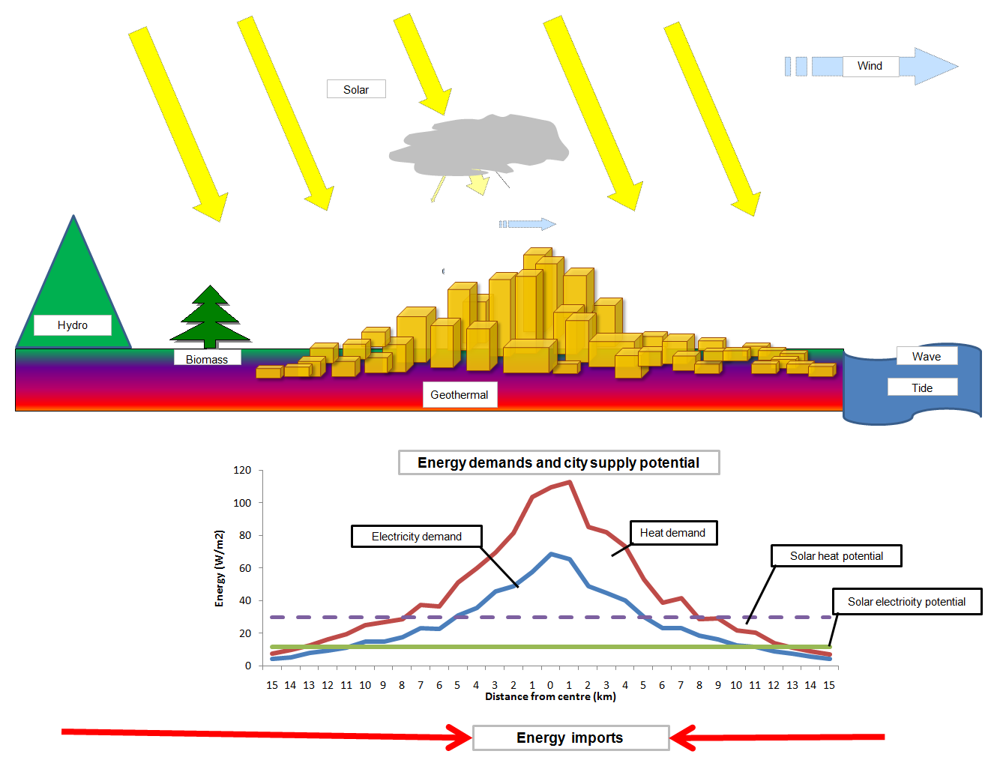
Leviathan – city level

Slide 30
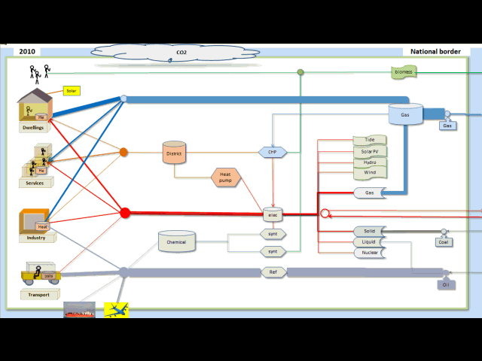
Leviathan’s evolution and physiology - the national energy system
Notes:
Energy demand, conversion and storage. Control system

Slide 31
Demand and supply system integration
Demands
Demands vary with activity and weather (temperature, wind, solar)
Heat pumps, solar energy vary with weather
High renewable fractions will include a large wind component:
How to deal with a deficit or surplus of renewable energy of 50 or 100 GW?
Supplies:
Renewables vary with weather
Dispatchable renewables
Matching:
Storage – heat, chemical, mechanical
Dispatchable supplies - fossil/biomass, some hydro
Transmission and trade
A large fraction of electricity will be used for heat.
Electricity is expensive to store, heat is cheap to store

