Slide 1
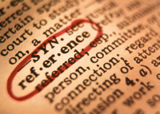
Bibliographic Referencing at the UCL Institute of Archaeology: Introduction and Refresher
Bibliographic Software Working Group & Academic Writing Support Team

Slide 2
What are references/citations?
‘Publications of many kinds employ pointers within the main body of the text to refer the reader to explanatory or additional material either on the same page or elsewhere in the work. Academic publications in particular need an apparatus to provide references to support, and sometimes to clarify and amplify, what is said in the text’.
New Hart’s Rules. The Oxford Style Guide. 2014. Oxford: Oxford University Press: 330.

Slide 3
Referencing: an overview
One of the essential skills for conducting research is being able to manage, organise and keep control of all the information sources you use in your work.
You will need to be able to easily record the full details of your sources, including how you found your information, so that you can easily find it again.
You also need to be fully aware of how to use information responsible and ethically. This includes correctly citing your sources to ensure academic integrity, to avoid plagiarism, and to ensure anyone reading your work can trace your sources.

Slide 4
Why do we reference or ‘cite’ in academic writing?
show that you are writing from a position of understanding of your topic
demonstrate that you have read widely and deeply
enable the reader to locate the source of each quote, idea or work/evidence (that was not your own)
show how you can use evidence and data creatively to form your own unique insights and ideas
support arguments and statements;
show which are the writer’s own ideas and data and which have been reported from the work of others;
to remind the writer of the original source of the information (references may be useful to the author, as a revision tool for example, as well as to readers).

Slide 5
Why do you need to reference? Why is referencing correctly so important for your assignments?
CRITERIA | SCALES
 | Outstanding | Excellent | Good | Fair | Adequate | Inadequate
Argument Does the essay answer the question, use a clear structure and build to a relevant conclusion. | Impressive response with relevant & nuanced argument, presenting significant nuanced & insightful conclusions. | A distinctive response that develops a clear argument & sensible conclusions, with evidence of nuance. | A sound response with a reasonable argument & straightforward, logical conclusions. | A reasonable response with a limited sense of argument, poor structure & partial conclusions. | An indirect response to the task set, with a gesture towards a relevant argument & conclusions. | Either no argument or argument presented in inappropriate & irrelevant. Conclusions absent or irrelevant.
Understanding Understanding of relevant issues and their relation to core concepts in arch theory/methodology. | Striking understanding of complexities & significance of issues. | Thorough understanding of issues with some sophisticated insights. | Sound understanding of issues, with insights into broader implications. | Reasonable understanding of the issues & their broader implications. | Rudimentary, intermittent understanding of the issues with confusions. | General misunderstanding of the issues under discussion.
Evidence Empirical knowledge and use of case-studies, selection of appropriate case-studies | Claims supported by impressive, detailed, distinctive and reflexive analysis of data. | Impressive, highly relevant & detailed evidence used to support most claims. | Significant amount of quality evidence, used to support most claims. | Some use of evidence but limited in quality & not always effectively used to support claims. | Evidence is limited in quality and quantity. Claims rarely backed up. | Evidence absent or irrelevant/ inaccurate. No evidence to support claims made.
Analysis Critical reflection + ability to recognise and evaluate own and other scholars’ assumptions. | Impressive and original thought, insights & analysis. Concepts deftly defined & accurately used with a strong sense of context. | Evidence of innovative analysis. Concepts deftly defined & used with some sense of theoretical context. | Evidence of student’s own analysis. Concepts defined & used systematically & effectively. | Reasonable reproduction of ideas from taught materials. Rudimentary definition & use of concepts. | Analysis relying on the partial reproduction of ideas from taught materials. Some concepts absent or wrongly used. | Erroneous analysis. Misunderstanding of the basic core of the taught materials. No conceptual material.
Sources Use of an appropriate range of relevant sources, discrimination of relative value of different sources. (3rd years: reading beyond reading list) | Ambitious reading & impressive understanding of relevant literatures. | Extensive reading & thorough understanding of literature consulted. | Evidence of plentiful relevant reading & sound understanding of literature consulted. | Evidence of relevant reading & some understanding of literature consulted. | Significant omissions in reading with weak understanding of literature consulted. | Very limited or irrelevant reading.
Writing Spelling, grammar, fluency; use of appropriate vocabulary | Style & word choice greatly enhances ideas & demonstrates verve. | Style & word choice show fluency with ideas & flashes of verve. | Style & word choice rarely detract from conveying of ideas. | Style & word choice sometimes detract from conveying of ideas. | Style & word choice seriously detract from conveying of ideas. | Style & word choice seriously interfere with comprehension.
Visuals Appropriate use of tables, charts & illustrations. Clarity and effectiveness in supporting argument. | Visuals actively contribute to argument & synthesise data in original forms. | Visuals actively highlight points and contribute to argument. | Visuals are generally presented effectively. | Visuals occasionally distract from argument or are poorly presented (size, legibility). | Visuals are missing or seriously detract from argument. | Visuals absent or irrelevant/ inaccurate.
Referencing Accurate citations and bibliographic formatting following IoA guidelines. | Claims fully supported by accurate citations and bibliography. | Claims supported by accurate citations and bibliography. | Citations and bibliography are generally accurate and complete. | Citations and bibliography are sometimes inaccurate and incomplete. | Citations are limited in accuracy. | Bibliography/ citations missing or inaccurate.

Slide 6
Using references: reading and writing
Using referencing in written assignments may seem daunting, but you’re already familiar with referencing through your reading – whether it’s e-books and journals or print.
There are several different forms of referencing that you will encounter in your academic work. The next slides give you examples. You will probably recognise them already.
NB: All referencing systems have two elements: a quick note associated with the text and a more detailed reference. You will need to ensure you have BOTH these elements in your work too.

Slide 7
What do they look like? Harvard
In-text reference
Reference list

Slide 8
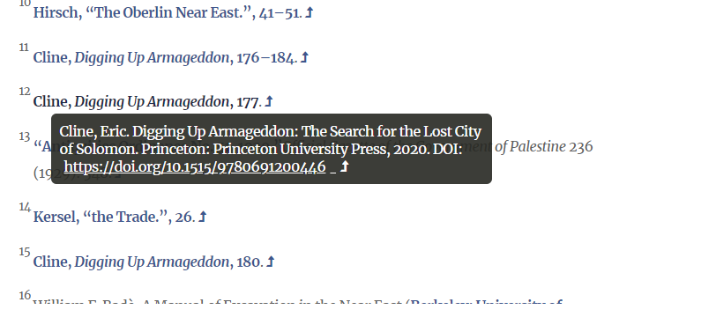
What do they look like? End Notes
End Note in text
End Note Reference
Expands to:

Slide 9
What do they look like? Foot Notes
Notes in text and full references directly below

Slide 10
What do they look like? No references
Here, there are no references in the text at all.
This generally means a book is a popular work.

Slide 11
When do YOU need to reference?
You must cite the source every time you incorporate research, words, ideas, data, or information that is not your own, even if it is from something which you do not consider 'academic', such as an unregulated website. (Technically, it is probably best to avoid these sources of information anyway)
While you are synthesizing and often summarizing many pieces of information, you must cite any concept that is not your own.
This includes any source that contributes, either directly or indirectly, to your knowledge and understanding of the material and the formulation of your arguments

Slide 12
You should reference if:
You do not have to reference if:
You are quoting exact words directly from another’s work.
You are using a famous quotation.
You are paraphrasing text written by someone else.
You are summarising ideas or points from someone else’s work.
You are reprinting tables, charts, diagrams, data, statistics or pictures.
You are using someone else’s idea.
You are writing from your own experience, experiment, opinion or analysis.
The information is ‘common knowledge’.*
The information is a widely accepted fact.
You are summarising ideas from several sources in order to describe what happened over a specific period.
*Very little knowledge is actually ‘common’. If in doubt, cite…

Slide 13
The most important thing about referencing?
Keep your referencing consistent throughout your work – both in-text and in the reference list.

Slide 14
Worried about plagiarism?
Referencing and avoiding plagiarism tutorial
Tips for avoiding plagiarism

Slide 15
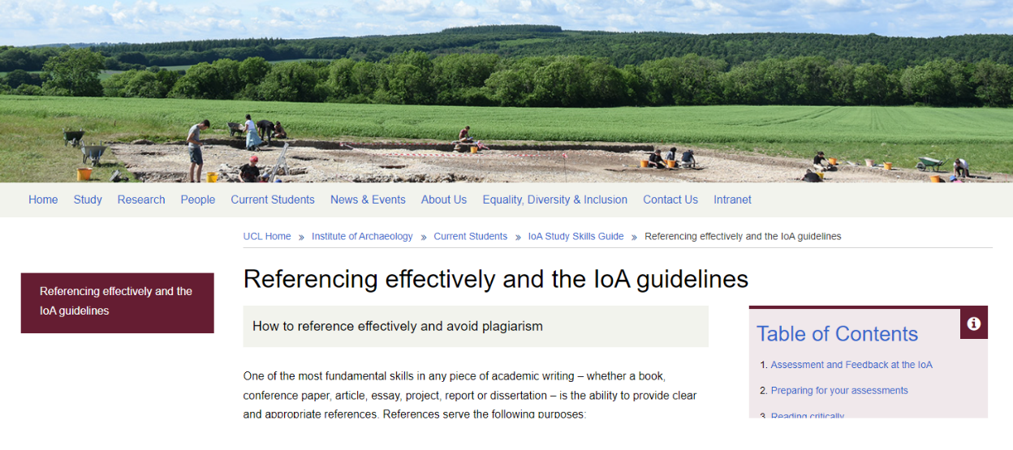
Information on referencing at the IOA
UCL Library Services guides
UCL Institute of Archaeology
Referencing glossary

Slide 16
Referencing systems: the IOA choice
The IOA uses the Harvard system, specifically the Harvard Cite Them Right style
You may find it useful to think of this using one of its descriptors:
An ‘Author-date system’

Slide 17
The Harvard System: in-text
The Harvard system uses a combination of in-text citations and a reference list or bibliography – the two elements mentioned earlier.
In-text citations are in an author-date format. This means that when citing a source in your work you will include:
author(s) or editor(s) surname or family name.
year of publication.
page number(s) if needed.

Slide 18
The Harvard System: reference list
The full reference to each source that you cite in your work should be included in a References section, at the end of the essay. This will list each source referenced, ordered alphabetically by author's surname.
The information included will broadly include:
Who has ‘made’ the item (the author, creator, compiler…)?
What is it called?
If part of a larger work, what is that called?
Where was (is) it disseminated/published?
Who is responsible for the dissemination/publishing?
When was it disseminated/published?
A direct quotation, or allusion, should always include the page number(s).

Slide 19
The Harvard System: guides & tutorials
Using the UCL Library Guide to Harvard is recommended.
Particularly the left hand toolbar!
Tutorial on using Harvard
FAQs
Harvard References A-Z – this gives you lots of different examples

Slide 20
Harvard Cite Them Right
There are many variations of the Harvard style. The IOA uses Harvard Cite Them Right.
Always remember to adapt any citations/references you collect to the Harvard Cite Them Right style when doing assignments/dissertations
You can find the Cite Them Right guide as an e-book through the library catalogue.
You need Section E: Harvard Referencing Style.
NB: You can’t download the whole book, but you can download the section you need – section E.

Slide 21
Worried about getting your references right?
Referencing is very standardised with underlying ‘rules’ or patterns. You might find it helpful to look for different elements of this pattern and how they repeat, notably punctuation.
Look over the introductory examples given in the document that accompanies this presentation.
Also use the Harvard A-Z list from UCL Library Services and if necessary, make any small changes to match the Harvard Cite Them Right style

Slide 22
Using bibliographic software to manage your referencing
Once you are familiar with the process of referencing, you can use bibliographic software packages to provide an easy, quick way to manage the referencing process.

Slide 23
Using bibliographic software to manage your referencing
There are many software packages available and everyone will have their own personal preference. Information on the packages UCL supports is available through our reference management software guides – includes start-up videos, and other resources.
Training sessions in these packages (predominantly online) are also available.
UCL supports:
EndNote. Online guide to using EndNote
Mendeley. Online guide to using Mendeley
Zotero. Online guide to using Zotero

Slide 24
Any questions & getting help
If you’re struggling to get to grips with referencing, then you may want to try the @Library Skills Moodle module
You can get 1:1 help through the UCL Institute of Archaeology Academic Writing Support team Institute of Archaeology
You can also email the librarian, Katie Meheux (k.meheux@ucl.ac.uk) for a 1:1 session in person or online.

