Slide 1
Medical Anthropology and the Anthropocene
  How are human bodies affected by and responding to the Anthropocene context?
  What are the consequences for health and wellbeing of ongoing environmental degradation, loss of biodiversity and climate change?
  What are the ‘embodied inequalities’ of the Anthropocene as this concerns health and illness and how can we understand, address and mitigate them?

Slide 2
New Challenges and Opportunities
  A cross-disciplinary agenda ?
    Medical Anthropology emerged/evolved in dialogue and collaboration with human ecology, public health, clinical medicine and global health as well as STS/ Geography, History (Medical Humanities)
    From ‘Biology, Biomedicine and Technology’ as a context or culture (Lock and Nugyen 2010) to terrain of collaborative research: Biocultural Anthropology, Biosocial Medical Anthropology
  Re–tooling Embodiment in medical anthropology of the Anthropocene
    Embodiment as key concept – from phenomenology to material feminism and beyond
    E.g.
      Temporal politics of embodiment: (Landecker) : how ‘human social histories constitute environments inside us as inherited metabolic patterns’ which register at the level of the cell’(2011/2017)
      Scalar approach to embodiment (Agard Jones): the ‘multiple level at which our material entanglements be they cellular, or commercial are connected to global politics’ (2016)
      Embodied Inequalities (Gibbon and Gamlin):

Slide 3
Three themes for Medical Anthropology
Indigenous Epistemologies, Health and the consequences of the Anthropocene
Human-Animal Health, (Ecology), Care and Biopolitics
Gender, Reproduction and Environmental Justice

Slide 4
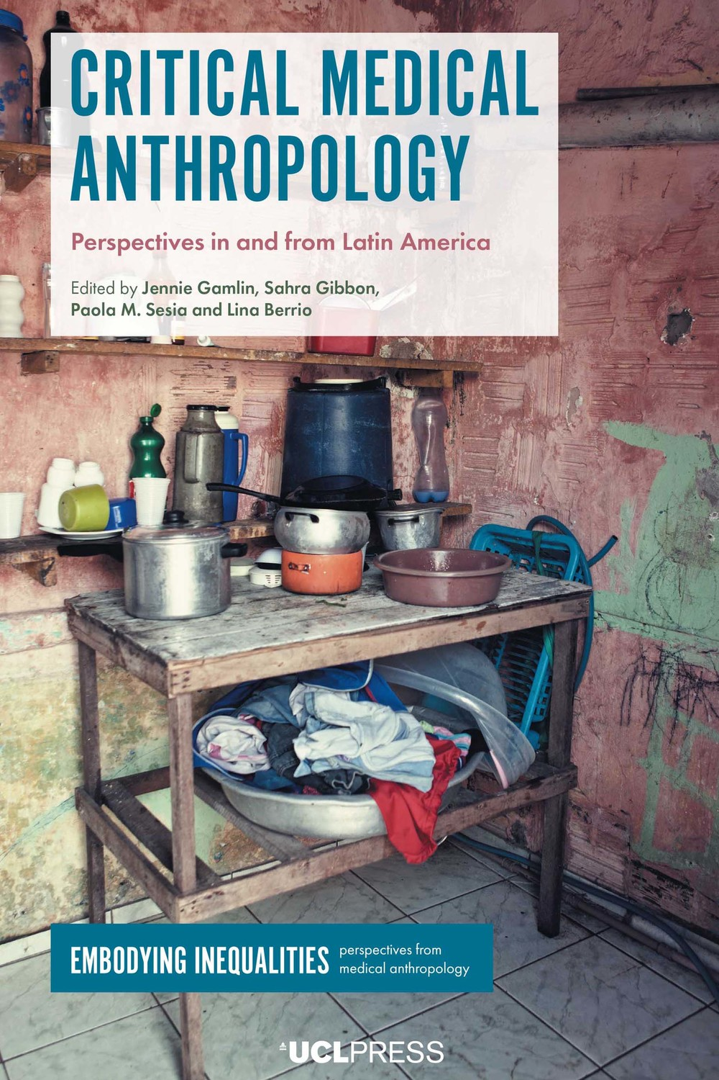
Indigenous Epistemologies and the health consequences of the Anthropocene
Urgent need to ‘decolonise knowledge’ in light of growing health effects of climate change and loss of global biodiversity (Tsing 2005)
Long history of critical medical anthropology (e.g. Scheper Hughes, Farmer, Petryna and Biehl) which now needs to incorporate ‘critical’ perspectives from non-English speaking and non-western approaches. e.g Latin America, Africa, Asia etc

Slide 5
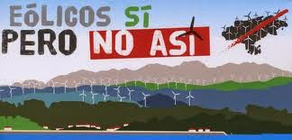
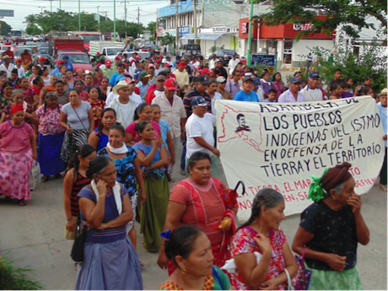
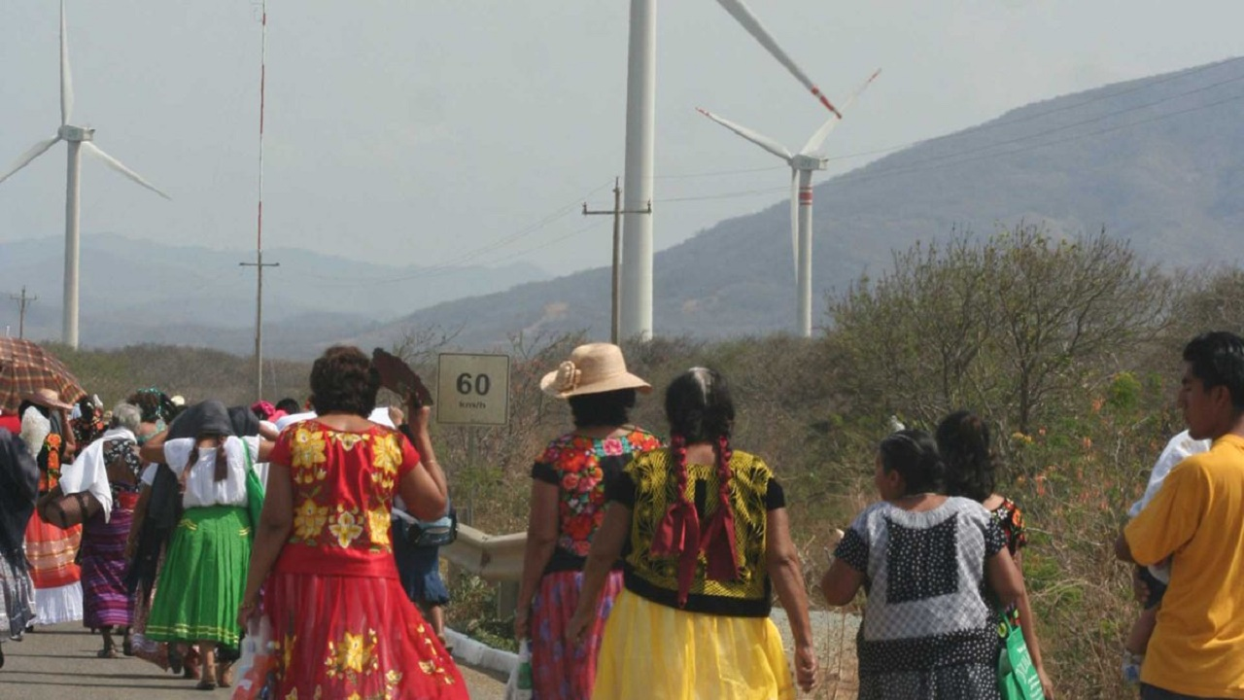
Undermining of indigenous knowledge and communities in globally ecologically vital Amazonian region (e.g. Brazil)
Indigenous experiences of sustainability programmes and unexpected negative health effects e.g. Mexico and impact of wind farms on diet and ecosystems (Altamirano-Jiménez 2017, Dunlap 2018 ).

Slide 6
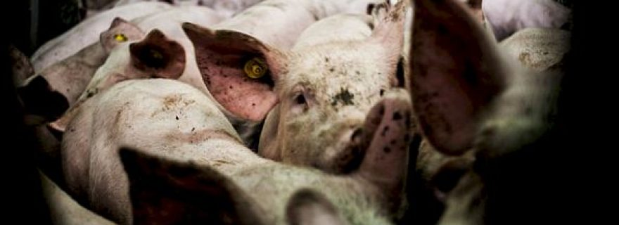
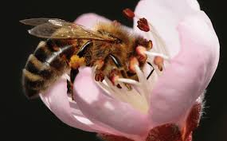
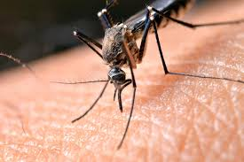
Human-Animal Health and Medical Anthropology
relevance of non-western world view that does not see a separation between environment, planet, human and non-human life: multi-species anthropology/ethnography (Kirksey and Helmreich 2010)
Particular relevance of in context of vector borne infectious disease: Zika, Ebola, Dengue, (Covid-19)
For medical Anthropology challenge and opportunity to re-think questions of ‘ecology, biopolitics and care’ (Brown and Nading 2019)

Slide 7
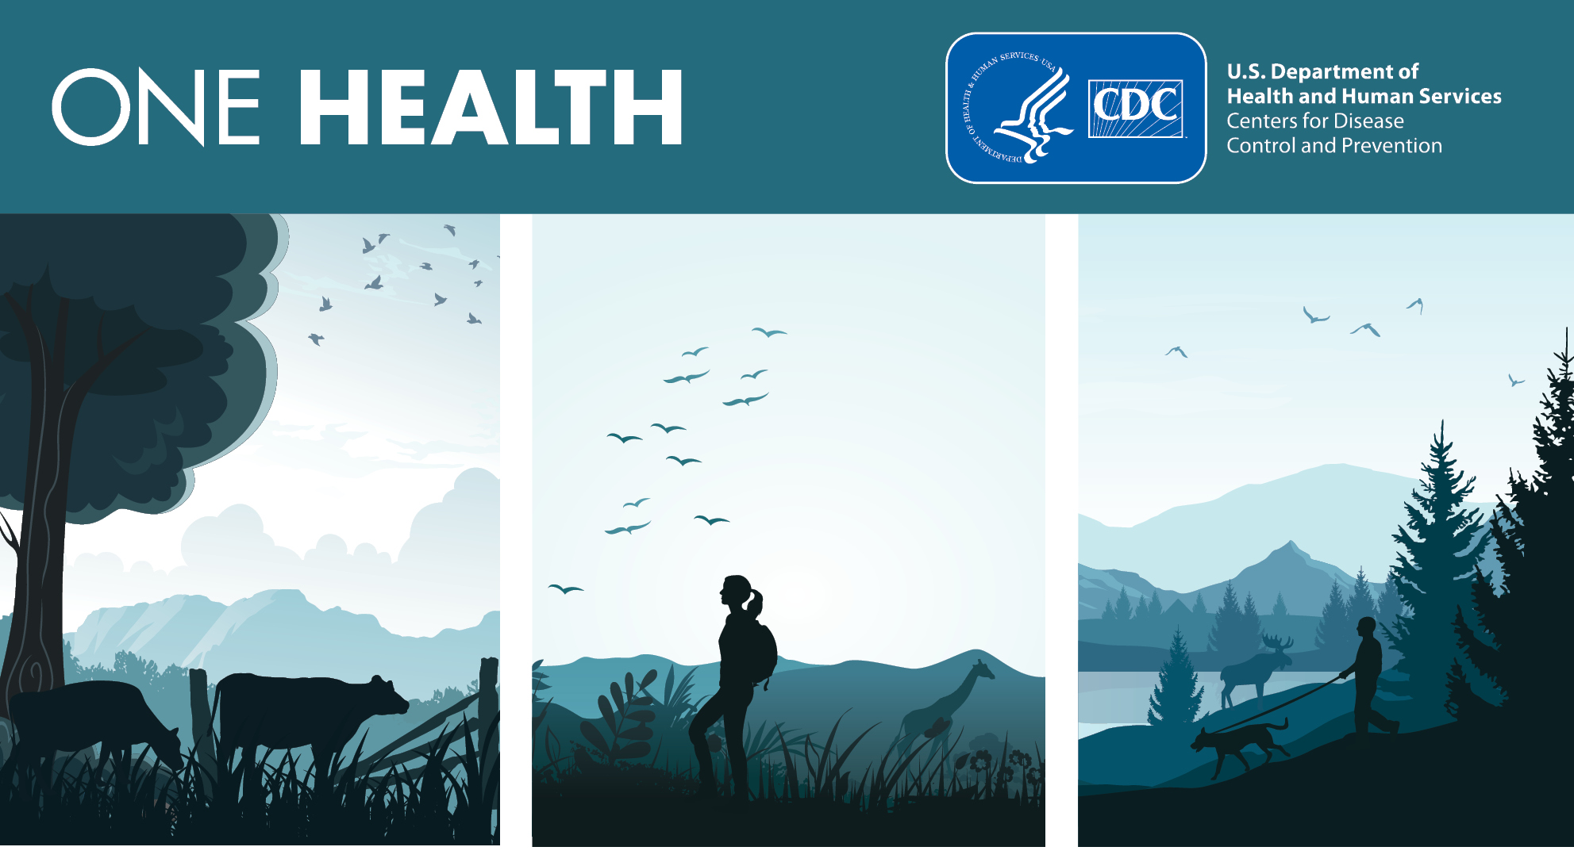
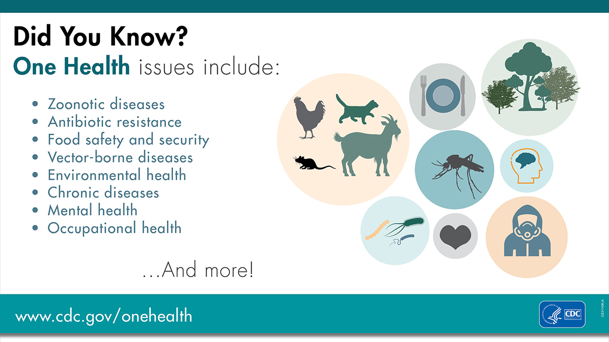
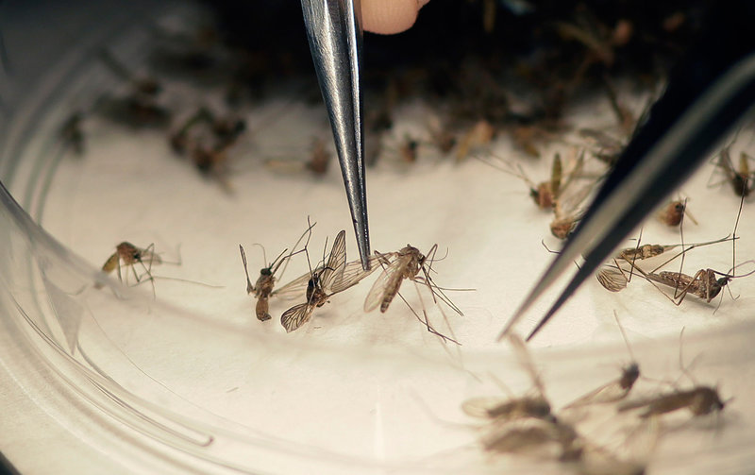
‘One Health’ global health agenda to ‘connect human, animal and environmental health’
  A new kind of ‘multi-species biopolitics’ and ‘global assemblage (Ong and Collier 2006)
  Problem of ‘abstract ecosystem model’ /animals only as ‘carriers of disease’ and ‘predictive approach’; (Brown and Nading 2019, Rock 2017)
Care: as relational, affective, linked to moralities/religion, inequalities and global political economies in diverse context of human-animal relations (e.g. Frieze, and Latimer 2018, Hurn and Badman-king 2019, Ticktin 2019)
  E.g. developing transgenic Mosquitos as tools for disease control (Lezaun and Porter 2015)

Slide 8
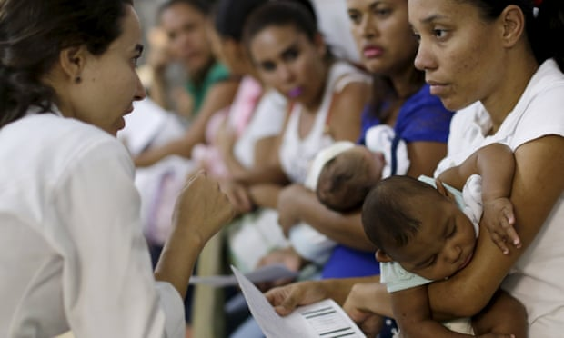
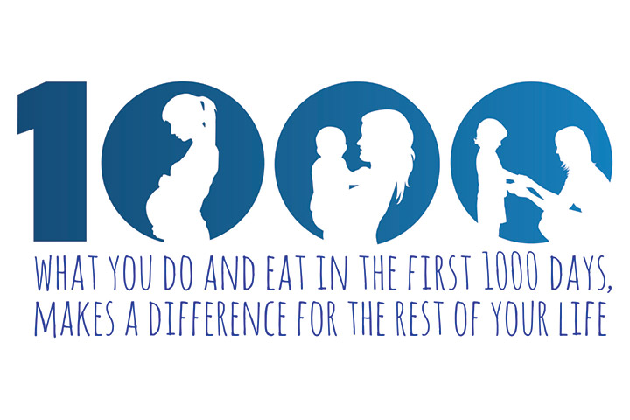
Gender, Reproductive Rights and Environmental Justice
Challenge idea that Anthropocene is a ‘human’ crisis where gender or feminist approach is not relevant and the homogenization of environmental consequences (MacGregor 2010, Dow and Lamoreaux forthcoming)
How human reproduction is directly bound with environmental issues in context of Anthropocene (Lappe, Hein and Landecker 2019, Haraway, Clarke and Murphy 2018)
  E.g. Zika Epidemic : Mosquitos, climate change and ecosystem change but of reproduction, and governance of women (Diniz 2017, Lowy 2018)
  E.g. Impacts of pollution in context of reproduction and reproductive rights/ questions of toxicity ( a long history e.g Carson Silent Spring) now new objects of study -Murphy 2011, Agard-Jones 2016)
  Women and pregnancy as ‘first/causal’ environments DoHAD/First 1000 Days/focus on ‘maternal environments’/ flattening of physical and social environments ( question of responsibilities) (Pentecost 2017)

Slide 9
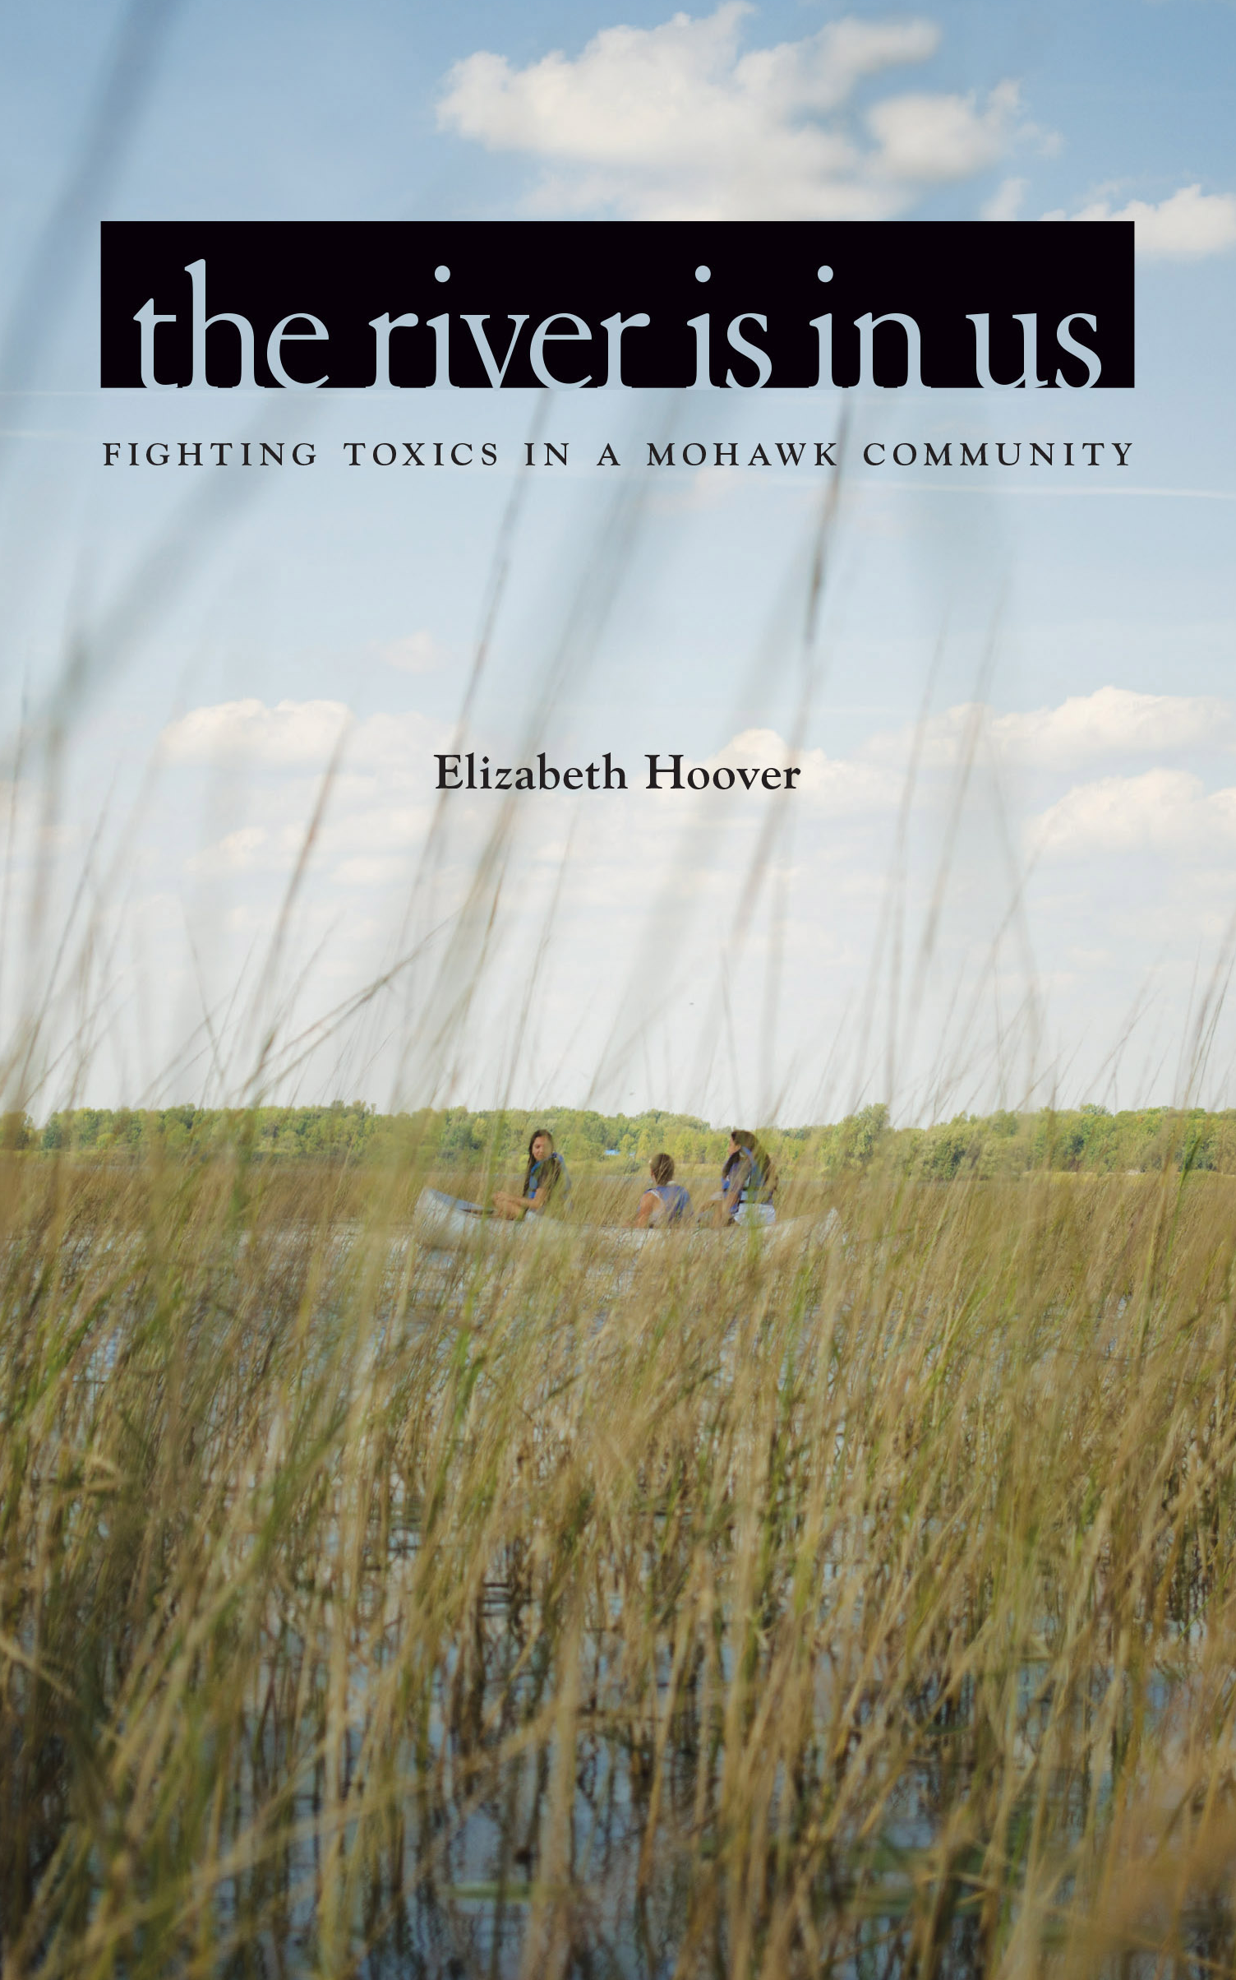
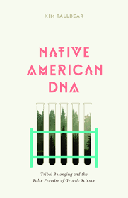
Foregrounding of reproductive justice or environmental reproductive justice (Hoover 2017) – moving beyond individual choice/rights
Feminist Intersectional Approaches : gendered subjectivities, race, class, colonialism and inequalities : as activism and method work across contexts and scales
  Kim Tall Bear 2011 :climate change, multi-species environmental awareness, reproductive advocacy not separate
  Vanessa Agard Jones 2016 role of endocrine disrupters in Caribbean : how bodies connected to ‘commodity chains, uneven colonial relations, postcolonial power and world system’
  Elizabeth Hoover 2017: ethnography among Mohawk how exposure to environmental contaminant PCB /stratification in distribution of industrial food waste affects ability to reproduce health children and culture – reclaiming reproduction in ‘de-colonized’ terms

Slide 10

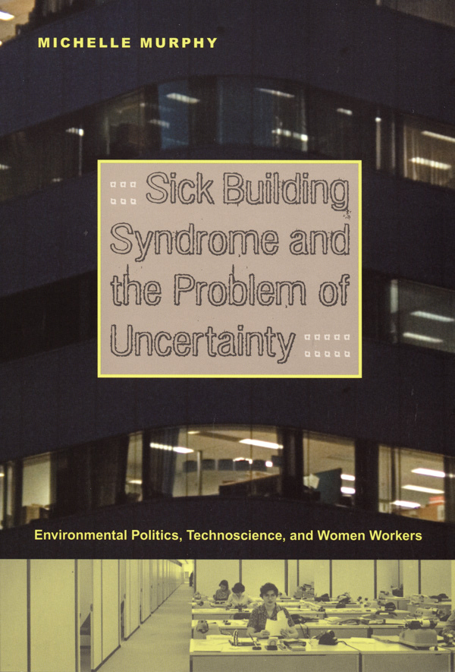
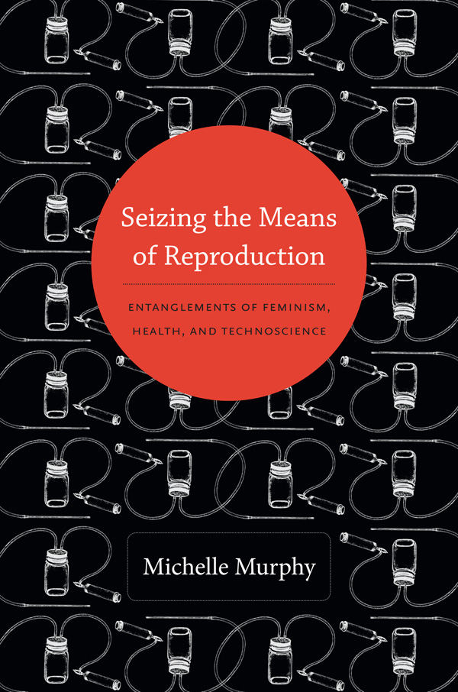
Question of structural inequalities gender, reproduction and environment centre stage
Distributed Reproduction (Murphy 2011, 2017)
  : reproduction as process that does not ‘just end at the skin’ or is only ‘in the body’ but is located in infrastructures
  : this includes ‘the temporal effects of chemical infrastructures, …state, military, agriculture and economic architectures’
Scalar contexts and consequences of Embodied Inequalities
(see also ‘Politics of Habitability’ Langwick 2018 , ‘Toxic Politics’ Liboiron et al 2018)

