Slide 1
Perioperative cases
Dr Rob Stephens
A Gasser, but so much more

Slide 4
Anaesthesia & Periop Medicine
13.30 Dr Rob Stephens
Perioperative Cases
14.30 Dr Sam Bampoe
Critical Care Case
15.30 – 16:00 BREAK
16:00 Dr Mo Khaku
Pain cases

Slide 5
What’s the Point?
Pass finals
Better FY Doctor
Understand what’s going on
Treat pain well
Reduce suffering
Transferrable skills

Slide 6
Introduction
Website, tutorials, coming to theatre
What you can take away from us?
Acute care (BLS, fluids, pre/postop care, CVS)
Who’s at risk from surgery? How can we help?
Physical skills (cannulae, airway etc)
How to prescribe drugs in the real world!
Likely postoperative complications

Slide 10
Each week
Topic of the week- workbook + tutorial
Article of the week
Podcast of the week 6-9 mins
1-4 SBA of the week 3 mins each
Come to theatre at least 2-3 days each 6 weeks- site specific
‘Key issues of the week’

Slide 11
Key issues

Slide 12
Key Issues of the week
Chapter 1 Pre-operative patient: Cardiac & Respiratory Systems
Walking up 1 flight of stairs without symptoms- a key fitness measure
Dysrythmias/Ht failure/ Ischaemic Ht Disease before surgery is a big deal
Carry on most drugs especially β blockers
But stop ACE inhibitors / Consider stopping Anticoagulants
Great caution re stopping any anticoagulation in those with coronary stents

Slide 13
Only 50 minutes!!
Search ..‘department of anaesthesia’

Slide 14
Anaesthesia, Surgery Perioperative Medicine
=Taking care of people having surgery
2-3M/year UK
may die = risky
having surgery is not nice
Pain, disruption, damage, long term etc
Before and after important for Finals / FY 1,2
Anaesthesia and actually doing surgery important – but not for Finals / FY
Come to theatre: “What am I learning + why?”

Slide 15
A dilemma
Eg Heart failure – Module A
CXR ECG etc – Module A
Movement, GI, Perioperative – Module B
Other stuff module C
Feels like you don’t know anything
But have to start somewhere
Chat to patients, Drs, Look at tests, Ix,

Slide 16
Stuff we’ll chat about
Why is Anaesthesia dangerous?
Anaesthesia Hx +Ex
similarities & some differences
What should worry us before surgery
What Ix and Mx do we do before surgery?
What can happen after surgery
and…

Slide 17
A brief guide to increasing your CXR confidence
At some point we’ll have..

Slide 18
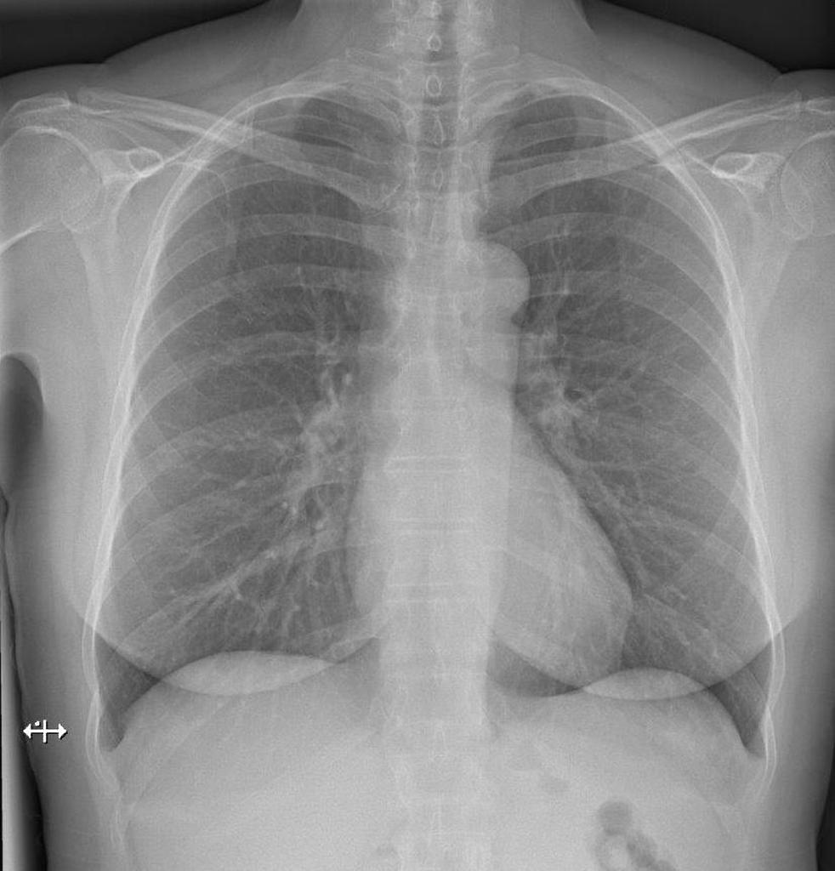
We’ll also have some

Slide 19
and

Slide 20
and

Slide 21
But first
What have you learnt a bit of so far?

Slide 22
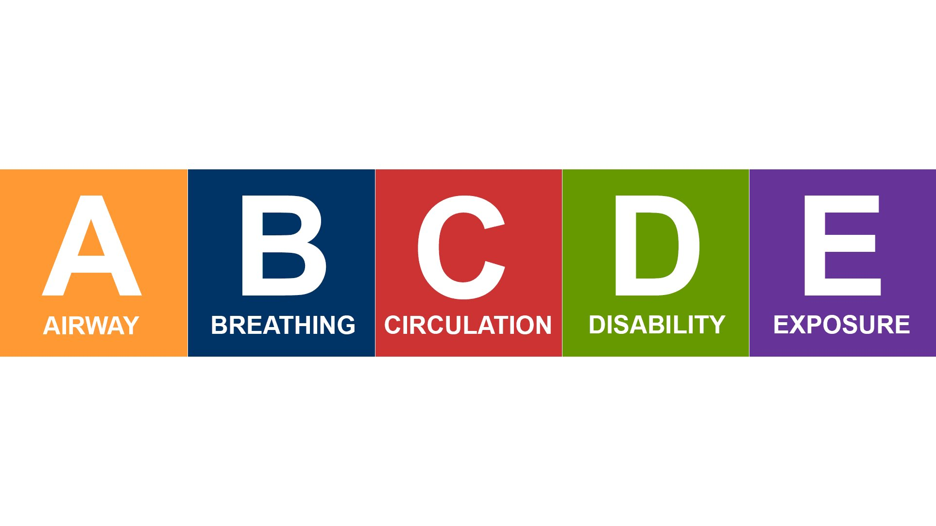
History
Examination
Investigation
Management
Side Effects
CVS
RS
GI
GU
NS
Other
Danger
Response?
DR

Slide 23
Anaesthesia
Triad of Anaesthesia
Hypnosis
Analgesia
+/-Neuromuscular paralysis

Slide 24
Anaesthesia: why’s it dangerous?
Triad of Anaesthesia
Hypnosis
Analgesia
+/-Neuromuscular paralysis

Slide 25
Anaesthesia- Hypnosis
Hypnosis = reducing consciousness
Either I/v or volatile
I/V Thiopentone, Propofol
Volatiles- gasses- eg Sevoflurane
Depresses function
I/V Ketamine
Different side effects
CVS
RS
GI
GU
NS
Other
MAP = CO x SVR

Slide 26
Anaesthesia
Triad of Anaesthesia
Hypnosis
Analgesia
+/-Neuromuscular paralysis

Slide 27
Anaesthesia: Analgesia
Psychology eg explain, kindness
Physical eg reduce swelling, cold compress, fix #
Systemic – ‘ladder’ plus adjvants (extras)
Simple –Paracetamol
NSAID – oral, I/v
Opioids = any drug acting on opioid receptors
Plus Gabapentin, Amitriptyline, Nitrous oxide etc
Local/regional – Na^{+ channel} Lignocaine, Bupivicaine
Spinal Epidural

Slide 28
Anaesthesia
Triad of Anaesthesia
Hypnosis
Analgesia
+/-Neuromuscular paralysis

Slide 29
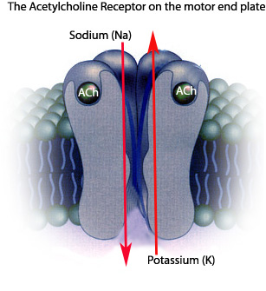
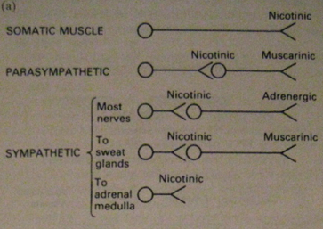
Neuromuscular paralysis = Block Nicotinic ACh Receptor

Slide 30
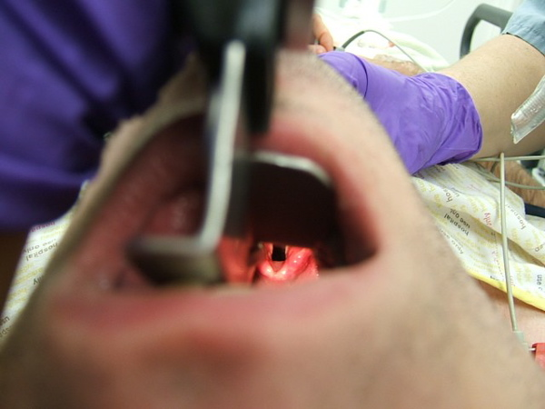
Neuromuscular paralysis

Slide 31
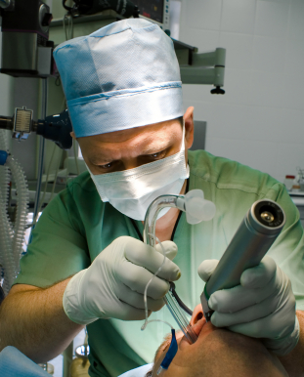

Slide 33
Our patient
68 years old female
Altered bowl habit
Tumour left colon
Surgery proposed
‘Preassessment’
Mild/moderate COPD
Type 2 diabetes mellitus
Hypertension
Chronic Kidney Disease

Slide 34
Preoperative: Assess Hx
Patient details
What operation
Past Medical History
Drugs, Allergies
Current health, function + ODQ
Anaesthetic history

Slide 35
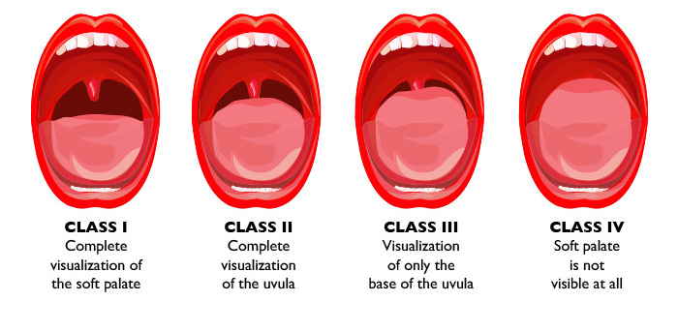
Preoperative: Assess Ex
Multi-system examination
Cardiovascular
Respiratory
Abdominal
Musculoskeletal
General
Anaesthetic assessment
Neck movement & jaw opening
Airway assessment (Mallampati)
Examination of spine if spinal/epidural required

Slide 36
SBA: Preoperative
Our 68 year old woman with stable mild chronic obstructive pulmonary disease, hypertension is to undergo scheduled laparotomy. Which preoperative measures are most appropriate?
A. Abdominal XR
B. Chest X-ray
C. ECHO cardiogram
D. Full blood count, Urea and Electrolytes
E. Stop her prophylactic b blockers

Slide 37
Preoperative: Assess Ix
Graded according to risk
Minor surgery…..vs Big, long, damaging surgery
Healthy person vs …… less healthy
Urgency of surgery
FBC Hb?
Group & Save Need to transfuse?
U & E kidneys ok?
Other preop bloods
ECG?
Other tests only if needed

Slide 38
Investigations Pre Op
Test | Result | Normal Range
Hb | 112 | 115 – 155 g/L
WCC | 9.5 | 3 - 10 x 10⁹/L
Plt | 209 | 150 – 400 x 10⁹/L
Na | 138 | 135 – 145 mmol/L
K | 4.2 | 3.5 – 5.0 mmol/L
Ur | 5.1 | 1.7 – 8.3 mmol/L
Cr | 65 | 49 – 92 umol/L
eGFR | 62 | > 90
CRP | 4.2 | 0 – 5 mg/L
What does this blood test show?

Slide 39
Preoperative: Assess Chat
Cardiovascular /Respiratory
SOBOE < 2 flights stairs? Reduced Heart Fn
Can’t assess exercise tolerance?
= Worried
Many other issues….
risk vs benefit of surgery vs other options
?postpone elective surgery to ’optimise’ ?
Carry on most drugs

Slide 40
SBA
Our-68 year-old female has been admitted. She has not had anything to eat for the last 6 hours. Which is the most appropriate management in regard to her aspiration risk?
Encourage oral fluid intake in the anaesthetic room as Lena appears clinically dehydrated
B) Use facemask oxygen to prevent any against any reflux or aspiration
C) Ensure that she takes her regular medication of proton pump inhibitors before her surgery as this will increase the pH level of the gastric contents
D) Put an naso-gastric tube to drain her stomach
E) Give her milky sugary coffee just before surgery

Slide 41
PRE-OP Chat
Fasting (2-6 rule)
6 hours before → no food
2 hours before → no clear fluids
Up to surgery → Small sips, medicines
Other factors to consider etc etc?
Pre-op medications required?
VTE prophylaxis prescribed?
Consent form completed?
Blood transfusion OK?
Pain relief discussed?

Slide 43
She has surgery

Slide 44
Side Effects
CVS
RS
GI
GU
NS
Other
Danger
Response?
DR
Drugs?
Everything
Else

Slide 48
Not looking great in recovery
A nurse uses the ‘SBAR’ or ‘ISRARD’ tool !!
What??

Slide 49
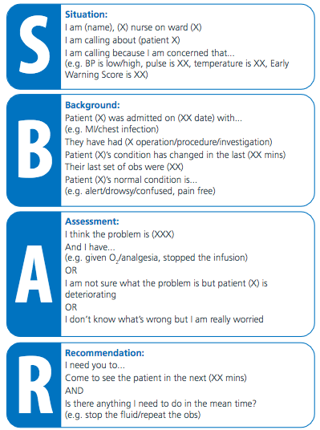
+ Introduction
+ Decision

Slide 50
Danger
Response?
DR
Drugs?
Everything
Else

Slide 51
Macy, who can regenerate her limbs

Slide 52
ABG

Slide 53
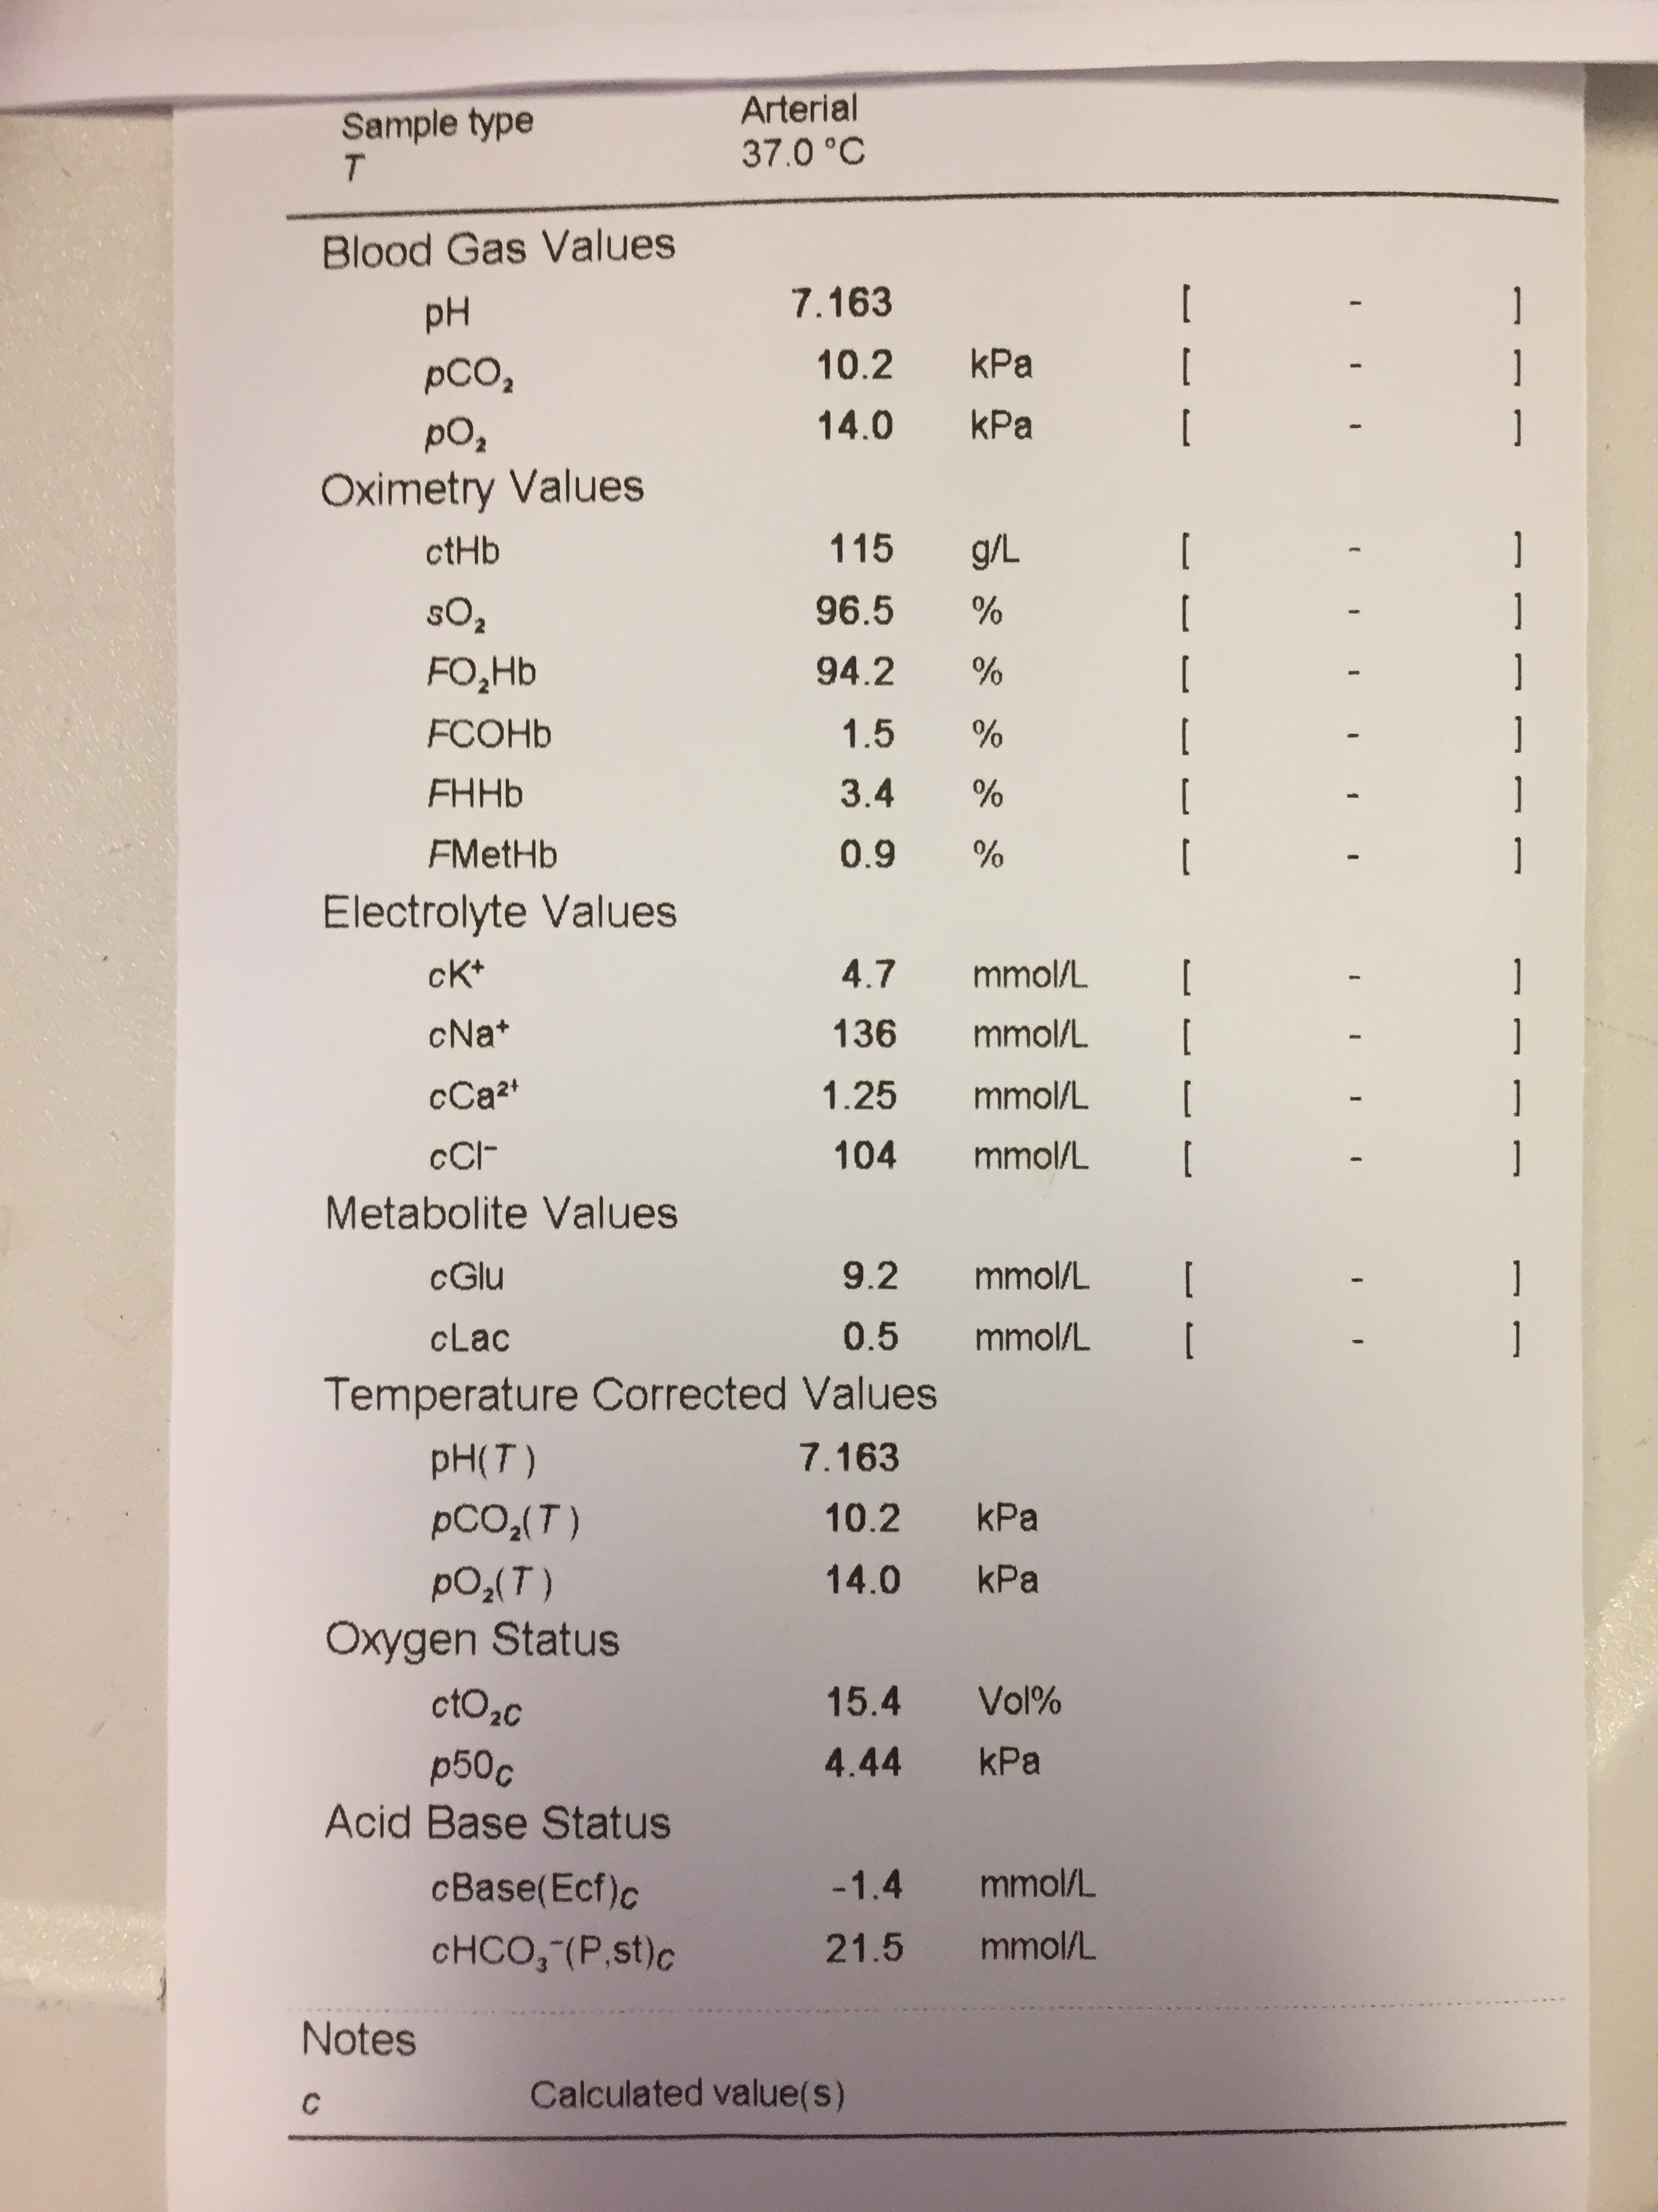
pH
pCO₂
p0₂
All the other stuff
HCO₃ or BEx
Notes:
There’s a lot of info-
Be very clear ACID Base / Oxygenation / Other info eg Na

Slide 54
4 pathologies
There are 4 pathologies of Acid base balance
Respiratory pCO₂
Metabolic HCO₃ or BEx
Acidosis
Alkalosis
Acidosis
Alkalosis

Slide 55
4 pathologies
There are 4 pathologies of Acid-Base balance
They can be
Acute= sudden, new, hours
Chronic = longer term, persistent, days
The body compensates to limit pH change
Respiratory pCO₂ instant
Metabolic HCO₃ or Bex 12+ hours

Slide 56
and

Slide 57
pH
pCO₂
HCO₃ or BEx

Slide 58
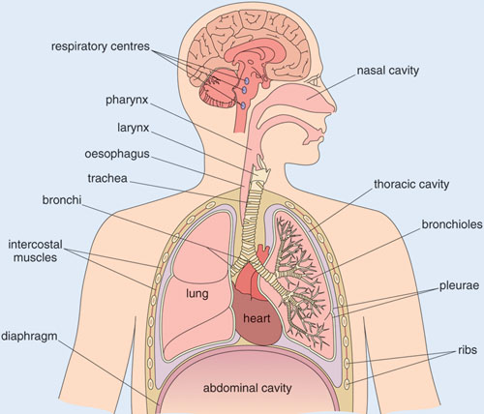
…..any ventilation change
Brain
Brainstem
Nerves to Muscles
Spinal Cord
Upper Airway= above larynx
Lower Airway=
below larynx
Intercostal Muscles
Diaghram
Pleura
Lungs
…..anything involved in making us breathe

Slide 59
…..any ventilation change
Brain
Brainstem
Nerves to Muscles
Can you think of a condition in each of these areas that might reduce ventilation?
Spinal Cord
Upper Airway= above larynx
Lower Airway=
below larynx
Intercostal Muscles
Diaghram
Pleura
Lungs

Slide 60
…..any ventilation change
Head Injury, Stroke
Brain
Head Injury, Stroke
Brainstem
Trauma, Local Anaesthesia
Nerves to Muscles
Trauma, Inflammation
Spinal Cord
Airway Obstruction eg Unconscious
Upper Airway= above larynx
Tumour, Infection
Lower Airway=
below larynx
Trauma, Fatigue
Intercostal Muscles
Abdominal Pathology
Diaghram
Pheumo/Haemo-thorax
Pleura
Trauma, bleeding, collapse, Infection
Lungs/Alveoli

Slide 61
pH
pCO₂
HCO₃ or BEx
7.25
3.6
Low
low
-10
15
Low
Low
Metabolic Acidosis
Partial Respiratory
Compensation
Let’s think about this stuff later

Slide 62
What’s next???

Slide 63
We’ll now have some

Slide 64
Chest X-ray in Practice
Clinical
What being performed for ?
Always write on request- the reason
Always examine the patient and correlate with findings
Look at previous X-rays
Be systematic and structured- then you don’t miss key abnormalities
Lots of ways to do it- ultimately it is important to adopt a system that you are comfortable and familiar with to ensure that it is used in practice every day
Don’t stress- even experts can miss things
Method

Slide 65
CXR
Name: BROWN, Heather Taken 24/04/19 16.42
DOB: 05/08/1945
Hosp no: 1234567
How would you interpret this chest radiograph?
PA
Erect

Slide 66
CXR
The Dr ABCDE Approach
Demographics
Rotation, inspiration, projection, exposure
Airway
Breathing
Cardiac
Diaphragm
Everything else inc tissues
Name: BROWN, Heather Taken 24/04/19 16.42
DOB: 05/08/1945
Hosp no: 1234567
PA Erect
Bones
Interventions
Tissues
Review areas
Notes:
RS had slight variation in pneumonic for this – chase.

Slide 69
D Details, Projection | This is a AP (mobile) / PA ……of x taken on y date. Left/ right correct? Clinical information- what am I looking for?
R Rotation & Adequacy | Rotated? Penetrated OK?
A Airways | Trace the trachea down to the hila: shifts, foreign bodies or abnormalities
B Breathing | Lung: Scrutinise the lung margin: clear? Start at the apex and work down comparing the symmetry of each side Pleura are normally invisible, but can become visible in fluid collections, plaques or masses
C Circulation | Heart Trace the borders. What’s the cardiothoracic ratio? DO NOT FORGET TO LOOK ‘BEHIND’ THE HEART Mediastinum Look for masses in the superior,anterior and posterior divisions
D Diaphragm | Trace hemidiaphragms and compare for symmetry Compare cardiophernic angles. Air under diaghram?
E Everything Else | Bones: Ribs,sternum, clavicles, scapula, spine and humerus Interventions: Tubes and lines, chest drains, pacemakers, artificial valves T – tissue Surgical emphysema, previous surgery

Slide 70
D Details, Projection | This is a AP (mobile) / PA ……of x taken on y date. Left/ right correct? Clinical information- what am I looking for?
R Rotation & Adequacy | Rotated? Penetrated OK?
A Airways | Trace the trachea down to the hila: shifts, foreign bodies or abnormalities
B Breathing | Lung: Scrutinise the lung margin: clear? Start at the apex and work down comparing the symmetry of each side Pleura are normally invisible, but can become visible in fluid collections, plaques or masses
C Circulation | Heart Trace the borders. What’s the cardiothoracic ratio? DO NOT FORGET TO LOOK ‘BEHIND’ THE HEART Mediastinum Look for masses in the superior,anterior and posterior divisions
D Diaphragm | Trace hemidiaphragms and compare for symmetry Compare cardiophernic angles. Air under diaghram?
E Everything Else | Bones: Ribs,sternum, clavicles, scapula, spine and humerus Interventions: Tubes and lines, chest drains, pacemakers, artificial valves T – tissue Surgical emphysema, previous surgery

Slide 72
Name: BROWN, Heather Taken 24/04/19 16.42
DOB: 05/08/1945
Hosp no: 1234567
PA
Erect
How would you interpret this chest radiograph?

Slide 73
D Details, Projection | This is a AP (mobile) / PA ……of x taken on y date. Left/ right correct? Clinical information- what am I looking for?
R Rotation & Adequacy | Rotated? Penetrated OK?
A Airways | Trace the trachea down to the hila: shifts, foreign bodies or abnormalities
B Breathing | Lung: Scrutinise the lung margin: clear? Start at the apex and work down comparing the symmetry of each side Pleura are normally invisible, but can become visible in fluid collections, plaques or masses
C Circulation | Heart Trace the borders. What’s the cardiothoracic ratio? DO NOT FORGET TO LOOK ‘BEHIND’ THE HEART Mediastinum Look for masses in the superior,anterior and posterior divisions
D Diaphragm | Trace hemidiaphragms and compare for symmetry Compare cardiophernic angles. Air under diaghram?
E Everything Else | Bones: Ribs,sternum, clavicles, scapula, spine and humerus Interventions: Tubes and lines, chest drains, pacemakers, artificial valves T – tissue Surgical emphysema, previous surgery

Slide 74
Name: BROWN, Heather Taken 24/04/19 16.42
DOB: 05/08/1945
Hosp no: 1234567
PA
Erect
How would you interpret this chest radiograph?

Slide 75
Name: BROWN, Heather Taken 24/04/19 16.42
DOB: 05/08/1945
Hosp no: 1234567
PA
Erect
How would you interpret this chest radiograph?

Slide 80
D Details, Projection | This is a AP (mobile) / PA ……of x taken on y date. Left/ right correct? Clinical information- what am I looking for?
R Rotation & Adequacy | Rotated? Penetrated OK?
A Airways | Trace the trachea down to the hila: shifts, foreign bodies or abnormalities
B Breathing | Lung: Scrutinise the lung margin: clear? Start at the apex and work down comparing the symmetry of each side Pleura are normally invisible, but can become visible in fluid collections, plaques or masses
C Circulation | Heart Trace the borders. What’s the cardiothoracic ratio? DO NOT FORGET TO LOOK ‘BEHIND’ THE HEART Mediastinum Look for masses in the superior,anterior and posterior divisions
D Diaphragm | Trace hemidiaphragms and compare for symmetry Compare cardiophernic angles. Air under diaghram?
E Everything Else | Bones: Ribs,sternum, clavicles, scapula, spine and humerus Interventions: Tubes and lines, chest drains, pacemakers, artificial valves T – tissue Surgical emphysema, previous surgery

Slide 81
Name: BROWN, Heather Taken 24/04/19 16.42
DOB: 05/08/1945
Hosp no: 1234567
PA
Erect
How would you interpret this chest radiograph?

Slide 82
Name: Our Patient
DOB: 05/08/1945
Hosp no: 1234567
Taken 24/04/19 16.42
L
AP

Slide 83
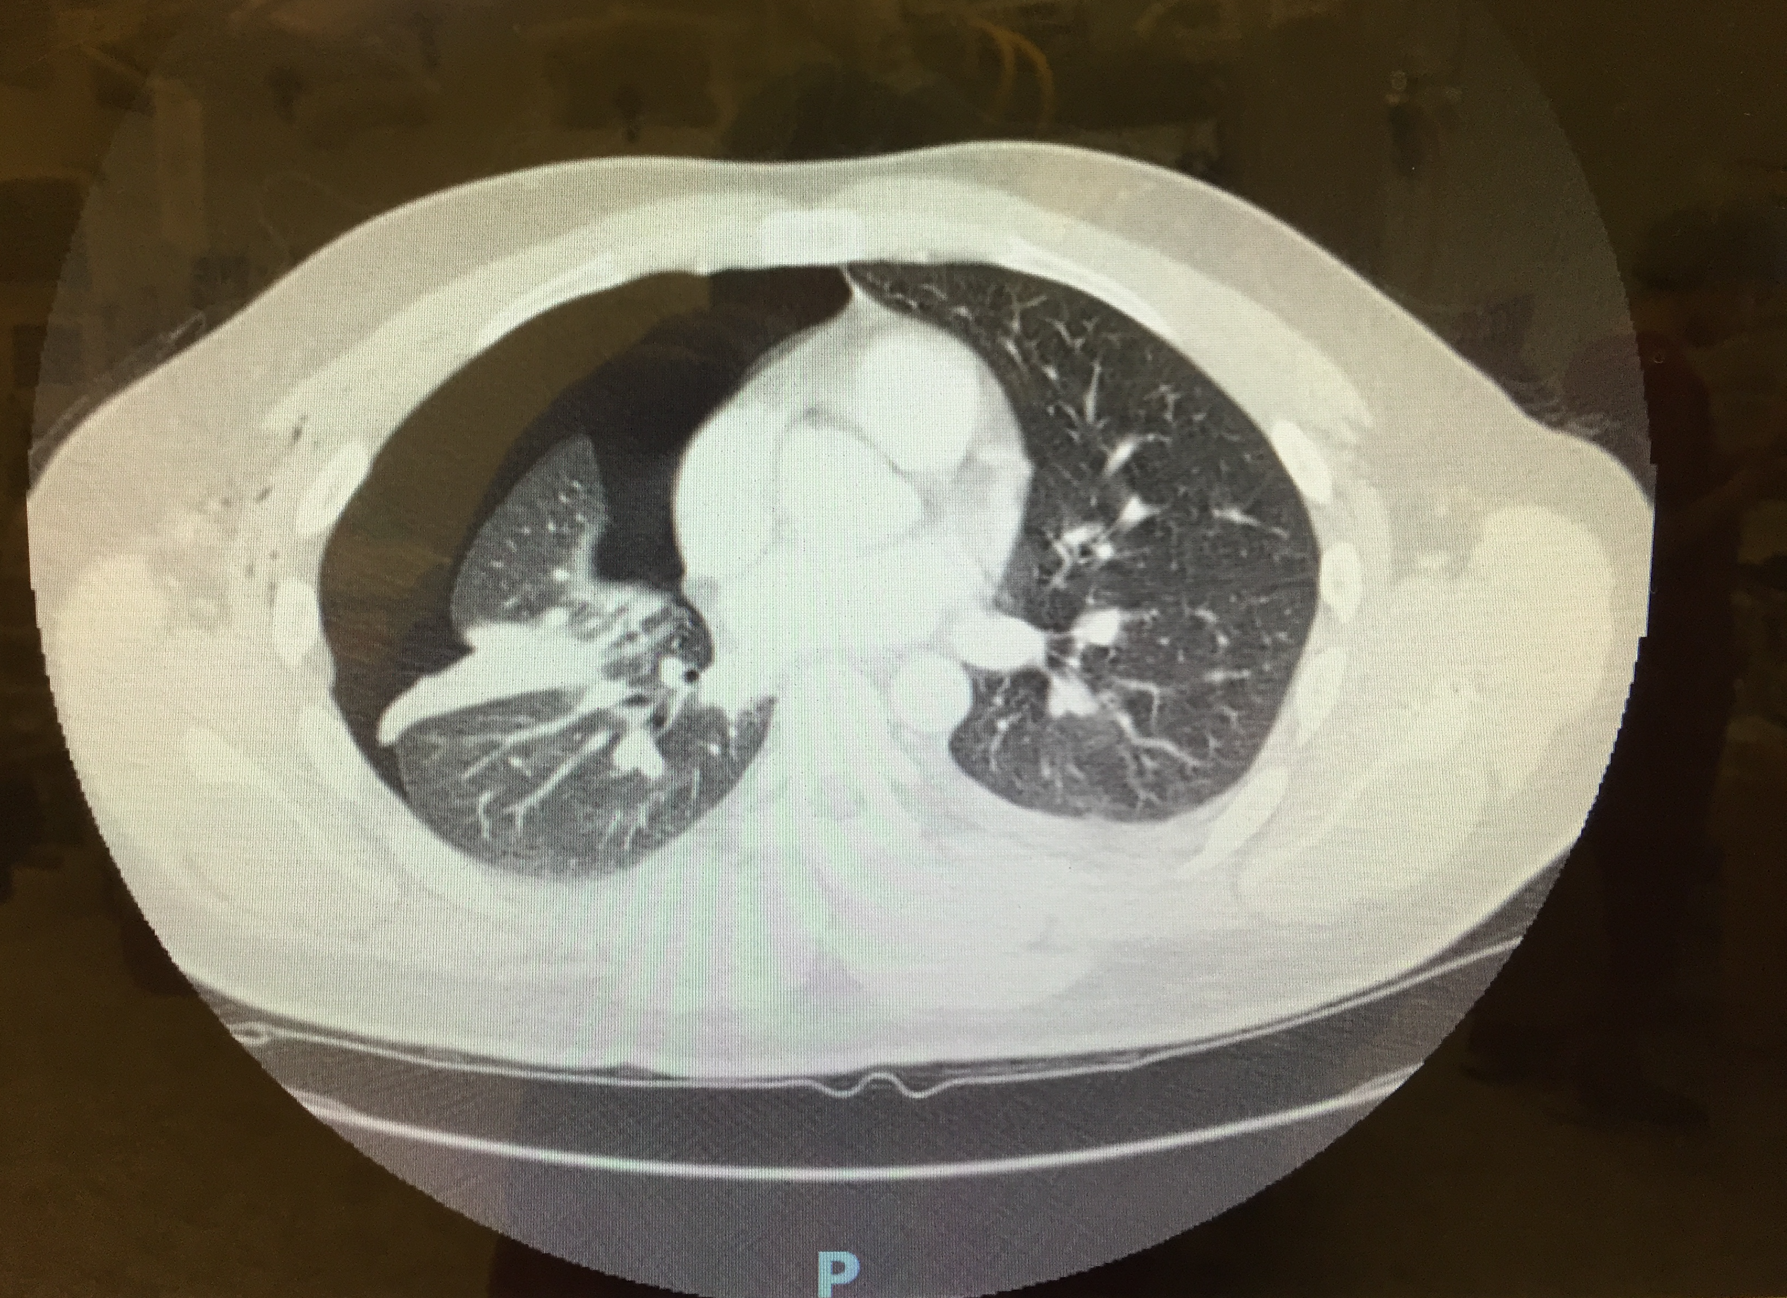

Slide 84
D Details, Projection | This is a AP (mobile) / PA ……of x taken on y date. Left/ right correct? Clinical information- what am I looking for?
R Rotation & Adequacy | Rotated? Penetrated OK?
A Airways | Trace the trachea down to the hila: shifts, foreign bodies or abnormalities
B Breathing | Lung: Scrutinise the lung margin: clear? Start at the apex and work down comparing the symmetry of each side Pleura are normally invisible, but can become visible in fluid collections, plaques or masses
C Circulation | Heart Trace the borders. What’s the cardiothoracic ratio? DO NOT FORGET TO LOOK ‘BEHIND’ THE HEART Mediastinum Look for masses in the superior,anterior and posterior divisions
D Diaphragm | Trace hemidiaphragms and compare for symmetry Compare cardiophernic angles. Air under diaghram?
E Everything Else | Bones: Ribs,sternum, clavicles, scapula, spine and humerus Interventions: Tubes and lines, chest drains, pacemakers, artificial valves T – tissue Surgical emphysema, previous surgery

Slide 86
Name: BROWN, Heather Taken 24/04/19 16.42
DOB: 05/08/1945
Hosp no: 1234567
PA
Erect
How would you interpret this chest radiograph?

Slide 87
D Details, Projection | This is a AP (mobile) / PA ……of x taken on y date. Left/ right correct? Clinical information- what am I looking for?
R Rotation & Adequacy | Rotated? Penetrated OK?
A Airways | Trace the trachea down to the hila: shifts, foreign bodies or abnormalities
B Breathing | Lung: Scrutinise the lung margin: clear? Start at the apex and work down comparing the symmetry of each side Pleura are normally invisible, but can become visible in fluid collections, plaques or masses
C Circulation | Heart Trace the borders. What’s the cardiothoracic ratio? DO NOT FORGET TO LOOK ‘BEHIND’ THE HEART Mediastinum Look for masses in the superior,anterior and posterior divisions
D Diaphragm | Trace hemidiaphragms and compare for symmetry Compare cardiophernic angles. Air under diaghram?
E Everything Else | Bones: Ribs,sternum, clavicles, scapula, spine and humerus Interventions: Tubes and lines, chest drains, pacemakers, artificial valves T – tissue Surgical emphysema, previous surgery

Slide 88
Name: BROWN, Heather Taken 24/04/19 16.42
DOB: 05/08/1945
Hosp no: 1234567
PA
Erect
How would you interpret this chest radiograph?

Slide 89
Name: Our Patient
DOB: 05/08/1945
Hosp no: 1234567
Taken 24/04/19 16.42
L
AP

Slide 90
D Details, Projection | This is a AP (mobile) / PA ……of x taken on y date. Left/ right correct? Clinical information- what am I looking for?
R Rotation & Adequacy | Rotated? Penetrated OK?
A Airways | Trace the trachea down to the hila: shifts, foreign bodies or abnormalities
B Breathing | Lung: Scrutinise the lung margin: clear? Start at the apex and work down comparing the symmetry of each side Pleura are normally invisible, but can become visible in fluid collections, plaques or masses
C Circulation | Heart Trace the borders. What’s the cardiothoracic ratio? DO NOT FORGET TO LOOK ‘BEHIND’ THE HEART Mediastinum Look for masses in the superior,anterior and posterior divisions
D Diaphragm | Trace hemidiaphragms and compare for symmetry Compare cardiophernic angles. Air under diaghram?
E Everything Else | Bones: Ribs,sternum, clavicles, scapula, spine and humerus Interventions: Tubes and lines, chest drains, pacemakers, artificial valves T – tissue Surgical emphysema, previous surgery

Slide 91
Name: BROWN, Heather Taken 24/04/19 16.42
DOB: 05/08/1945
Hosp no: 1234567
PA
Erect
How would you interpret this chest radiograph?

Slide 96
Interpreting Chest-Xrays
The Dr ABCDE Approach
D – Details and Projection
R – Rotation and Adequacy
A – Airways
B – Breathing: Lungs and Pleura
C – Circulation: Heart & Mediastinum
D – Diaphragm
E – Everything Else:
Bones and tissues
Interventions
Tissues
Review areas

Slide 97
Our lady
Recovery area
Goes to ward
?Intensive Care = ICU = Critical care = ITU
Early mobilisation, sips of fluid
Complications?
Local to surgery vs general
Immediate, Early, late
CVS
RS
GI
GU
NS
Other

Slide 98
Bloods Post Op day 2
Test | Result | Normal Range
Hb | 102 | 115 – 155 g/L
WCC | 13.5 | 3 - 10 x 10⁹/L
Plt | 209 | 150 – 400 x 10⁹/L
Na | 138 | 135 – 145 mmol/L
K | 4.2 | 3.5 – 5.0 mmol/L
Ur | 5.1 | 1.7 – 8.3 mmol/L
Cr | 65 | 49 – 92 umol/L
eGFR | 52 | > 90
CRP | 142 | 0 – 5 mg/L
What does this blood test show?

Slide 99
Stuff we chatted about
Why is Anaesthesia dangerous?
Anaesthesia Hx +Ex
similarities & some differences
What should worry us before surgery
What Ix and Mx do we do before surgery?
What can happen after surgery
and… CXR ECG ABG
depressant
Poor function
Risk: Patient surgery urgency
Drugs
Eating Drinking

Slide 100
thanks
Loads more specifics in your 12 weeks
SBA series
Podcast each week
Tutorials
Come to theatre!

