Slide 1
PERIOPERATIVE FLUID THERAPY
Final FRCA Teaching
Dr. Gautam Kumar

Slide 2
Download the talk!
Search
‘UCL Gautam kumar’
www.ucl.ac.uk/anaesthesia/people/dr-gautam-kumar

Slide 3
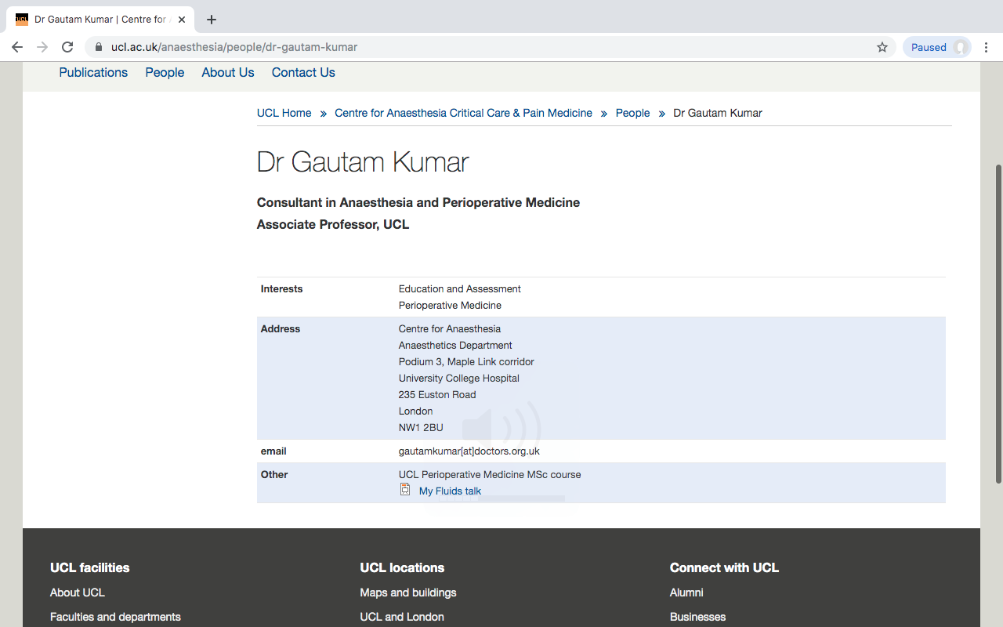

Slide 4
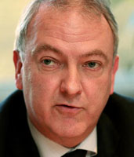
"It is increasingly recognised that the choice of fluid administered to surgical patients may have a profound impact on their outcome"
Sir Bruce Keogh, NHS Medical Director, 2013
Notes:
perioperative fluid therapy remains a controversial topic
But nonetheless is recognised that it may have a profound effect on patient outcome

Slide 5
From the Exam Syllabus…
‘Outlines/recalls the principles of appropriate post operative fluid regimes including volumes, types of fluids…’
‘Prescribes appropriate postoperative fluid regimes’
‘Explain how correct solutions and volumes are used for replacement of fluid loss. Particular attention must be given to the risks of hyponatraemia if hypotonic solutions are used for fluid resuscitation’
‘Crystalloid fluids: Composition; suitable fluids for maintenance and replacement of losses. Comparison with colloids; unwanted effects’
‘Colloids: composition…’
‘Demonstrates knowledge of body fluids and the functions and constituents’

Slide 6
Fluid Therapy
Basic principles/physiology
Fluid types
Fluid therapy guidelines
Notes:
In summary:

Slide 7
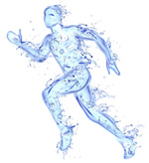
Fluid Physiology

Slide 8
Questions
Most of the body’s water is located in the:
    Plasma
    Interstitial fluid compartment
    Intracellular space
    Muscular Tissue
2. Approximately what percentage of TBW is intracellular fluid
    35%
    45%
    65%
    85%

Slide 9
3. Plasma volume is:
    1 litre
    3 litres
    7 litres
    10 litres
4. If 1L of solute-free water is lost from the body, how much fluid is lost by the ICF compartment?
    333ml
    667ml
    1 litre
    none
Notes:
Q3 and 4

Slide 10
5. What is the average daily volume intake from eating:
    250ml
    500ml
    750ml
    1500ml
6. What is the average daily volume intake from drinking:
    250ml
    500ml
    750ml
    1500ml
Notes:
Q5 and 6

Slide 11
7. What is the daily average sodium requirement (mmol/kg/day)?
    0.1-0.2
    0.5-1.0
    1-2
    2-4
8. What is the daily average potassium requirement (mmol/kg/day)?
    0.1
    0.7
    1.5
    2
Notes:
Q7 and 8

Slide 12
9. The colloid osmotic pressure of blood plasma is due to its high concentration of:
    Glucose
    Haemoglobin
    Albumin
    Sodium
10. Glycocalyx damage is caused by all of the following except
    Hypernatraemia
    Atherosclerosis
    Inflammation
    Hypovolaemia
Notes:
Q9 and 10

Slide 13

Body Water
Related to physiological as well as pathological variables.
Weight - weight TBW
Sex – Men: TBW
Age - Age TBW
Notes:
total body water is affected by not only pathological processes such as dehydration but also physiological variables such as weight, sex and age.
- as your weight increases your absolute TBW content increases.
- Woman on average a lower TBW due to having an increased proportion of hydrophobic fat cells
- the older you are, the lower proportion of body water is present.

Slide 14
AGE | TBW as a % of total body weight
Neonate | 80
6 months | 70
1 year | 60
Adult | 60
Elderly | 50
Notes:
- this decreases from about 80% TBW at birth to about 60% as an adult and as low as 50% in the elderly.

Slide 15
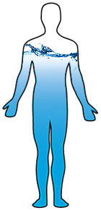
Most tissues are water-rich and contain 60-80% water. The three major exceptions to this are:
  Plasma: 93% water
  Fat: 10-15% water
  Bone: 20% water
Notes:
most body tissues are similar and contain about 60-80% water
fat cells are hydrophobic and contain about 10% water,
plasma which is predominantly water with the addition of proteins and blood cells
bone, which is about 20% water.

Slide 16
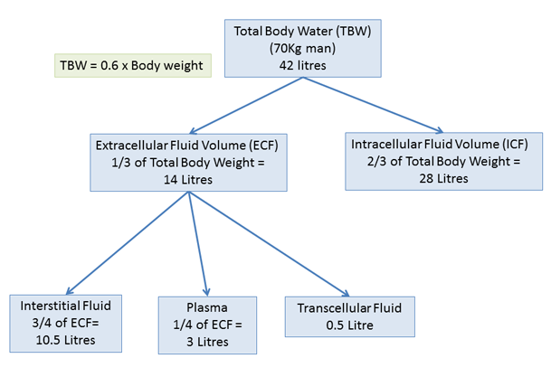
Body fluid compartments
HEAVY WATER
INULIN
Con1 X Vol1 = Con2 X (Vol1 + Vol2)
RADIOACTIVE ALBUMIN; EVANS BLUE
Notes:
water is distributed amongst these conceptual, non-continuous compartments separated by a semi-permiable membrane.
- most body water is located in the intracellular space (answer 1) which makes up about 2/3 or 65% of total body water (answer 2).
Of the extracellular fluid volume, the majority is interstitial fluid (about 2/3 or ¾ depending where you read) with about ¼ (3-4L) (answer 3) constituting plasma.
A small amount comprises transcellular fluid and this is other fluid compartments such as CSF, synovial fluid and intraocular fluid.
just for completeness there may be an mcq asking you what can be used to measure the various compartments, so I have included it here.
By the dilution method where by knowing the volume and concentration of a given solution, and by knowing the final concentration, you can calculate the final volume. So, total water can be measured using heavy or radioisotope labelled water as it passes freely between all compartments, extracellular volume by inulin and plasma by radioactive albumin or evans blue. Intracellular or interstitial compartments can not be directly measured.

Slide 17
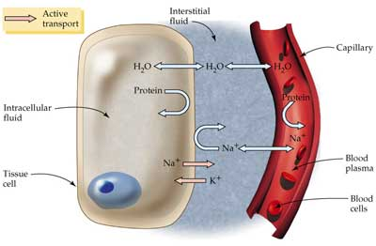
Body fluid compartments
Intracellular fluid
Interstitial fluid
Intravascular fluid
Extracellular fluid
Notes:
Looking a bit more at fluid compartments
Each compartment has a different electrolyte composition and osmotic value

Slide 18
Body fluid compartments
Intracellular fluid
Interstitial fluid
Intravascular fluid
Extracellular fluid
Notes:
Water can pass freely between IV, IS and IC compartments
So, with the answer to Q4 If 1L of solute-free water is lost from the body, how much fluid is lost by the ICF compartment? 667ml since 2/3 of volume is intracellular

Slide 19
Body fluid compartments
Intracellular fluid
Interstitial fluid
Intravascular fluid
Extracellular fluid
Notes:
Proteins do not pass through compartments

Slide 20
Body fluid compartments
Intracellular fluid
Interstitial fluid
Intravascular fluid
Extracellular fluid
Notes:
And sodium can pass freely from plamsa to the interstitium

Slide 21
Body fluid compartments
Intracellular fluid
Interstitial fluid
Intravascular fluid
Extracellular fluid
Notes:
But is actively taken up to the intracellular fluid from the interstitial fluid.

Slide 22
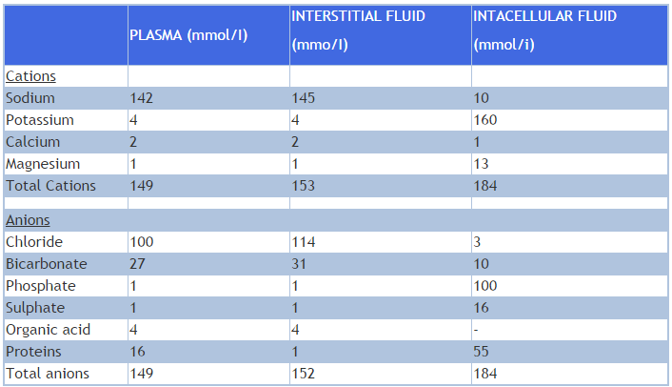
Ionic composition of fluid compartments
Notes:
Not going to go through it now but with the ionic composition of fluid compartments
But sodium and chloride are primarily extracellular ions with potassium and phosphate intracellular ions.

Slide 23
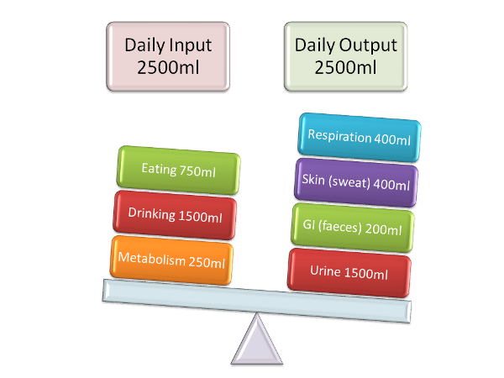
Water Balance
Estimation of Daily Water Requirements in Unstressed Healthy Adults:
Based on metabolic rate 80-110 mls/100kcals
Based on body surface area 1.5 l/m2/day
Based on weight 30-40 mls/kg/day
Notes:
As well as composition of compartments we have to look at fluid and electrolyte balance to maintain homeostasis.
Based on weight, estimated maintenance daily water requirements is approx. 30-40ml/kg. So for a 70kg adult, that’s about 1.5L from drinking and 750ml from eating (Answers to 5 and 6.)
Most the output is in the urine but a considerable amount is the insensible losses (those those that can’t be measured) through respiration and perspiration.

Slide 24
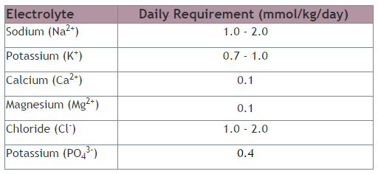
Electrolyte Balance
The fluid loss contains varying amount of electrolytes.
The table below shows average daily required electrolyte requirements in healthy individuals:
Phosphate
Notes:
The fluid that is lost contains a varying amount of electrolytes that need to be replaced. Sodium is 1-2mmol/kg (question 7) and potassium about 0.7mmol/kg (question 8). Note as well the daily requirement of chloride which is under 2 mmol/kg/day.

Slide 25
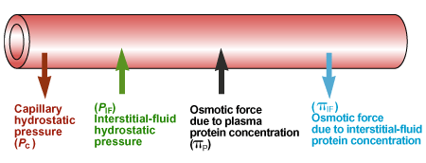
Starling’s Forces
Jv = (Pc - Pif) - (∏c - ∏if)
where:
Jv is the net fluid movement between compartments
(Pc - Pif) - (∏c - ∏if) is the net driving force
Pc is the capillary hydrostatic pressure
Pif is the interstitial hydrostatic pressure
∏c is the capillary oncotic pressure
∏if is the interstitial oncotic pressure
Notes:
Changing tact, classic models of capillary circulation/forces have been used as a basis upon which maintenance and resuscitation fluids were selected. This was primarily Starling’s forces which show the net movement of fluid across capillary membranes is due to the balance between the hydrostatic pressue and oncotic pressures in the capillary and interstitium.

Slide 26
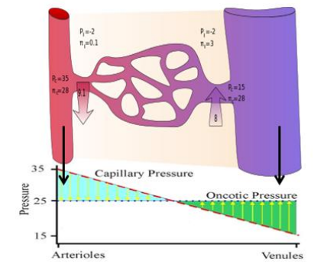
Notes:
Infact, the colloid osmotic pressure, that exerted by proteins such as the high concentration of Albumin (q9) is fairly constant with the hydrostatic pressure along the capillary decreasing from the arteriolar to venous end meaning fluid is initially given off but then taken up with any excess returned to the circulation by the lymphatic system.

Slide 27
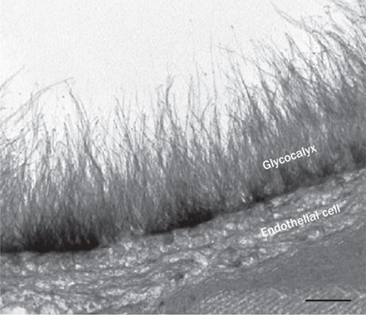
Glycocalyx
Notes:
In recent years, a new idea as been postulated to counter Starlings principle. This is the endothelial glycocalyx.

Slide 28
Glycocalyx
luminal side of healthy vasculature
Crystalloids freely pass, colloids are held
Protecting this structure in surgical practice means limiting the surgical trauma and avoiding intravascular hypervolaemia.
Notes:
the endothelial glycocalyx, located on the luminal side of healthy vasculature. While crystalloids can freely pass through the glycocalyx, colloids are held back in the vasculature by this structure. This is reflected by a markedly higher intravascular persistence of isooncotic colloids (80-100%) versus crystalloids (around 20%), at least as long as the glycocalyx is intact. Protecting this structure in surgical practice means limiting the surgical trauma and avoiding intravascular hypervolemia.
The Glycocalyx Model emphasises the view of colloids as preferred plasma substitutes but focuses on the central volume of distribution of an infused fluid, its rate of distribution to a peripheral volume, and its rate of excretion.

Slide 29
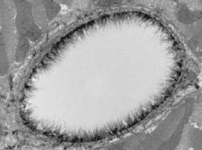
Glycocalyx
Damaged by:
Hypernatraemia
Hypervolaemia
Atherosclerosis
Reperfusion injury
Inflammation
Notes:
glycocalyx is damaged by hypervolaemia not hypovolaemia as well as hypernatraemia, atherosclerosis and diabetes, reperfusion injury and inflammation

Slide 30
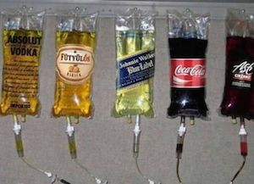
IV FLUIDS

Slide 31
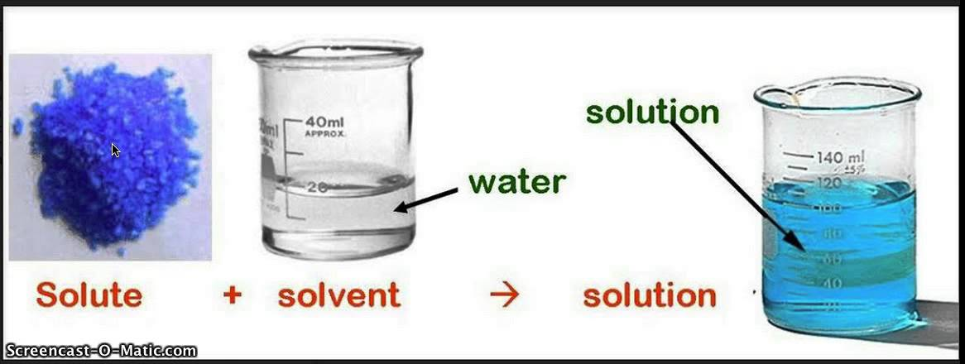
The majority of an IV solution is sterile water.
Crystalloids are solutions of electrolytes and sterile water that may be isotonic, hypotonic and hypertonic to plasma.
Colloids are human plasma derivatives (e.g. FFP, HAS) or semi-synthetic (e.g. dextrans, gelatins, starches). Colloids may be dissolved in isotonic saline or in a balanced electrolyte solution.
Notes:
The majority of an IV solution is sterile water.
Chemically, water is referred to as a “solvent.” and dissolves “solutes.” - electrolytes (charged particles such as sodium, potassium, and chloride) and/or other larger compounds such as proteins or molecules.

Slide 32
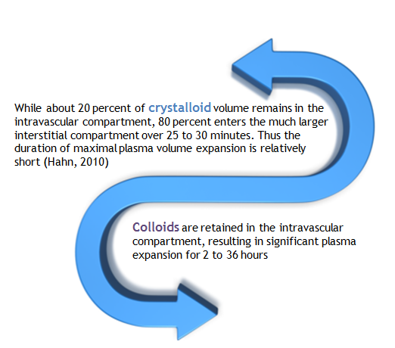
Notes:
The main difference between colloids and crystalloids is how long they stay in the vascular compartment.

Slide 33
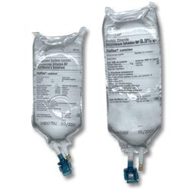
Crystalloids
Notes:
Now looking at colloids and crystallois seperately.
To start with crystaloids

Slide 34
SAQ Examination
Compare the electrolyte content and osmolality of 0.9% sodium chloride (Normal Saline) and compound sodium lactate solution (Hartmann’s). (40%)
b) Why might compound sodium lactate solution be a better crystalloid replacement fluid than 0.9% sodium chloride? (40%)
c) Explain the effects of a large infusion of 0.9% sodium chloride on acid base balance and electrolytes. (20%)
Notes:
Before going through some stuff on crystalloids these is to show you they have come up as a SAQ previously – this question asked 3 times previously.

Slide 35
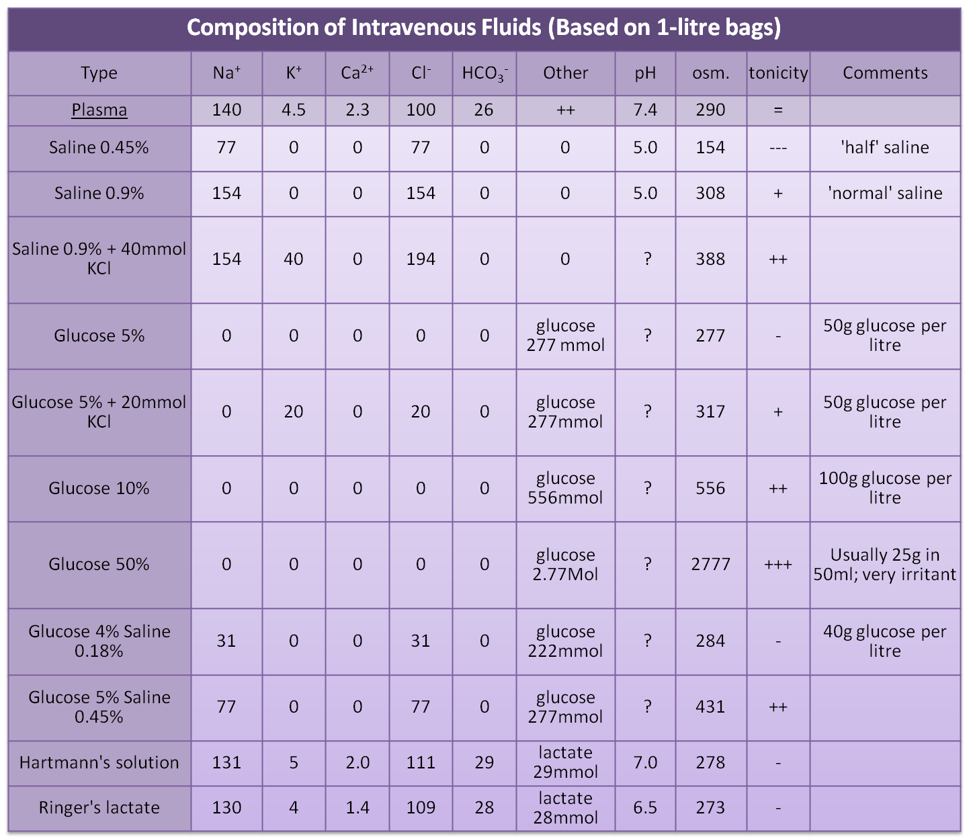
Notes:
So, Comparing the electrolyte content and osmolality of various crystalloids, if we focus on Hartmanns and 0.9% sodium chloride this essentially answers the 1st part of the SAQ.
1L of Saline has 154mmol of Na and chloride and hence an osmolality of 308mmol and pH of 5.0
Hartmanns has 131 mmol of Na, 5 of potassium, 2 of calcium, 111 of chloride and 29 of Bicarb which is buffered as lactate. It’s osmolarity is 278 and has a pH of 7.

Slide 36
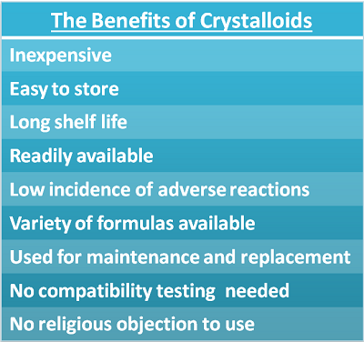
The benefits of crystalloids
Notes:
Some of the non-metabolic benefits of crystalloids I came up with include:

Slide 37
Balanced (vs Unbalanced) Solutions
both crystalloid and colloid
modified with bicarbonate or bicarbonate precursor buffers (gluconate, lactate etc)
closely resemble the composition of human plasma as opposed to ‘unbalanced’ non-buffered salt solutions such as 0.9% NaCl.
Notes:
When talking about IV fluids, especially crystalloids we have to talk about balanced and unbalanced solutions. ‘balanced’ solutions are modified with bicarbonate or bicarbonate precursor buffers, such as maleate, gluconate, lactate or acetate in order to more closely resemble the composition of human plasma as opposed to ‘unbalanced’ non-buffered salt solutions such as 0.9% NaCl.

Slide 38
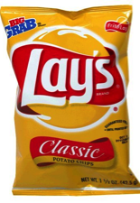

“Normal” Saline
How much NaCl is in each liter of 0.9% saline?
9 grams
Notes:
Infact, not only is saline unbalanced, it contains 1.5 – 2 times your daily salt requirements.
1L contains as much salt as in this number of packets of crisps.
0.9% saline contains Na and Cl in equal amounts (154 mmol/l)
Unlike plasma
Adding NaCl to plasma increases the Cl concentration more than that of Na
0.9% saline reduces plasma SID and leads to hyperchloremic metabolic acidosis

Slide 39
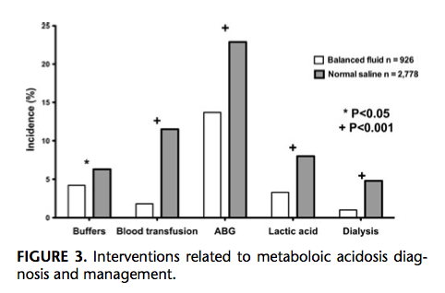
Resource Utilization
Shaw et al (2012) Ann Surg
Notes:
Patients receiving saline had more postoperative infections, renal failure requiring dialysis,
blood transfusions and electrolyte disturbances.Furthermore, physicians caring for these
patients ordered more tests (arterial blood gases and lactate levels) and more treatments
(buffers, blood products, and Dialysis) presumably to investigate and manage observed
acid-base abnormalities and their consequences in these patients.

Slide 40
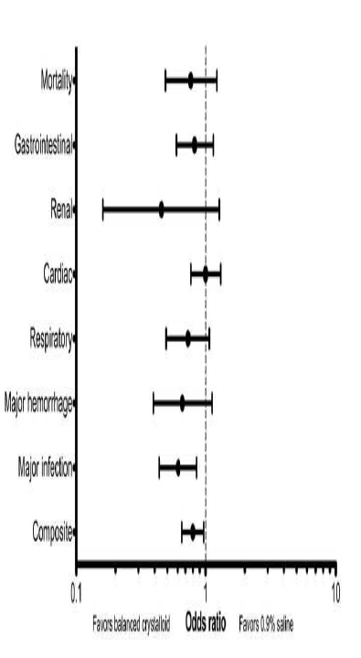
Risk adjusted major complications
All patients
Shaw et al (2012) Ann Surg

Slide 41
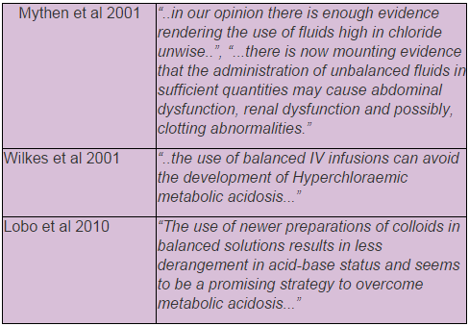
Evidence Against Unbalanced Solutions
Notes:
This has led to big names and researchers to advocate the use of balanced solutions at various points throughout the past few years.

Slide 42
The Abuse of Normal Salt Solution
George H. Evans, JAMA 1911
“One cannot fail to be impressed with the danger…(of) the utter recklessness with which salt solution is frequently prescribed, particularly in the postoperative period…”
“…the disastrous role played by the salt solution is often lost in light of the serious conditions that call forth its use.”
Notes:
42

Slide 43
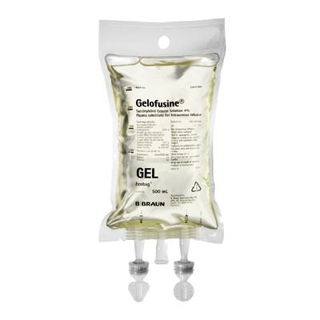
Colloids
Notes:
Moving on to discuss colloids

Slide 44
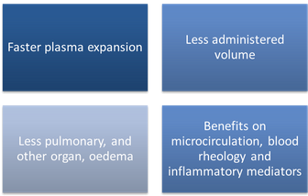
Colloids
Commonly cited reasons for using colloids

Slide 45
Faster plasma expansion
Resuscitation is equally effective with crystalloids and colloids:
The CRYSTMAS trial - no significant difference in the time to reach haemodynamic stability.
The VISEP Trial - the ScvO2 and MAP normalised equally fast when comparing HES and Hartmann’s for fluid resuscitation.
Bayer et al., 2012 - no difference in the duration of time required to reverse evidence of septic shock between crystalloids, 4% gelatins and 6% HES 130/0.4.
“…In conclusion, the current evidence for faster resuscitation is marginal and does not lead to improved outcomes in critically ill patients.”
Notes:
The VISEP trial (Efficacy of Volume Substitution and Insulin Therapy in Severe Sepsis) from 2008 (537 patients, largest trial in this area, stopped early due to renal failure in HES group) showed that when comparing hydroxyethyl starch and compound sodium lactate for fluid resuscitation, the ScvO2 (central venous saturations) and MAP (mean arterial pressure) normalised equally fast.
Bayer - The perceived risk of excess fluid accumulation with crystalloids appeared to be minor, short lived and had no adverse effects on patient outcome.

Slide 46
Less administered volume
Classical thinking is three to four times the volume of crystalloids is required to achieve the same haemodynamic effect as colloids (animal data)
CRYSTMAS trial - 1.4:1 (300ml on average)
The SAFE trial - 1.3:1
VISEP trial 1.5:1 (HES to NaCl)
The 6S trial - no difference in the absolute volumes of HES or Ringer’s acetate administered.
Four additional RCTs report ratios ranging from 1.6-2.1:1
Notes:
Protagonists of colloid solutions have argued that colloids are more effective in expanding intravascular volume due to their retention within the intravascular space and maintenance of colloid oncotic pressure. The volume-sparing effect of colloids compared to crystalloids has traditionally been considered to be an advantage, conventionally described in a colloid:crystalloid ratio of 1:3.

Slide 47
The counter argument
Studies performed in severe sepsis – damaged glycocalyx and leaky capillaries
Studies on healthy volunteers or elective surgery, the 1:3 rule has held
Notes:
These 2 theoretical advantages therefore do not hold up when clinical evidence is considered.
However, these studies are all performed in ITU patients with sepsis where they have a damaged glycocalyx and thus not the structural integrity to retain colloid in the intravascular space. In healthy volunteers, the 1-3 ratio has held strong

Slide 48
5:1(Colloid)
Notes:
One study from 3 years ago showed a ratio of 5-1 comparing Ringers lactate to Albumin for resuscitation
For Colloids to be effective (and thus cost effective) there MUST be an intact glycocalyx and a volume deficit.
Thus, Colloids are probably not effective in Sepsis and blunt trauma and may cause harm (known for HES).

Slide 49
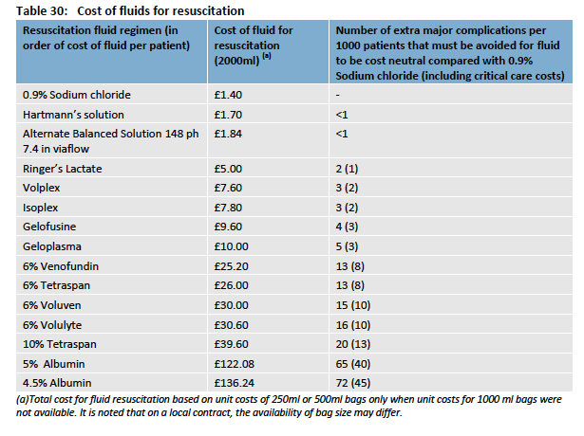
Notes:
Mentioning cost-effective. 2L of hartmanns costs about £1.70 whereas 2L of geloplasma is £10 and albumin over £100

Slide 50
Less Pulmonary oedema
Trials comparing resuscitation with 0.9% saline, 5% albumin, 4% gelatin and HES in septic and non septic ICU patients show that the type of fluid had no effect on pulmonary permeability and oedema (Anaesth Analg 2006, Crit Care Med 2009).
In severe sepsis, the VISEP trial showed no difference in pulmonary SOFA subscore
No clinical trial has demonstrated a benefit of colloid over crystalloid in ARDS.
Notes:
Moving on, there is no evidence that using colloids result in less pulmonary oedema or ARDS compared to crytalloids.

Slide 51
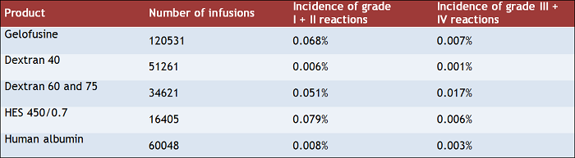
Colloids and anaphylaxis
All colloidal solutions for volume replacement, including human albumin solutions, can induce anaphylactic or anaphylactoid reactions.
Notes:
A problem with colloids is that they can induce anaphylactoid reactions in about 1 in 1000 to 1 in 2000 administartions with severe reactions a lot rarer. However, it is still considerably higher than crystalloids.

Slide 52

Fluid Guidelines

Slide 53
GIFTASUP
The British Consensus Guidelines on Intravenous Fluid Therapy for Adult Surgical Patients (GIFTASUP)
Published in 2008, in response to concern about the high incidence of sodium and water overload in postoperative patients
Notes:
First up, the British Consensus Guidelines on Intravenous Fluid Therapy for Adult Surgical Patients (GIFTASUP) published in 2008, in response to concern about the high incidence of sodium and water overload in postoperative patients

Slide 54
Recommendation 1: Because of the risk of hyperchloraemic, when crystalloid resuscitation or replacement is indicated, balanced salt solutions e.g. Hartmann’s solution should replace 0.9% saline, except in cases of hypochloraemia e.g. from vomiting or gastric drainage. (Evidence level 1b)
Recommendation 2: Solutions such as 4%/0.18% dextrose/saline and 5% dextrose are important sources of free water for maintenance, but should be used with caution as excessive amounts may cause dangerous hyponatraemia, especially in children and the elderly. These solutions are not appropriate for resuscitation or replacement therapy except in conditions of significant free water deficit e.g. diabetes insipidus. (1b)
Recommendation 3: To meet maintenance requirements, adult patients should receive sodium 50-100 mmol/day, potassium 40-80 mmol/day in 1.5-2.5 litres of water by the oral, enteral or parenteral route (or a combination of routes). Additional amounts should only be given to correct deficit or continuing losses. Careful monitoring should be undertaken using clinical examination, fluid balance charts, and regular weighing when possible. (5)
Notes:
Some of their recommendations include:
Suggesting to avoid normal saline and use balance salt solutions instead. Interesting that it’s recommendation number 1.
Use free water solutions with caution
Careful fluid balance with recommendations for electrolyte intake

Slide 55
NICE Guidelines
The NICE guidelines are based upon the principle that hospitilised patients need IV fluids for one of four reasons.
Notes:
More important for you, the NICE guidelines published in the last few years.
based upon the principle that hospitilised patients need IV fluids for one of four reasons.

Slide 56
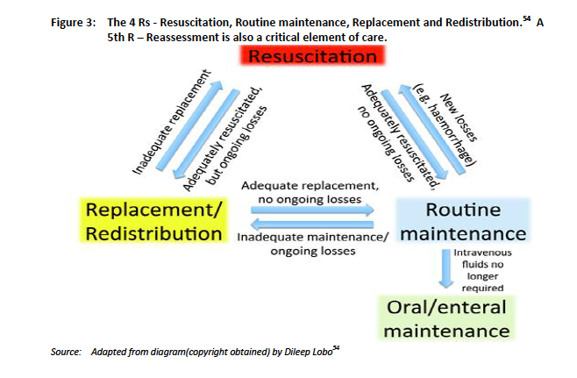

Guidance.nice.org.uk/cg174
Notes:
Resuscitation, routine maintenance, replacement and redustribution all linked with patients dynamically moving between states depending on their state and management so far. There is also a 5th R which is reassessment and continually present.

Slide 57
Initial Assessment
Assess whether the patient is hypovolaemic. Indicators that a patient may need urgent fluid resuscitation include:
  systolic blood pressure is less than 100 mmHg
  heart rate is more than 90 beats per minute
  capillary refill time is more than 2 seconds or peripheries are cold to touch
  respiratory rate is more than 20 breaths per minute
  National Early Warning Score (NEWS) is 5 or more
  passive leg raising suggests fluid responsiveness
Assess the patient's likely fluid and electrolyte needs from their history, clinical examination, current medications, clinical monitoring and laboratory investigations

Slide 58
Resuscitation
Use crystalloids that contain sodium in the range 130–154 mmol/l, with a bolus of 500 ml over less than 15 minutes.
Do not use tetrastarch for resuscitation, unless as part of a clinical trial.
Consider human albumin solution 4–5% only for resuscitation in patients with severe sepsis.
Notes:
Resus: IV fluids may need to be given urgently to restore circulation to vital organs following loss of intravascular volume due to bleeding, plasma loss, or excessive external fluid and electrolyte loss, usually from the gastrointestinal (GI) tract, or severe internal losses (e.g. from fluid redistribution in sepsis).
Use a non-hyponatraemic crystalloid solution quickly.

Slide 59
Routine Maintenance
If patients need IV fluids for routine maintenance alone, restrict the initial prescription to:
  25–30 ml/kg/day of water
  approximately 1 mmol/kg/day of potassium, sodium and chloride
  approximately 50–100 g/day of glucose to limit starvation ketosis.
Do not exceed 30 ml/kg/day
Prescribie less fluid (for example, 25 ml/kg/day fluid) for patients who are older or frail have renal impairment or cardiac failure.
When prescribing for routine maintenance alone, consider using 25–30 ml/kg/day sodium chloride 0.18% in 4% glucose with 27 mmol/l potassium on day 1
Consider delivering IV fluids for routine maintenance during daytime hours to promote sleep and wellbeing
Notes:
Routine maintenance: IV fluids are sometimes needed for patients who simply cannot meet their normal fluid or electrolyte needs by oral or enteral routes but who are otherwise well in terms of fluid and electrolyte balance and handling.
The guidelines suggest giving 25-30ml/kg of fluid (i.e. 2L for an average adult) and not more than that with a lot less sodium than normal. We are advised in our hospittal for routine post-op maintenance if needed to prescribe Dextrose saline or dextrose with supplemented potassium.

Slide 60
Replacement
Adjust the IV prescription (add to or subtract from maintenance needs) to account for existing fluid and/or electrolyte deficits or excesses, ongoing losses or abnormal distribution.
Redistribution
In addition to external fluid and electrolyte losses, some hospital patients have marked internal fluid distribution changes or abnormal fluid handling. This type of problem is seen particularly in those who are septic, otherwise critically ill, post-major surgery or those with major cardiac, liver or renal co-morbidity. Many of these patients develop oedema from sodium and water excess and some sequester fluids in the GI tract or thoracic/peritoneal cavities.
Following administration of IV fluids there should always be a period of ....
Notes:
Replacement: In some patients, IV fluids to treat losses from intravascular and or other fluid compartments, are not needed urgently for resuscitation, but are still required to correct existing water and/or electrolyte deficits or ongoing external losses. These losses are usually from the GI or urinary tract, although high insensible losses occur with fever, and burns patients can lose high volumes of what is effectively plasma. Sometimes, these deficits have developed slowly with associated compensatory adaptations of tissue electrolyte and fluid distribution that must be taken into account in subsequent replacement regimens (e.g. cautious, slow replacement to reduce risks of pontine demyelinosis).

Slide 61
Reassessment
Reassess with ABCDE
If patients have received IV fluids containing chloride concentrations greater than 120 mmol/l monitor their serum chloride concentration daily. If patients develop hyperchloraemia or acidaemia, reassess their IV fluid prescription and assess their acid–base status. Consider less frequent monitoring for patients who are stable.
Notes:
So, monitor chloride and sodium if giving lots of water.

Slide 62
Conclusion
Physiology - ?MCQs, ?SAQs
IV Fluids - ?MCQs, ?SAQs
Guidelines - ?SAQs

