Slide 1
Anaesthesia, Acute Physiology &
Perioperative Medicine iBSc Modules
How to look after ill people well
Science behind it
How we can improve patient’s care
Amazing teachers, great feedback

Slide 2
Dr Rob CM Stephens
Consultant in Anaesthesia
Honorary Senior Lecturer UCL
Google ‘UCL stephens’

Slide 3
Video

Slide 4
= for interest and
to give context

Slide 5
Introduction
What’s this lecture?
How basic science underpins Medicine!
Show relevance!
Introduce some clinical concepts..
Walk you through a patient’s journey
Practice SBA’s
Win £60

Slide 6
£60

Slide 7
Contents
Our patient, man or woman, from anywhere
Home symptoms
See GP
Tests at the GP’s
Sees Doctors at hospital
Needs surgery
Has surgery
….with complications
Goes home… at last!

Slide 8
We’re going to cover
Anatomy
Cancer
Chest X Ray
Electrocardiographs ECG
Blood
Anaemia
Ethics –consent and confidentiality
And more!!

Slide 9
Our patient

Slide 10
At Home
78 years old
Several chronic medical conditions..
Starts to feel discomfort “in the front of my stomach” ..
6 weeks go by..….

Slide 11
?
“in the front of my stomach”
List the organs that might be involved…

Slide 13
Abdomen and Pelvis
Gastrointestinal
GI tract- stomach, small bowl, large bowl
Spleen
Liver, Gall bladder, Biliary tree
Pancreas
Kidney / Ureters / Bladder / Prostate / genitals
Ovaries + Uterus/cervix
Blood vessels
Muscles, connective tissue, nerves, bones
Skin
GI tract- stomach, small bowl, large bowl
Spleen
Liver, Gall bladder, Biliary tree
Pancreas
Kidney / Ureters / Bladder / Prostate / genitals
Ovaries + Uterus/cervix
Blood vessels
Muscles, connective tissue, nerves, bones
Skin
Hepato-Pancreato-Biliary ‘HPB’
Urology
Gynaecology
Vascular
Orthopaedics
Dermatology

Slide 14
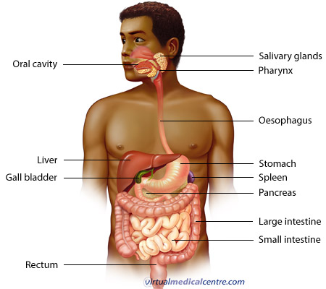

Slide 15
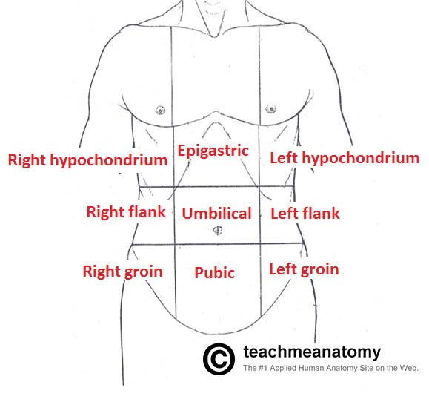
Right
Upper
Quadrant
Left
Upper
Quadrant
Right
Lower
Quadrant
Left
Lower
Quadrant

Slide 16
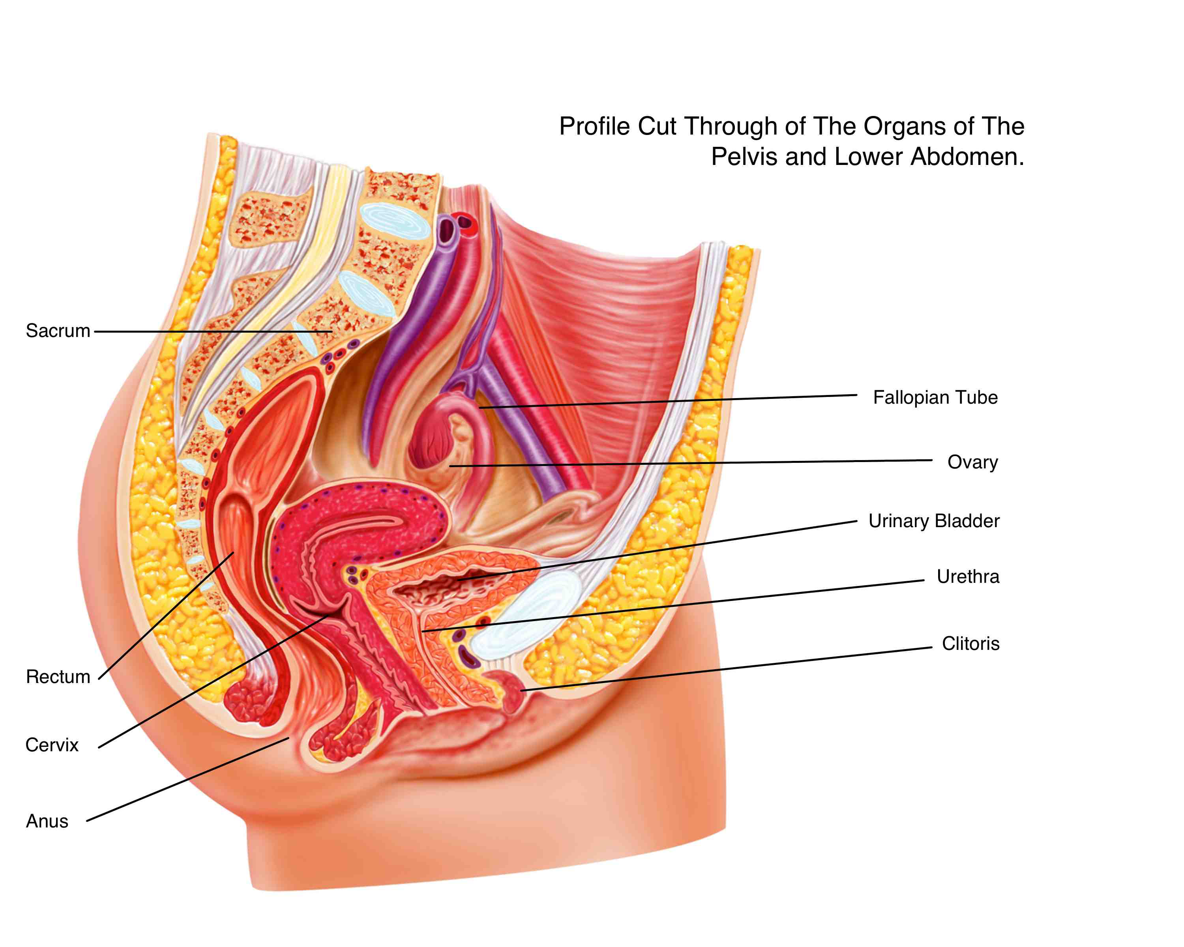
Women have a
Uterus, 2 Ovaries, Cervix & Vagina

Slide 17
History
Examination
Investigation
Management
Danger
Response?
DR

Slide 18
Our patient is still at home
People comment on weight loss
Starts to notice altered bowl habits …
…loose/harder..
Thinks there was blood in stool- not sure…

Slide 19
?
List the organs of the gastrointestinal tract
-top to bottom!

Slide 21
Organs
Mouth- Oropharnyx
Oesophagus
Stomach
Duodenum, Jejunum, Ileum, Caecum
Ascending Colon, Transverse + Descending
Sigmoid, Rectum + Anus

Slide 23
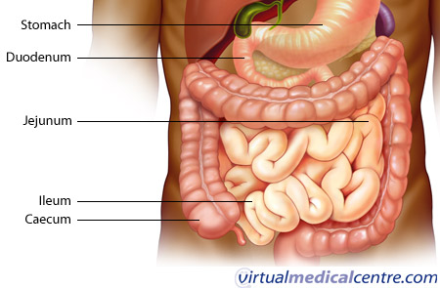

Slide 24
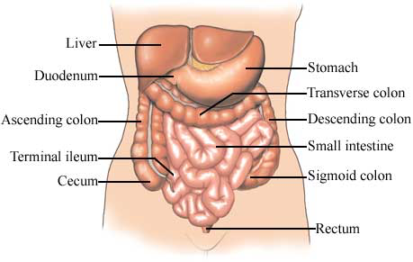
Caecum
Thanks to Dr John B Bassett

Slide 25
GP visit
History
Examination
Investigation
Treatment
Wt loss of 1 stone in 10 weeks
Says he’s more breathless + tired
Initial Investigations
Full blood Count
Urea + Electrolytes
GP is concerned- refers to hospital

Slide 26
Full Blood Count
?
What is a Full Blood Count?
What is wrong with the FBC

Slide 27
Full Blood Count
result normal range
Haemoglobin 85g/L man 130-180 g/L
woman 115-165 g/L
MCV 65 77 - 95 fL
White Cell count 8.5
Neutrophils 2 - 7.5 x 10⁹/L 40-75%
Lymphocytes. 1.2 -3.6 x 10⁹/L 20-45%
Monocytes 0.2 - 1.0 x 10⁹/L 2-10%
Eosinophils 0 - 0.4 x 10⁹/L 1-6%
Basophils
Platelets 167 150-400 x10⁹/L

Slide 28
?

Slide 29
SBA

Slide 31
MCV units femtoliters (fL, or 10⁻¹⁵L)
mean corpuscular volume
Dr Rakesh Popat UCL

Slide 32
Mechanism of Anaemia
Dr Rakesh Popat UCL

Slide 33
Low mean corpuscular volume
Eg chronic blood loss
Dr Rakesh Popat UCL

Slide 34
Normocytic Anaemia= normal cell size
normal mean corpuscular volume
Failure of Red Cell Formation
Anaemia of Chronic Disease
Marrow suppression / failure /Infiltration/
Increased red cell loss/destruction
Acute blood loss- initially
Hypersplenism
Hemolytic disorders
Congenital conditions
Hemoglobinopathies eg HbS
Red Cell Membrane eg Hereditary spherocytosis
Red Cell Enzyme eg G-6-PD

Slide 35
high mean corpuscular volume
Seen in Blood loss- often Reticulocytes on a blood film
Dr Rakesh Popat UCL

Slide 36
Hospital Tests
Sees Gastro-Intestinal Medicine Doctor
Weight loss
Altered bowl habit
Microcytic anaemia
? Saw blood in stool?
Decides to do endoscopy
Lower GI endoscopy
= Colonoscopy
- Upper GI Endoscopy
= Oesophago-Gastro-Duodenoscopy = OGD
History
Examination
Investigation
Treatment

Slide 37
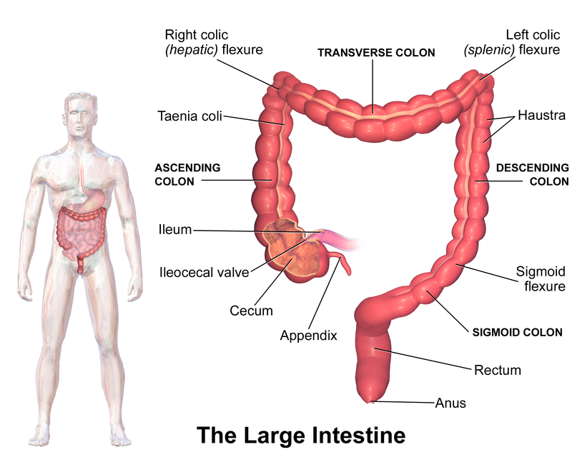
Thanks to Blausen 0604 LargeIntestine by BruceBlaus

Slide 38
Video

Slide 39
?
Valvulae conniventes, Plicae circulares
or Haustra
What are the lines

Slide 41
Small vs Large bowl
Large bowel
Bowel markings or folds do not fully cross the lumen of the bowel - the haustra
Peripheral Position
Small bowel
Bowel markings often continuous across the bowel – Valvulae Conniventes / Plicae Circulares
Central Position

Slide 42
Haustra
Valvulae conniventes, Plicae circulares

Slide 43
Anaesthetists are fab

Slide 44
A Tumour in the bowl

Slide 45
SBA

Slide 47
Types of tumours- behavior

Slide 48
Malignant Tumours = cancer microscopy
Pleomorphic- variation in cell size and shape
Mitotic activity - Increased in more malignant tumors and often abnormal in shape
Necrosis – tumour cells dying when they out- grow their blood supply. Common in fast growing tumours

Slide 49
A clinical picture of a removed tumour

Slide 50
Cancer Diagnosis- Investigations
Imaging eg USS, XR, CT, MRI
Microscopy
Immunohistochemistry
Genetics
Molecular techniques
Cytology – cells shed from tumour
e.g sputum, urine, cervical smear, fluid or aspirated (‘FNA’= fine needle aspiration)
Histology– a sample of tissue itself
Biopsy – percutaneous or endoscopically
Resection at surgery –formal grading / stage
History
Examination
Investigation
Treatment

Slide 51
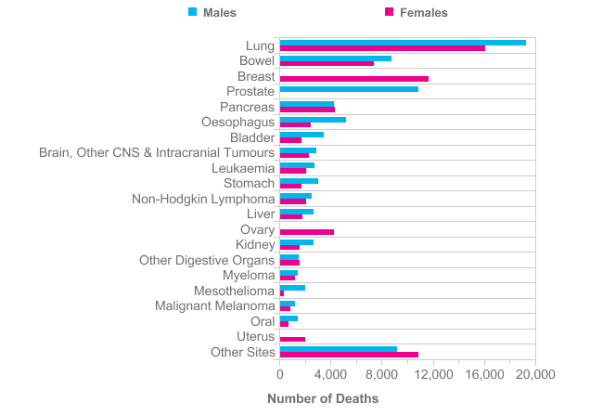
Lung
Bowl
Breast
Prostate
http://www.cancerresearchuk.org

Slide 52
Sees Surgeon
History
Examination
Investigation
Treatment
History, Examination etc
Discuss in blood transfusion
Surgery, Chemo, Radiotherapy
+/- immune (mAb) +/- hormonal
MDT discussion = Multi Disciplinary Team
Discuss + has blood transfusion
Consent for surgery

Slide 53
Ethics
Everyday practice
1: Consent
2: Confidentiality
Thanks UCL Medical Ethics and Law Unit

Slide 54
Ethics 1: Consent
Thanks UCL Medical Ethics and Law Unit

Slide 55
SBA

Slide 57
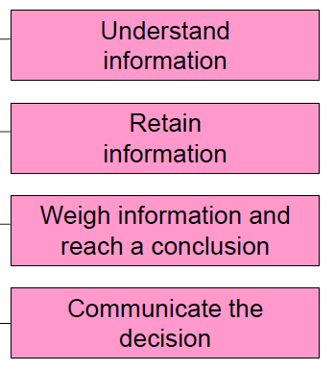
Capacity
UCL Medical Ethics and Law Unit

Slide 58
Requirements for valid consent
The patient must have the capacity to consent
-be competent
The consent must be freely given
-voluntary & no coercion
The person consenting must be suitably informed
-be adequately informed
-risks, benefit, alternatives
UCL Medical Ethics and Law Unit

Slide 59
Do we need consent if…
It’s an emergency and they’re unconscious?
We discover something extra during surgery?

Slide 60
Pt details

Slide 62
Ethics 2: Confidentiality
Allows patients to seek medical help or to give doctors the information we need to provide good care.
But sharing appropriate information is essential to the efficient provision of safe, effective care
GMC: “……..information about patients will be held in confidence by their doctors”.
“You must be prepared to explain and justify your decisions and actions. “
More information at Confidentiality GMC 2013

Slide 63
Ethics 2: Confidentiality
?
How can we breach it ?
More information at Confidentiality GMC 2013

Slide 64
Ethics 2: Confidentiality
Confidentiality vs need to unload after stress
Is it OK to talk to friends / partner / parents?
Is it OK to write on Facebook?
Is it OK to Tweet?
Be careful…
More information at Confidentiality GMC 2013

Slide 65
But it’s relevant and important
Mobile phones!

Slide 66
Ethics 2: Confidentiality
But it’s relevant
No features identifying a patient
Be careful about where you work- relative could identify a patient
No features identifying a colleague
Be very careful
on social media- effectively in public domain
in public – lifts, on phone etc
If you wouldn’t say it in public….
More information at www.gmc-uk.org

Slide 67
Back to our patient….

Slide 68
Sees Anaesthetist Preassessment
But the details to follow are relevant
History
Examination
Investigation
Treatment
Takes bloods
Electocardiograph ECG
Discusses Transfusion
Discusses Risk

Slide 69
SBA

Slide 71
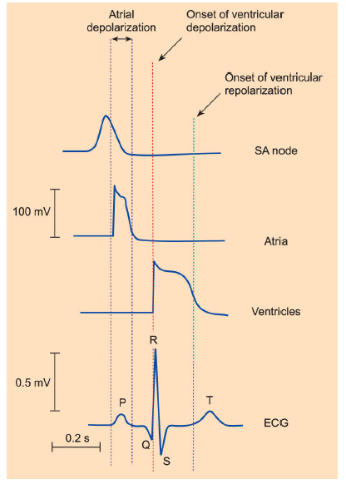
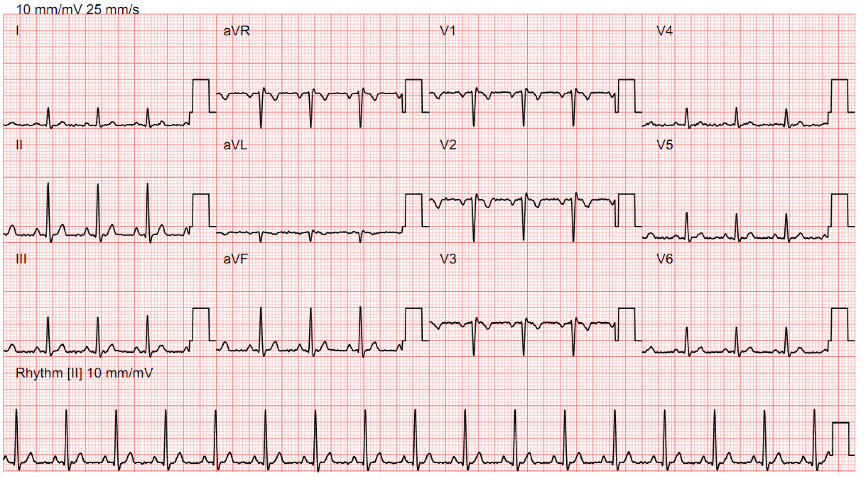
ECG
Individual cells
Dr Jonathan Fry

Slide 72
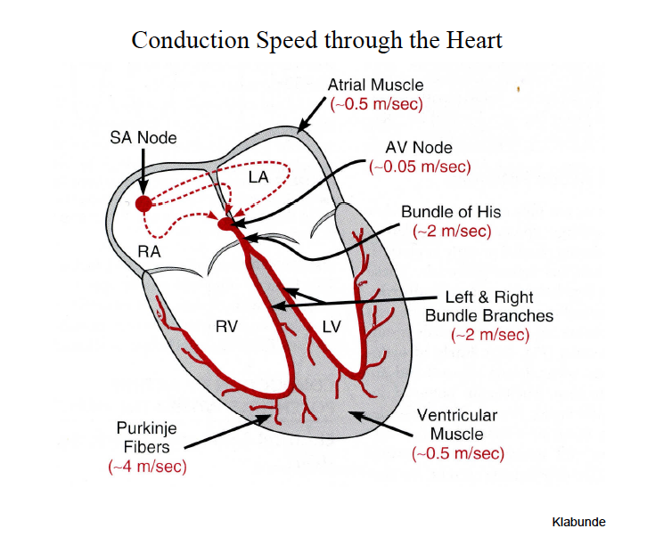
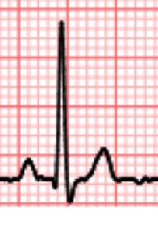
Atrial
Depolarisation
P
Ventricular
Depolarisation
QRS
Ventricular
Repolarisation
T
Atrial repolarisation

Slide 73
ECG
ECG is electrical activity of heart
Measured by leads on chest normally
12 ‘leads’ =
6 chest leads are physical electrical leads
6 limb leads are electrically computed leads

Slide 74
Normal
Date taken
Clinical Info
Speed and Amplitude
First Name
Second name
Date of birth
Hospital Number
Chest leads
Limb leads
Rhythm strip

Slide 75
First Name
Second name
Date of birth
Hospital Number
6 Chest leads
Dr Jonathan Fry

Slide 76
ECG
12 ‘leads’ =
6 chest leads are physical electrical leads
6 limb leads are electrically computed leads

Slide 77
Normal ECG
You won’t have to fully
interpret 12 lead ECG’s!
Date taken
Clinical Info
Speed and Amplitude
First Name
Second name
Date of birth
Hospital Number

Slide 78
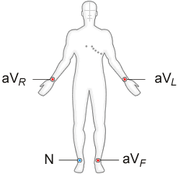
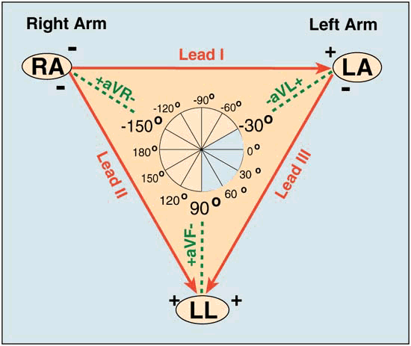
Limb leads- physical placement
4 physical leads are electrically computed to make 6 limb leads on the ECG

Slide 79
I
III
II

Slide 80
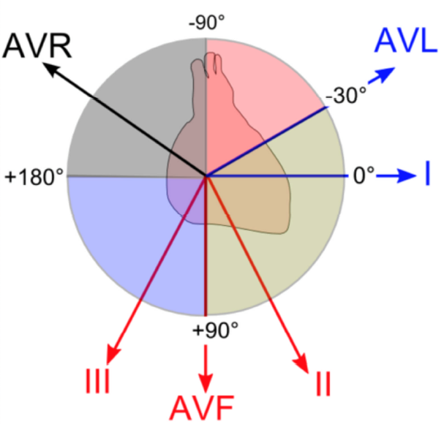
‘6 Limb leads’
Dr Jonathan Fry

Slide 81
Normal ECG
You won’t have to fully
interpret 12 lead ECG’s!
Date taken
Clinical Info
Speed and Amplitude
First Name
Second name
Date of birth
Hospital Number

Slide 82
Normal ECG
You won’t have to fully
interpret 12 lead ECG’s!
Date taken
Clinical Info
Speed and Amplitude
First Name
Second name
Date of birth
Hospital Number

Slide 83
Date taken
Clinical Info
Speed and Amplitude
First Name
Second name
Date of birth
Hospital Number
Dr Jonathan Fry

Slide 84
Normal ECG
You won’t have to fully
interpret 12 lead ECG’s!
Date taken
Clinical Info
Speed and Amplitude
First Name
Second name
Date of birth
Hospital Number

Slide 85
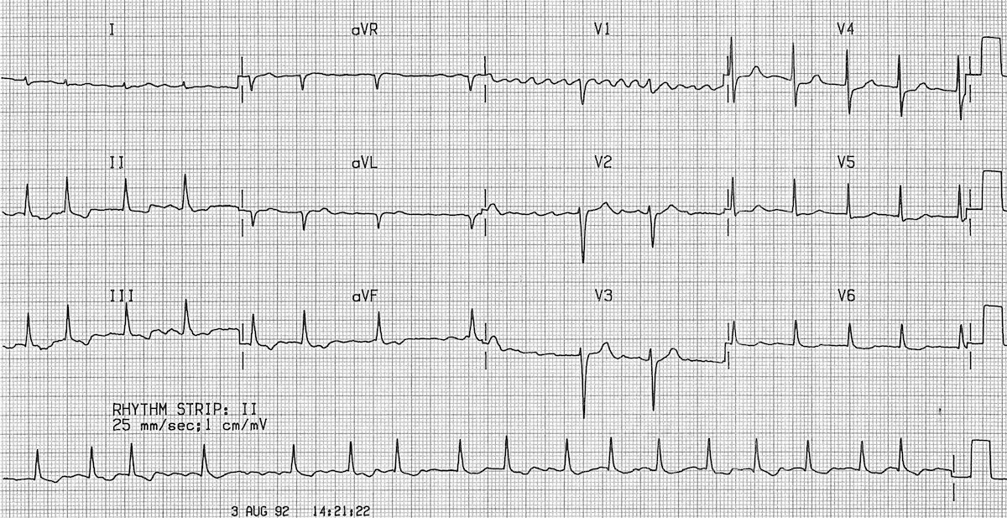
Our Patient’s ECG
Date taken
Clinical Info
Speed and Amplitude
First Name
Second name
Date of birth
Hospital Number
P QRS T

Slide 86
rhythm traces
?
Traces of Atrial Fibrillation or normal?
? Problems with AF

Slide 87
£60

Slide 88
Break
Quiz
https://www.surveymonkey.com/r/WPY6SFF

Slide 89
£60

Slide 90
SBA

Slide 92
Autonomic Physiology
Metabotropic – via secondary messenger vs
Ionotropic – form an ion pore
Parasympathetic
- synapse (ACh, Nicotinic) near organ
- postganglionic (ACh Muscarinic)
Sympathetic
- synapse (ACh, Nicotinic) in Thoracic Chain, near spinal cord
- postganglionic (NA α_{1,2} & β_{1,2,3} adrenoceptor)

Slide 93
Our patient …discusses Transfusion
Why discuss?
Patients need to know what’s going to happen
Side effects
Some people don’t want eg Jehovah’s Witness
Must discuss

Slide 94
Discusses Transfusion
?Side effects

Slide 96
Side effects of blood products
Infections
Hepatitis BC, HIV, other viruses
Immune
Major ABO reactions
Other immune
Iron overload- RBC
Other side effects-usually from lots of blood
cold, coagulation, low Ca⁺⁺, high K⁺

Slide 97
White Cells
Dr John-Paul Westwood

Slide 98
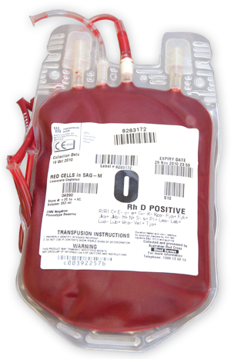
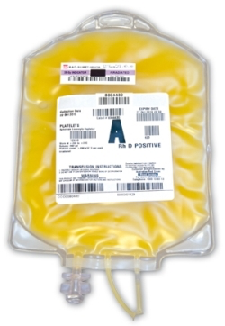
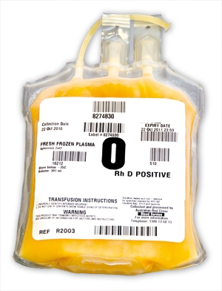
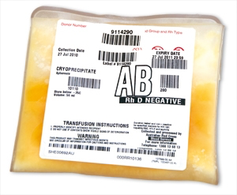
Platelets
‘Cryoprecipitate’
Fibrinogen
‘Blood’
Packed Red Cells
FFP
Fresh Frozen Plasma
Haemoglobin
0₂ carriage
Low Plt number
Abnormal Plt Fn
Clotting Factors
Fibrinogen

Slide 99
SBA

Slide 100
 | A Antibodies | B Antibodies | A + B Antibodies | Plasma | Frequency UK
O Cells
A Cells
B Cells
AB Cells
80+% Rhesus D positive- have D antigen on cells = Rhesus Factor
80% of Rhesus –ve will develop antibodies if have Rh+ transfusion
Which is the ‘Universal donor’ ?
Which is the ‘Universal recipient’ ?
Many other red cell antigen groups eg Kell, Lewis, Duffy, Kidd ++
NBTS UK data www.blood.co.uk

Slide 102
 | A Antibodies | B Antibodies | A + B Antibodies | Plasma | Frequency UK
O Cells |  |  | yes | AB Ab | 47%
A Cells |  | yes |  | B Ab | 39%
B Cells | yes |  |  | A Ab | 10%
AB Cells |  |  |  | No Ab | 4%
80+% Rhesus D positive- have D antigen on cells = Rhesus Factor
80% of Rhesus –ve will develop antibodies if have Rh+ transfusion
Which is the ‘Universal donor’ O
Which is the ‘Universal recipient’ AB
Many other red cell antigen groups eg Kell, Lewis, Duffy, Kidd ++
NBTS UK data www.blood.co.uk

Slide 103
SBA

Slide 104
Genetics of ABO
Parent 1 Parent 2
Genetics AO or BO
or OO
Genetics AO or BO
or OO
Patient Blood group 0
Genetics 00

Slide 106
SBA

Slide 107
Haemoglobin
Normal
Haemoglobin A 2 α and 2 β chains
Haemoglobin A2 2 α and 2 δ chains
Haemoglobin F 2 α and 2 γ chains
Haemoglobin S replaces both β-globin subunits in the haemoglobin
The gene defect is a known mutation of a single nucleotide change (A to T) of the β-globin gene, which results in glutamic acid (E/Glu) being substituted by valine (V/Val) at position 6
Low oxygen tension - sickling -damage the cell membrane- rigid blood cells can’t deform as they pass through narrow capillaries, leading to vessel occlusion and ischaemia.
Homozygous- both copies of the gene- more affected person
Heterozygous- ‘carrier’ – will likely not be aware

Slide 108
Transfusion Errors!
But important!
Clinical and Lab Errors
2013 deaths
12 after ABO incompatable Transfusion
5 clinical, 7 Laboratory
22 deaths due to other causes
4 parts to a patients Identity
Blood / CXR / ECG / patient notes / consent etc etc
First Name
Second name
Date of birth
Hospital Number
Boring
…..but v important!!
SHOT 2013 report

Slide 109
Our Patient has surgery…
Colectomy= col…..ectomy
Right / left / hemi- / total
What are you going to do with bowl end?!
Stoma vs connect up

Slide 110
Surgery

Slide 111
Surgery is a big deal
Needs Anaesthesia
“will I wake up?”
“will I wake up during the surgery?” = awareness
Patients often have complications – minor / major
Pain after / can’t work / do activities
May never recover same function
May die
Sympathetic response, physical challenges, inflammation

Slide 112
What’s the problem? Risk
Hospital
Mortality %
Large intestine; complex major procedure 22.4
General abdominal; major > 69 years 15.8
Complex hip or knee joint revision 11.6
Elective abdominal vascular surgery 7.4
Coronary Artery Bypass Graft only 1.5
Primary hip replacement 0.4
Pearce 2006

Slide 114
Risk video

Slide 115
SBA

Slide 116
During surgery
Cardiovascular challenges – equasions
Fluid challenge
Cardiac Output measurement

Slide 117
SBA

Slide 119
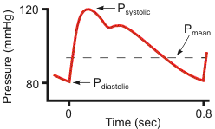
Equation 1
Mean Arterial Pressure =
Cardiac Output x Systemic Vascular Resistance
MAP -CVP = CO x SVR
MAP & CO measured
SVR calculated- not measured directly
‘Cardiogenic’ = of the heart
‘Vaso…Veno …dilation/constriction’
tiny
SV x HR

Slide 120
Equation 1 implication
Mean Arterial Pressure = CO x SVR
2 ways to alter blood pressure
‘Pathology’ of low blood pressure….
CO Cardiac causes or changes in blood volume
SVR Sepsis and Anaphylaxis
Myocardium- muscle
Rhythm- rate
Valves - forward flow
Oxygenated blood coming back to the heart = normal venous return
Relax + fill properly
SV x HR

Slide 121
Equation 2
The amount of Oxygen leaving the heart
…..in the blood each minute =
called Oxygen Delivery = DO₂
= amount of blood pumped each minute
x the amount of oxygen in the blood
= CO x Oxygen content of blood
Haemoglobin concentration
SV x HR
% Hb0₂ saturation

Slide 122
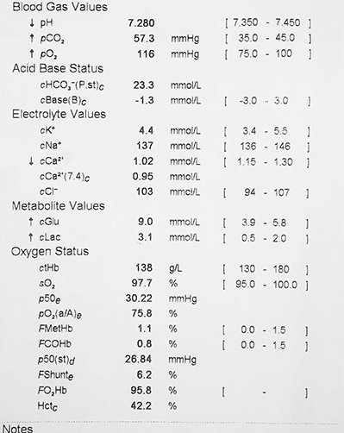
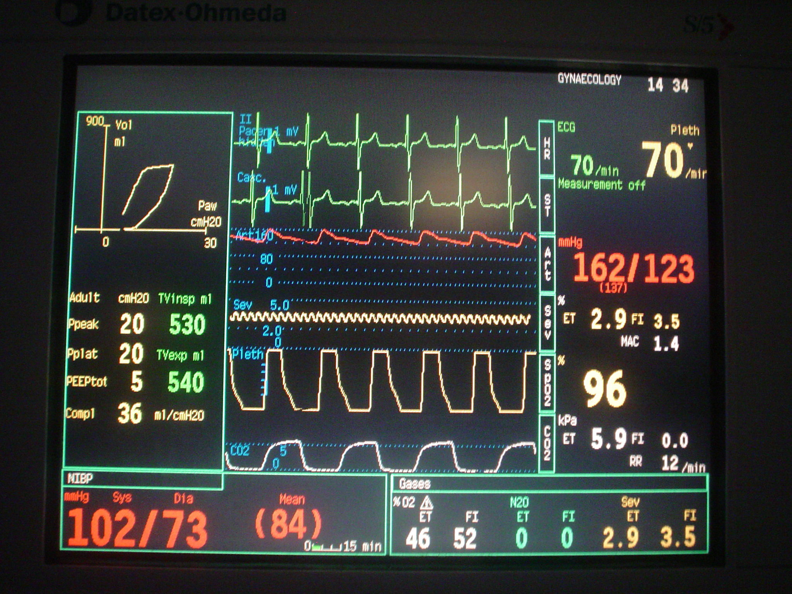
Equation 2 Implications
Oxygen Delivery DO₂
DO₂ = CO x Oxygen content
reduced DO₂
⬇CO
Hb O₂% saturation
⬇Haemoglobin
Haemoglobin concentration
% Hb0₂ saturation
SV x HR
Measure SV and HR

Slide 123
Fluid challenge
300ml
Intravenous
Fluid
300ml
Intravenous
Fluid
300ml
Intravenous
Fluid
Stroke volume (mL)
Left Ventricular End-Diastolic Pressure (mmHg)

Slide 124
Doppler

Slide 125
Hartmann’s Bag

Slide 126
Doppler

Slide 127
1
2
3
Stroke volume (mL)
4
5
Left Ventricular End-Diastolic Pressure (mmHg)

Slide 128
Data/SBA on Curves – which one?
Extrapolations of the Frank- Starling relationship is….?
B blockers
Heart failure
Increased inotropy
Response to bleeding= sympathetic activation
Vasodilation=less resistance to flow

Slide 129
1
2
3
Stroke volume (mL)
4
5
Left Ventricular End-Diastolic Pressure (mmHg)

Slide 130
Ways to measure Cardiac output
Oesophageal Doppler Monitor Picture

Slide 131
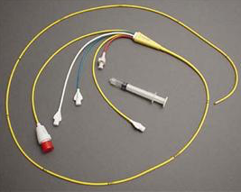
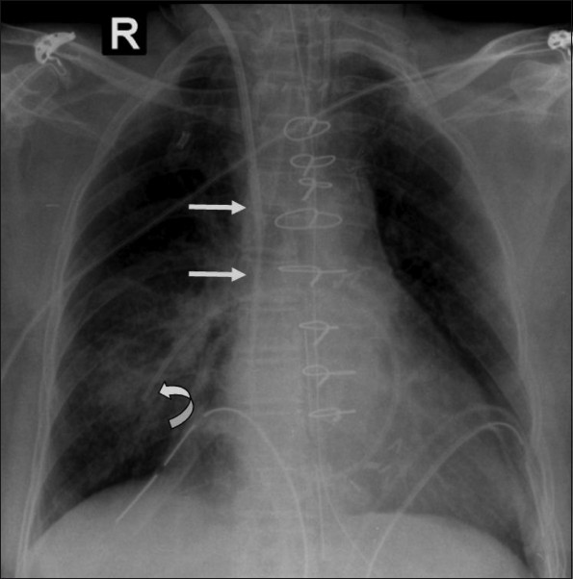
Ways to measure Cardiac output
Oesophageal Doppler Monitor
Pulmonary artery catheter

Slide 132
Ways to measure Cardiac output
Oesophageal Doppler Monitor
Pulmonary artery catheter
ECHO cardiography
– only one gives structure & function

Slide 133
Ways to measure Cardiac output
Oesophageal Doppler Monitor
Pulmonary artery catheter
ECHO cardiography
– only one gives structure & function
Dye dilution LiDCO:
Pulse contour analysis: LiDCO and PiCCO

Slide 134
£60

Slide 135
Break No 2

Slide 136
SBA

Slide 138
Planned after surgery
Pain relief = analgesia
Fluid therapy – if they can’t drink
Deep Vein Thrombosis prevention = DVT prophylaxis
Nausea and vomiting
Anti-constipation drugs
Exercise/ Mobilise / Eat and drink

Slide 139
Dr Hannah Cohen

Slide 140
Dr Hannah Cohen

Slide 141
Our Patient
Woken up after surgery
Pain is OK, breathing OK

Slide 142
ICU Patient

Slide 143
Our Patient; Day 2 post op
Notices harder to breathe
Can’t finish speaking his/her sentences
Nurses : respiratory rate 24 /min
Nurses: Oxygen Saturation SaO₂ 88 %
What could cause this?

Slide 145
Postoperative Complication 1
Shortness of Breath
Hospital acquired pneumonia
Atelectasis= areas of lung collapse
Pulmonary Embolism
Pulmonary Oedema = Cardiac Failure
Pneumothorax

Slide 146
On Examination
History
Examination
Investigation
Treatment
Cardiovascular Feels warm to touch. HS I + II + O.
Respiratory
Inspection
Palpation
Percussion
Auscultation
Neurological
Alert, orientated, GCS 15/15
Peripheral vascular
All peripheral pulses palpable
Abdominal
Inspection
Palpation
Percussion
Auscultation
xxx
Notes:
RS:
Inspection: Laboured breathing, patient coughing
Palpation: NAD
Percussion: increased percussion note RLL
Abdo:
Inspection: midline laparotomy scar, looks clean and dry. Urinary catheter in situ
Palpation: Abdo soft, mild generalised tenderness.
Percussion: NAD
Ausculation: BS sluggish

Slide 147
What you going to do?
History
Examination
Investigation
Treatment
Urine ?
Bloods?
ECG ?
X-Ray: Chest X-Ray?
Special investigations: ABG, sputum culture, blood cultures
Mnemonic: UBEXS
Notes:
Think: Bedside, imaging, specialist. i.e. ABG, ECG, repeat bloods today, Blood cultures, urine dip; CXR

Slide 148
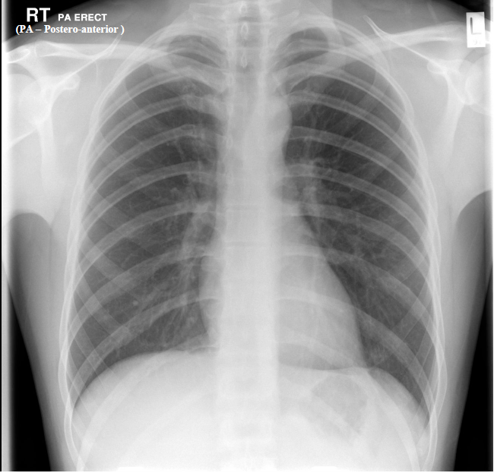
First Name
Second name
Date of birth
Hospital Number
Name date AP/PA and Left Right

Slide 149
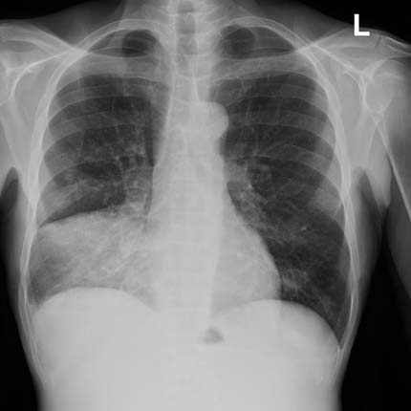
xxxx
First Name
Second name
Date of birth
Hospital Number

Slide 150
SBA

Slide 152
Postoperative Complication 1
Pneumonia = lower Respiratory Tract Infection
Community vs Hospital Acquired
Infections causing shortness of breath in UK
Bacterial
Viral
Fungal

Slide 153
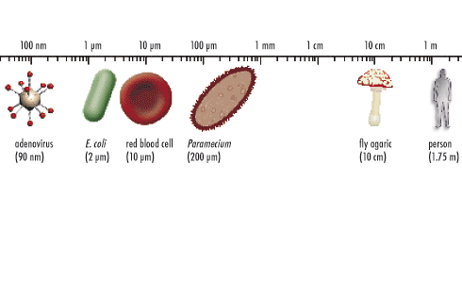
Infections
Virus
Small + Inert
Dependence on host
DNA or RNA
Bacteria
Prokaryotes – no nucleus or organelles
Gram stain +/- peptidoglycan
Antibiotics useful
Bacilli/rod Cocci Spirochates
Release toxins
Fungi
Eukaryotes,
Common in Environment
Yeasts (unicellular),
Moulds (filamentous)
Dimorphic- either form
Bacteria
Virus
Protozoa
Fungi
Helminths
Helminths
Eukaryotes, complex, multicellular
Complex lifestyle
Tapeworms (cestodes)
Flukes (trematodes)
Round worms (nematodes)
Protozoa
Eukaryote, Unicellular
Complex life cycles
No vaccines
Usually good treatment/prevention

Slide 154
SBA

Slide 156
Common Bacterial causes:
Community Acquired Pneumonia

Slide 157
Common Bacterial causes of Hospital Acquired pneumonia
Pseudomonas aeruginosa
Klebsiella species
Escherichia coli
Acinetobacter species
Staphylococcus aureus
Streptococcus pneumoniae
Haempohilus influenzae
Gram Negative more common
Staph Aureus more common
ATS 2004

Slide 158
Gram Positive vs Gram Negative
 | Gram Positive | Gram Negative
Cell Wall thickness | 20-80 nm | 10 nm
Number of layers in wall | 1 | 2
Peptidoglycan | high | low
Lipid/Lipoprotein % | low | high
Releases | Sometime exotoxin | Endotoxin =lipopolysaccharide
Lipotechtoic acid | yes | no
Penicillin Sensitive | yes | less
Thanks Dr TV Rao

Slide 159
TLC Product 2014

Slide 160
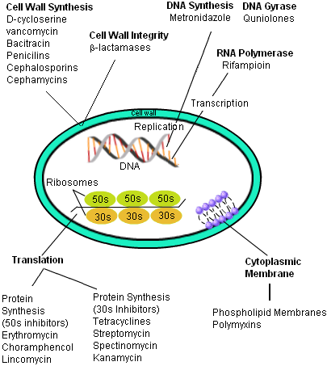
How
Antibiotics
Work
Folate Synthesis
Sulphonamides
Trimethoprim
TutorVista.com

Slide 161
SBA

Slide 162
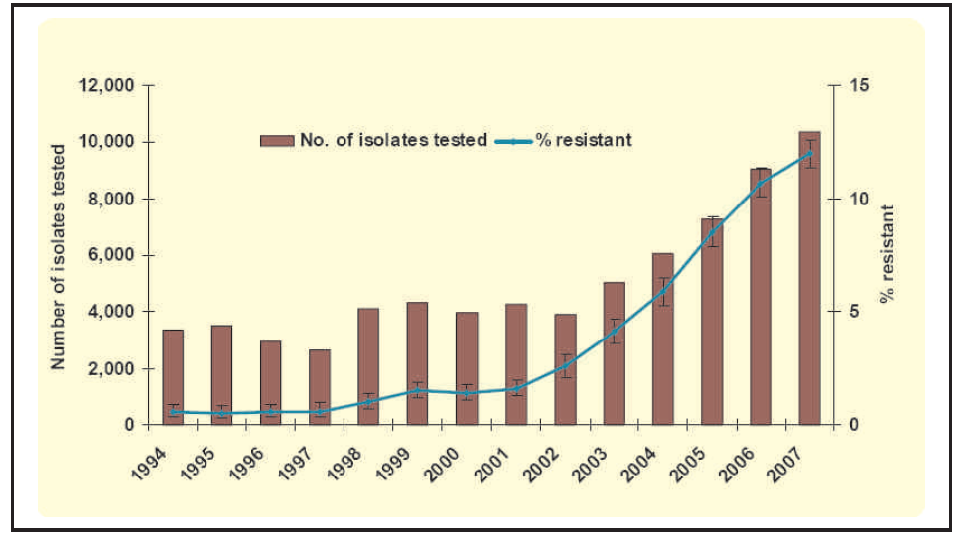
Antibiotic resistance
Health Protection Agency 2004-2008/NAO Cefotaxime resistance

Slide 163
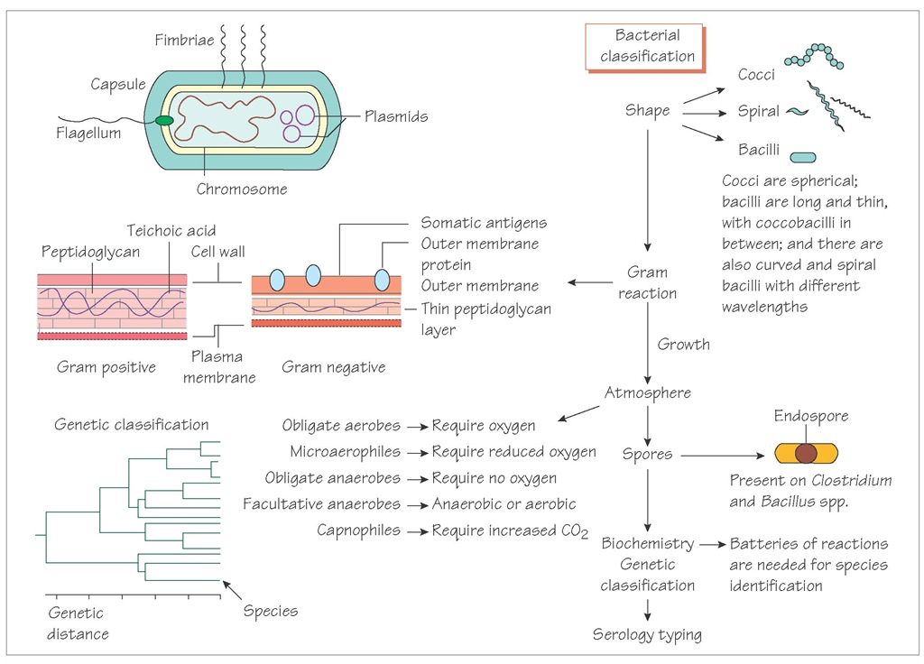
Bacterial classification
What when how

Slide 164
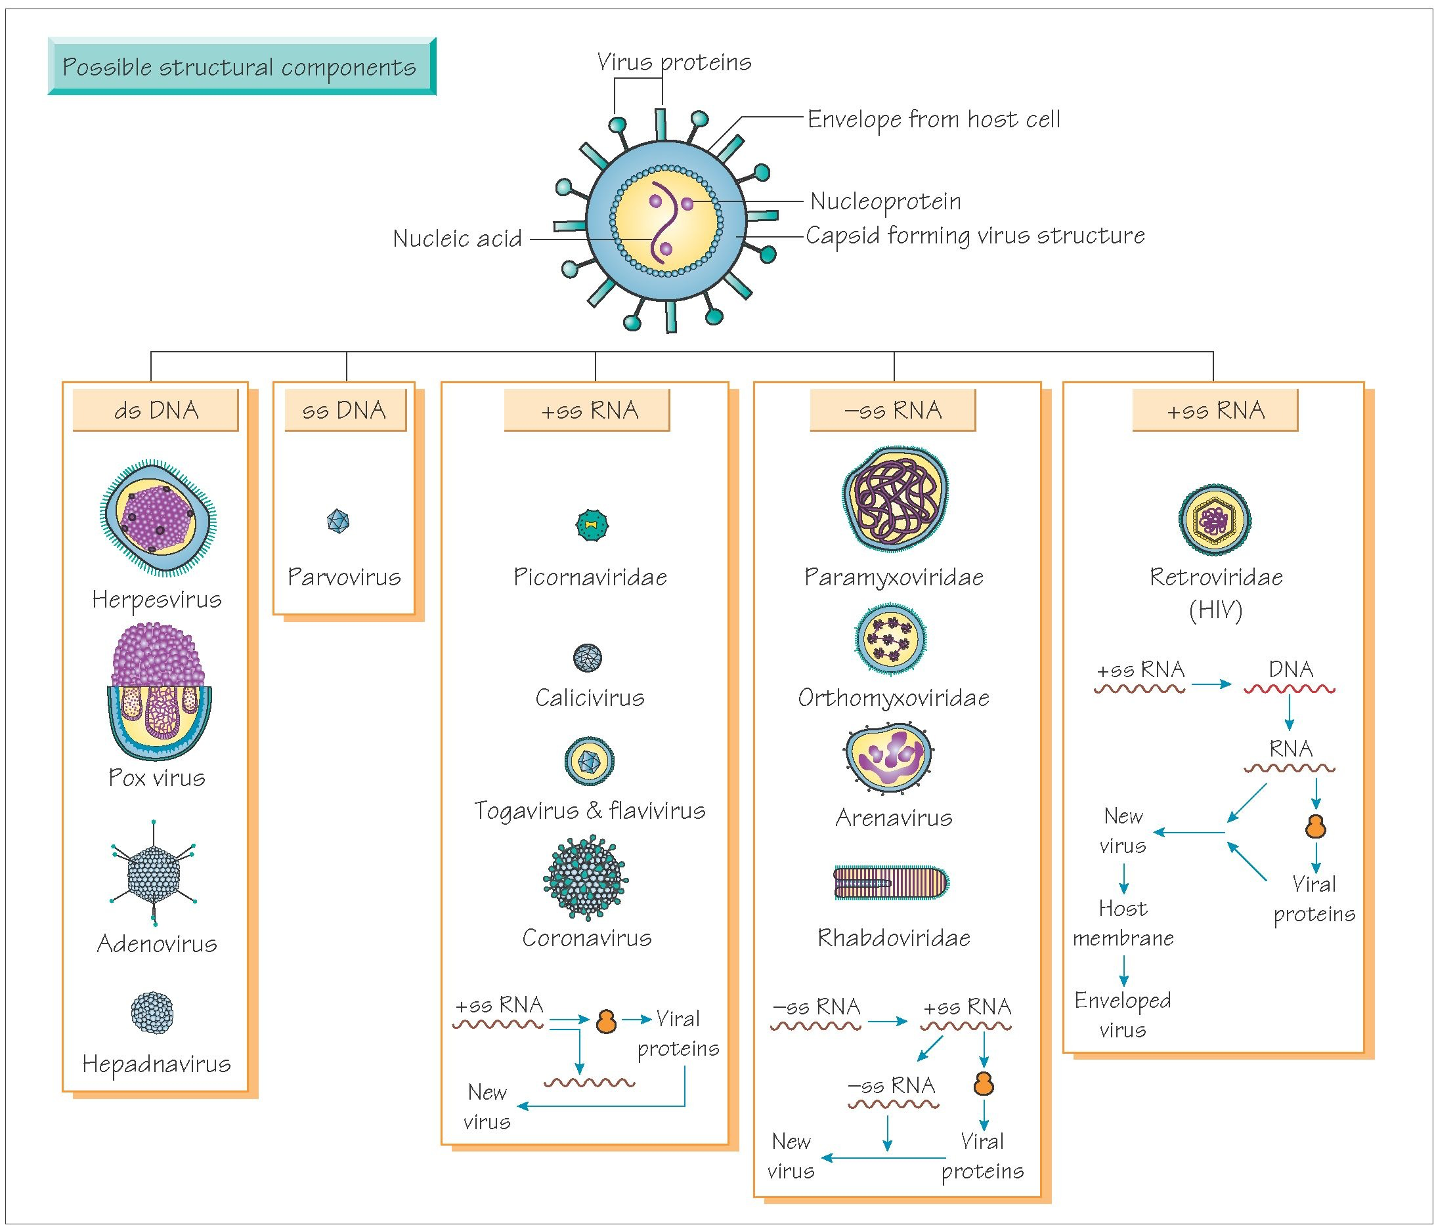
Viral classification
What when how

Slide 165
Postoperative Complication 2
Day 3
Our patient’s shortness of breath worsens
Someone takes an ‘arterial blood gas’
Blood from an artery
blood from lungs- left heart – aorta….
radial artery

Slide 166
Arterial blood gas Lots of information!
pH
pCO₂
pO₂
HCO₃⁻
BEx
Lactate
Hb,
Na⁺, K⁺ etc etc
pH- a measure of acidity / alkilinity
Respiratory- ventilation
Acid base
Metabolic
Oxygenation
Other measurements
Notes:
Interpret this ABG

Slide 167
Arterial blood gas Lots of information!
pH up
pH
pCO₂
HCO₃⁻
BEx
pH down
pH- H⁺ acid more H⁺ vs less H⁺
Respiratory- ventilation- breathing
CO₂ + H₂0 H₂CO₃ H⁺ + HCO₃ ⁻
Metabolic= everything apart from C0₂
= everything apart from lungs/ventilation
H₂CO₃ H⁺ + HCO₃ ⁻
Notes:
Interpret this ABG

Slide 168
SBA

Slide 170
Blood Gas

Slide 171
Arterial blood gas
OK?
pH 7.22 low Acid
pCO₂ 4.5 kPa normal
pO₂ 7.8 kPa low
HCO₃⁻ 16.7 mmol/L low
BE -8.7 low
Lactate 4.8 mmol/L high
Notes:
Interpret this ABG

Slide 172
Hypoxia
Hypoxia - inadequate oxygenation of the tissues..
Classified based on how it is produced:
Hypoxic hypoxia
Reduced PO₂ in arterial blood supply to the tissue
Anaemic hypoxia
Reduced O₂ carrying capacity of the arterial blood
Stagnant hypoxia
Inadequate blood flow to the tissues. PaO₂may be normal
Cytotoxic hypoxia
Poisoning at the tissue level which stops oxidative metabolism.
ie respiratory failure
Type 1 or 2
Eg Anaemia
Eg Cardiac Failure or
Arterial Thrombus
Eg Cyanide or
?Sepsis

Slide 173
Arterial blood gas
OK?
pH 7.52 high alkaline
pCO₂ 2.5 kPa low
pO₂ 7.8 kPa low
HCO₃⁻ 24 mmol/L normal
BE -0.5 normal
Lactate 0.8 mmol/L normal
Notes:
Interpret this ABG

Slide 174
Our patient is given oxygen…..

Slide 175
Blood Gas

Slide 176
‘DRABC’
Danger?
Response
Airway
Breathing
Circulation
Disability

Slide 177
Respiratory Failure
= low Oxygen levels breathing room air
= low partial pressure Oxygen = PaO₂ < 8 kPa
Normal is ~10-13 kPa
= both ie type 1 and 2 respiratory Failure
Difference is
Type 2 – failure of ‘ventilation’ as well
= failure to move air in and out
= can’t get CO₂ out of the body
=so CO₂ builds up in the body – raised blood levels

Slide 178
Respiratory Failure
Type 1 PaO₂ < 8kPa PaCO₂ normal/low
Type 2 PaO₂ < 8kPa PaCO₂ raised
Assumption - breathing air
If PaO₂ >13kPa – must be breathing extra oxygen!

Slide 179
Our Patient’s arterial blood gas
OK?
pH 7.42 normal
pCO₂ 4.5 kPa normal
pO₂ 7.8 kPa low
HCO₃⁻ 21.7 mmol/L low/normal
BE -2.7 low
Lactate 0.8 mmol/L normal
Notes:
Interpret this ABG

Slide 180
Causes of type 1 respiratory failure
Anything that interferes with Oxygen Transfer
ie Ventilation or Perfusion (regional V/Q)
Pneumonia
Pulmonary Embolus
Pneumothorax
Asthma
Pulmonary Oedema
Interstitial Lung Disease
Pulmonary Artery Hypertension
etc

Slide 181
Causes of type 2 respiratory failure
Anything that interferes with Ventilation
Brain
Head Injury, Poisons, Drugs, Anaesthesia
Spinal, Nervous, neuro-muscular junction
Guillain-Barré, Phrenic injury, NMJ blockers, spinal cord trauma, Myaesthenia gravis
Muscular
Fatigue, (PE), Hypovolaemia
Chest Wall / Cavity
Raised abdominal pressure, (pneumothorax), effusion, rib fracture
Airways disease
Asthma, COPD, Upper airway Obstruction

Slide 182
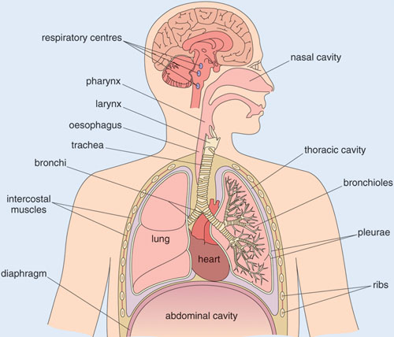
…..any ventilation change
Brain
Brainstem
Nerves to Muscles
Spinal Cord
Upper Airway= above larynx
Lower Airway=
below larynx
Intercostal Muscles
Diaghram
Pleura
Lungs
…..anything involved in making us breathe

Slide 183
First Name
Second name
Date of birth
Hospital Number
Normal Chest Radiograph
Name date AP/PA and Left Right

Slide 184
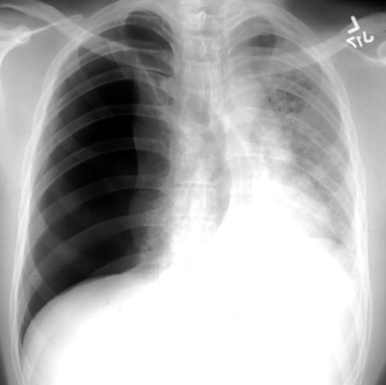
First Name
Second name
Date of birth
Hospital Number
www.med-ed.virginia.edu

Slide 185
First Name
Second name
Date of birth
Hospital Number
CT Scan

Slide 186
First Name
Second name
Date of birth
Hospital Number
CT Scan

Slide 187
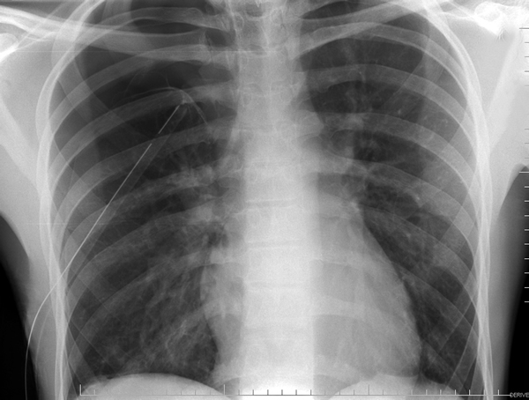
First Name
Second name
Date of birth
Hospital Number

Slide 188
Our patient
Gone through a lot
Home day 12 after her/his hemicolectomy

Slide 189
We’ve covered
Abdominal anatomy
Cancer
Chest X Ray
Electro Cardio Graphs ECG
Blood Gas analysis/Hypoxia
Blood products
Anaemia
Ethics –consent and confidentiality
Infections
Pneumonia, Pneumothorax
15 SBAs
Good luck
You all know so so much more than we did!

Slide 190
Thank you for the slides from
Dr Rakesh Popat UCL Cancer Institute & UCLH
Dr John-Paul Westwood, Consultant Haematologist, UCLH
Dr Jonathen Fry, UCL and Royal Free Hospital
Dr Hannah Cohen, Haematologist, UCLH and UCL
Mr Peter Gogalniceanu, UCL
Google Images

Slide 191
Anaesthesia, Acute Physiology &
Perioperative Medicine iBSc Modules
How to look after ill people well
Science behind it
How we can improve patient’s care
Amazing teachers, great feedback

Slide 192
Break CXR
Different chest x rays.. What is..
Normal including names, dob, no
PPM
Air under diaghram
ECG dots
CVP
Intubated
Lobar consolidation

