Slide 1
UCL HUMAN RESOURCES
HR User Group – 08 March
Introduction – John Parr
MyHR – Jon Everard & John Pickering
Athena Swan Update - Sarah Guise & Nikoleta Pappa
Policy Updates – Sarah Danzie
Q&A – hosted by John Parr

Slide 2
HR User Group
Jon Everard Director HR Systems Transformation Project (MyHR)
John Pickering Business Change Manager

Slide 3
Agenda
Why MyHR ? – Current Pain Points & Benefits
Scope – much more than a system replacement
Data Capture & Cleanse Activities
Change Impact Overview – UCL and Departmental Roles
Training – The benefits of Oracle Forms
  Payments
  Contract Changes
  New Starters
Training – Workshop design
Timeline
AOB

Slide 4
Why are we implementing MyHR? – Current Pain Points and Benefits
A quick reminder…
Multiple Systems & Interfaces
Complicated & cumbersome processes
High effort in create reports and poor data quality
Duplication of effort and a significant administration workload
Complex organisational management
Multiple systems and different working practices
No visibility of the progress of requests
Little local empowerment
A Single fully integrated HR management system
Reduced approvals, handoffs, duplication of manual work and non-added value activities
Reduce manual processes and the overall administrative burden
Improved analytics to enable high quality and timely management information to inform decision making
Empowerment: Clear, unambiguous responsibility and accountability
Full integration with MyFinance

Slide 5
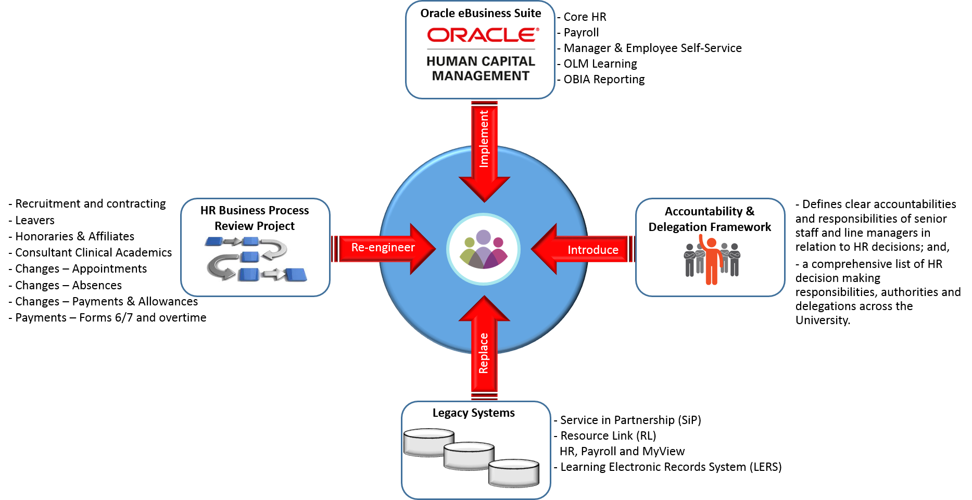
MyHR
Phase 1 – What’s changing?

Slide 6

Data Capture & Cleanse Activity 1
Finance
Payroll
Procurement
Management
Reporting
OLM
Human Resources
Critical success Factors essential for the Oracle build
We need accurate and complete.
1. Working Patterns
2. Line Manager (UPI Number)
Why?
Oracle is a fully integrated system. Work patterns are used to manage absence and calculate payroll payments and deductions.
Oracle works on supervisory hierarchies – Line Management data is required to ensure the correct managers/supervisors receive notifications and approvals…
This data is also required to provide managers with accurate reporting.
Extended Deadline to 14 March

Slide 7
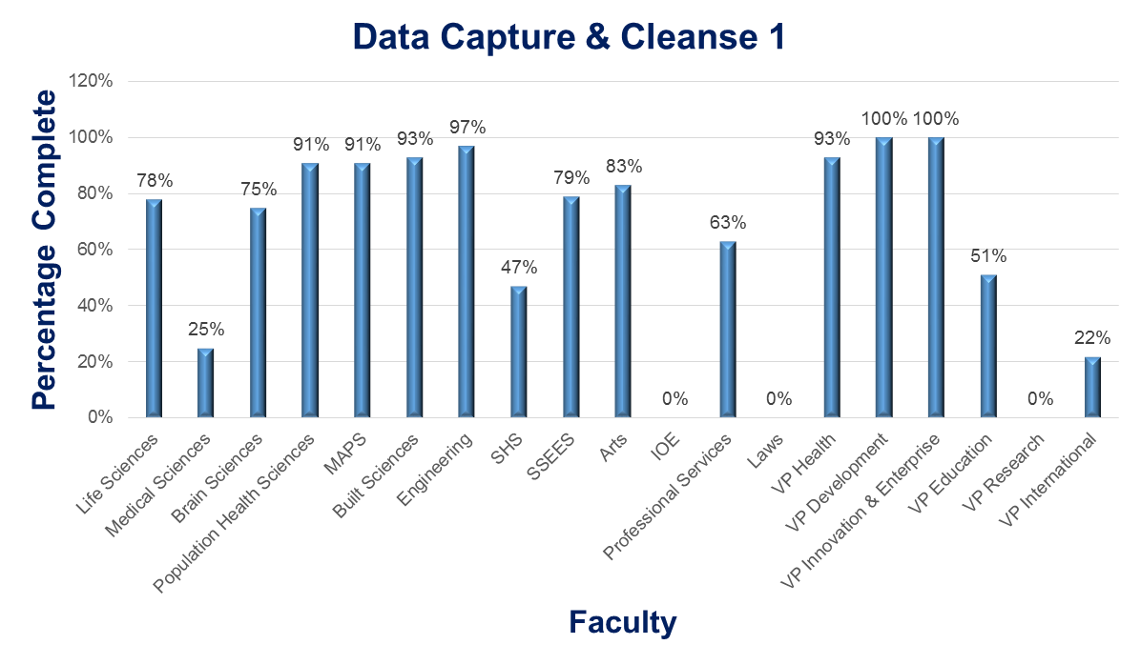
Data Cleanse Activity 1 – Status
Thank you for conducting this business critical activity!
UCL Completion as of 7th March = 63%

Slide 8
Data Capture & Cleanse – by phase
Phase | Activity | Planning Date
One (a.) | Capture work patterns + supervisory hierarchy (Line Manager) | 14 March
One (b.) | 100% returns (TBC) | April
One (c.) | Cutover – Capture delta (Changes) + validate | July
Two | All employees (not casuals) ) validate employee personal, and post information, update changes, capture gaps – to be | May
Go-Live: | all employees to login, update changes, and capture new information e.g. actual work location (building, floor, room – not currently held in RL | July
Lessons learnt – Data Capture & Cleanse Working Group

Slide 9






MyHR Change Impact
High Level – All Staff and Departmental Roles
All Staff and Managers
Faculty/Departmental Roles
Payments: (Oracle Forms)
Overtime
One-Off Duties
Honorary
Higher Duty Allowance, Regrades
Employee Self-Service
ESS
Manager Self-Service
MSS
Contract Changes: (Oracle Forms)
Update assignment details
Assignment Costing
Salary Changes
Ending Assignments (Contracts)
Absence Management
New Starters: (Oracle Forms)
Creating Multiple Assignments
Assignment Costing
Transfers
Rehire Employee/Contingent Worker

Slide 10


Faculty/Department Payments Role
Departmental Process | System Task
Overtime | Check grade and eligibility
Payments (One Off duties) | Search person record, Submit payment Form (Oracle)
Payments to Workers | Worker records, Mark ‘Active’, validate Assignment, Submit hours for payment (Oracle)
Payments for Honorary | Worker records, Mark ‘Active’, validate Assignment, Submit hours for payment (Oracle)
Higher Duty Allowance | Submit payment + Cost Code and Request (Oracle)
Regrades | Complete form Cost Code, end date + docs. (Oracle)
Clinical Allowances | Complete form Cost Code, end date + docs. (Oracle)
Payments
Please nominate two people per Department to be trained in this role
2

Slide 11
Faculty/Department Contract Changes Role
Departmental Process | System Task
Changes to Appointment | Request position change, Complete change form attach documentation (Oracle)
Leavers – Terminations of Contract, End of Assignment etc. | Leaver, admin. Submit Termination Form (Oracle)
Maternity, Paternity, Adoption etc. | Enter dates, Change of Appointments (Oracle)
Leave of Absence | Submit Absence dates reason + docs. (Oracle) Update employee records
Honorary Status (Emeritus) | Search, Create record, Mark ‘Active, Complete Honorary record, run Confirmation letter (Oracle)
Affiliate Academic Status | Search, Create record, Mark ‘Active’ Provide Finance information for Customer Code (Oracle)
Contract Changes
Please nominate two people per Department to be trained in this role
2

Slide 12
Faculty/Department Recruitment & Contracting Role
Departmental Process | System Task
Approval Administration | Hiring Dept. & Financial – Replace/New Position
Advertisement & Candidate Selection | Prepare advert. Create PO, Screen & Select
New Appointments | Create new starter (Oracle) Update record
Onboarding – Day 1 | Enter start date ‘Active’ (Oracle) Probation..
Transfers | Releasing/Receiving, Create Assignment
Creating New Worker Records | Searching for or creating Unique Oracle IDs
Multiple Assignments | Creating Multiple Assignments – Costing (Oracle)
Rehire Employee/Returning | Managed and administrated (Oracle)
BI Publisher/Running Letters | Oracle Functionality (Oracle)
New Starter
Please nominate two people per Department to be trained in this role
2

Slide 13
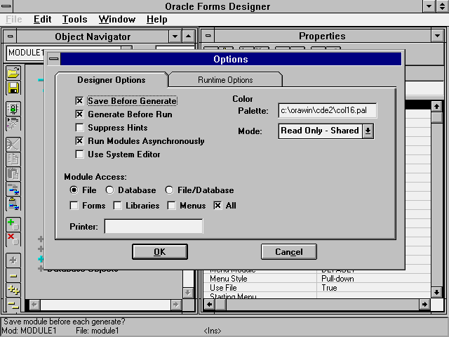
Using Oracle Forms – Payments, Contract Changes and New Starters
Oracle Form:
An Oracle form is a logical collection of fields, regions, and blocks that share a common purpose appear on a single screen. Oracle forms look just like the paper forms we use in our departments now e.g. payments, contracts etc. All you need to do to enter data is to type onto the form.
Benefits:
Paperless – reduces admin. burden
Reduces user error and rework
User friendly and intuitive
Improved reporting

Slide 14


Workshop Design… Instructor-Led Training (ILT) ERP Best Practice
Setting the context
Explanation
Demonstration
Practice
Test
Strict compliance to HR Policy
The ‘reason why’ based on adult learning principles
End-to-end walkthrough of each process & sub-Process
Hands-on practice to instill confidence
Ensure learning has been transferred
Resources:
Experienced Oracle Instructor/Trainer
HR Floorwalker
Slideware, Quick Reference Guides
Work Station
Training Environment
Success Measure: Competency Statement
1. I understand the importance of HR compliance and the consequences of non-compliance
2. I understand the importance of following the process and completing the Oracle Form correctly
3. I have the knowledge and skills to perform this HR role within my department
4. I have reference material and know how to get help should I need it…

Slide 15
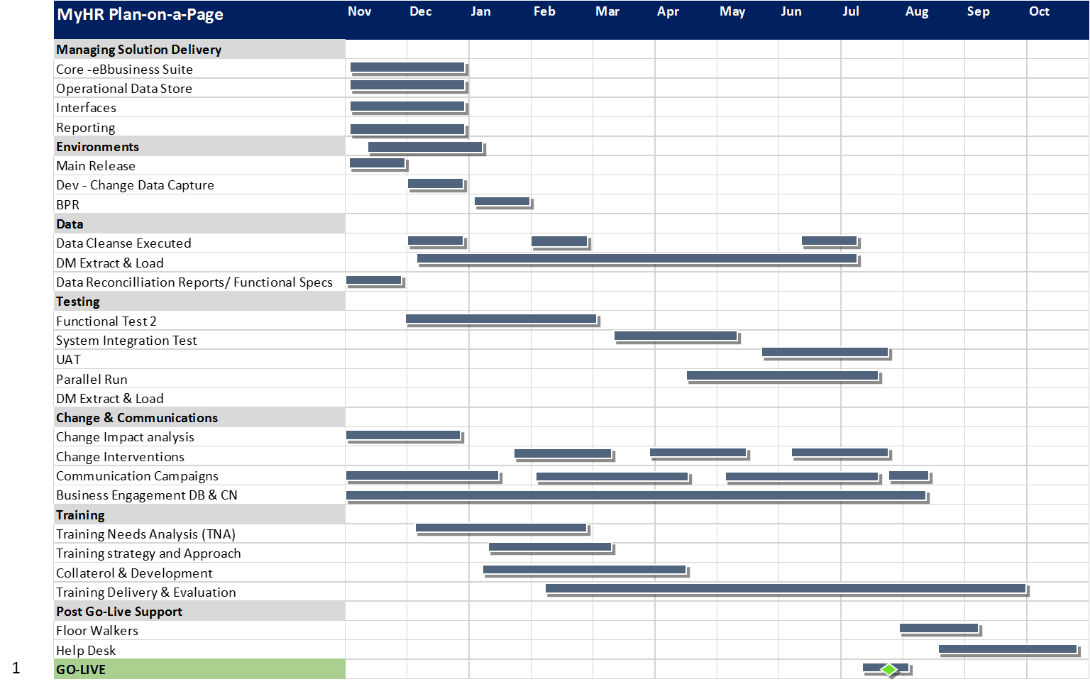

MyHR Timeline

Slide 16
My HR
For more information please go to the MyHR website @
https://www.ucl.ac.uk/myhr
Any questions? Please contact us via the MyHR Mailbox @
myhr@ucl.ac.uk
Thank you for your time
"Change is hard because people overestimate the value of what they have and underestimate the value of what they may gain by giving that up."

Slide 17
Back-up slides

Slide 18

Deployment Board and Change Network
The Deployment Board:
The Change Network:
Takes local ownership and leads the change in their area of responsibility
Agrees Operational Readiness Criteria & Checkpoints – Training, Policy, Process, Data, Testing, PGLS etc.
Provides leadership to ensure that UCL is ready and able to accept and work with Oracle and the new business processes to be implemented
Influences positive change and serve as advocates for MyHR and process/policy changes
Facilitates local communication and issue mitigation across UCL and the MyHR Team in order to manage the implementation effectively
Validates the Change Impact Assessment and Training Needs Analysis (TNA) – drives training attendance
  Is a two-way communication channel to ensure rapid and accurate communications
  A cross-functional network outside the project team with direct access to end users to help co-ordinate project activities that require engagement with the Faculties
  Influences positive change and serve as advocates for the new ways of working - focuses on benefits
  Is a formal network to leverage peer to peer communication (in addition to traditional communication methods)
  Executes specific ‘hands on’ tasks on behalf of their business area – Testing, Training etc.
  Helps to build confidence and create acceptance for the changes
The Project Team ensures that the solution is ready for the business and the Deployment Board supported by the Change Network ensures the business is ready for the solution

Slide 19
Summary of Actions – for Departments
Continue to conduct Data Cleanse by 14 March
Nominate Change Network members in your Faculty ensuring cross-departmental coverage by 10 March
Identify and nominate colleagues for Departmental HR Transactional Roles:
  Payments
  Contract Changes
  Recruitment & Contracting (New Starters) by 21 March i.e. Our next Deployment Board

Slide 20
Policy Updates
Sarah Danzie
Head of Employment Policy and Governance

Slide 21
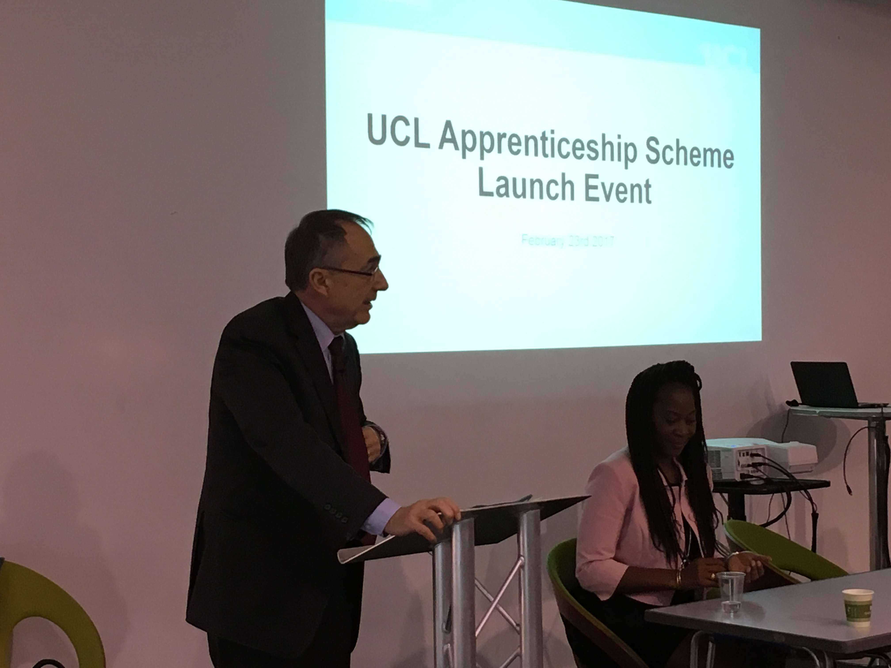
UCL APPRENTICESHIPS

Slide 22

UCL APPRENTICESHIP SCHEME
Formal launch held 23 February
5 Apprentices recruited so far in ISD
UCL to pay 0.5% of total wage bill to Apprenticeship Levy from 6 April
Funds available to pay for apprentices training and some staff development programmes

Slide 23
WHAT IS AN APPRENTICESHIP
A real job gaining on-the job experience and a recognised qualification
Working towards an approved apprenticeship standard
Must work a minimum of 30 hours per week
Must spend at least 20% of time ‘off-the-job’ training
Must last at least 12 months in duration (typically up to 4 years)

Slide 24
UCL NEEDS HELP TO ….
Help us gauge the level of demand for apprenticeships through our online survey
Think about apprenticeships as a development opportunity to support existing staff to gain new skills e.g. management or digital technology solutions
Please contact Sarah Danzie or Tash Khan-Davis for further information

Slide 25
UPDATES:
Capability Policy launched with effect from 1 February 2017
Social Media policy in development
Tier 4 Timesheets being piloted – to ensure UKVI compliance across all departments
HR Employment briefings – more to be scheduled in the Autumn
BREXIT support – coping and resilience strategies

